Slide 1
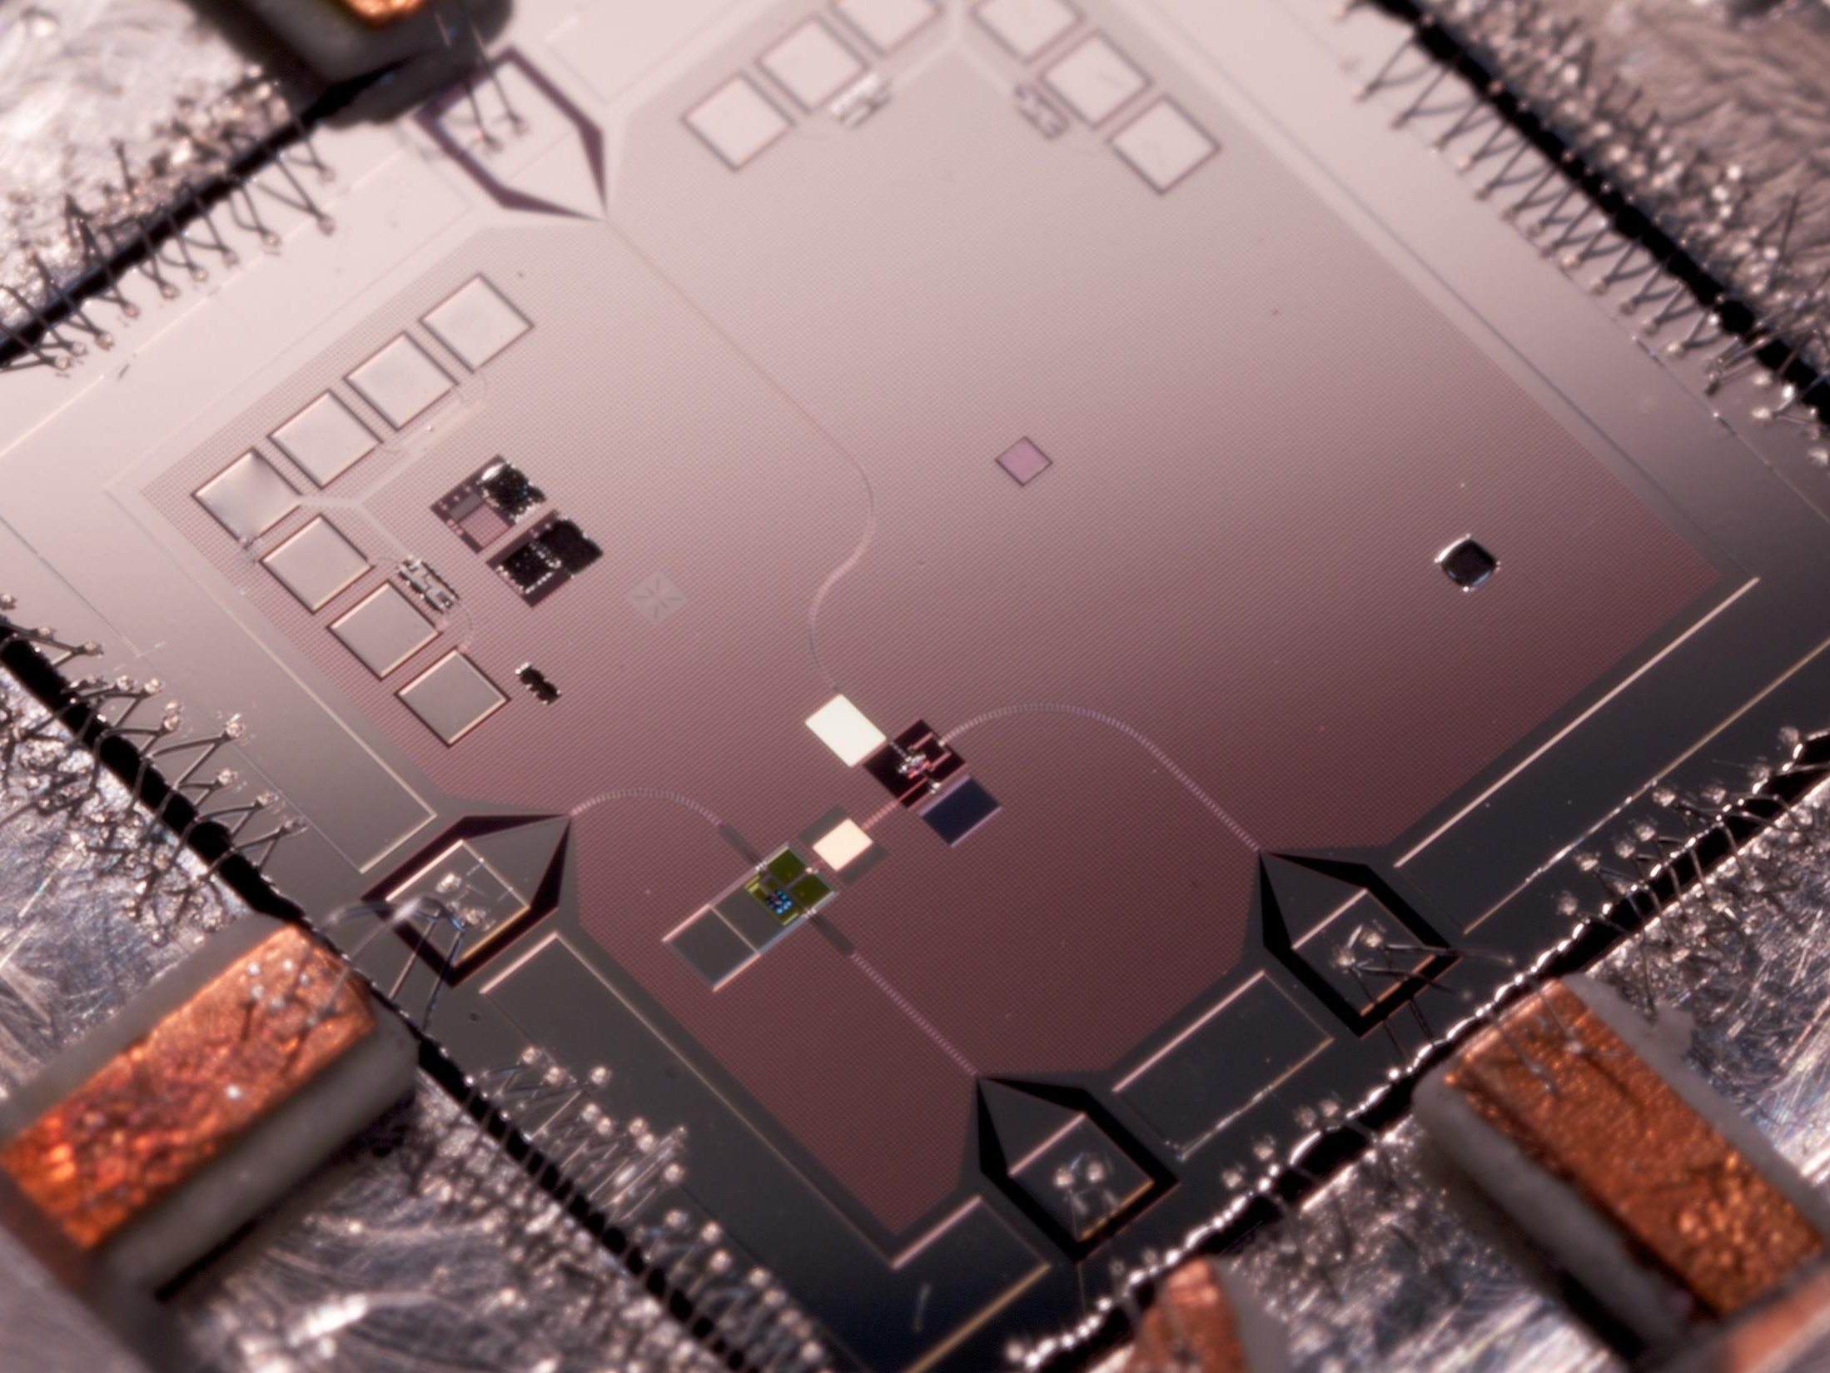
Sampling from
Quantum Random Circuits
The way to …
Cohort project
Team 1 (add a name?)
Notes:
Hi, we will show you how to use quantum random circuit sampling for …

Slide 2
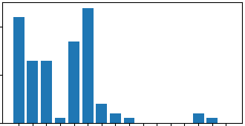
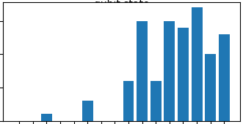
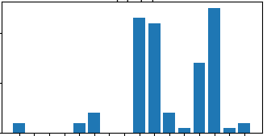
Quantum random circuits: sampling
Picture of (quantum) random circuit
Notes:
A quantum random circuit is a device that provides a random distribution of outcomes every time we run it.
Google showed in 2018 that quantum computers are much more efficient in sampling from random distributions than classical ones!

Slide 3
Quantum random circuits: certification
Picture of (quantum) random circuit
Notes:
A quantum random circuit is a device that provides a random distribution of outcomes every time we run it.
Google showed in 2018 that quantum computers are much more efficient in sampling from random distributions than classical ones!

Slide 4
Applications (a few of them)
Virtual environment design for gaming
Aircraft modelling with simulating flight in turbulence
Random Topology Power Grids for testing
Financial modelling simulation for market drivers
Prototyping new quantum and classical processor architectures
Notes:
Quantum random circuit sampling can be useful to address problems by mapping each gate of the quantum circuit to a specific parameter of the problem.
For instance, by mapping the gates to different environments in a gaming landscape (e.g. desert, water or forest) one could dynamically sample different environments, with a different distribution of resources, to effectively improve the virtual reality of the game!
Similarly this approach can be extended to sample and test power grid topologies, prototype processor architecture or even simulate financial market drivers and atmospheric conditions for aircraft modelling.

Slide 5
The future is in …
Notes:
We have to choose what to focus on and give a reason why.

