Slide 1
Sustaining the Unified Digital Format Registry (UDFR)
Digital Preservation 2012
Library of Congress, July 24-25, 2012
Stephen Abrams
UC Curation Center
California Digital Library
http://www.cdlib.org/uc3

Slide 2
Agenda
Background
Current status
Demonstration
Next steps

Slide 3
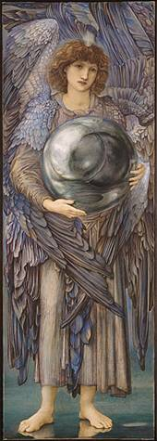
Why formats?
“Format” is the dividing line between bits and information
ffd8ffe000104a46
4946000102010083
00830000ffed0fb0
50686f746f73686f
7020332e30003842
494d03e90a507269
6e7420496e666f00
0000007800000000
0048004800000000
02f40240ffeeffee
0306025203470528
03fc000200000048
00480000000002d8
0228000100000064
0000000100030...
SOI
APP0 JFIF 1.2
APP13 IPTC
APP2 ICC
DQT
SOF0 183x512
DRI
DHT
SOS
ECS0
RST0
ECS1
RST1
ECS2
...
Notes:
Edward Burne-Jones (British, 1833-1898)
The Days of Creation: the First Day, 1870-1876
Watercolor and gouache, 102.2×35.5 cm
Fogg Art Museum, Harvard University, 1943.454
Bequest of Grenville L. Winthrop

Slide 4
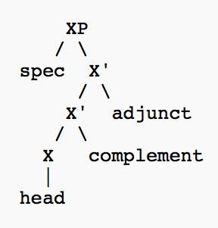
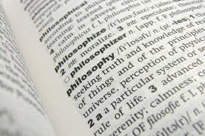
Why formats?
There are many necessary preservation activities that can be usefully performed on bits qua bits
to preserve information you most act on formatted bits and know what those formats represent
Preservation of content syntax and semantics
(both the structure and meaning of the digital representation)

Slide 5
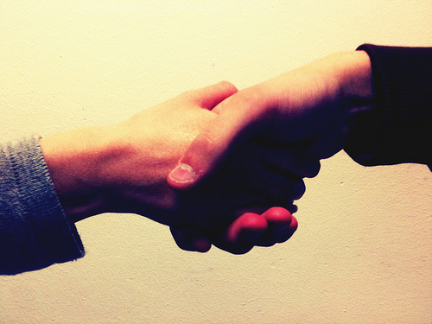
Unified Digital Format Registry
“A reliable, publicly accessible, and sustainable knowledge base of file format representation information for use by the digital preservation community”
http://udfr.org/
udfr-l@listserv.ucop.edu
“Unification” of the function and holdings of PRONOM and GDFR , available July 3, 2012
http://www.nationalarchives.gov.uk/PRONOM
http://gdfr.info/
Funded by the Library of Congress
Open source platform / GPL
Semantic wiki

Slide 6



A bit of history …
PRONOM – National Archives [UK], 2002
http://www.nationalarchives.gov.uk/PRONOM
“ready access to reliable technical information about the nature of electronic records”
JHOVE – Harvard, 2003
http://hul.harvard.edu/jhove
“digital object validation and characterization”
Global Digital Format Registry (GDFR) –
Harvard/OCLC, 2006
http://gdfr.info/
“a distributed and replicated registry of format information populated and vetted by experts and enthusiasts world-wide”

Slide 7


A bit of history …
Proto-UDFR – Ad hoc stakeholder community, 2009
Resolve PRONOM IPR issues and develop a community-supported open source solution
Advance beyond legacy RDBMS (PRONOM) and XMLDB (GDFR) technology
UDFR – CDL, January 2011
http://udfr.org/
udfr-l@listserv.ucop.edu
“a semantic registry for digital preservation”
LC/NDIIPP funded
Stakeholder meeting, April 2011
Beta release, November 2011
Production release, July 2012

Slide 8
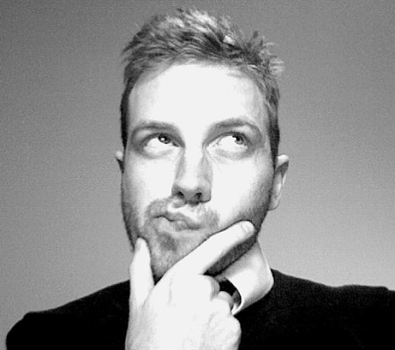
Representation information
What you need to know about something in order to exploit that thing meaningfully [OAIS/ISO 14720]
Information that lets you answer important preservation questions (directly or indirectly)
What format is it?
What are its significant properties?
Is it valid?
Is it at risk?
How can I render/play/read it?
What can it be transformed into?

Slide 9

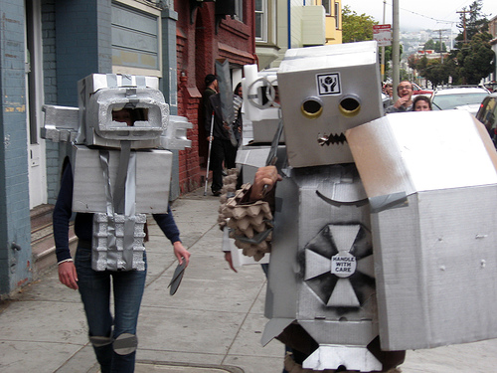
Why semantic?
The semantic web lets anyone say anything about anything
Understandable to both people and machines
The web is (or soon will be) a semantic web
Linked Data interoperability
http://linkeddata.org/
Notes:
Shout! – Mark Wheadon, http://www.flickr.com/photos/mark_wheadon/2557902153
Robots! – Jere Keys, http://www.flickr.com/photos/tyreseus/527207577

Slide 10
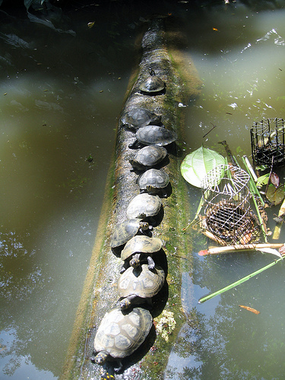
Why semantic?
Triples all the way down…
Data expressed as triples
Data definition (i.e., ontology) expressed as triples
Ontology definition expressed as triples
…
Facilitates self-configuration and easy extension
However, the form and function of a semantic wiki may be unfamiliar
Notes:
Turtles all the way down, http://www.flickr.com/photos/rgalgon/6457781479

Slide 11
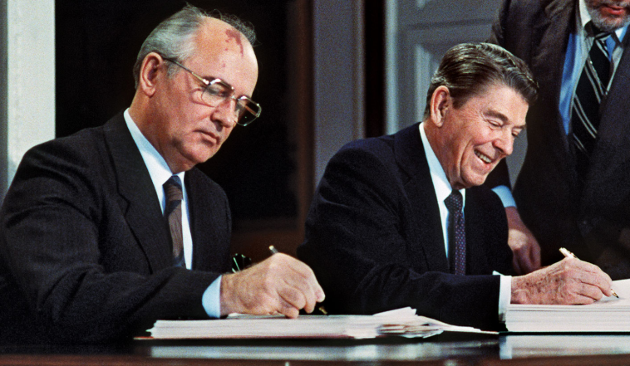
Provenance
Open contribution
Self-registration, but no further barriers
Complete change history at the assertion level
Who made the assertion, and when
Confidence based on individual/institutional reputation
Imprimatur of technically knowledgeable reviewers
“Trust, but verify”
Notes:
Gorbachev and Reagan -- AFP/Getty Images, http://www.britannica.com/bps/media-view/121436/1/0/0

Slide 12
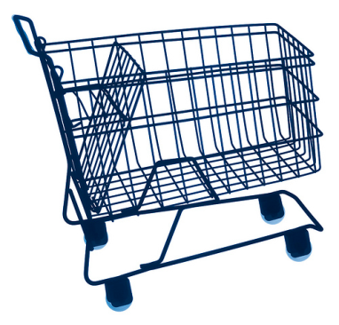
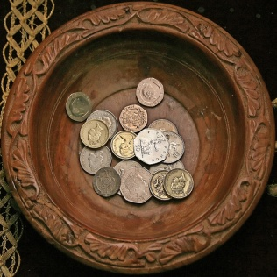


Roles
Consumer Anonymous read
Contributor Read + write
Self-registration
Reviewer Read + write + review
Administratively granted
Administrator Read + write + review + administer
Notes:
Shopping cart -- http://www.flickr.com/photos/tjmartins/3889307169
Collection plate -- http://www.flickr.com/photos/lwr/166988094

Slide 13
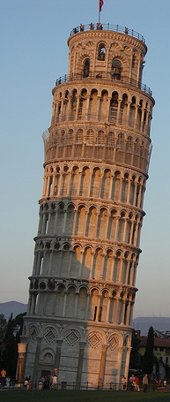
Technology stack
Apache httpd
http://httpd.apache.org/
HTTP / SPARQL
http://www.w3.org/TR/rdf-sparql-query
RDFauthor/JavaScript
http://aksw.org/Projects/RDFauthor
Noid
http://wiki.ucop.edu/display/Curation/NOID
OntoWiki
http://ontowiki.net/
Erfurt API
http://aksw.org/Projects/Erfurt
Zend framework
http://framework.zend.com/
Virtuoso quadstore
http://virtuoso.openlinksw.com/
PHP
http://www.php.net/
RDF
http://www.w3.org/RDF
Notes:
Leaning Tower of Pisa – Stephen and Claire Farnsworth, http://www.flickr.com/photos/the_farnsworths/2623592483

Slide 14
Code repository
All code (and ontologies) managed in public repositories at GitHub
https://github.com/UDFR
OntoWiki
https://github.com/UDFR/OntoWiki
Forked from https://github.com/AKSW/OntoWiki
Erfurt
https://github.com/UDFR/Erfurt
Forked from https://github.com/AKSW/Erfurt
RDFauthor
https://github.com/UDFR/RDFauthor
Forked from https://github.com/AKSW/RDFauthor
All CDL development available under GPL license

Slide 15
UDFR schema
Abstract Base
Controlled Vocabulary
…
holder
dependency
holder
creator
Process
IPR
Agent
owner
Abstract Product
product
Holding
Digest
Abstract Signature
maintainer
reference
file
embodies
ipr
specification
digest
Software
Hardware
Media
Abstract Format
Document
File
External Signature
Internal Signature
input / output
signature
Assessment
Grammar
Character Encoding
File Format
Compression Algorithm
assessment
grammar

Slide 16
Code repository
All ontologies (and code) managed in public repositories at GitHub
https://github.com/UDFR
Ontologies
https://github.com/UDFR/UDFR-Models
udfrs [onto.owl] UDFR schema
http://udfr.org/onto#
udfr [udfr.owl] UDFR instance data
http://udfr.org/udfr/
profile [profile.owl] UDFR user profiles
http://udfr.org/profile/

Slide 17
Initial data loads
PRONOM as of 2012-02-21
http://www.nationalarchives.gov.uk/PRONOM
846 file formats
28 character encodings
17 compression algorithms
1,237 identifiers
1,006 external signatures
494 internal signatures
71 MIME types (not in Appspot)
156 agents
268 software packages
2,080 software processes
23 IPR statements
217 relationships
8,274
Special thanks to TNA
Spencer Ross
Tracey Powell
Tim Gollins
548
dedupulicated, June 2012
7,816

Slide 18
Initial data loads
MIME types from Appspot as of 2012-02-22
http://mediatypes.appspot.com/
“Routinely scrapped from IANA using code in the mediatypes Google Code project”
809 application/*
125 audio/*
39 image/*
19 message/*
14 model/*
14 multipart/*
51 text/*
56 video/*
1,127
Plus 71 defined by PRONOM

Slide 19
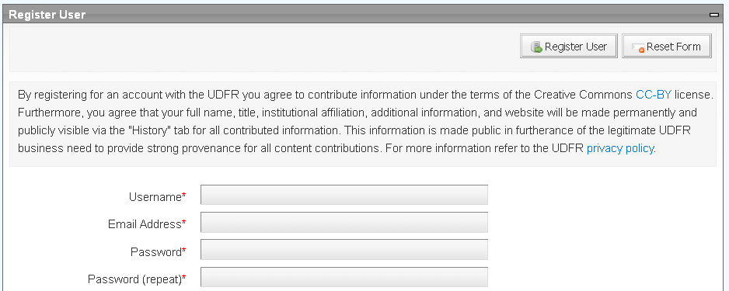
Data licensing
PRONOM data contributed under UK Open Government License (OGL)
http://www.nationalarchives.gov.uk/doc/open-government-licence/
Other submissions contributed under under Creative Commons Attribution license (CC-BY)
http://creativecommons.org/licenses/by/3.0/

Slide 20
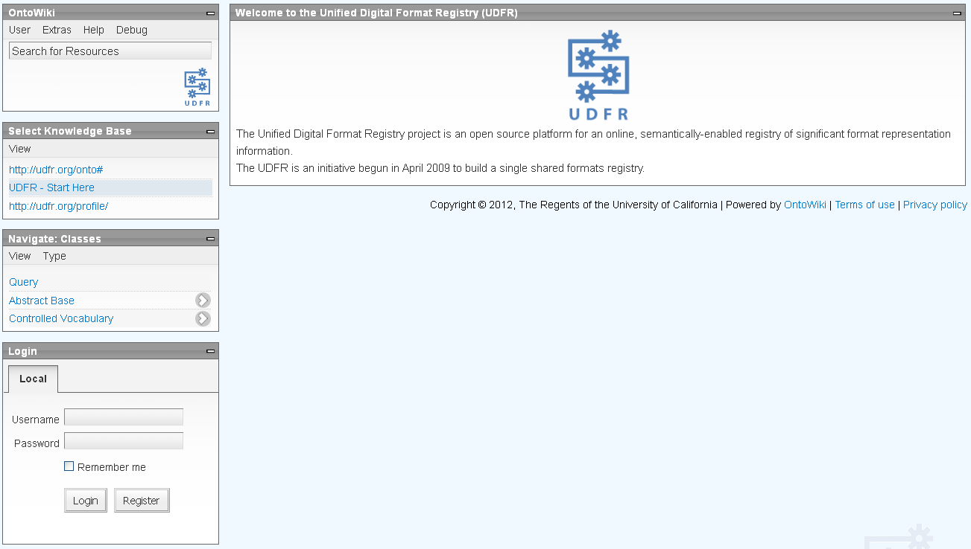
UI layout
Workspace pane
Function dependent
OntoWiki pane
Register/login/logout
SPARQL query form
Documentation
Session reset
Knowledge base pane
Ontology browser pane
Register/login pane
http://udfr.org/

Slide 21
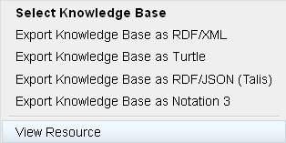
Contextual menus
Contextual menu
http://udfr.org/

Slide 22
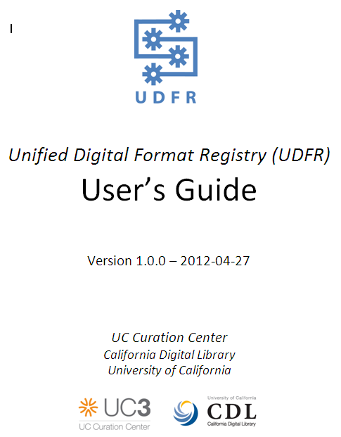
User’s Guide
http://udfr.org/docs/UDFR-Users-Guide-v1.0.0.pdf

Slide 23
Demonstration
http://udfr.org/

Slide 24
Next steps
Operational control
CDL will continue to host the UDFR for one year while a more permanent hosting strategy can be identified
Administrative control
The “admin” role – necessary for adding user privileges, modifying the ontologies, and bulk imports – is held by CDL staff
How can this responsibility be shared?
Technical control
How to share “committer” responsibility for the codebase?
How to coordinate additional development activity?

Slide 25
Next steps
Technical development
Synchronization with PRONOM and other external sources of bulk imports
UI enhancements to provide lower-barrier learning curve
RESTful API (in additional to SPARQL endpoint)
Replication to mirror sites
Others?
Bring under the OPF code repository/issue tracking umbrella

Slide 26
Next steps
Import additional data sources
Library of Congress Sustainability of Digital Formats
http://www.digitalpreservation.gov/formats/
IT History Society hardware database
http://www.ithistory.org/hardware/hardware-name.php
NIST NSRL (National Software Reference Library)
http://www.nsrl.nist.gov/
Stanford CPUdb
http://cpudb.stanford.edu/
TOTEM (Trustworthy Online Technical Environment Metadata) database http://keep-totem.co.uk/
Other candidates?
How important is merging?

Slide 27
Next steps
Encourage adoption and use
Identify an evangelist
Marketing/outreach
Cf. Chris Rusbridge’s blog posing the question, “What was the problem” that UDFR was trying to solve?
http://unsustainableideas.wordpress.com/2012/07/04/the-solution-is-42-what-was-the-problem/
Enable the reviewer function
Who will review? What are the criteria?
Sustainable community governance
Who will make the decisions?

Slide 28

Questions and discussion

Slide 29
For more information
UDFR
http://udfr.org/
http://github.com/UDFR
udfr-l@listserv.ucop.edu
(to subscribe, mail “SUB UDFR-L <name>” to
listserv@ucop.edu)
OntoWiki
http://ontowiki.net/Projects/OntoWiki
Erfurt
http://aksw.org/Projects/Erfurt
RDFauthor
http://aksw.org/Projects/RDFauthor
Zend
http://framework.zend.com/
Virtuoso
http://www.openlinksw.com/dataspace/dav/wiki/Main/VOSRDFWP
AKSW, Universität Leipzig
http://aksw.org/
Philipp Frischmuth Norman Heino
Sebastian Tramp
National Archives, UK
http://www.nationalarchives.gov.uk/
Tim Gollins Tracey Powell
Spencer Ross
Library of Congress
http://www.digitalpreservation.gov
Martha Anderson Leslie Johnston
UC Curation Center
http://www.cdlib.org/uc3
uc3@ucop.edu
Stephen Abrams Lisa Dawn Colvin
Patricia Cruse John Kunze
Margaret Low Mark Reyes
Abhishek Salve Marisa Strong

