Slide 1



Beyond Borders
SAA Annual Meeting
San Diego, August 5-9, 2012
Unified Digital Format Registry (UDFR)
A Community Resource for Effective Preservation
Stephen Abrams
University of California Curation Center
California Digital Library

Slide 2
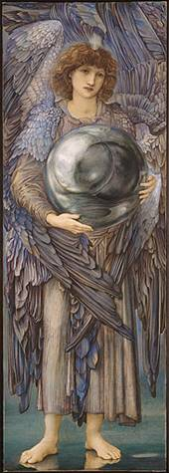
Why are formats important?
“Format” is the dividing line between bits and information
A set of syntactic and semantic rules for mapping between bits and information
ffd8ffe000104a46
4946000102010083
00830000ffed0fb0
50686f746f73686f
7020332e30003842
494d03e90a507269
6e7420496e666f00
0000007800000000
0048004800000000
02f40240ffeeffee
0306025203470528
03fc000200000048
00480000000002d8
0228000100000064
0000000100030...
SOI
APP0 JFIF 1.2
APP13 IPTC
APP2 ICC
DQT
SOF0 183x512
DRI
DHT
SOS
ECS0
RST0
ECS1
RST1
ECS2
...
Notes:
Edward Burne-Jones (British, 1833-1898)
The Days of Creation: the First Day, 1870-1876
Watercolor and gouache, 102.2×35.5 cm
Fogg Art Museum, Harvard University, 1943.454
Bequest of Grenville L. Winthrop

Slide 3

Unified Digital Format Registry
“A reliable, publicly accessible, and sustainable knowledge base of file format representation information for use by the digital preservation community”
http://udfr.org/
udfr-l@listserv.ucop.edu
“Unification” of the function and holdings of
PRONOM http://www.nationalarchives.gov.uk/PRONOM
GDFR (Global Digital Format Registry)
http://gdfr.info/
Library of Congress/NDIIPP funding
Open source platform
Semantic wiki
Open contribution and editing /
strong provenance

Slide 4
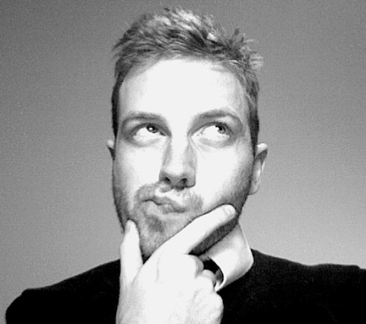
Representation information
What you need to know about something in order to exploit that thing meaningfully [OAIS/ISO 14720]
Information that lets you answer important preservation questions
What format is it?
What are its significant properties?
Is it valid?
Is it at risk?
How can I read it? Render it? Play it?
What can it be transformed into, and
how?

Slide 5
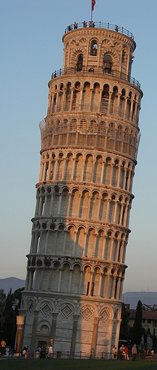
Technology stack
Apache httpd
http://httpd.apache.org/
HTTP / SPARQL
http://www.w3.org/TR/rdf-sparql-query
RDFauthor/JavaScript
http://aksw.org/Projects/RDFauthor
Noid
http://wiki.ucop.edu/display/Curation/NOID
OntoWiki
http://ontowiki.net/
Erfurt API
http://aksw.org/Projects/Erfurt
Zend framework
http://framework.zend.com/
Virtuoso quadstore
http://virtuoso.openlinksw.com/
PHP
http://www.php.net/
RDF
http://www.w3.org/RDF
Notes:
Leaning Tower of Pisa – Stephen and Claire Farnsworth, http://www.flickr.com/photos/the_farnsworths/2623592483

Slide 6
Ontology
Abstract Base
Controlled Vocabulary
…
holder
dependency
holder
creator
Process
IPR
Agent
owner
Abstract Product
product
Holding
Digest
Abstract Signature
maintainer
reference
file
embodies
ipr
specification
digest
Software
Hardware
Media
Abstract Format
Document
File
External Signature
Internal Signature
input / output
signature
Assessment
Grammar
Character Encoding
File Format
Compression Algorithm
assessment
grammar

Slide 7

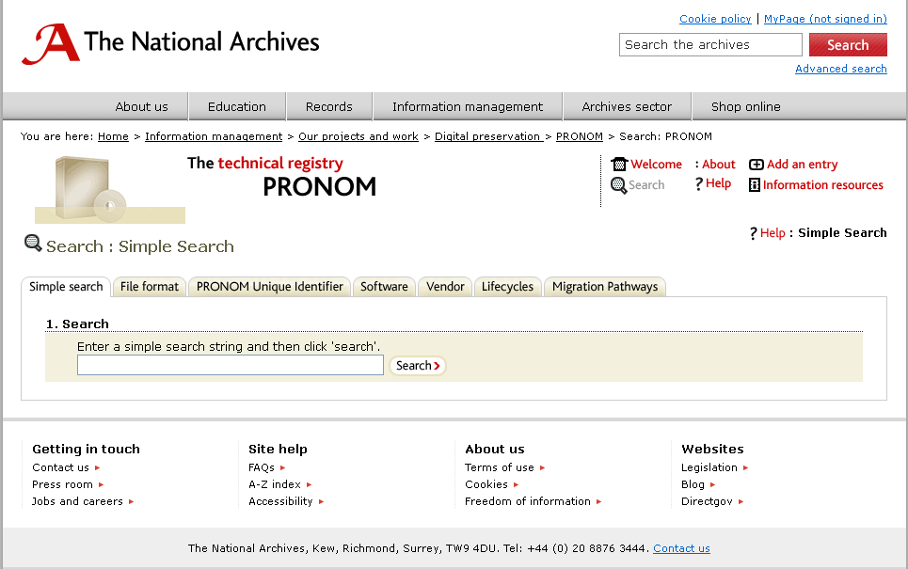
Initial data loads
PRONOM as of 2012-02-21
http://www.nationalarchives.gov.uk/PRONOM
846 file formats
28 character encodings
17 compression algorithms
1,237 identifiers
548 external signatures
494 internal signatures
71 MIME types (not in IANA)
156 agents
268 software packages
2,080 software processes
23 IPR statements
217 relationships
7,816
Special thanks to TNA
Tim Gollins
Tracey Powell
Spencer Ross

Slide 8
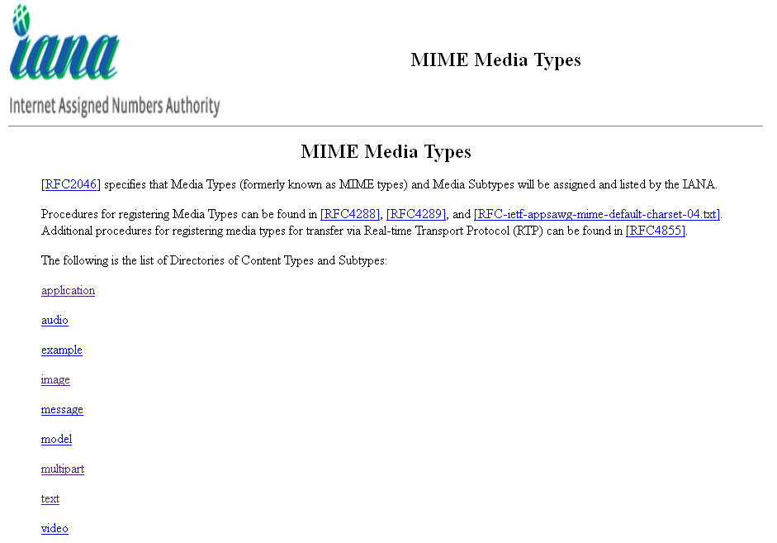
Initial data loads
MIME types from Appspot as of 2012-02-22
http://mediatypes.appspot.com/
“Routinely scrapped from IANA using code in the mediatypes Google Code project”
809 application/*
125 audio/*
39 image/*
19 message/*
14 model/*
14 multipart/*
51 text/*
56 video/*
1,127
Plus 71 defined by PRONOM

Slide 9
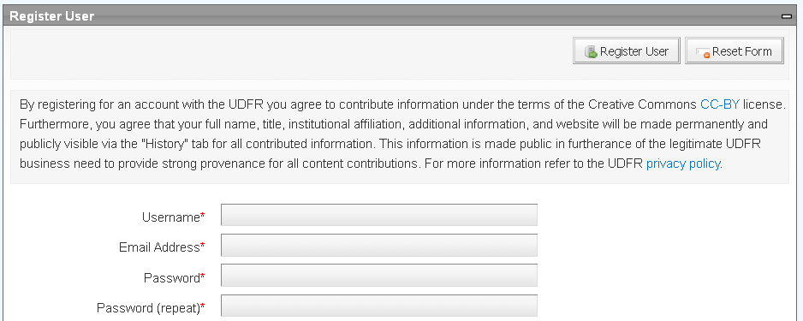
Data licensing
PRONOM data contributed under UK Open Government License (OGL)
http://www.nationalarchives.gov.uk/doc/open-government-licence/
Other submissions contributed under under Creative Commons Attribution license (CC-BY)
http://creativecommons.org/licenses/by/3.0/

Slide 10
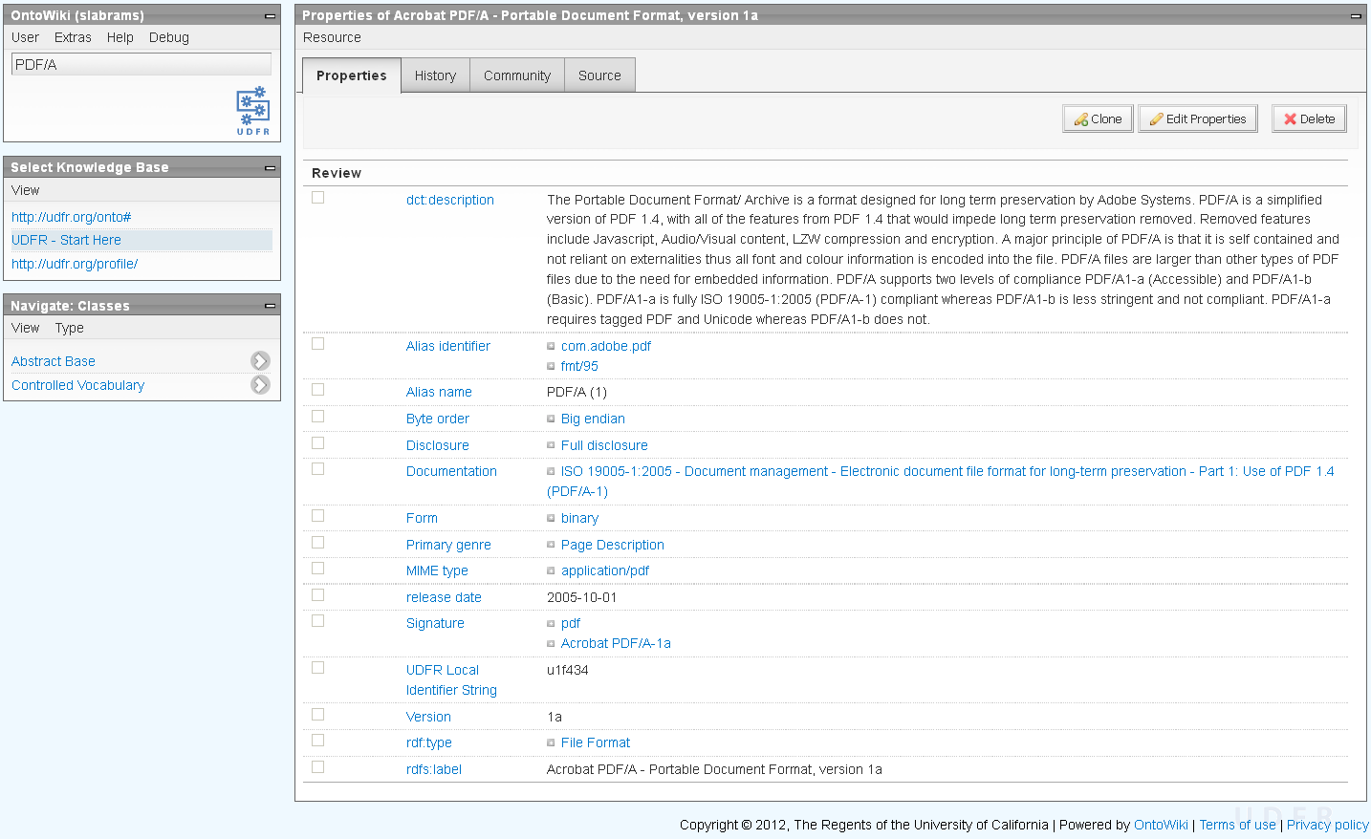
Search or browse for information
http://udfr.org/

Slide 11
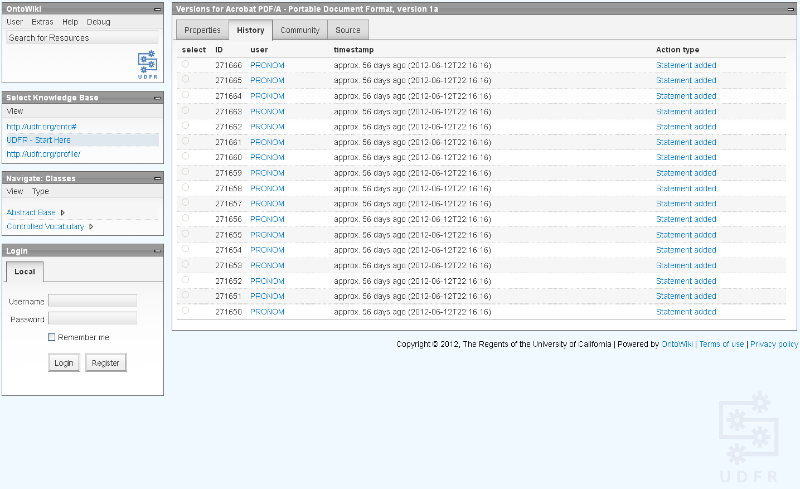
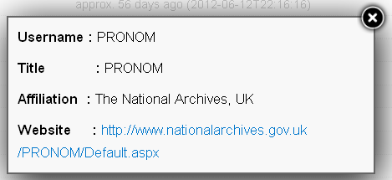
Review provenance
http://udfr.org/

Slide 12
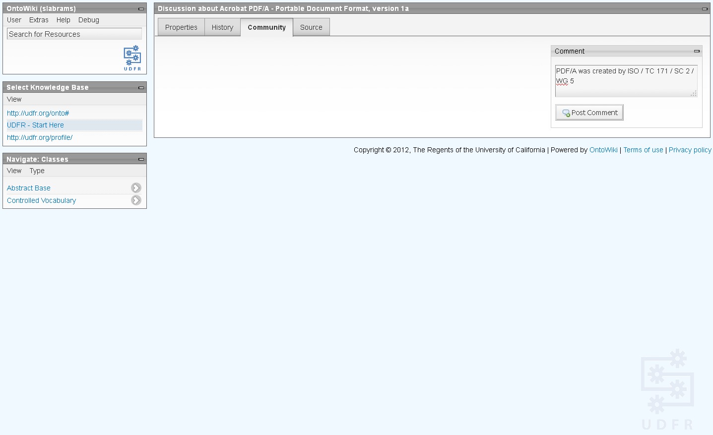
Annotate information
http://udfr.org/

Slide 13
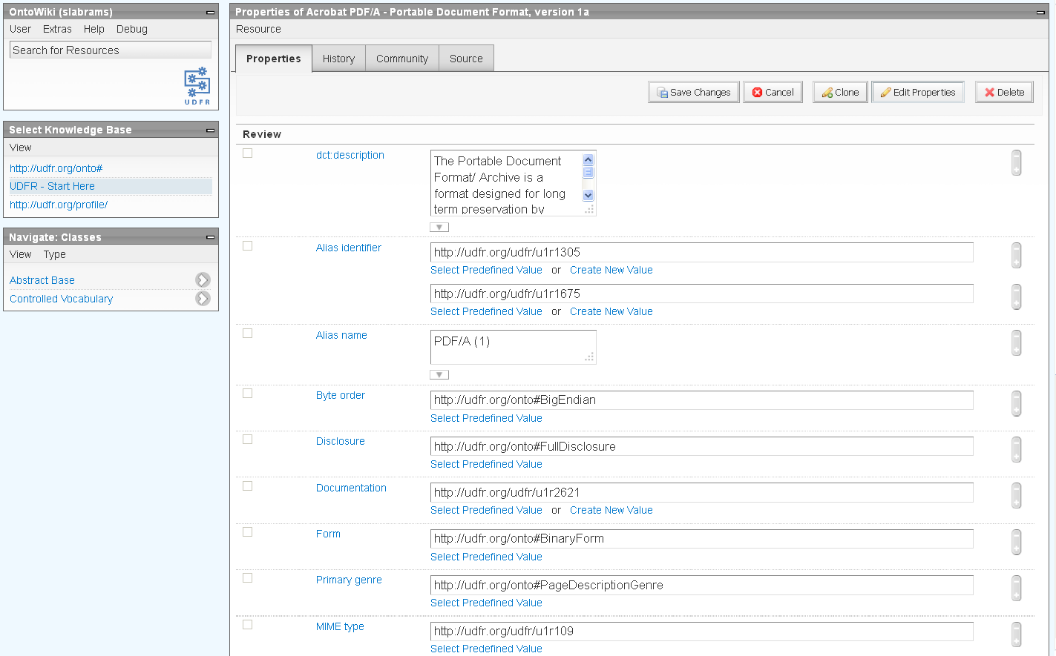
Contribute or edit information
http://udfr.org/

Slide 14
Next steps
Operational control
CDL will continue to host the UDFR for one year while a more permanent hosting strategy can be identified
Administrative control
The “admin” role – necessary for adding user privileges, modifying the ontologies, and bulk imports – is held by CDL staff
How can this responsibility be shared?
Technical control
Who will share “committer” responsibility for the codebase?
How to coordinate additional development activity?

Slide 15
Next steps
Technical development
Synchronization with PRONOM and other external sources of bulk imports
UI enhancements to provide lower-barrier learning curve
RESTful API (in additional to SPARQL endpoint)
Replication to mirror sites
Others?
Bring under the OPF code repository/issue tracking umbrella

Slide 16
Next steps
Import additional data sources
Library of Congress Sustainability of Digital Formats
http://www.digitalpreservation.gov/formats/
IT History Society hardware database
http://www.ithistory.org/hardware/hardware-name.php
National Library of Australia Mediapedia
http://www.nla.gov.au/mediapedia
NIST NSRL (National Software Reference Library)
http://www.nsrl.nist.gov/
Stanford CPUdb
http://cpudb.stanford.edu/
TOTEM (Trustworthy Online Technical Environment Metadata) database http://keep-totem.co.uk/
Other candidates?

Slide 17
Next steps
Use it
Contribute or refine information
Contribute to open source development
Tell us what you think

Slide 18




For more information
UDFR
http://udfr.org/
http://github.com/UDFR
udfr-l@listserv.ucop.edu
UC Curation Center
http://www.cdlib.org/uc3
uc3@ucop.edu
Stephen Abrams
Lisa Dawn Colvin
Patricia Cruse
John Kunze
Margaret Low
Mark Reyes
Abhishek Salve
Marisa Strong
AKSW, Universität Leipzig
http://aksw.org/
http://ontowiki.net/
Philipp Frischmuth
Norman Heino
Sebastian Tramp
Library of Congress
http://www.digitalpreservation.gov/
Martha Anderson
Leslie Johnston
National Archives [UK]
http://www.nationalarchives.gov.uk/
http://www.nationalarchives.gov.uk/PRONOM
Tim Gollins
Tracey Powell
Spenser Ross

