Slide 1
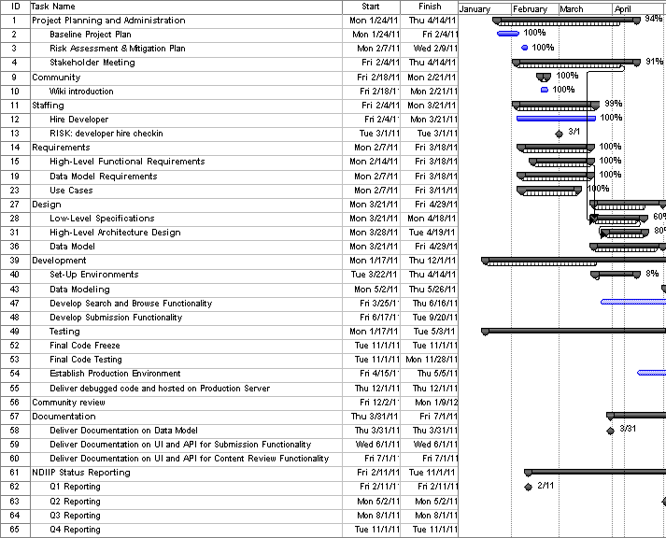
UDFR Progress to Date

Slide 2
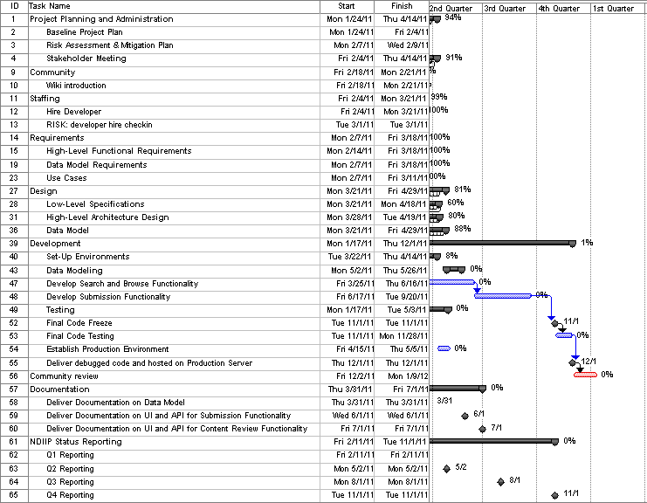
UDFR Project Schedule

