Slide 1
Data modeling
Goal:
Agree on data modeling process and ontology

Slide 2
Agenda
Scope
Provenance/ Governance (briefly)
Identifiers
Guiding Principles, Terms, Concepts
Controlled Vocabularies

Slide 3
Scope
Current model is based on PRONOM 6 and UDFR
Is there a useful distinction between “fact” and “institutional policy”?
What should be contained in the registry?
Fact | Assessment | Policy
JPG2000 is an image compression format. | JPEG2000 is a well-adopted standard. | JPG2000 is acceptable by CDL for reformatting photographs

Slide 4
Scope
Are there other aspects of PRONOM 7 we want to include in the registry?

Slide 5
Provenance (briefly)
Representation within the model is statements about the provenance
Statements about the formats, rather than who stated those facts.
Provenance about the registry information itself can be managed by
Open Provenance Vocabulary whether as reified statements or statements
about particular triples or graphs.
What is the proper granularity for provenance and technical review, per-property or per-aggregate entity (e.g., format, agent, document, etc)

Slide 6
Governance (briefly)
More food for thought (to be extended tomorrow):
What level of technical review should/will contributed information be subject, and by whom?
What are the criteria for contributor eligibility? Anonymous? Public, but known? Self-nominated, but vetted? Invited?

Slide 7
Identifiers (1)
There are multiple identifiers that are defined in the model:
  PRONOM ID (PUID)
  GDFR Identifier
  UDFR Identifier
  UDFR SystemID (internal registry ID)

Slide 8
Identifiers (2)
UDFR Identifier:
  A globally unique identifier across registry instances
  A persistent identifier
    Can be ported to persistent space at later time
  Non-opaque
    identical or mappable to URI local name
    machine-actionable
Should UDFR identifier be opaque or transparent?

Slide 9
Identifiers (3)
Node
  Create a zero-padded numeric sequence for organizational node ids (e.g. “001”) to be used within the identifier.
Format
  Keep version information as it is defined idiosyncractically by the original format creator. Parse it to reveal family and other useful categorizations.

Slide 10
Identifiers (4)
UDFRID = (addressable-prefix , “/” , identifier )| (addressable-prefix , “#” , identifier);
addressable-prefix = “http://udfr.org/udfr” | (“http://n2t.net/” , udfr-ezid) ;
udfr-ezid = 5 * digit ;
identifier = node-id , “/” , entity-code , “/” , local-id , “/” , version-id ;
node-id = 3 * digit ;
entity-code = “f” | “n”
local-id = alpha , {alphanumeric-with-slash} ;
version-id
digit = [0 – 9] ;
alpha = [a-zA-Z] ;
alphanumeric = [alpha | digit]
alphanumeric-with-slash = [alphanumeric | “/”] .
For example: http://udfr.org/udfr/001/f/pdf/a/1
http://udfr.org/udfr/001/f/pdf/1.7

Slide 11
Goals and guiding principles
Support existing functionality and use cases
Reuse and map to existing ontologies where it makes sense (“linked data”)
Primarily be a descriptive ontology, with the goal of expanding to machine-actionable semantic representations where needed
Create natural partitions to modularize
Enable for expansion
Be consistent
Have the application be model-driven (yet domain model-agnostic) as much as possible

Slide 12
Terms
Resource | An object or element expressed in RDF. A resource is identified by a URI.
Class | Typically represents a concept. A set of individuals which may possess a set of properties or relationships.
Instance | An individual member of a class.
Property | Represents a relationship or attribute. Owl divides properties into Object Properties, which relate two resources and Datatype Properties, which relate a resource to a datatype.

Slide 13
Conceptual Entities
SimpleBaseEntity – Contains all basic provenance/governance properties such as:
    administrativeStatus
    baseNote
    identifier
    creationDate, modificationDate
    veriticationDate, verificationStatus, verifiedBy

Slide 14
Conceptual Entities
CoreEntity – Classes where the circumstance of its creation are meaningful:
    Assessment
    Document
    File
    Format: CharacterEncoding, CompressionTechnique, FileFormat
    Holding
    Identifier
    IntellectualPropertyRightsClaim
    Product: Hardware and Software Products
Has additional properties relating to release information and agents who created them.

Slide 15
Conceptual Entities
EnumeratedTypes – Class of Enumerated Type Classes (List of Values) as well as the GDFR Facets. Examples include:
    ByteOrderType
    CompressionFamilyTeyp
    CountryCode
    DisclosureType
    DocumentIntentType
    FormatRoleType
    LanguageCode
    MediaType

Slide 16
Conceptual Entities
Format – use GDFR definition of Format to include:
    File Format
    Character Encoding
    Compression Technique
Most properties are defined at Format level (to be inherited by subclasses)
Should we use GDFR definition of Format?

Slide 17
Properties
Should the registry support actionable inheritance of properties?
For example, should BWF automatically inherit all properties defined for “generic” WAVE?
When should inference take place? At UI entry time?
Current relationships from GDFR (restricted, extended, …) may be difficult to formalize. Shall we just replace with “isDerivedFrom” property?

Slide 18
Controlled Vocabularies
Semantic: RDF, RDFS, OWL
Vocabulary/Thesaurus: SKOS
Metadata: DC, DCTERMS
Agents: FOAF
Provenance: OPMV (Open Provenance model Vocabulary)
Country Codes/ Language Codes
Organization IDs
MIME Types
Governance
?

Slide 19
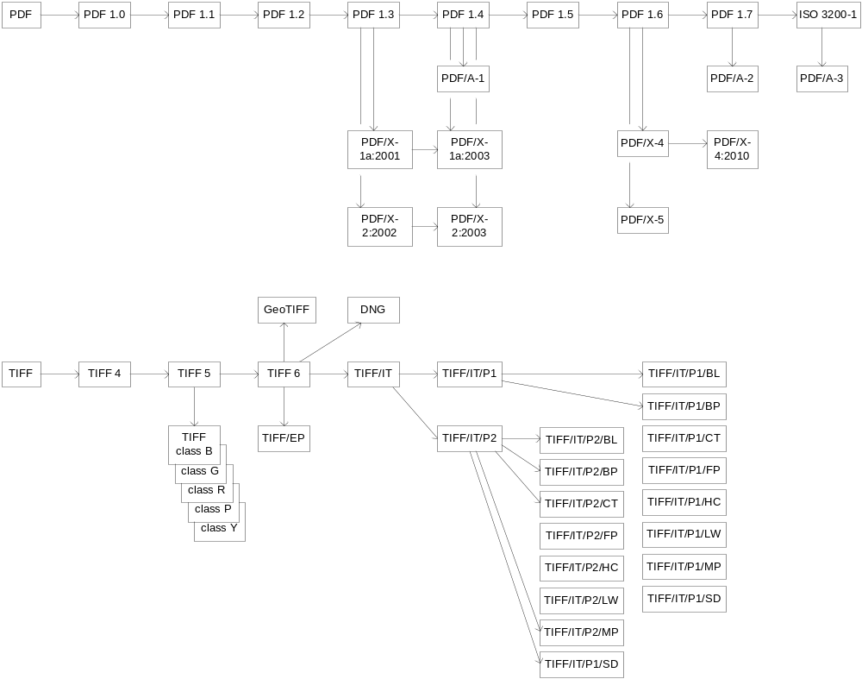

Slide 20
Questions/ Concerns ?

