Slide 1
Project Plan and Schedule
Goal:
Agree on project plan and schedule

Slide 2
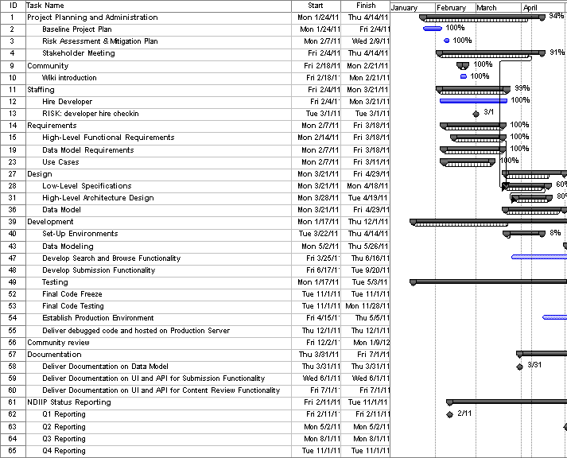
Schedule up to this point:

Slide 3
Challenges
Open-source technology stack not as mature in some areas, with complex inter-dependencies
Potential complexity within data model
Developer hire took time

Slide 4
Addressing Challenges
Picking technologies that are more mature with community support
Modularize data model to simplify implementation for phase 1, while still planning for future
Prioritize requirements to address scope with shortened development period

Slide 5
Project Approach
Agile-like
  Daily communication on development
  Weekly status updates
  Project plan based on features
  Low overhead internal pm tools (wiki, redmine)
  Iterate: Set up at least one early release of features to stakeholders

Slide 6
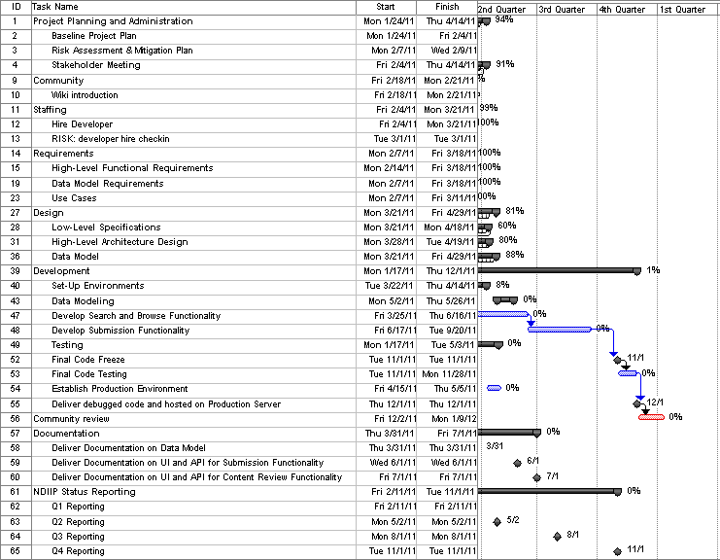
Where are we now?

Slide 7
Where are we now?
After the meeting, our goals:
Finish setting up development environment and infrastructure
Work Stakeholder decisions into requirements and planning
Update wiki monthly on progress

Slide 8
Questions/ Concerns ?

