Slide 1
Technical Architecture
Goal:
Agree on key technology decisions

Slide 2
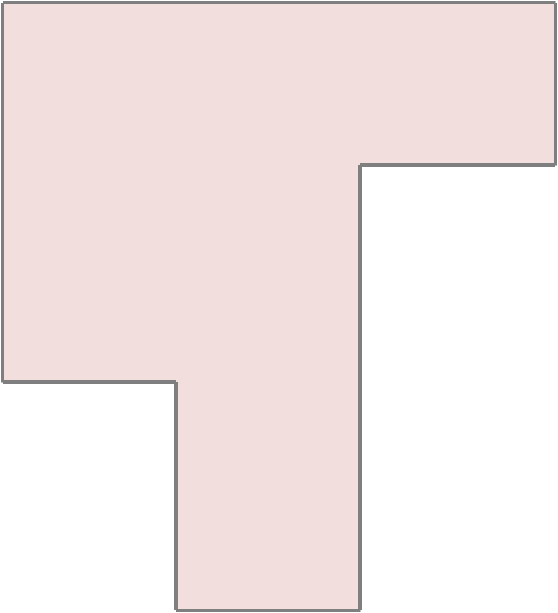
Technical Architecture
Presentation
Drupal
UI ( HTML / CSS / JavaScript / HTTP )
Widgets
Style sheets
Localization
Registry business logic
Jena / TBD
Solr
Pubsubhubbub
API ( REST/HTTP, SPAQL, ATOM, OpenSearch, OAI-PHM, etc.)
IdM/Authn/Authz
(access control)
CMS
(asset mgmt.)
Semantics
(constraints/reasoning)
Index/Search
(discovery)
Syndication
(notification/replication)
Persistence
POSIX
SPARQL
File system
Triple/quad
store

Slide 3
Technical Architecture
Look at open-source platform solutions
Semantic MediaWiki
  Very Flexible UI, but basically semantic annotations, would need to make translations
Onto Wiki
  Native Semantic representation underneath (not just annotations), but difficulty with support and to install
OpenStruct
Not technically a wiki, but a set of technologies used to build semantic applications. Has a difficult installation.
Decided we can use some of the technologies used, but need to create our own semantic layer.

Slide 4
Technical Architecture
Solution:
Create open-source platform similar to Structs, but create our own semantic layer.
Jena – well-supported and team has experience with this technology
Triple Store – have more options to choose right solution.

Slide 5
Technical Architecture
.
Replication model: master/slave(s) or peer-to-peer?

