Slide 1
Using the DMPTool for your NIH Data Management and Sharing Plan
Participating institution version
Notes:
This slide deck was developed by a team of DMPTool administrators and medical librarians as part of an NIH focused DMPTool working group in Winter of 2022.
Betsy Gunia, Johns Hopkins University, betsy.gunia@jhu.edu
Megan O’Donnell, Iowa State University, mno@iastate.edu
Jim Martin, University of Arizona, djmartin@arizona.edu
Lesley Skalla, Duke University Medical Center Library, lesley.skalla@duke.edu
Katy Smith, Saint Louis University, katy.smith@slu.edu

Slide 2
Why Use the DMPTool for your NIH DMSP?
Because the DMPTool:
Is a free and open, web-based form for writing your plan
Leads you through writing your plan by breaking it down by the NIH required elements
Provides links to useful guidance from NIH, suggested answers, and additional resources
Allows you to receive feedback on your draft from [Your Service Name] Optional-remove if you are not a participating institution
Place for Your Contact Info
Your Own Logo Here
Notes:
DMPTool is a free, online tool that was built to assist researchers with developing data management plans.
It can be used for all funders, not just NIH and is supported by the California Digital Library (receives no money from NIH or other funders).
DMPTool leads you through each step of the required NIH elements using an easy to follow form and provides links to useful guidance, example answers, and additional resources.
OPTIONAL: There’s also an optional review feature that allows you to send a plan to your institutions DMPTool administrators for feedback.

Slide 3
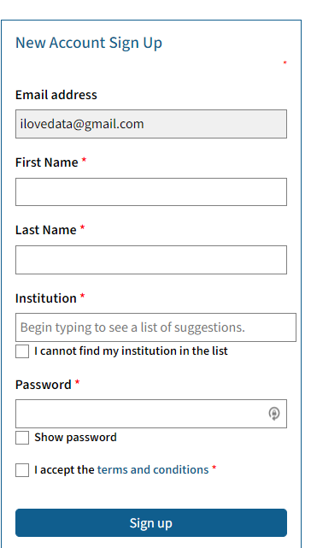
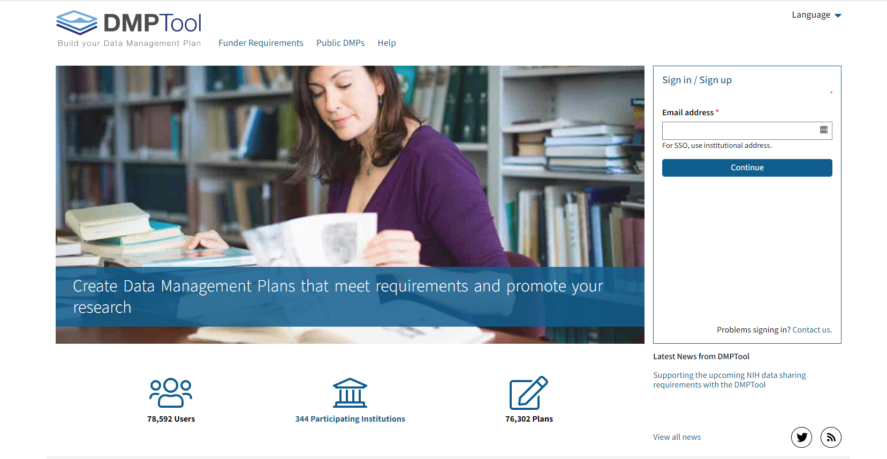
How to Login
Funder Requirements
Public DMSPs
Help
Your Institutional Email
Place for Your Contact Info
Your Own Logo Here
Notes:
If you are at a participating institution, you can login with your institutional address and password.
If not, you will need to create an account. Enter your email and hit continue. You will then be directed to create a password for your DMPTool account.

Slide 4
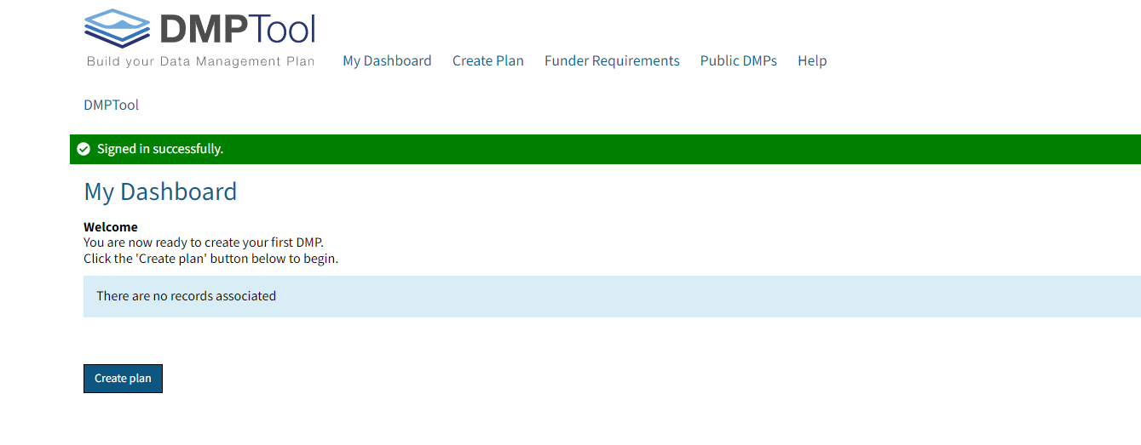
Dashboard
Place for Your Contact Info
Your Own Logo Here
Notes:
After signing in you’ll see a button to “Create plan” as well as a menu at the top of the screen that provides links to the My Dashboard, Funder Requirements, Public DMPs and the Help menu.

Slide 5
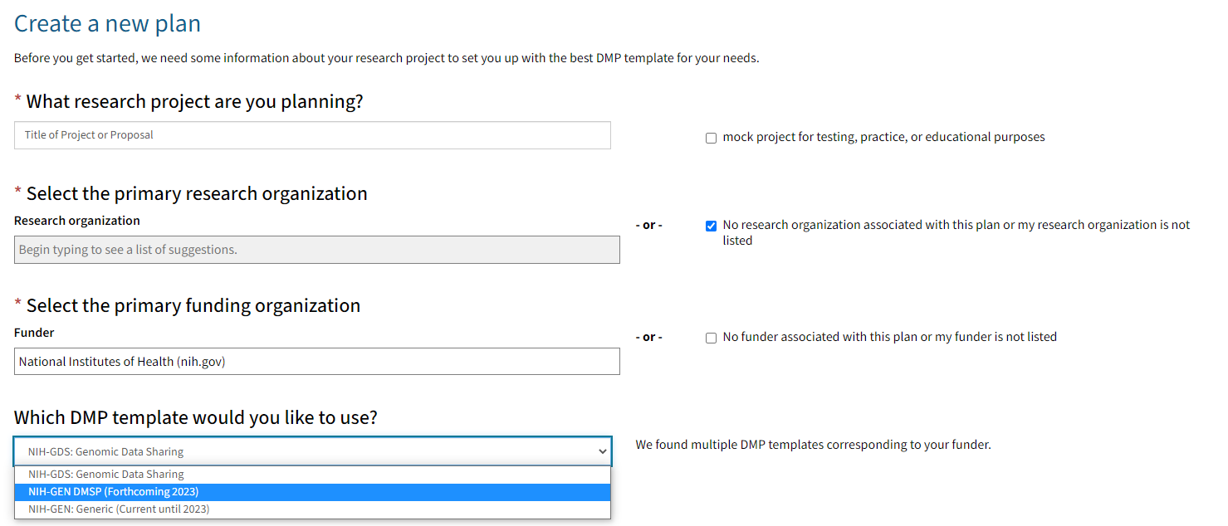

Create a new NIH DMSP
Title of Project/Proposal
Institutional Affiliation
Type your funder
Select Template
Place for Your Contact Info
Your Own Logo Here
Notes:
Okay, we are ready to create our plan!
Before beginning a plan, the DMPTool will walk you through a few required questions to determine the best template for your needs.
What research project are you planning? Keep in mind basic best practices/naming conventions. Click to check the “mock project” box if you are taking DMPTool for a test drive.
Select your institutional affiliation. If your organization is not listed OR if there is no associated organization, leave the box blank and click to check the “No research organization associated with this plan or my research organization is not listed.” Once this box is checked, the “required question” indicating red asterisk for the Research Organization will disappear.
Enter the Funder (NIH and National Institutes of Health are both accepted).
Once the Funder is entered, and additional question to Select Template opens with choices: To create a new NIH DMSP, choose NIH-GEN DMSP (forthcoming 2023). Please note: some funders have or will have multiple templates.
Click Create Plan.

Slide 6
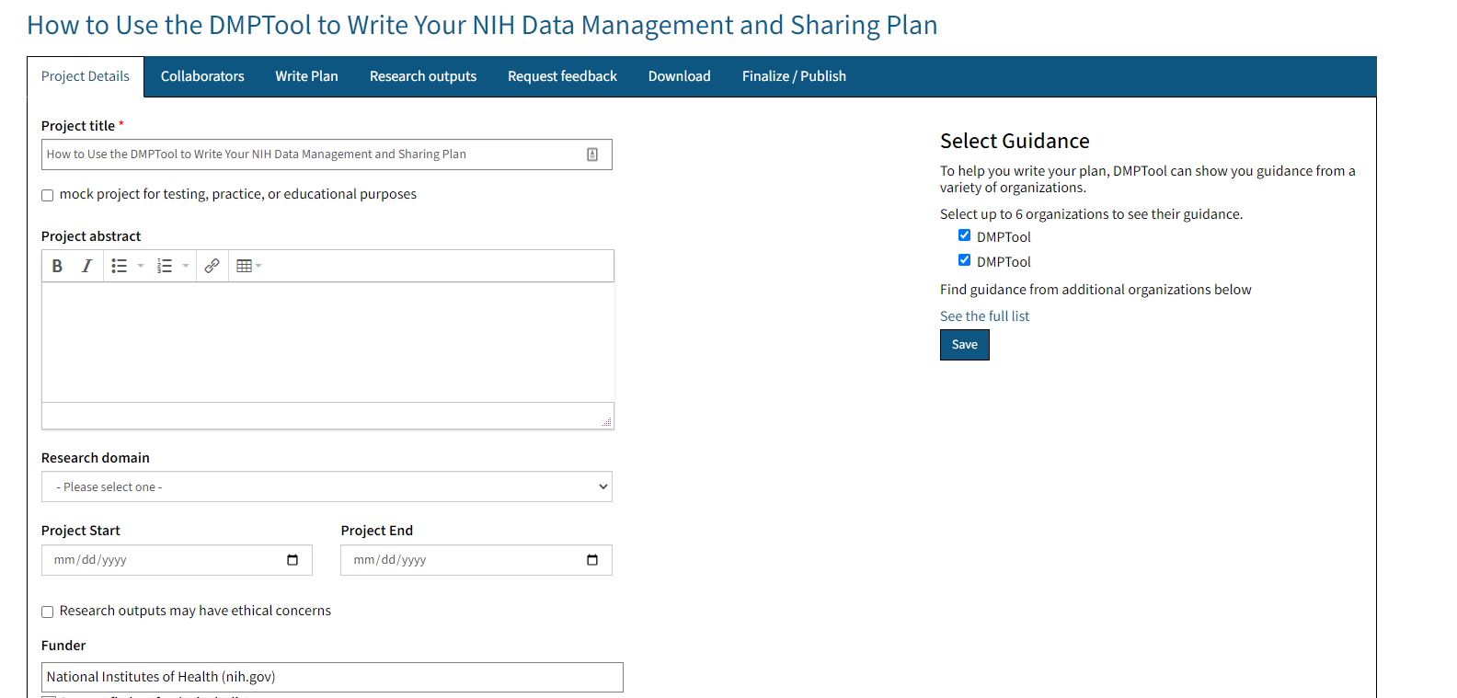
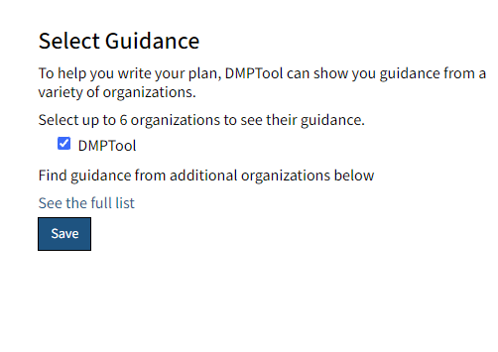
Overview of Available Tabs
Place for Your Contact Info
Your Own Logo Here
Notes:
Before we jump further into writing the plan, let’s review the available tabs. We will then go through each tab in detail:
Project Details
Collaborators
Write Plan
Research Outputs
Request Feedback (participating institutions only)
Download
Finalize/Publish

Slide 7
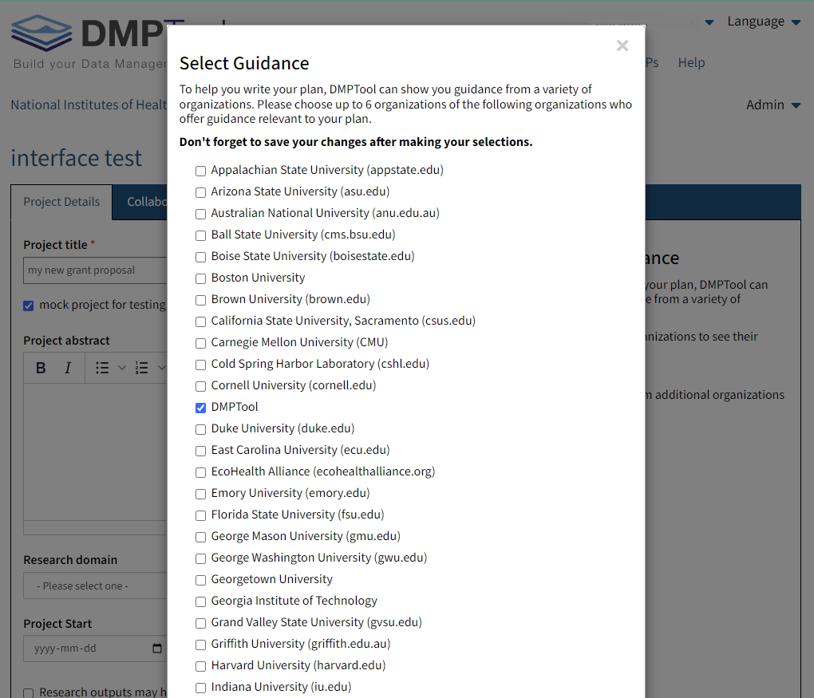
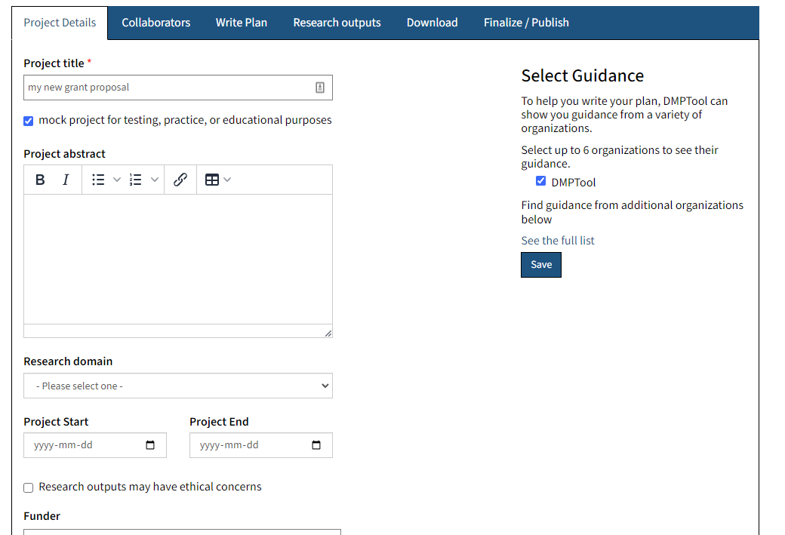
Project Details
Using the DMPTool to add Project Details and to Select Guidance.
Place for Your Contact Info
Your Own Logo Here
Notes:
The Project Details tab is where you can enter basic information about your research project to help you, and others identify it. In addition to giving your DMP a title, you can also enter start and end dates, and funding information.
On the right hand side there’s a “Select Guidance” menu that’s easy to miss. If you click “see the full list” then you can load guidance from different institutions. By default, DMPTool and your institution are selected if available but you can activate or deactivate as you choose.

Slide 8
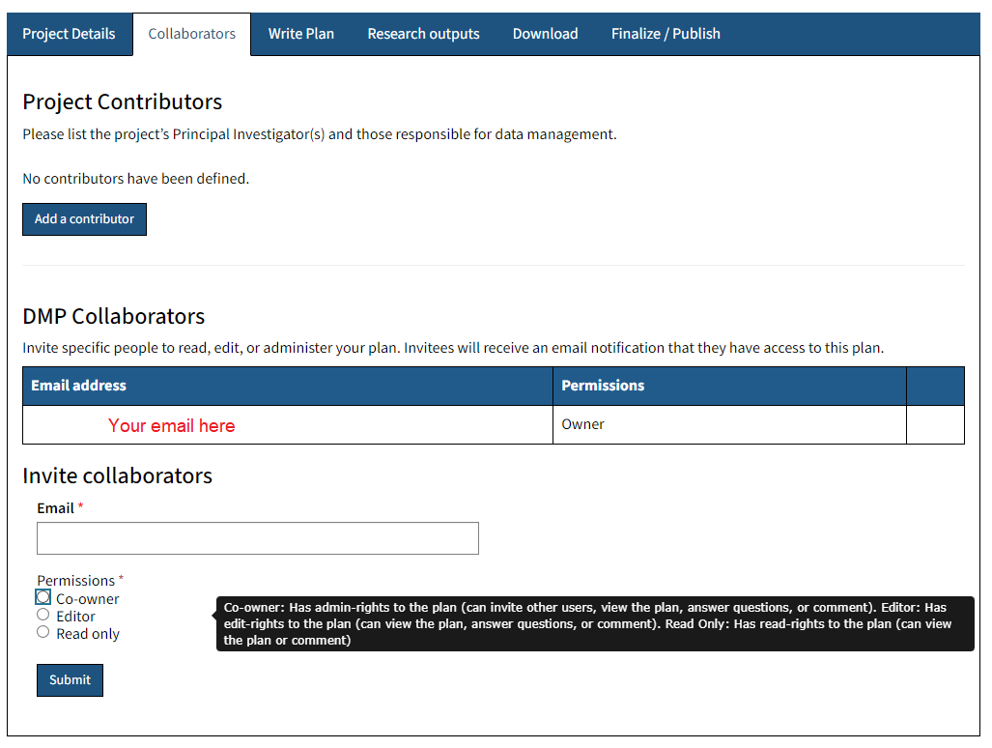
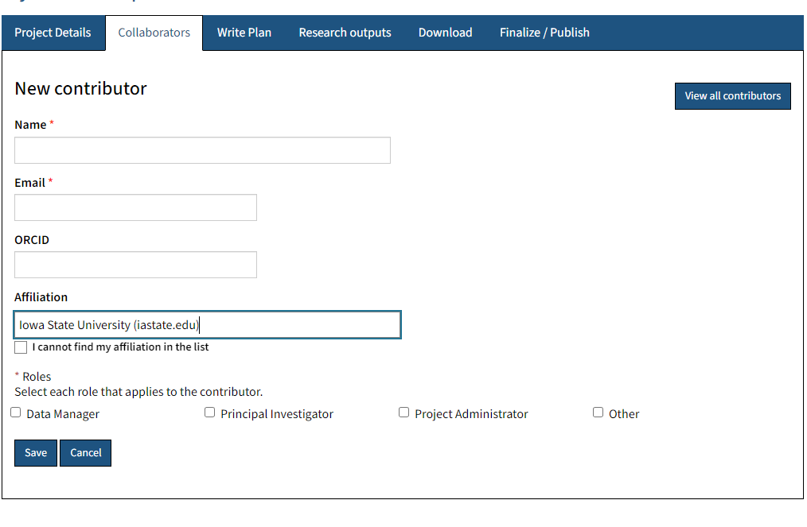
Collaborators
Using the DMPTool to add Collaborators.
Place for Your Contact Info
Your Own Logo Here
Notes:
The Collaborators tab lets you add contributors, co-owners, editors, and readers.
Readers can only view and comment on plans.
Editors can view, comment, and edit the plan and Co-owners can do everything an editor can and also add people.
These permissions do not affect plan authorship. To add co-authors you will need to add Contributors. Contributors can also be assigned to up to four roles: Data manager, Principal investigator, Project administrator, and other.

Slide 9
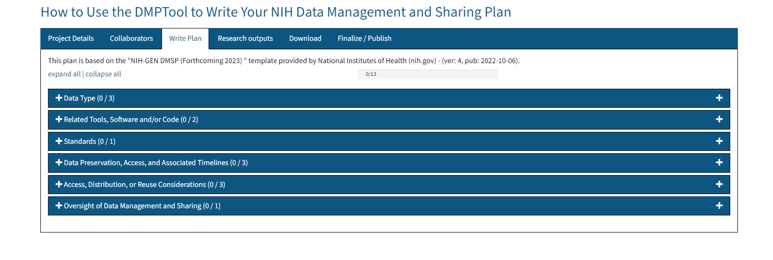
Write Your Plan
Write Plan
Place for Your Contact Info
Your Own Logo Here
Notes:
The Write Plan tab is where you will spend the most time.
You’ll notice that the title of each blue bar matches one of the elements listed in NIH’s supplemental guidance as an element to address in a DMSP.
Click on plus sign to view details about that specific element.

Slide 10
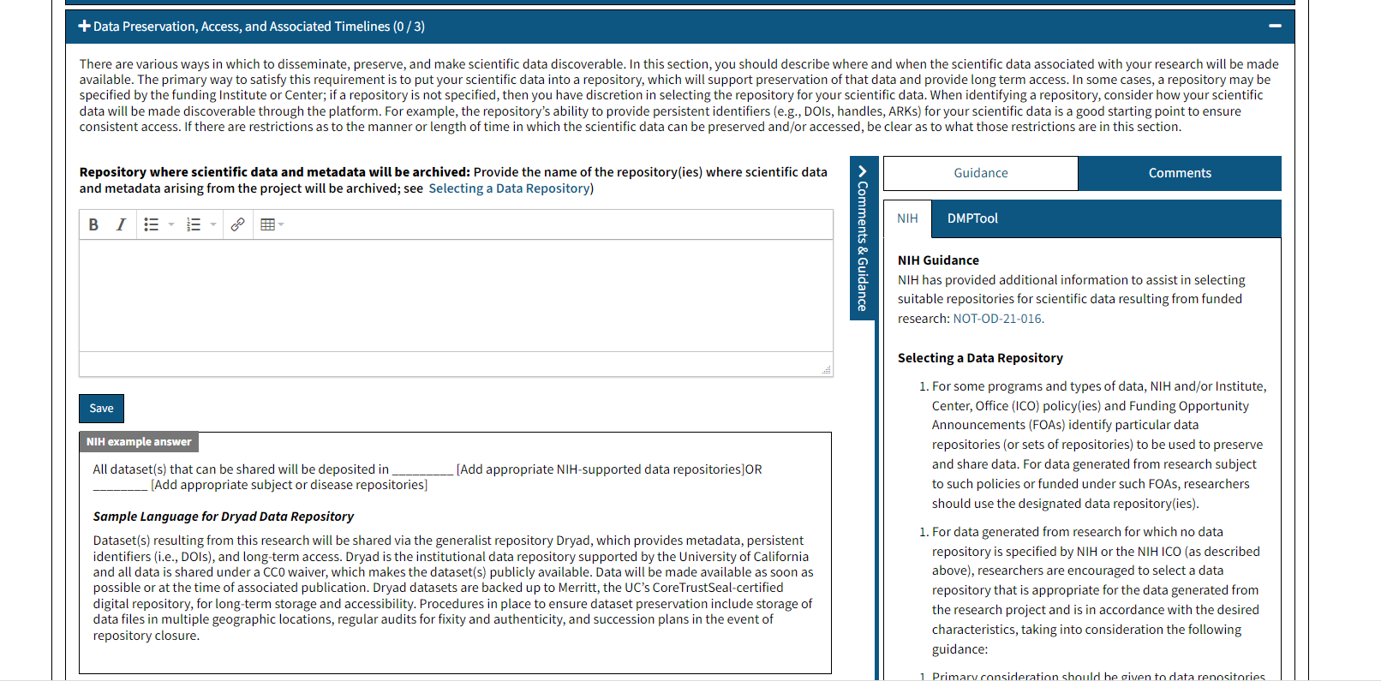
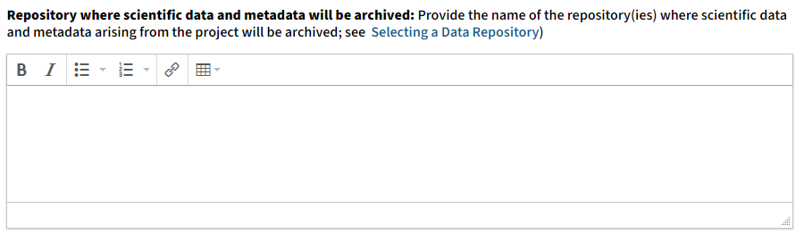
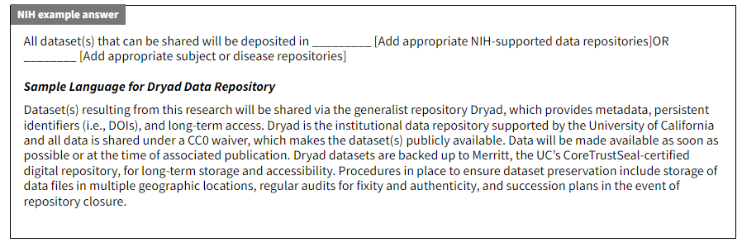
Write Your Text for Each Element
Place for Your Contact Info
Your Own Logo Here
Notes:
When you expand one of the sections you’ll see some new features. First, you’ll see an overview of what the section needs to address - this wording exactly matches the wording provided by NIH - followed by a text-entry box for you to compose your answer.
Underneath the text-box you’ll see example, “fill in the blank” answers to give you an idea of what kind, and how much information to include in your own answer. Do NOT reuse the examples as your own answer as they contain details that will not be relevant to your own research.
To the right of all this, you’ll see a sidebar with “Guidance” and “Comments” sections. The Guidance section is where you’ll see additional information that relates or applies to the section you’re addressing. If you selected specific institutions on the Project Details screen they’ll appear here. The Comments function is only relevant if you intend to share your draft in DMPTool with others.

Slide 11
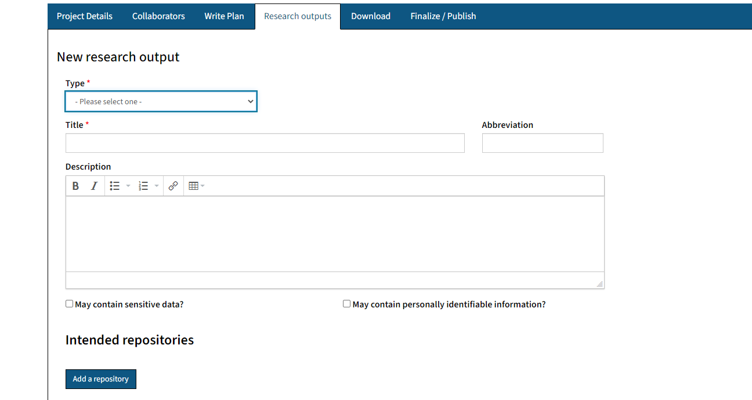
Research Outputs
Place for Your Contact Info
Your Own Logo Here
Notes:
The Research Outputs tab lets you track and plan for reportable project outputs such as datasets, images, software, workflows and more. Completing this tab is optional - it is not required by NIH or any other funder. However, we recommend using it because it provides an easy way to identify and report outputs as the information entered on the Research Outputs tab can be exported with the rest of your plan or separately.
(FYI: it cannot be downloaded as a CSV file at the moment due to a bug).
To use the Research Outputs tab you Add a research output then select it’s Type and enter a Title. Entering a short Description can help differentiate between outputs, but it is not required. You can also check boxes to indicate if the output contains sensitive info or PII (personally identifiable information).

Slide 12
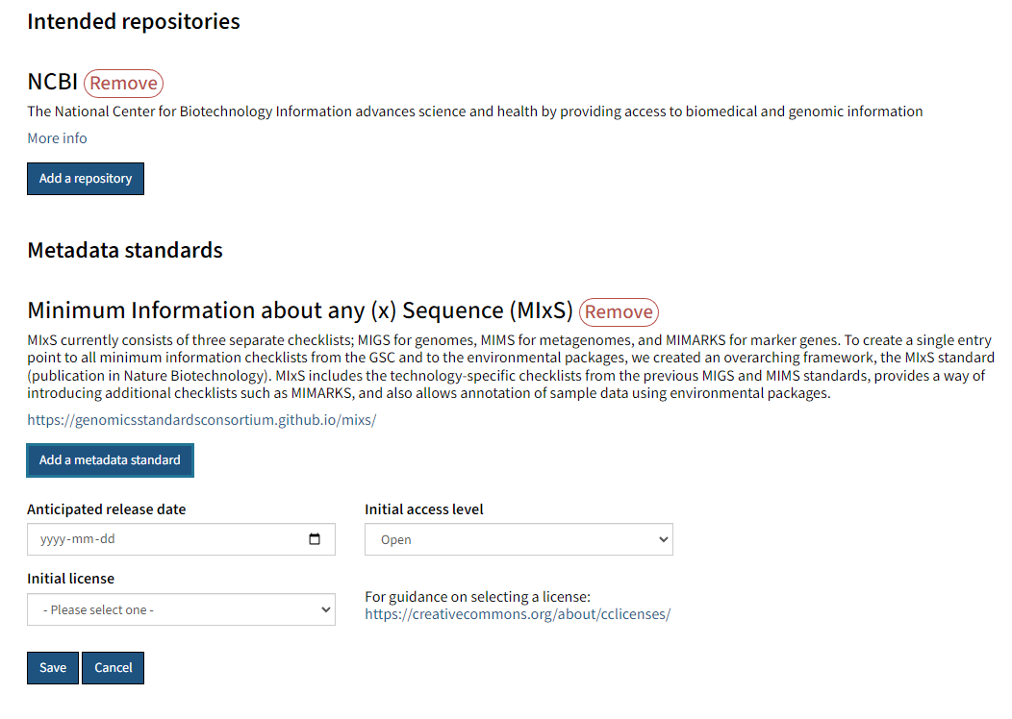
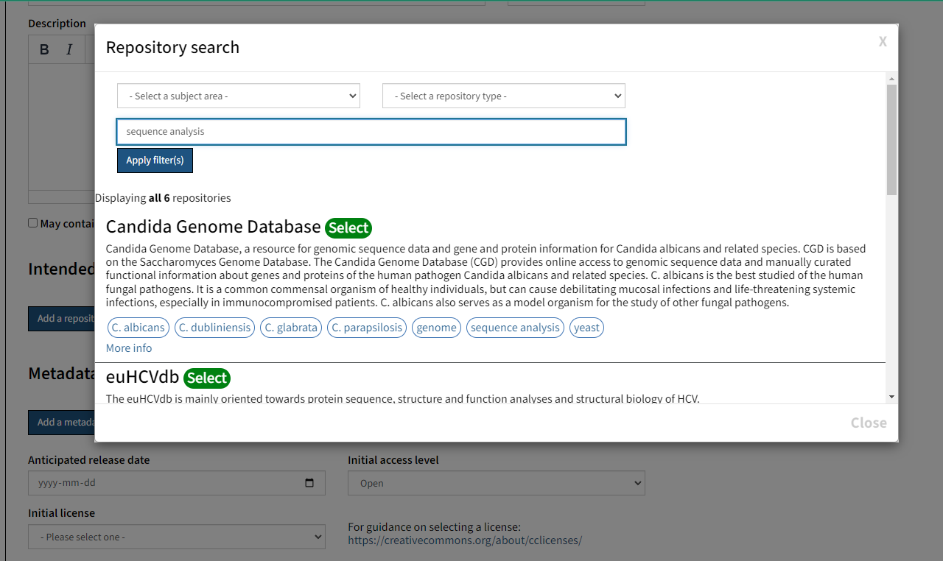
Research Outputs: Repositories and Metadata
Place for Your Contact Info
Your Own Logo Here
Notes:
The next sections can help you plan for long-term access and data sharing. You can assign a Repository to each Research Output by searching by name, topic or keyword. There are thousands of repositories in the system so make sure to confirm repository policies before selecting it! Many repositories in this list are specialized and limit both what, and who, can deposit data into them.
Lastly, you can add information about metadata standards (if applicable), licensing, file sizes, and planned release date. Similar to the repository search, the Metadata Standard search contains a dynamic list of common standards that you can link to. It’s ok to not know what to enter in these last sections at the start of this process, and since you can update it at any time, you can use this tab to maintain an accurate final inventory to to report back to NIH.

Slide 13
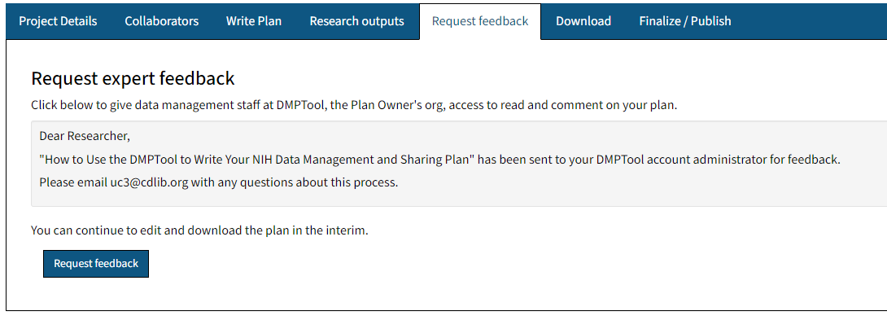
Research Feedback*
* This tab only appears if you are a participating institution. Remove from slide deck if you are not
Place for Your Contact Info
Your Own Logo Here
Notes:
OPTIONAL - THIS ONLY APPLIES TO DMPTOOL PARTNER INSTITUTIONS; if you don’t see this tab after signing in with your institutional email then, you’re not at a partner institution. To utilize this feature you will need to enable it first. On the "Organization details" page there is a "Request feedback" tab. This is where you can enable the functionality for users at your organization to request feedback on their plans.
Another optional feature I recommend is using the “Request feedback” feature. This alerts your school’s DMPTool admins, usually your librarians, that you have a plan ready to review. You’ll receive feedback in the Comments area of the Write Plan tab. This feature lets you easily connect with the experts at your institution while working on your draft.

Slide 14
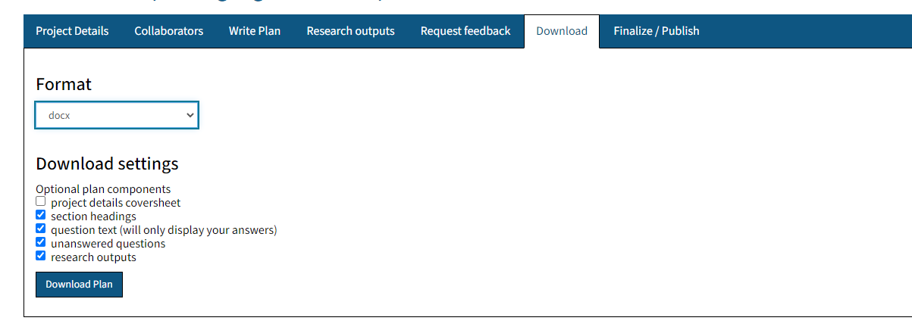
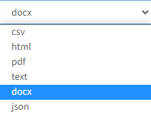
Download
Place for Your Contact Info
Your Own Logo Here
Notes:
When your plan is ready to be finalized, navigate to the Download tab. This tab provides two sets of options: format and components.
For components, make sure to include “question text” and “section headings” so you can see both the topic and your answer. Unanswered questions can be left checked since all questions should have been answered; Project details cover sheet contains the information from the Project Details tab, which may be useful for your own record keeping but not submitted as part of a funding proposal. Lastly, if research outputs were added you should also check this box.
For formats, Docx, Microsoft Word, is recommended so you can edit both answers and page formatting to ensure your plan meets the typical 2-page limit.
NOTE: Research outputs cannot be downloaded in CSV format at the moment.

Slide 15
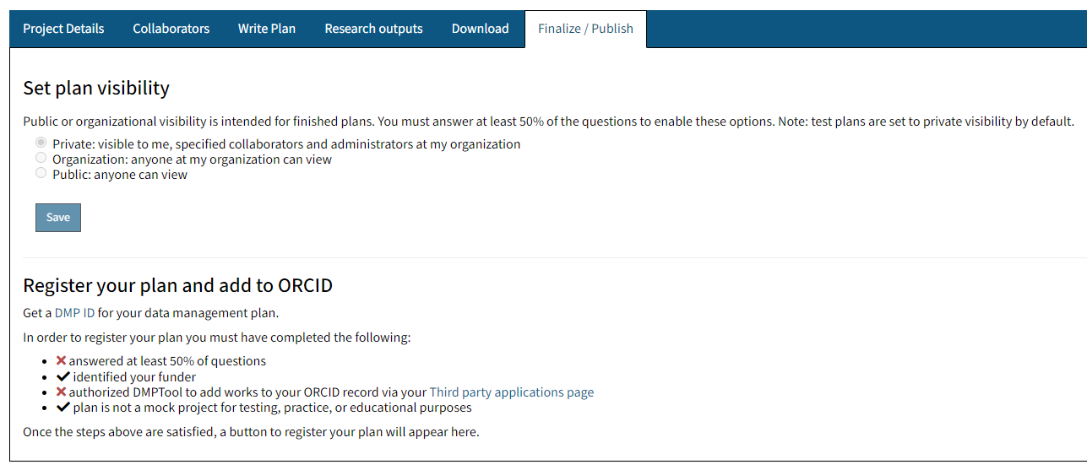
Finalize/Publish
Place for Your Contact Info
Your Own Logo Here
Notes:
DMP Tool can also publish your DMSP and research output lists. By default, all plans are set to ‘private’ and only the author, and added collaborators if any, can access your plan. Once your plan is at least 50% done you’ll be able to make your plan available to other people at your institution (may not apply) and to the public. Public plans help graduate students and other researchers learn what’s expected and how others are answering funder expectations.
You can also register for a DMP ID. A DMP ID is a unique persistent identifier for data management plans. DMP-IDs makes core information about your data management plan such as authors, funder, project description, and research outputs -- but not your answers -- public. Doing this does a couple of things: 1) it will push information about your DMP to your ORCID account and include it as a work on your ORCID profile page., 2) it makes your DMP citable, 3) it facilitates connecting research outputs, funding, and plans.

Slide 16

Learn more about DMPTool and Writing an NIH Data Management and Sharing Plan
https://blog.dmptool.org/
https://sharing.nih.gov/
Placeholder
placeholder
Place for Your Contact Info
Your Own Logo Here
Notes:
That’s it for today’s overview. You can learn more about DMPTool on their blog and get the latest information about DMS plans on Sharing.NIH.gov.
NOTE: add links to your local resources here too!

