Slide 1

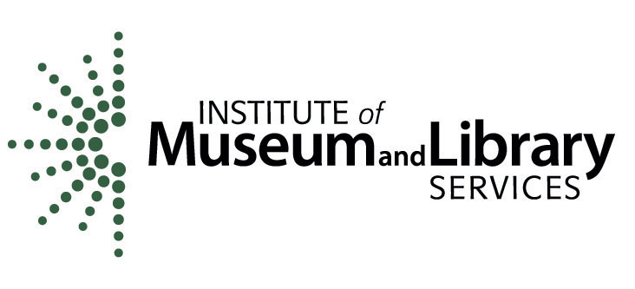

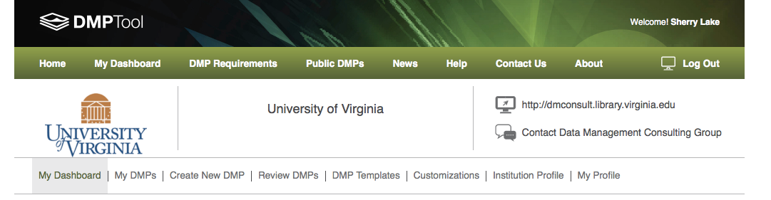
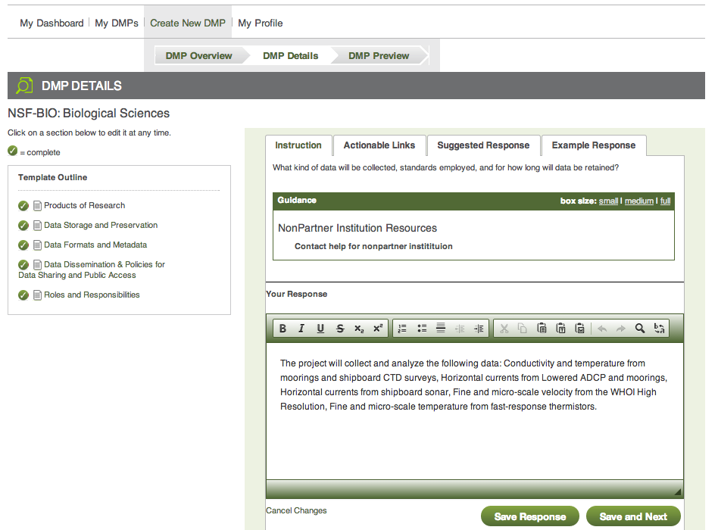
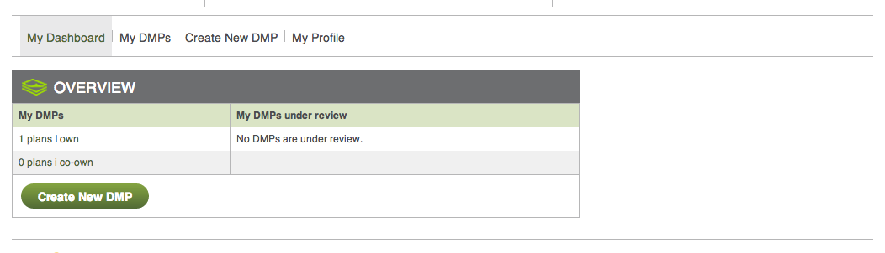
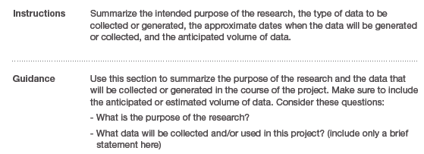
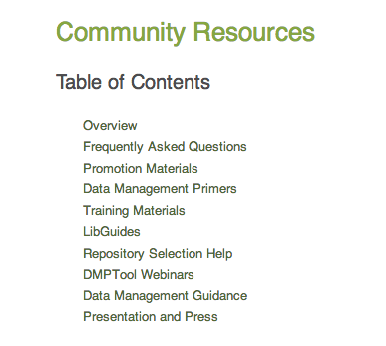
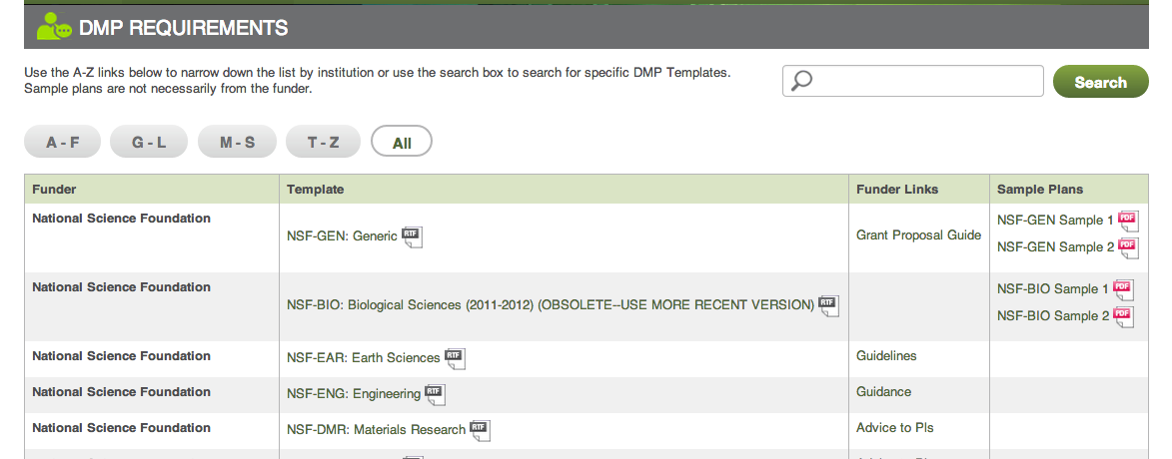


Expert Resources
& Support for Data Management Planning
In brief: Many funding agencies require data management plans (DMP) as part of grant proposals. The DMPTool helps institutions & researchers to create high-quality DMPs that meet funder requirements, including those from:
DMPTool Benefits for Researchers
Help you meet the funding requirements of your next grant with current data management planning information
Put you in touch with expert help at your institution and help you comply with your institutional requirements
Improve the quality of your research and increase its impact through better data management practices
Collaborative plan creation and co-ownership with colleagues
Institution-specific templates and help
What is the DMPTool?
More DMPTool Features
Free step-by-step web application for creating data management plans for funders
Log in with institution credentials
Funder-provided information & plan outline
institution-specific resources
Suggested answers & help text
Dashboard displaying current plans owned & co-owned
Plus:
Public repository of data management plans
Administrative interface for institutions
Review capabilities
Space to answer questions
General data management resources
Funder guidelines & links to websites
Founding partners: DataONE; Digital Curation Centre; Smithsonian Institution; UC Curation Center, California Digital Library; UCLA Library; UC San Diego Libraries; University of Illinois; University of Virginia Libraries
website
blog
twitter
dmptool.org
blog.dmptool.org
@TheDMPTool
Learn More
Notes:
30 x38

