Slide 1
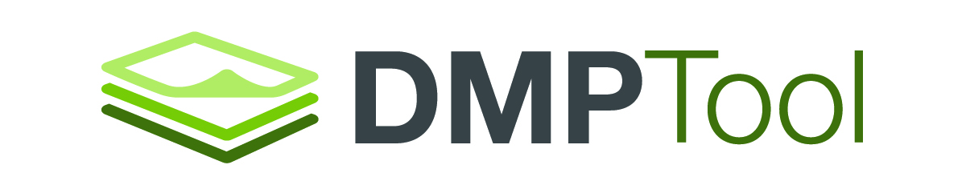
Need to write a data management plan?
Check out
.org
Free & easy to use
Step-by-step guidance
Links to funder requirements
Data management help
Created by libraries with funding from the Alfred P. Sloan Foundation

Slide 2
Did you know?
We can help!
Funders require data management plans alongside proposals.
.org
Free & easy to use
Step-by-step guidance
Links to funder requirements
Data management help
<Your name/org here>
<Your email here>
<your website here>
<your location>
Created by libraries with funding from the Alfred P. Sloan Foundation

