Slide 1
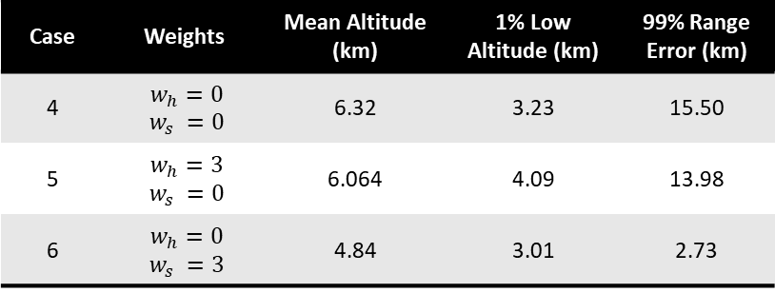
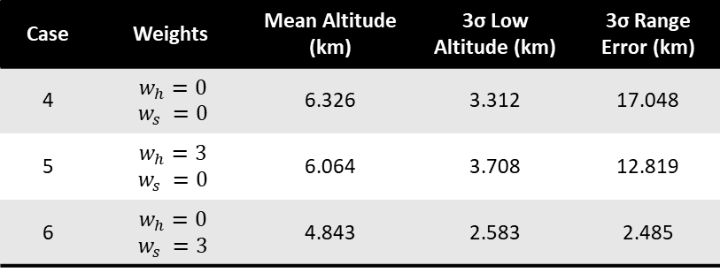
Fixed, nominal gains
Case | Bank Angle Limits | Mean Altitude (km) | 3σ Low Altitude (km) | 3σ Range Error (km)
1 | [0°, 90°] | 6.387 | 2.863 | 21.865
2 | [15°, 75°] | 6.200 | 3.532 | 15.718
3 | [30°, 60°] | 4.808 | 2.365 | 3.783
Case | Bank Angle Limits | Mean Altitude (km) | 1% Low Altitude (km) | 99% Range Error (km)
1 | [0°, 90°] | 6.38 | 2.63 | 20.01
2 | [15°, 75°] | 6.20 | 3.59 | 16.29
3 | [30°, 60°] | 4.80 | 2.79 | 4.26
Case | Weights | Mean Altitude (km) | 3σ Low Altitude (km) | 3σ Range Error (km)
4 | $w_{h}=0$ $$w_{s} =0$$ | 6.326 | 3.312 | 17.048
5 | $w_{h}=3$ $w_{s} =0$ | 6.064 | 3.708 | 12.819
6 | $w_{h}=0$ $w_{s} =3$ | 4.843 | 2.583 | 2.485
Case | Weights | Mean Altitude (km) | 1% Low Altitude (km) | 99% Range Error (km)
4 | $w_{h}=0$ $$w_{s} =0$$ | 6.32 | 3.23 | 15.50
5 | $w_{h}=3$ $w_{s} =0$ | 6.064 | 4.09 | 13.98
6 | $w_{h}=0$ $w_{s} =3$ | 4.84 | 3.01 | 2.73

Slide 2

Case | Bank Angle Limits | Mean Altitude (km) | 3σ Low Altitude (km) | 3σ Range Error (km)
1 | [0°, 90°] | 6.438 | 3.043 | 21.670
2 | [15°, 75°] | 6.205 | 3.549 | 16.008
3 | [30°, 60°] | 4.804 | 2.367 | 4.084
Fixed, optimized for case 6 gains
Case | Weights | Mean Altitude (km) | 3σ Low Altitude (km) | 3σ Range Error (km)
4 | $w_{h}=0$ $$w_{s} =0$$ | 6.334 | 3.356 | 17.372
5 | $w_{h}=3$ $w_{s} =0$ | 6.052 | 3.693 | 12.366
6 | $w_{h}=0$ $w_{s} =3$ | 4.723 | 2.470 | 1.896

Slide 3

Case | Bank Angle Limits | Mean Altitude (km) | 3σ Low Altitude (km) | 3σ Range Error (km)
1 | [0°, 90°] | 6.846 | 4.569 | 55.103
2 | [15°, 75°] | 6.357 | 4.173 | 37.840
3 | [30°, 60°] | 4.928 | 2.363 | 12.252
Optimized for each case gains
Case | Weights | Mean Altitude (km) | 3σ Low Altitude (km) | 3σ Range Error (km)
4 | $w_{h}=0$ $$w_{s} =0$$ | 6.307 | 3.166 | 9.988
5 | $w_{h}=3$ $w_{s} =0$ | 6.296 | 4.124 | 31.736
6 | $w_{h}=0$ $w_{s} =3$ | 4.723 | 2.470 | 1.896

Slide 4
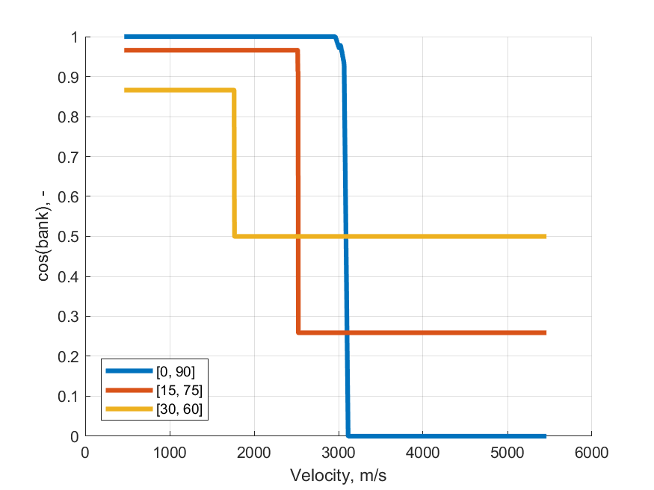
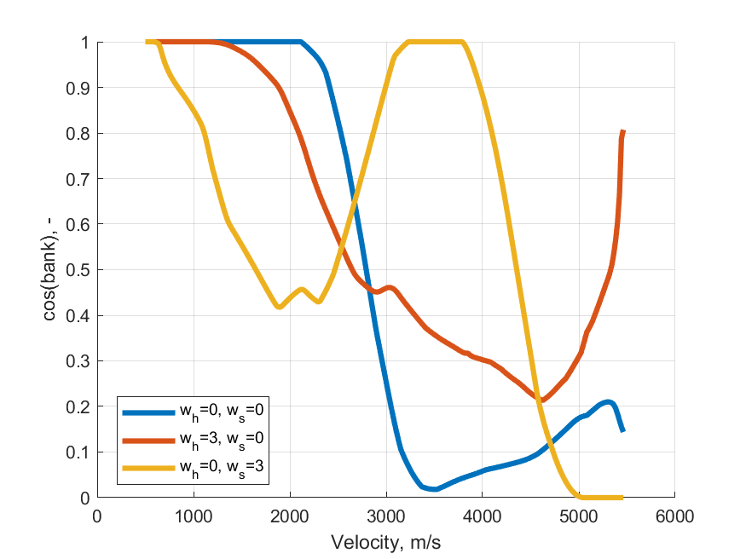

Slide 5
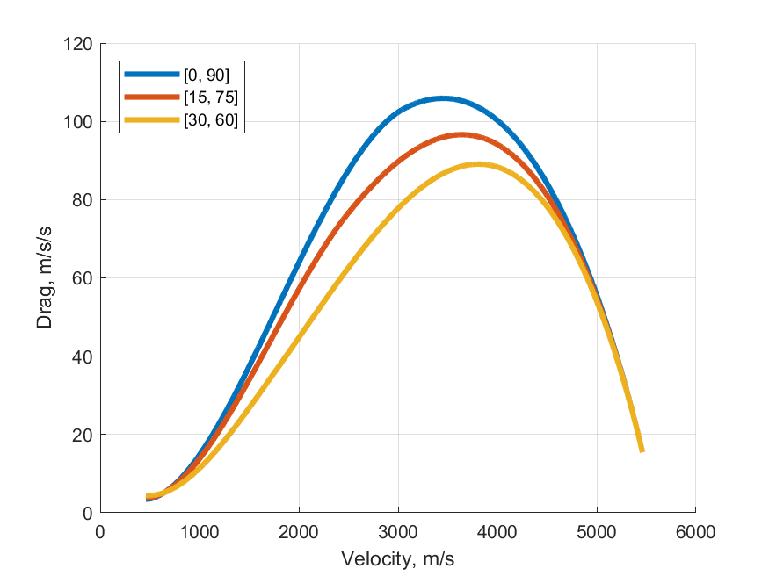
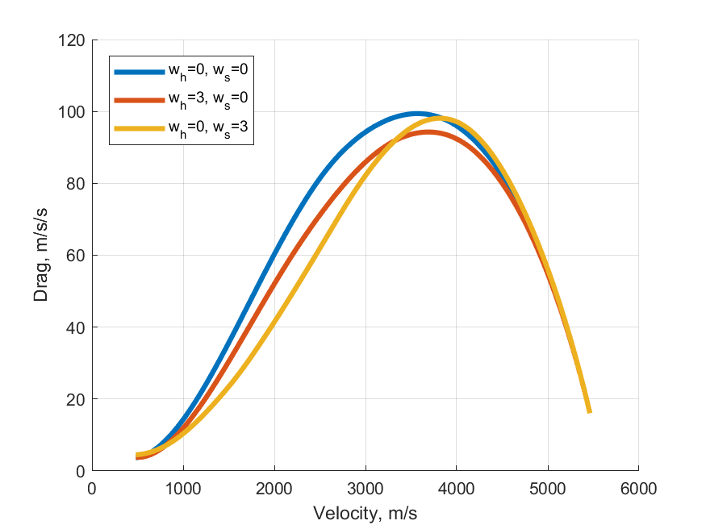

Slide 6
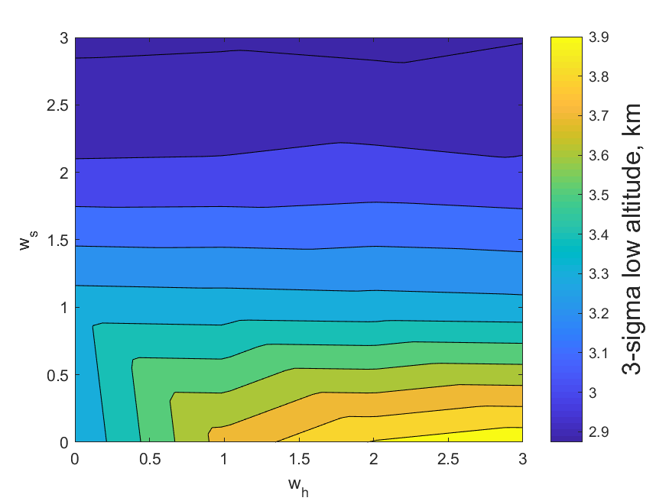
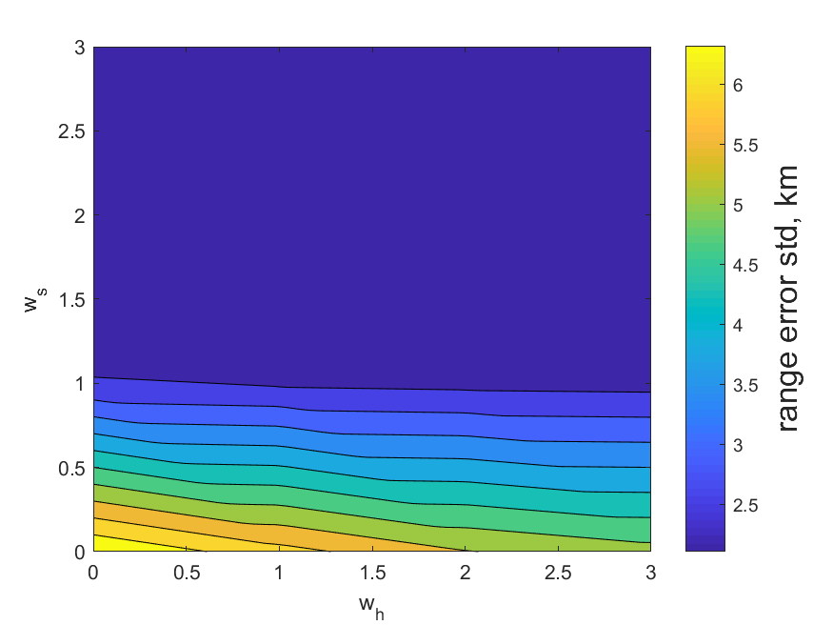

Slide 7
