Slide 1
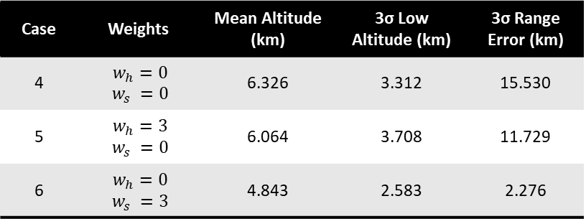
Case | Bank Angle Limits | Mean Altitude (km) | 3σ Low Altitude (km) | 3σ Range Error (km)
1 | [0°, 90°] | 6.387 | 2.863 | 17.663
2 | [15°, 75°] | 6.200 | 3.532 | 14.055
3 | [30°, 60°] | 4.808 | 2.365 | 3.726
Fixed, nominal gains
Case | Weights | Mean Altitude (km) | 3σ Low Altitude (km) | 3σ Range Error (km)
4 | $w_{h}=0$ $$w_{s} =0$$ | 6.326 | 3.312 | 15.530
5 | $w_{h}=3$ $w_{s} =0$ | 6.064 | 3.708 | 11.729
6 | $w_{h}=0$ $w_{s} =3$ | 4.843 | 2.583 | 2.276

Slide 2
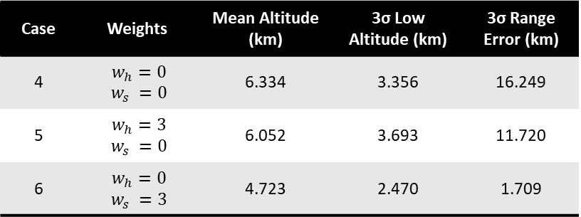
Case | Bank Angle Limits | Mean Altitude (km) | 3σ Low Altitude (km) | 3σ Range Error (km)
1 | [0°, 90°] | 6.438 | 3.043 | 18.504
2 | [15°, 75°] | 6.205 | 3.549 | 14.311
3 | [30°, 60°] | 4.804 | 2.367 | 3.913
Fixed, optimized for case 6 gains
Case | Weights | Mean Altitude (km) | 3σ Low Altitude (km) | 3σ Range Error (km)
4 | $w_{h}=0$ $$w_{s} =0$$ | 6.334 | 3.356 | 16.249
5 | $w_{h}=3$ $w_{s} =0$ | 6.052 | 3.693 | 11.720
6 | $w_{h}=0$ $w_{s} =3$ | 4.723 | 2.470 | 1.709

Slide 3
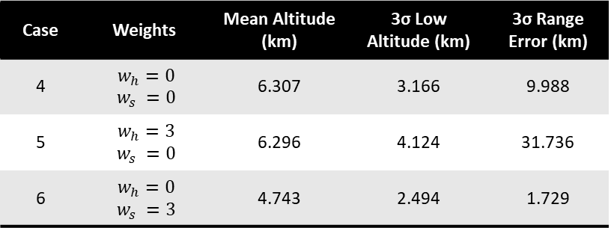
Case | Bank Angle Limits | Mean Altitude (km) | 3σ Low Altitude (km) | 3σ Range Error (km)
1 | [0°, 90°] | 6.846 | 4.569 | 53.903
2 | [15°, 75°] | 6.357 | 4.173 | 37.840
3 | [30°, 60°] | 4.928 | 2.363 | 12.252
Optimized for each case gains
Case | Weights | Mean Altitude (km) | 3σ Low Altitude (km) | 3σ Range Error (km)
4 | $w_{h}=0$ $$w_{s} =0$$ | 6.307 | 3.166 | 9.988
5 | $w_{h}=3$ $w_{s} =0$ | 6.296 | 4.124 | 31.736
6 | $w_{h}=0$ $w_{s} =3$ | 4.743 | 2.494 | 1.729

Slide 4
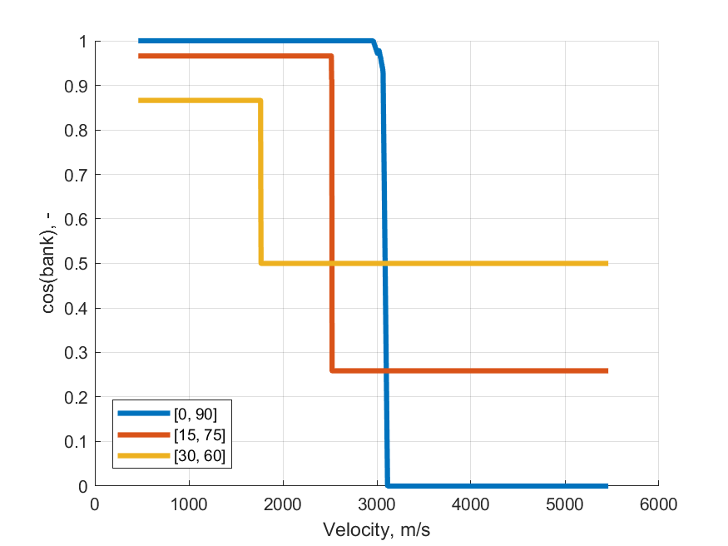
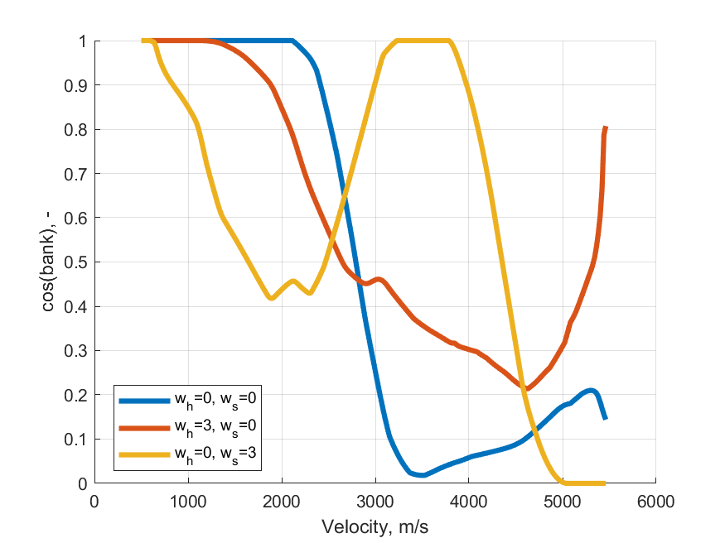

Slide 5
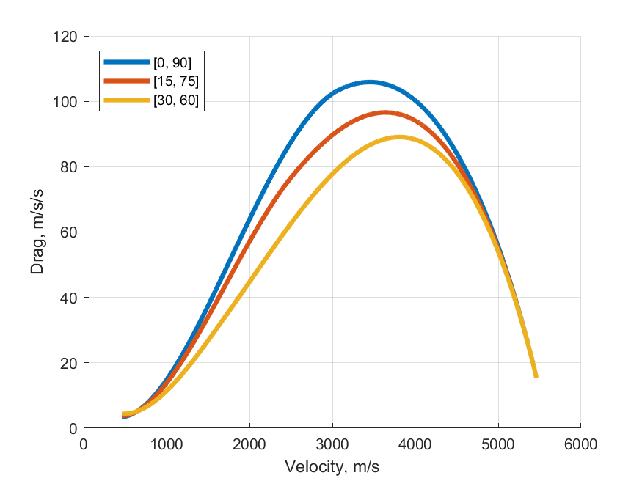
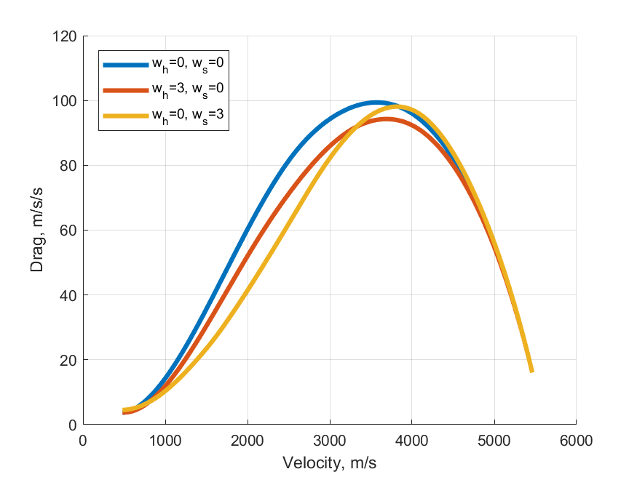

Slide 6
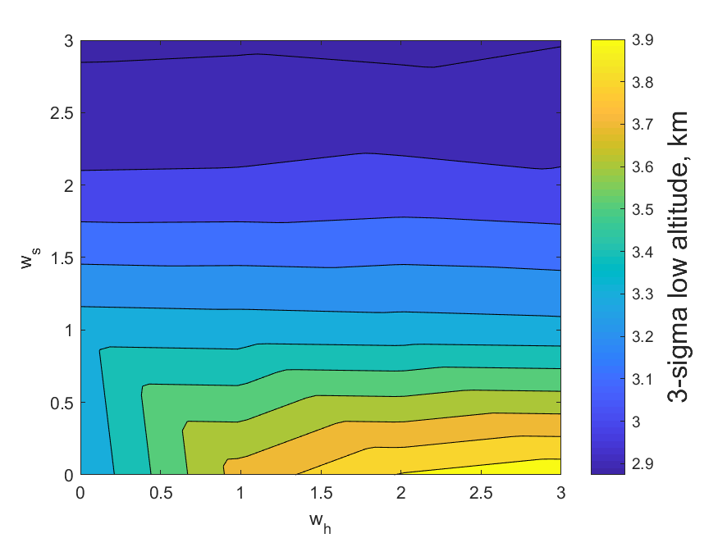
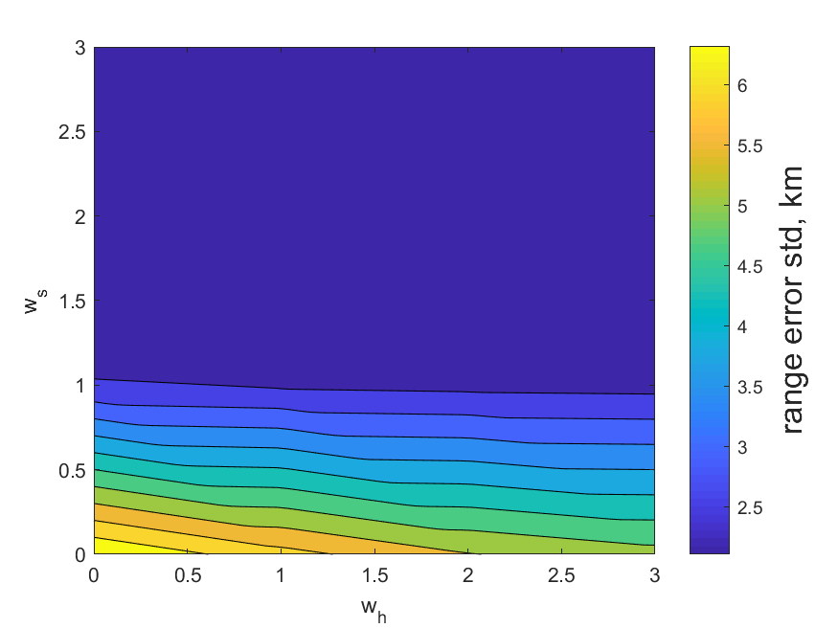

Slide 7
