Slide 1
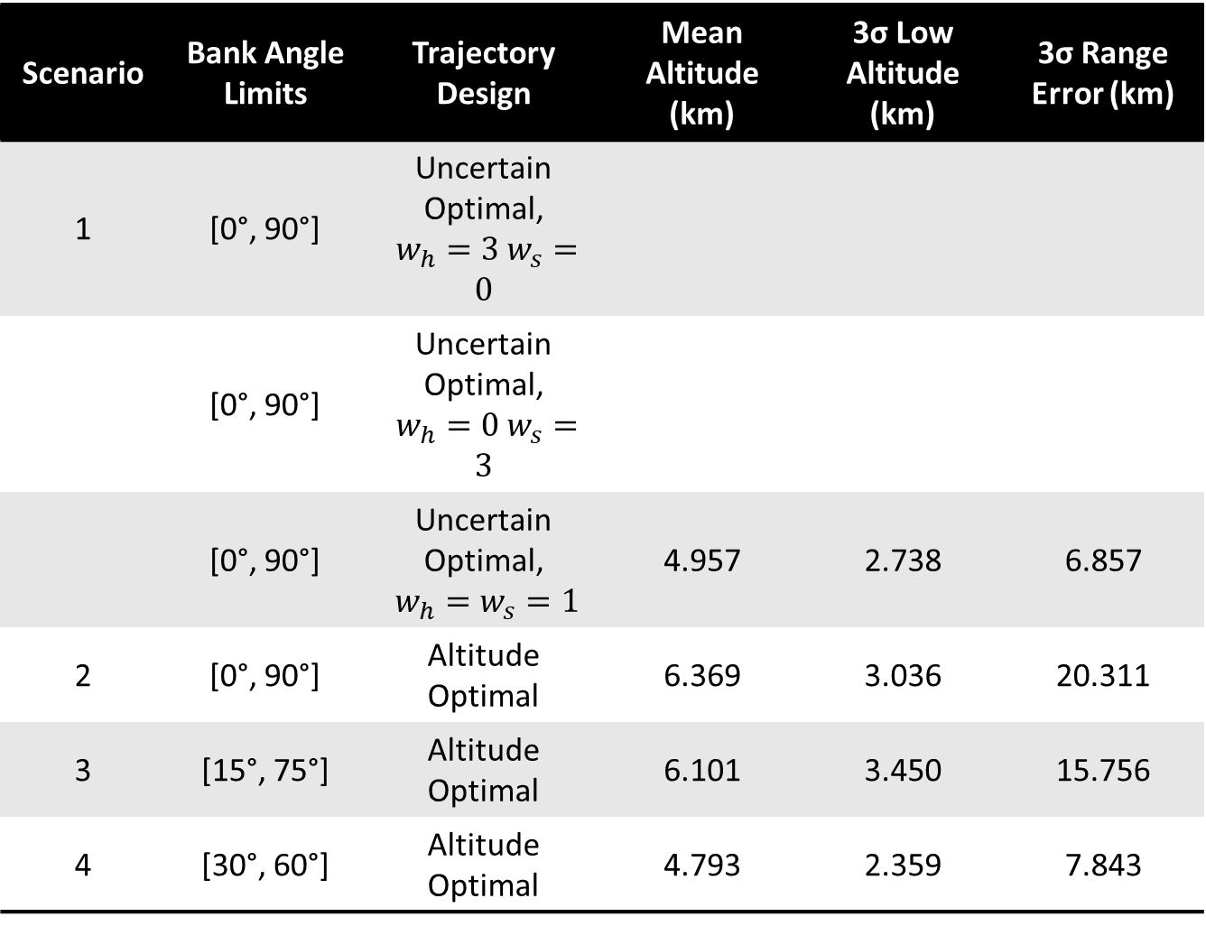
Scenario | Bank Angle Limits | Trajectory Design | Mean Altitude (km) | 3σ Low Altitude (km) | 3σ Range Error (km)
1 | [0°, 90°] | Uncertain Optimal, $w_{h}=3 w_{s}=0$
 | [0°, 90°] | Uncertain Optimal, $w_{h}=0 w_{s}=3$
 | [0°, 90°] | Uncertain Optimal, $w_{h}=w_{s}=1$ | 4.957 | 2.738 | 6.857
2 | [0°, 90°] | Altitude Optimal | 6.369 | 3.036 | 20.311
3 | [15°, 75°] | Altitude Optimal | 6.101 | 3.450 | 15.756
4 | [30°, 60°] | Altitude Optimal | 4.793 | 2.359 | 7.843

