Slide 1
Robust Optimal Entry Guidance for High Elevation Landing
Connor Noyes

Slide 2
Outline
Motivation
Contributions
Results – key takeaways
Conclusion, Questions, Discussion

Slide 3
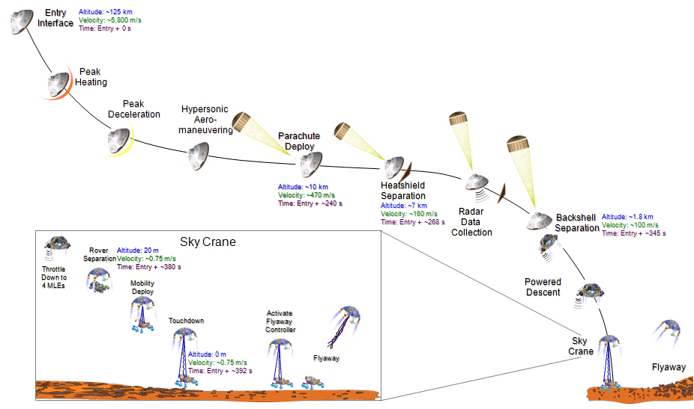
Mars EDL Sequence
Entry Phase

Slide 4
Guidance Requirements
Parachute deployment required within 10 km of planned deployment point
Derived from 25 km x 20 km landing footprint req.
Parachute deployment must occur at least 6 km above the targeted site elevation
Entry Interface
Parachute Deploy
Deploy must occur high enough to provide timeline margin for descent and landing operations
Powered Descent
Wind drift on chute expands the ellipse
Touchdown

Slide 5
Entry, Descent, and Landing State of the Art
Mars 2020- modified Apollo entry guidance, DGB Chute, Sky-Crane Descent stage
Low-lifting vehicle, L/D ~ 0.24, yields limited control authority
BC = m/(C_{D}*A) ~ 120 kg/m²
Reference trajectory designed for slow maneuvers and wide margins
Closed-loop performance evaluated via Monte Carlo
Iteration with human in the loop until requirements are satisfied

Slide 6
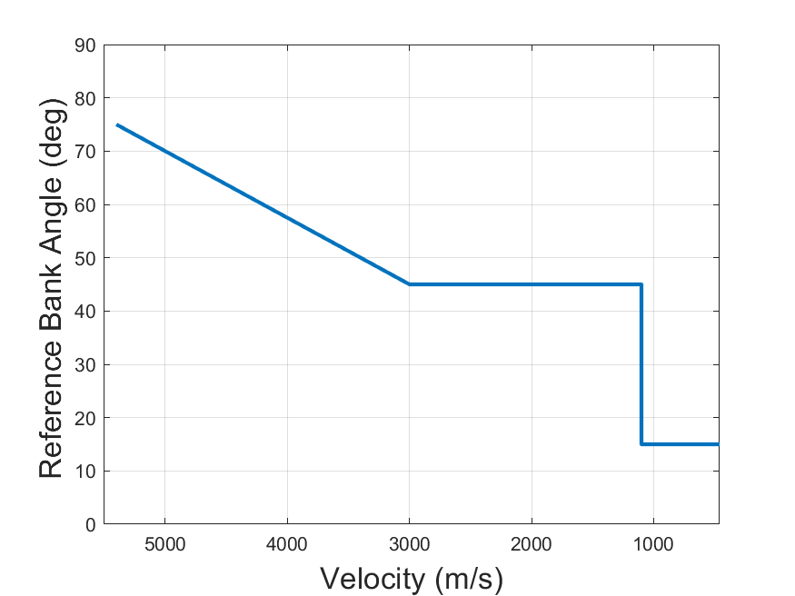
MSL Control Parametrization
Design process sweeps over parameters of the reference bank angle and the entry FPA
Early bank angle
Late bank angle
Velocity at which late bank angle is reached
Heading
Alignment
Notes:
Show MSL parametrization, and show design map(s) created by iterating over different values of the parameters. In contrast, the weights in our parametrization make the same design map much more intuitive and in fact reduces the number of parameters to sweep over.

Slide 7
Goals
Using the same class of guidance control law (implementable on current hardware), design a longitudinal guidance that
Results in performance (3σ low altitude and 3σ range error) as good, or better, than ETPC used by MSL/Mars 2020
Is faster (by orders of magnitude) to design, specifically by eliminating Monte Carlo in the loop
Has fewer, more intuitive parameters available to trade performance in key variables

Slide 8
Reference tracking entry guidance performance can be improved in two ways:
Improve the feedback control design
Improve the reference trajectory design

Slide 9
The literature on reference tracking control laws for Entry Guidance is vast
LQR, Sliding Mode, Observer-based, (N)MPC, etc.
The literature on how to (optimally) design a reference trajectory is not
Most work in the area is on optimal control of nominal trajectory
Ad hoc margins are applied to increase robustness
Robust optimal control offers a way to incorporate the control law and determine an optimal reference for the closed-loop dynamics

Slide 10
Robust Optimal Control

Slide 11
Numerical Solution Approach
Robust optimal control problem is converted into a larger deterministic problem via the unscented transform
The deterministic problem is solved via differential dynamic programming

Slide 12
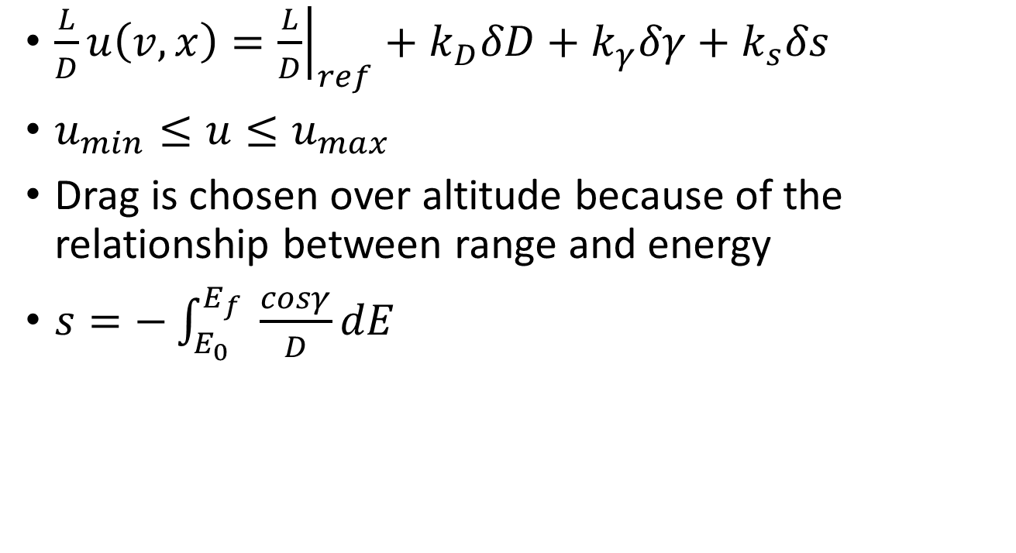
Guidance Control Law
$\frac{L}{D}u\left(v,x\right)={\left.\frac{L}{D}\right|}_{ref}+k_{D}δD+k_{γ}δγ+k_{s}δs$
$u_{min}≤u≤u_{max}$
Drag is chosen over altitude because of the relationship between range and energy
$s=−\int_{E_{0}}^{E_{f}}{ \frac{cosγ}{D}dE}$
Notes:
Edot = -VD, cubic in velocity and exponential in altitude through density

Slide 13

Objective Functional
$\min{J}=−\overline{h}+w_{h}σ_{h}+w_{s}σ_{s}$

Slide 14
Conventional planning (show altitude optimal, then optimal with fixed margins)
Robust planning (show how profiles change for

Slide 15
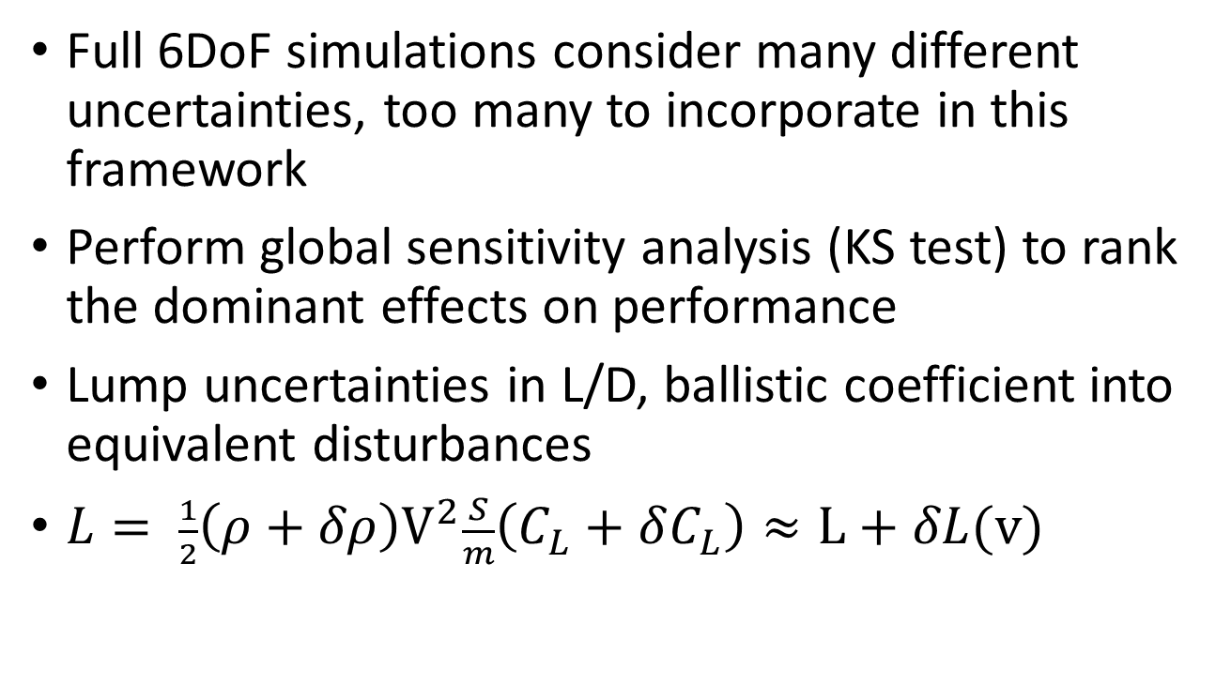
Dimension Reduction
Full 6DoF simulations consider many different uncertainties, too many to incorporate in this framework
Perform global sensitivity analysis (KS test) to rank the dominant effects on performance
Lump uncertainties in L/D, ballistic coefficient into equivalent disturbances
$L= \frac{1}{2}{\left(ρ+δρ\right)V}^{2}\frac{S}{m}\left(C_{L}+δC_{L}\right)≈L+δL(v)$
Notes:
Something not pursued but maybe necessary to incorporate other effects (stochastic variations)

Slide 16
Unscented Transform
Constructs mean and variance from transformed “sigma points” rather than propagate moments directly
Allows accurate capturing of saturation, and other nonlinearities
For an stochastic OCP with n state variables, p parametric uncertainties, the resulting deterministic OCP features (2(n+p)+1)n state variables
Notes:
Many reasons why UT is preferred to linearization, another is because any time there is significant saturation, the true distribution is becoming more asymmetric.

Slide 17
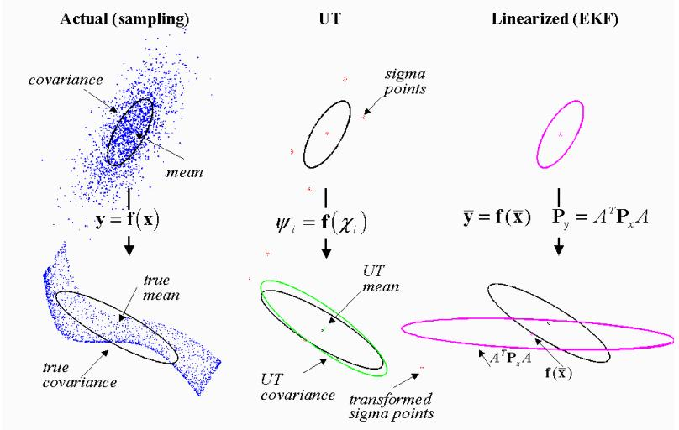
Unscented Transform

Slide 18
Differential Dynamic Programming
Solves N small problems (quadratic programs in m control variables) compared to nonlinear programming methods (e.g. SQP) that solve a single large-scale problem across N time points, n state variables, and m controls
For small n (<15), NLP methods are quite effective and allow for general nonlinear constraints
For larger n, the (approximated) Hessians involved in (Quasi-)Newton methods become intractable to even store, requiring limited memory versions

