Slide 1
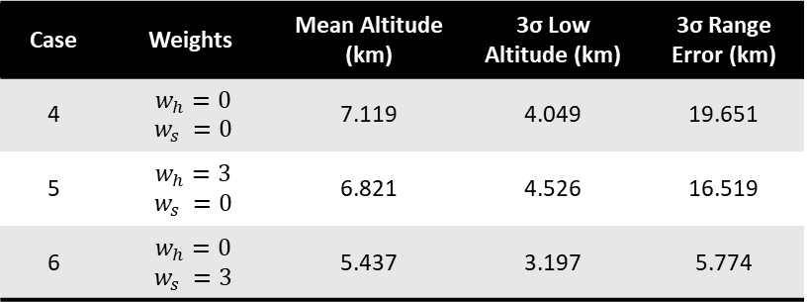
Case | Bank Angle Limits | Mean Altitude (km) | 3σ Low Altitude (km) | 3σ Range Error (km)
1 | [0°, 90°] | 6.369 | 3.036 | 20.311
2 | [15°, 75°] | 6.101 | 3.450 | 15.756
3 | [30°, 60°] | 4.793 | 2.359 | 7.843
Case | Weights | Mean Altitude (km) | 3σ Low Altitude (km) | 3σ Range Error (km)
4 | $w_{h}=0$ $$w_{s} =0$$ | 7.119 | 4.049 | 19.651
5 | $w_{h}=3$ $w_{s} =0$ | 6.821 | 4.526 | 16.519
6 | $w_{h}=0$ $w_{s} =3$ | 5.437 | 3.197 | 5.774

Slide 2
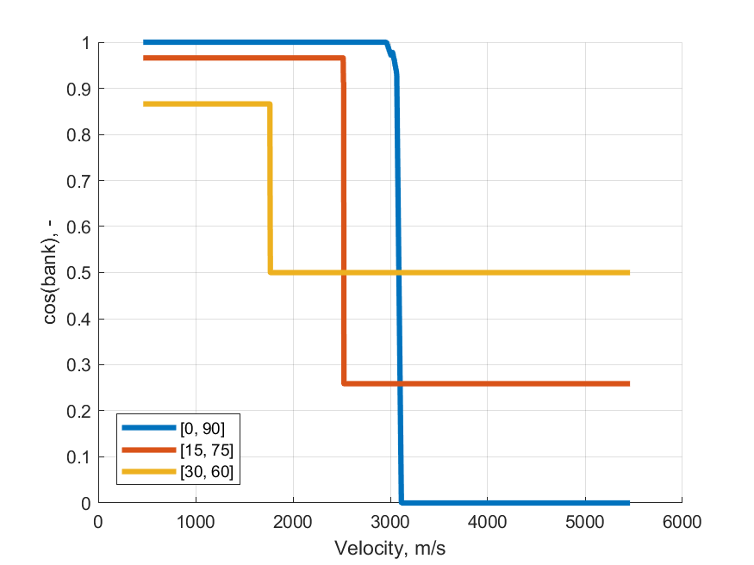
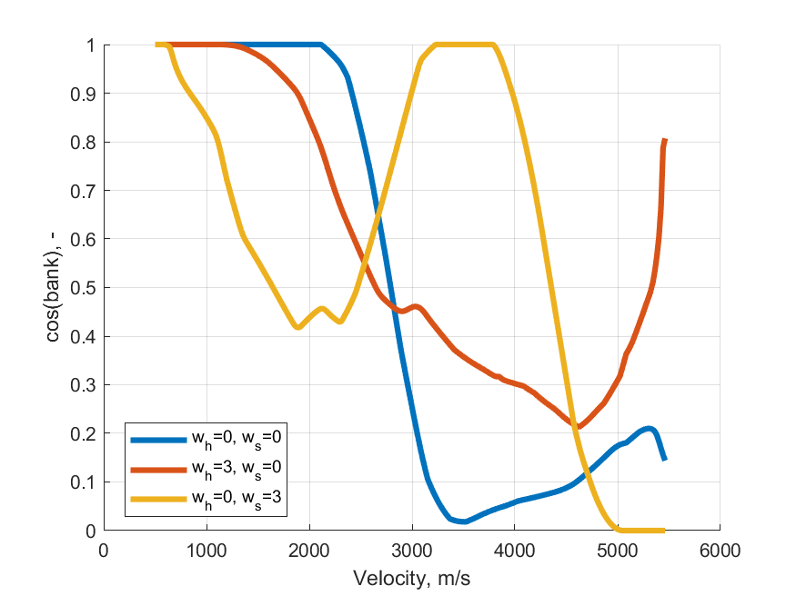

Slide 3
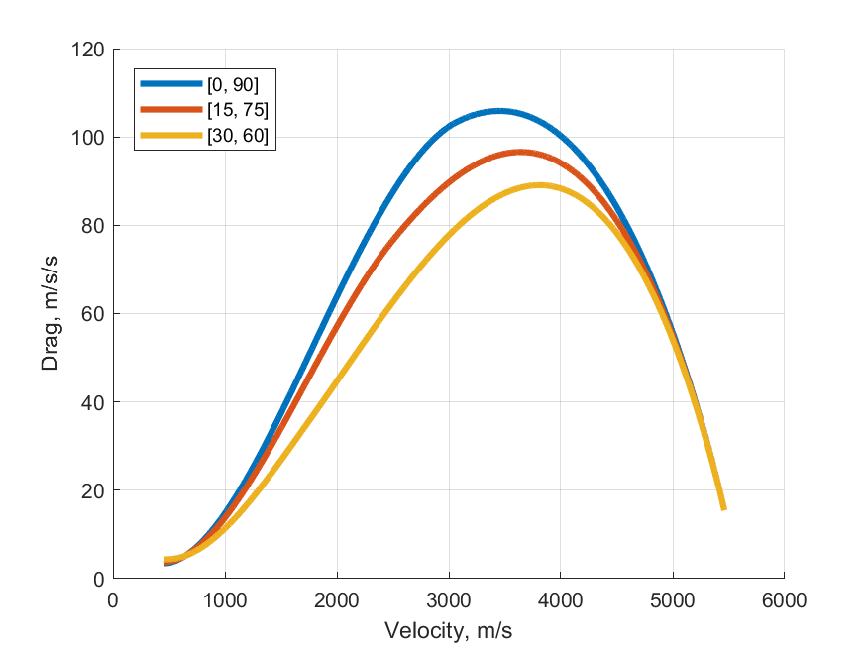
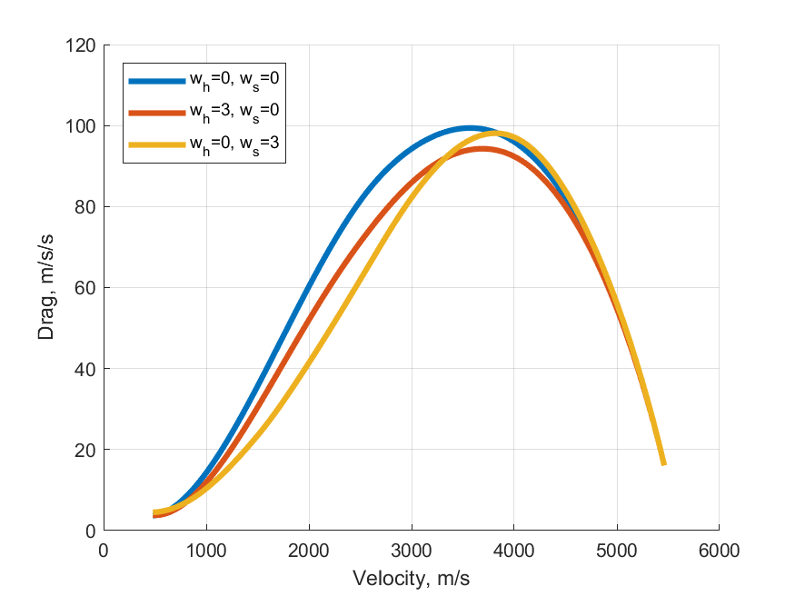

Slide 4
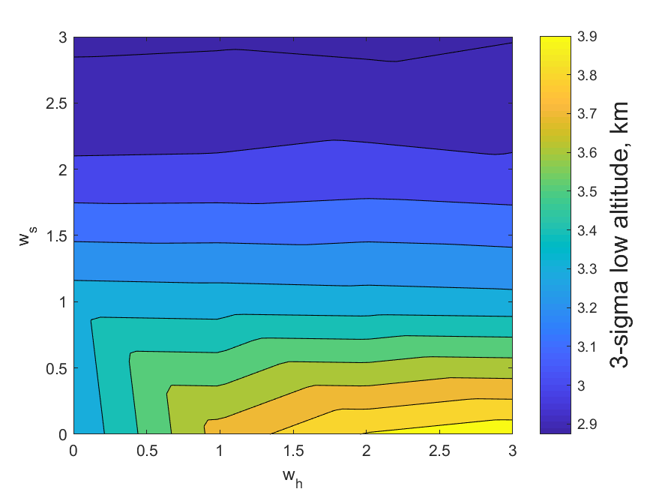
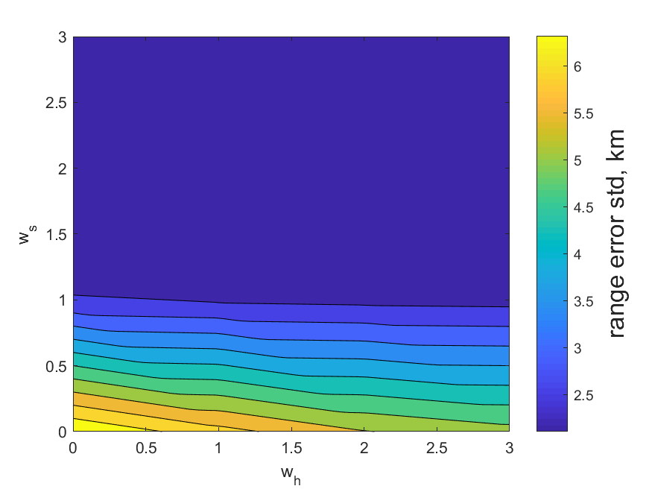

Slide 5
