Slide 1
Nominal Optimization
For various fixed bank angles, global optimization is performed to minimize SRP fuel consumption
Optimization Variables:
Entry FPA
Bank Reversal Velocity
Target Downrange
Along a given entry trajectory, the lowest SRP fuel cost to land at the target is reported
Optimal trajectories always ignite at the minimum altitude constraint
The “high elevation” parametrization yields superior performance, but perhaps not as large an improvement as expected (~10%)

Slide 2
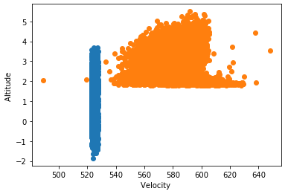
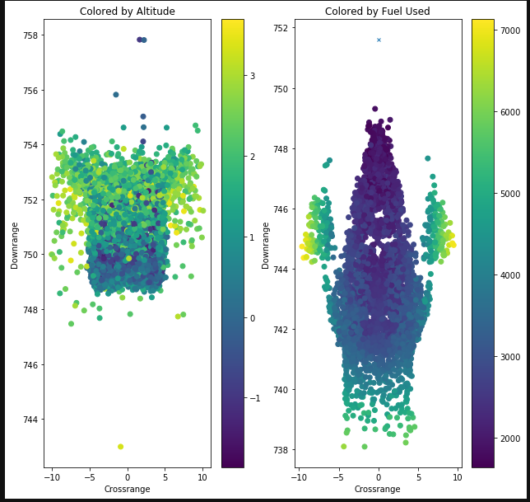
Apollo + Adaptive Trigger
Adaptive Trigger based on tabulated optimal solutions
Traditional Apollo trigger at fixed velocity from reference trajectory

Slide 3
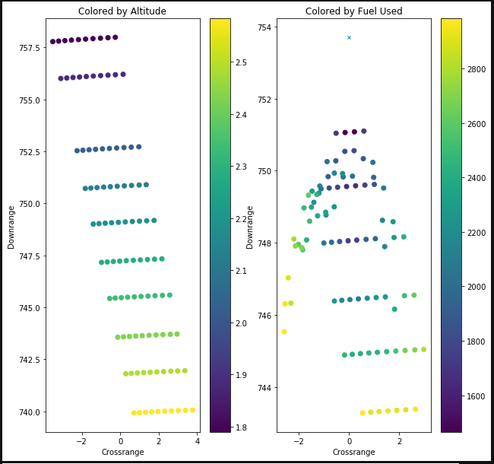
Changing 2nd reversal
Changing 1st reversal

Slide 4
For the same altitude, velocity, and flight path angle, any point on the red circle will produce an equivalent SRP trajectory so long as the heading points to the target
Targeted Landing Site
Optimal SRP Ignition (Nominal Scenario)
This is interesting because it means that unlike with parachute architectures which attempt to arrive at zero crossrange, there is no such restriction on the ignition conditions. Instead, matching heading is the important feature.
Entry trajectory, steered by bank angle commands, executed by small
RCS thrusters
Downrange
Atmospheric entry interface
Crossrange

Slide 5
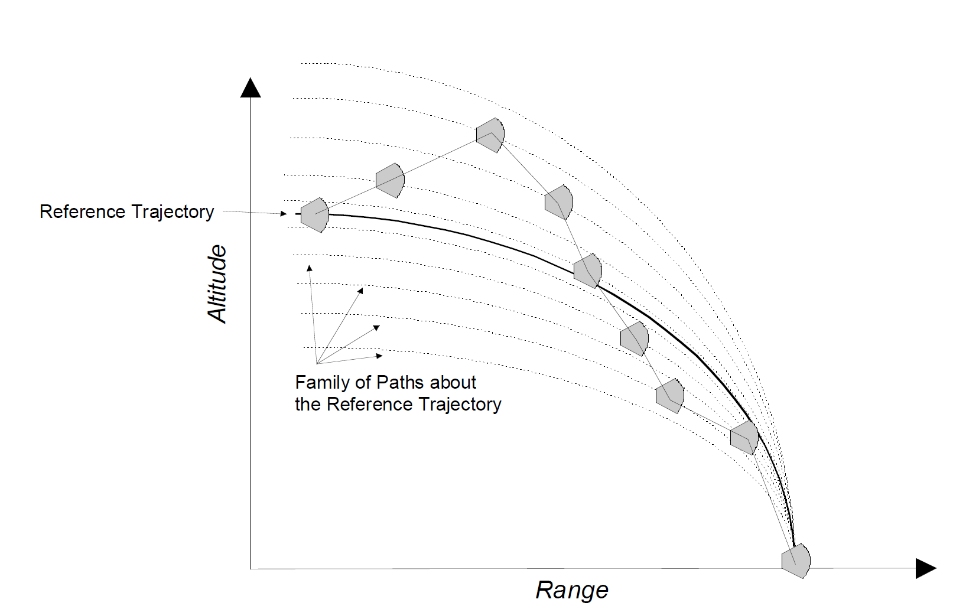
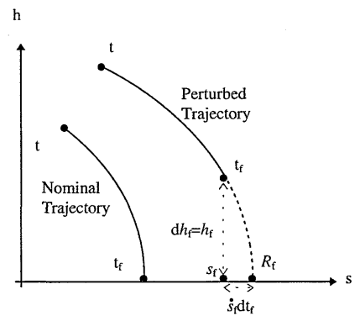

Slide 6
Optimal Ignition Surface at a fixed velocity

Slide 7
Entry Phase
Powered
Descent Phase
Guided via bank angle modulation
Entry Interface:
125 km altitude
5-6 km/s entry velocity
SRP Ignition
Phase transition

Slide 8
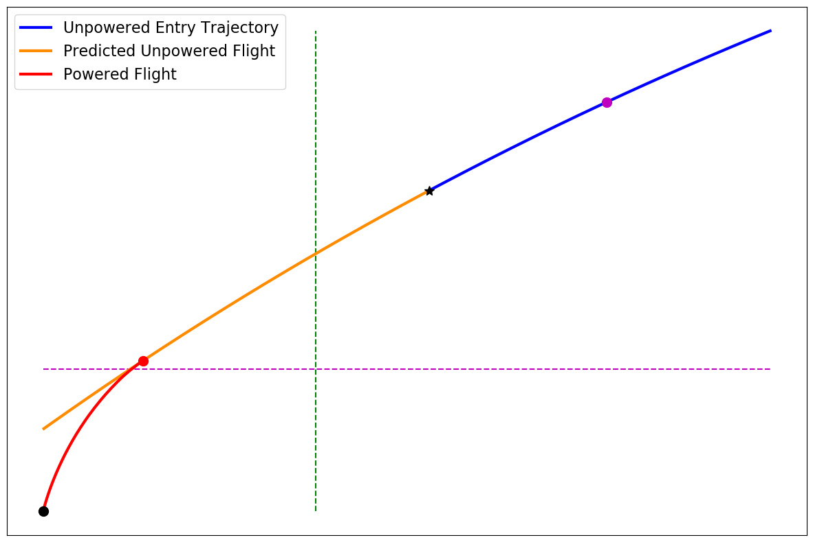
Maximum Ignition distance
Maximum
Ignition velocity
Current state
Altitude
Optimal Ignition point
Trajectory interval checked for optimum
Minimum Ignition altitude
Powered descent target
Downrange distance to target

Slide 9
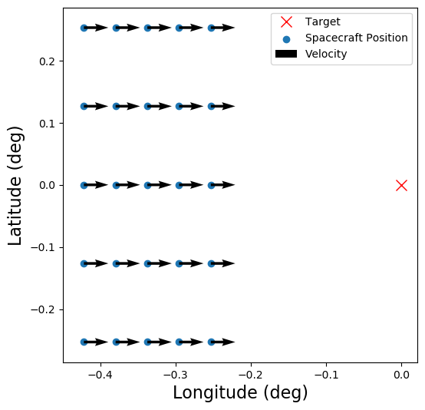
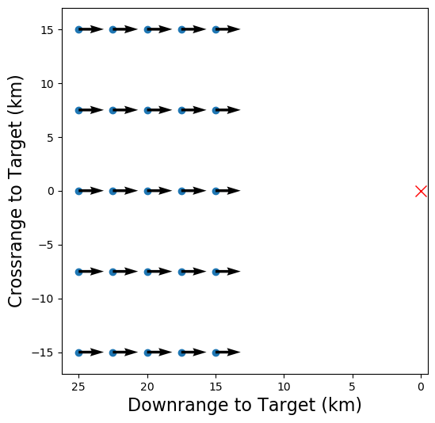
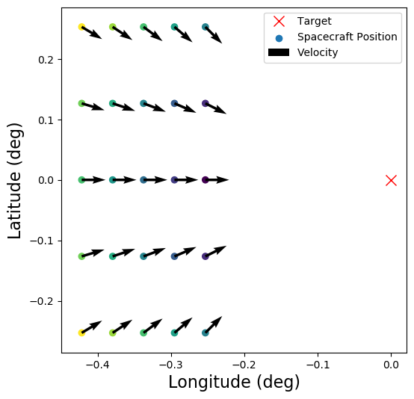
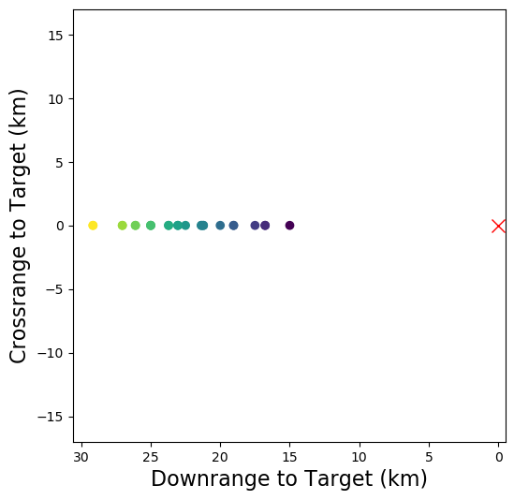

Slide 10
Feasible trajectory
Feasible ignition set, F_{M}
Optimal trajectory
Optimal ignition point along a trajectory

Slide 11
R_{P}
F_{M}
Altitude
Reachable set boundary
Minimum ignition altitude
Infeasible trajectory
Optimal trajectory
Target
Downrange
Optimal ignition point along a trajectory
Feasible trajectory
The infeasible trajectory is a part of the entry reachable set that does not intersect the powered feasible set

Slide 12
Feasible Ignition Subset
Optimal ignition point
Altitude
Reachable set boundary
Minimum ignition altitude
Infeasible trajectory
Optimal trajectory
Target
Downrange
Feasible trajectory
The infeasible trajectory is a part of the entry reachable set that does not intersect the powered feasible set

Slide 13
Scenario | PMF (%) | PMF-Nominal (%) | Ignition Velocity (m/s)
Nominal | 18.07 | 0.00 | 525.7
-10% C_{D} | 19.98 | 1.92 | 550.6
+10% C_{D} | 17.25 | -0.81 | 494.6
-10% C_{L} | 18.16 | 0.09 | 516.7
+10% C_{L} | 17.97 | -0.10 | 526.9
-10% ρ₀ | 18.94 | 0.88 | 548.7
+10% ρ₀ | 17.74 | -0.33 | 501.8
-10% h_{s} | 18.92 | 0.86 | 531.6
+10% h_{s} | 17.82 | -0.24 | 506.1
-10p and -10CD should have similar impacts – somehow Cd is worse. Note the almost identical ignition velocities

Slide 14
Scenario | PMF (%) | Downrange to Target (m) | Crossrange to Target (m) | Altitude (m) | Horizontal Velocity (m/s) | Vertical Velocity (m/s)
Nominal | 18.07 | 10390.75 | 473.1 | 3111.9 | -501.3 | -135.0
-10% C_{D} | 19.98 | 15587.7 | 1125.3 | 3145.4 | -534.2 | -133.5
+10% C_{D} | 17.25 | 10709.4 | 428.4 | 3363.0 | -471.1 | -150.5
-10% C_{L} | 18.16 | 11398.7 | 293.0 | 3246.1 | -496.4 | -143.3
+10% C_{L} | 17.97 | 12897.7 | 532.2 | 3471.2 | -506.9 | -143.8
-10% ρ₀ | 18.94 | 12963.6 | 614.5 | 3355.4 | -532.5 | -132.1
+10% ρ₀ | 17.74 | 11790.4 | 198.7 | 3502.2 | -478.6 | -151.0
-10% h_{s} | 18.92 | 15130.6 | 265.2 | 3154.6 | -513.4 | -137.7
+10% h_{s} | 17.82 | 10722.2 | 438.8 | 3330.6 | -483.4 | -149.7

Slide 15
Property | Value | Units
Ballistic coefficient | 310 | kg/m²
Lift to drag ratio | 0.24 | -
Bank angle magnitude limit | 90 | deg
Bank angle rate limit | 10 | deg/s
Initial thrust to weight ratio | 4 | -
Specific Impulse | 295 | s
Quantity | Nominal | 3σ
Lift coefficient | 0.35 | 10%
Drag coefficient | 1.46 | 10%
Entry radius | 3522 km | 0
Entry longitude | 66.87° | 0.15°
Entry latitude | 21.28° | 0.08°
Entry velocity | 5500 m/s | 3 m/s
Entry flight path angle | -15.75° | 0.25°
Entry heading angle | -13.60° | 0.25°
0.1 deg = 6 km approx

Slide 16
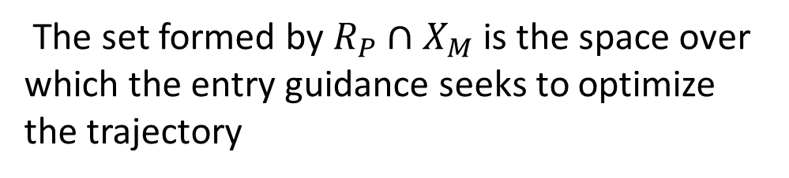
SRP Feasible Set, X_{M} , computed on the ground (fixed over time)
Entry
Reachable Set, R_{P} , a function of the current state
The set formed by $R_{P}∩X_{M}$ is the space over which the entry guidance seeks to optimize the trajectory

Slide 17

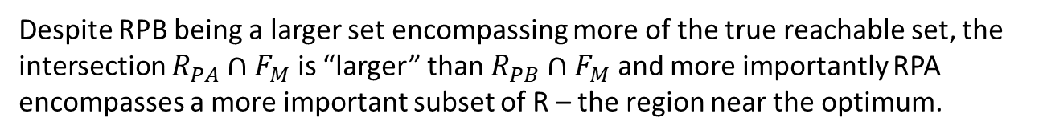

Despite RPB being a larger set encompassing more of the true reachable set, the intersection $R_{PA}∩F_{M}$ is “larger” than $R_{PB}∩F_{M}$ and more importantly RPA encompasses a more important subset of R – the region near the optimum.
Optimal Point in $R∩F_{M}$
Optimal Point in${ R}_{P} ∩F_{M}$
F_{M}
F_{M}
Entry Reachable Set R_{PA}
Entry
Reachable Set R_{PB}
R
R

Slide 18
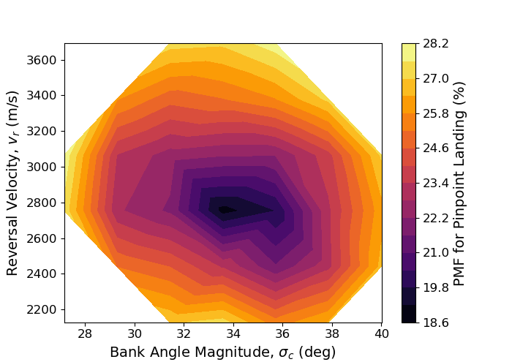
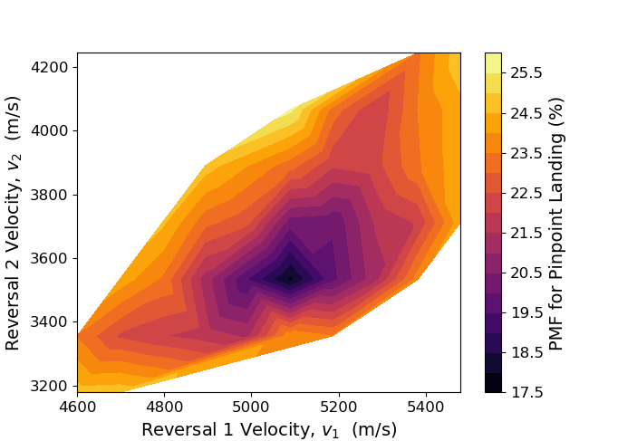

Slide 19
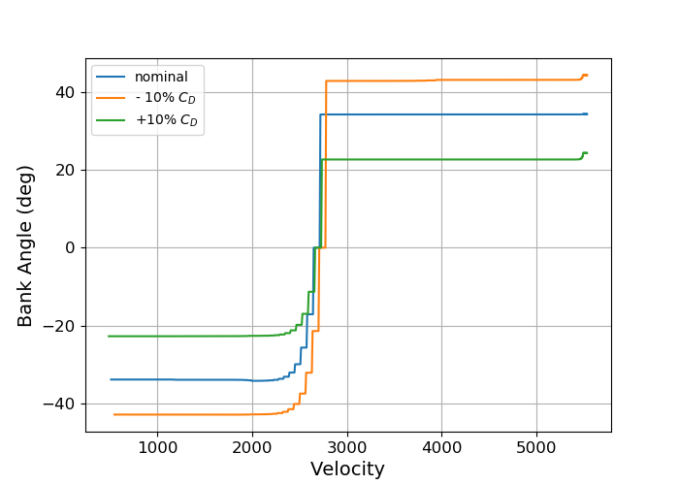
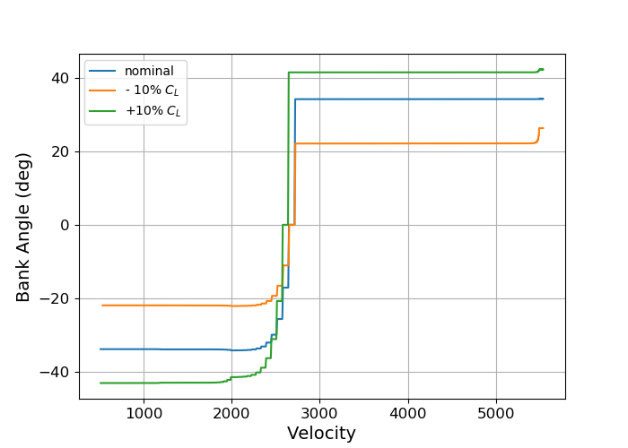
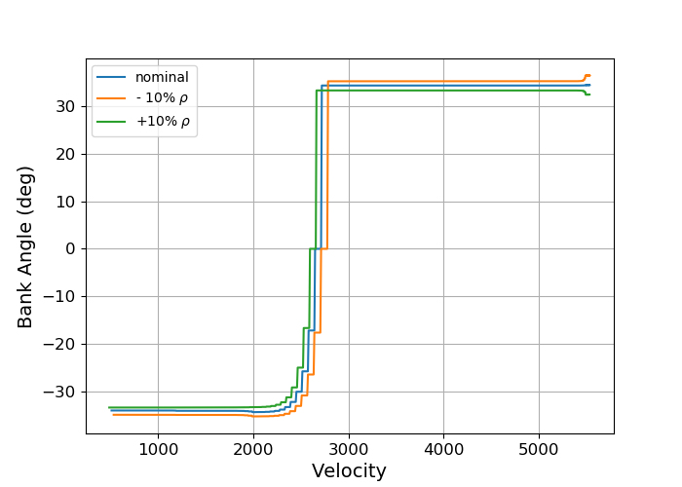
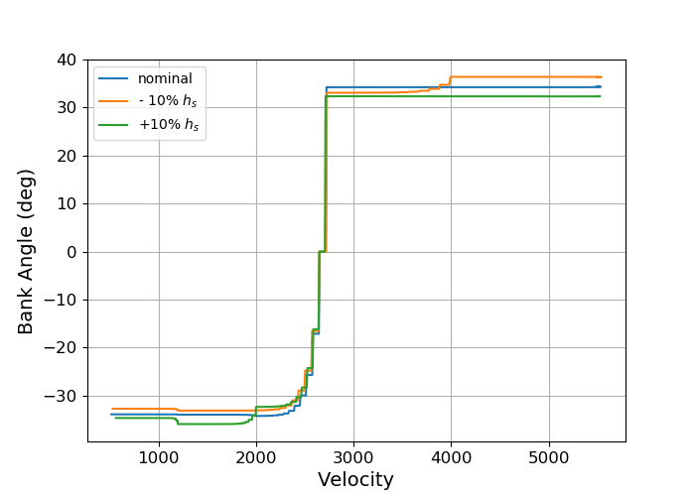

Slide 20
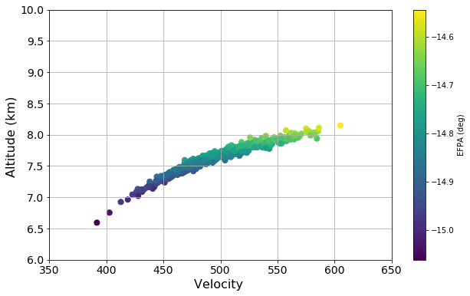
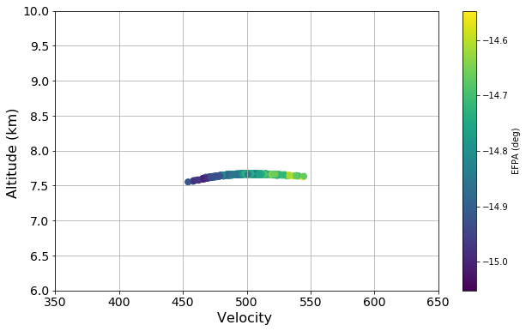
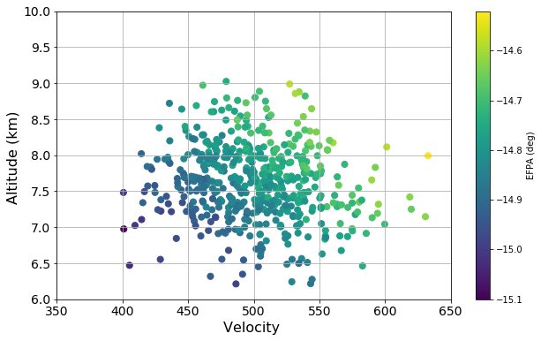
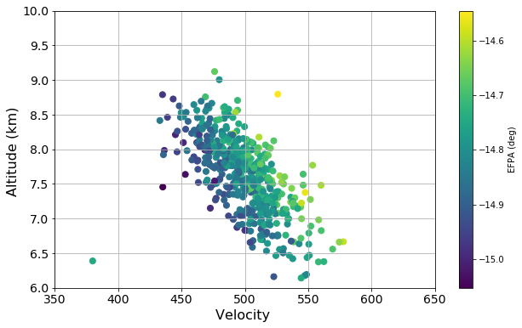
Open Loop
Closed Loop
ESF (EFPA)
Dispersions Only
ESF + Aero/Atmos
Dispersions

