Slide 1
A Stochastic Optimal Control Approach to Mars Entry, Descent, and Landing
Connor Noyes

Slide 2
Outline
Entry, Descent, Landing Overview
Entry Guidance Review
Powered Descent Guidance Review
Related Stochastic Literature Review
Description of proposed approach
Applications to EDL
Conclusion, Questions, Discussion

Slide 3
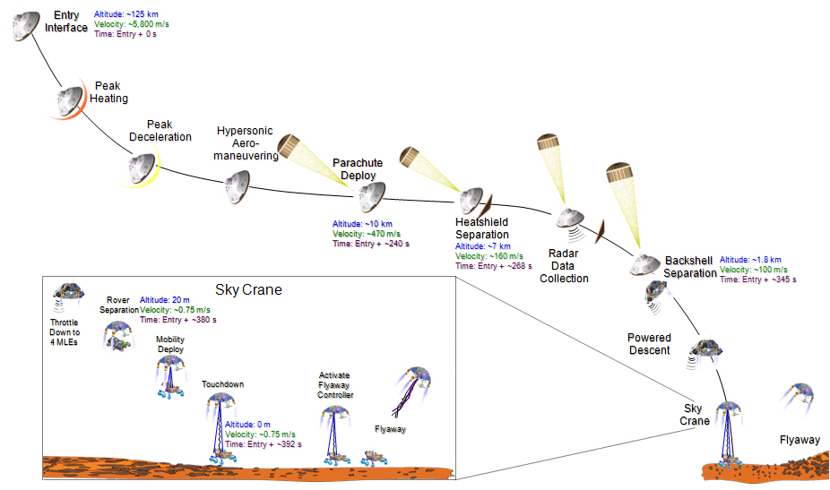
MSL EDL Sequence

Slide 4
Entry, Descent, and Landing State of the Art
Mars Science Laboratory - modified Apollo entry guidance, DGB Chute, Sky-Crane Descent stage
Low-lifting vehicle, L/D ~ 0.24, yields limited control authority
BC = m/(D*A) ~ 120 kg/m²
Reference trajectory designed for slow maneuvers and wide margins
Closed-loop performance evaluated via Monte Carlo
Iteration with human in the loop until margins are satisfied

Slide 5
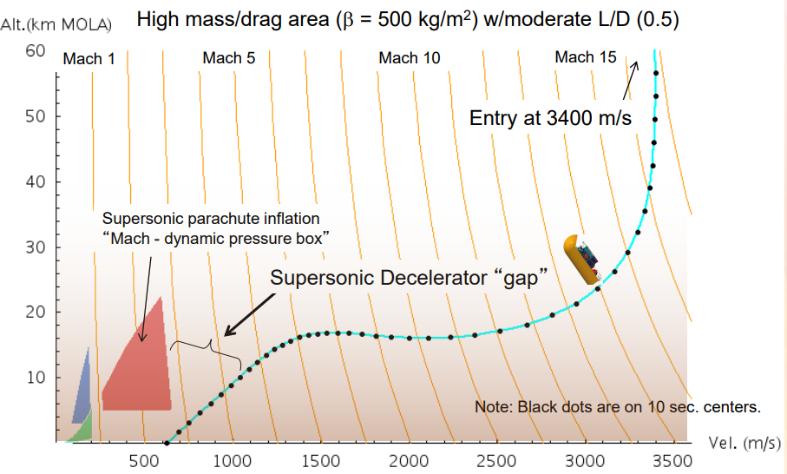
Future EDL Missions
Future missions will require delivery of heavier payloads
Human class missions will require 10x landed mass
Parachute architectures simply do not scale to high ballistic coefficients¹
Supersonic retropropulsion is one enabling technology

Slide 6
EDL Concept of Operations
Entry phase – vehicle is guided by orienting the lift vector, controlled by reaction control thrusters
Bank angle is treated as the only control variable
Powered descent phase – supersonic retropropulsion is used to null nearly all of the vehicle’s remaining velocity
3D thrust magnitude and direction is the control
Landing phase – final vertical descent phase to soft touchdown

Slide 7
Coupled Design
Stochastic optimal control problem is converted into a larger deterministic problem via the unscented transform
The deterministic problem is solved via differential dynamic programming

Slide 8
Motivated by optimal control objectives in aerospace applications that result in “bang-bang” solutions
Fuel-Optimal Powered Descent Trajectories
Altitude-Optimal Entry Trajectories
A common heuristic is to leave a fixed amount of control margin
Increases robustness, decreases optimality

Slide 9

Mean-Variance Objectives
$J=E\left[∙\right]+kV[∙]$

Slide 10
Conventional planning (show altitude optimal, then optimal with fixed margins)
Robust planning (show how profiles change for

Slide 11
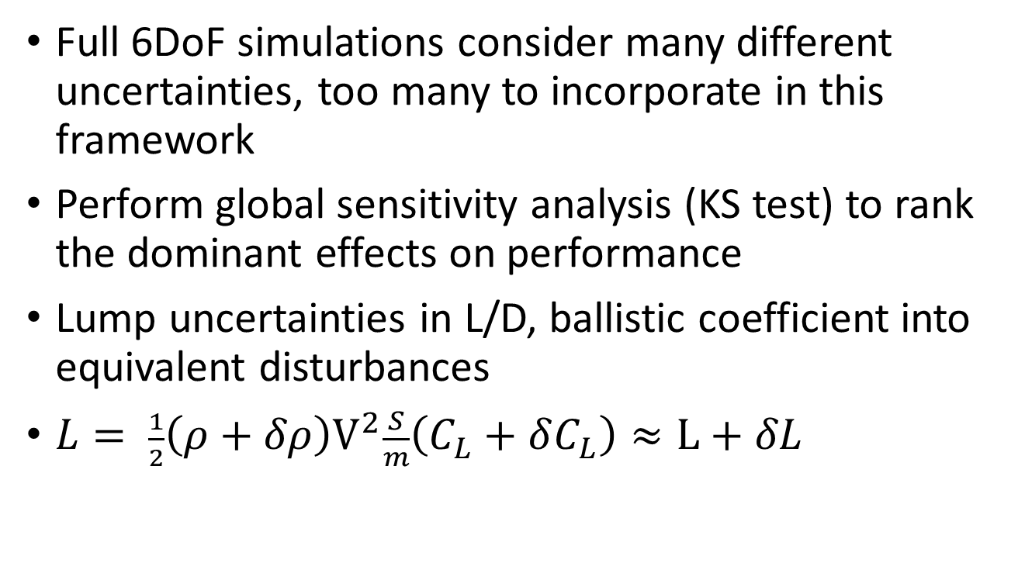
Dimension Reduction
Full 6DoF simulations consider many different uncertainties, too many to incorporate in this framework
Perform global sensitivity analysis (KS test) to rank the dominant effects on performance
Lump uncertainties in L/D, ballistic coefficient into equivalent disturbances
$L= \frac{1}{2}{\left(ρ+δρ\right)V}^{2}\frac{S}{m}\left(C_{L}+δC_{L}\right)≈L+δL$

Slide 12
Unscented Transform
Constructs mean and variance from transformed “sigma points” rather than propagate moments directly
Allows accurate capturing of saturation, and other nonlinearities
For an stochastic OCP with n state variables, p parametric uncertainties, the resulting deterministic OCP features (2(n+p)+1)n state variables
Notes:
Many reasons why UT is preferred to linearization, another is because any time there is significant saturation, the true distribution is becoming more asymmetric.

Slide 13
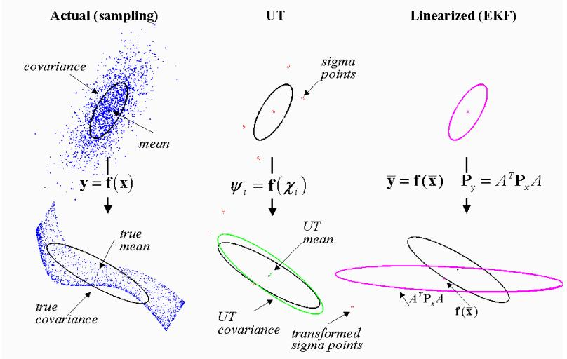
Unscented Transform

Slide 14
Differential Dynamic Programming
Solves N small problems (quadratic programs in m control variables) compared to nonlinear programming methods (e.g. SQP) that solve a single large-scale problem across N time points, n state variables, and m controls
For small n (<15), NLP methods are quite effective and allow for general nonlinear constraints
For larger n, the (approximated) Hessians involved in Quasi-newton methods become intractable to even store, requiring limited memory versions

