Slide 1
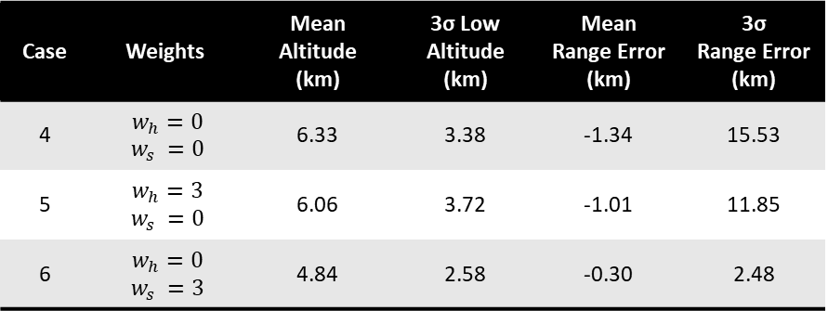
Fixed, nominal gains
Case | Bank Angle Limits | Mean Altitude (km) | 3σ Low Altitude (km) | Mean Range Error (km) | 3σ Range Error (km)
1 | [0°, 90°] | 6.38 | 2.87 | -4.26 | 17.80
2 | [15°, 75°] | 6.20 | 3.49 | -1.86 | 13.94
3 | [30°, 60°] | 4.80 | 2.36 | 0.12 | 3.83
Case | Weights | Mean Altitude (km) | 3σ Low Altitude (km) | Mean Range Error (km) | 3σ Range Error (km)
4 | $w_{h}=0$ $$w_{s} =0$$ | 6.33 | 3.38 | -1.34 | 15.53
5 | $w_{h}=3$ $w_{s} =0$ | 6.06 | 3.72 | -1.01 | 11.85
6 | $w_{h}=0$ $w_{s} =3$ | 4.84 | 2.58 | -0.30 | 2.48

Slide 2
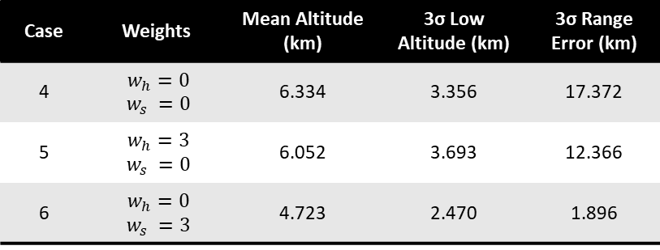
Case | Bank Angle Limits | Mean Altitude (km) | 3σ Low Altitude (km) | 3σ Range Error (km)
1 | [0°, 90°] | 6.438 | 3.043 | 21.670
2 | [15°, 75°] | 6.205 | 3.549 | 16.008
3 | [30°, 60°] | 4.804 | 2.367 | 4.084
Fixed, optimized for case 6 gains
Case | Weights | Mean Altitude (km) | 3σ Low Altitude (km) | 3σ Range Error (km)
4 | $w_{h}=0$ $$w_{s} =0$$ | 6.334 | 3.356 | 17.372
5 | $w_{h}=3$ $w_{s} =0$ | 6.052 | 3.693 | 12.366
6 | $w_{h}=0$ $w_{s} =3$ | 4.723 | 2.470 | 1.896

Slide 3

Case | Bank Angle Limits | Mean Altitude (km) | 3σ Low Altitude (km) | 3σ Range Error (km)
1 | [0°, 90°] | 6.846 | 4.569 | 55.103
2 | [15°, 75°] | 6.357 | 4.173 | 37.840
3 | [30°, 60°] | 4.928 | 2.363 | 12.252
Optimized for each case gains
Case | Weights | Mean Altitude (km) | 3σ Low Altitude (km) | 3σ Range Error (km)
4 | $w_{h}=0$ $$w_{s} =0$$ | 6.307 | 3.166 | 9.988
5 | $w_{h}=3$ $w_{s} =0$ | 6.296 | 4.124 | 31.736
6 | $w_{h}=0$ $w_{s} =3$ | 4.723 | 2.470 | 1.896

Slide 4
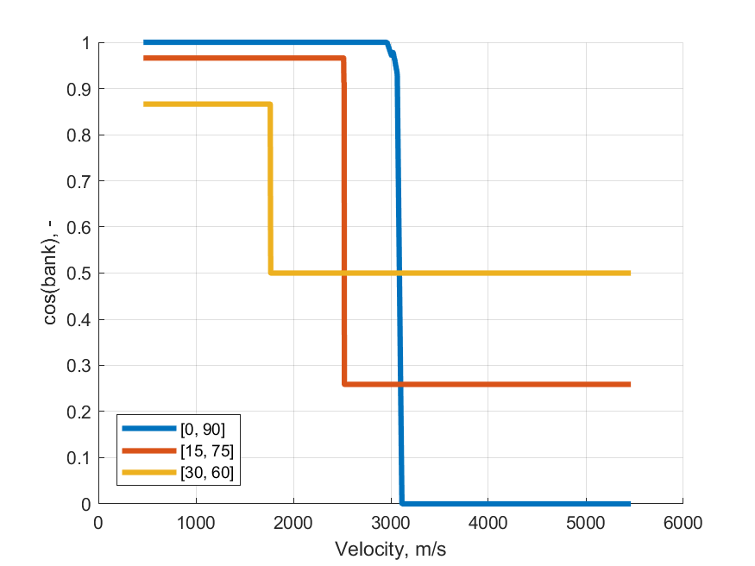
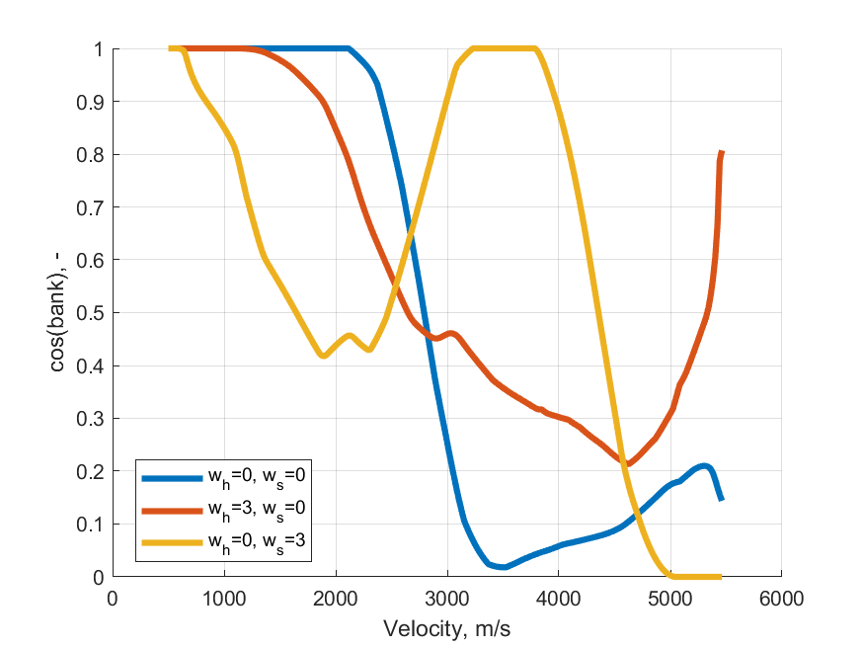

Slide 5
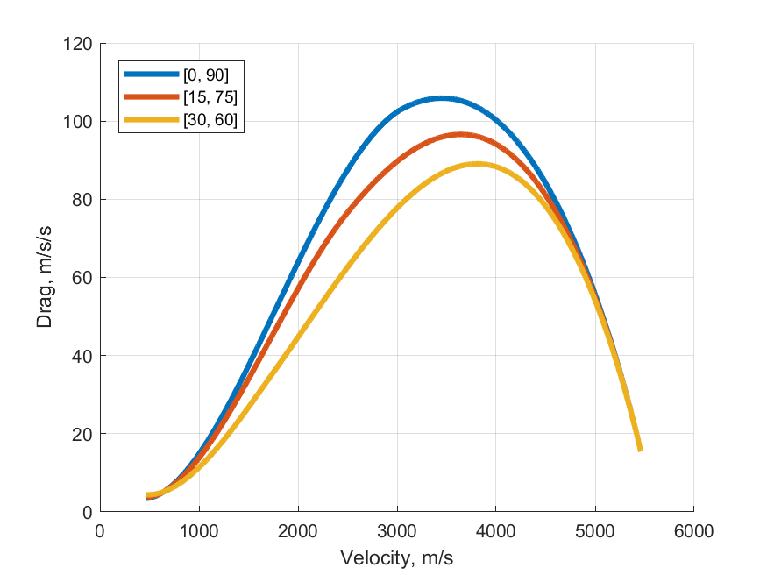
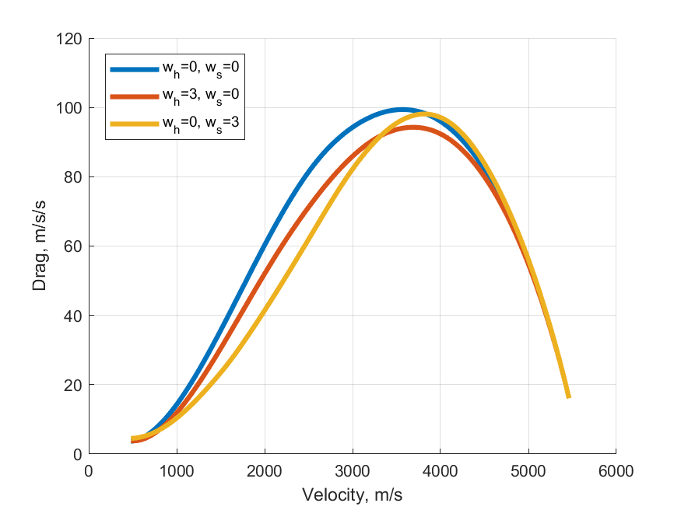

Slide 6
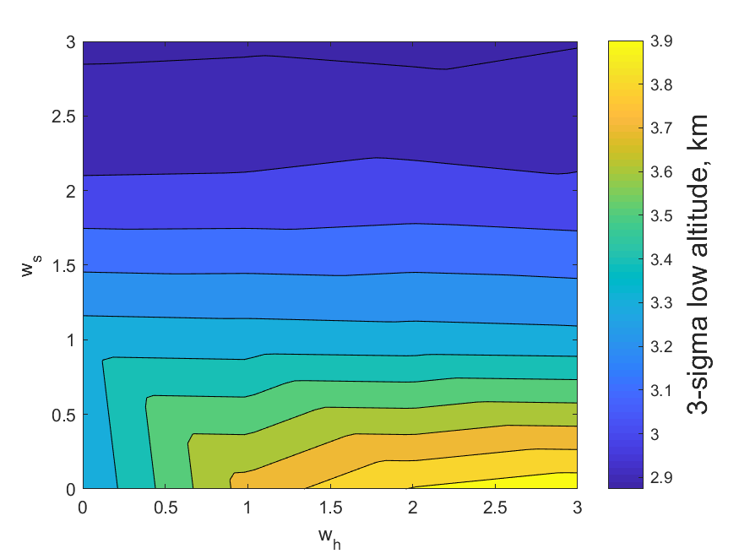
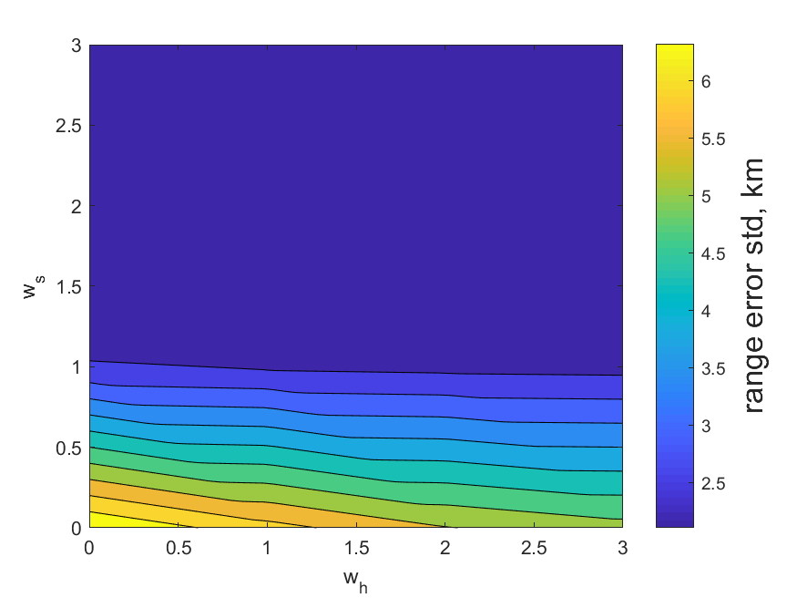

Slide 7
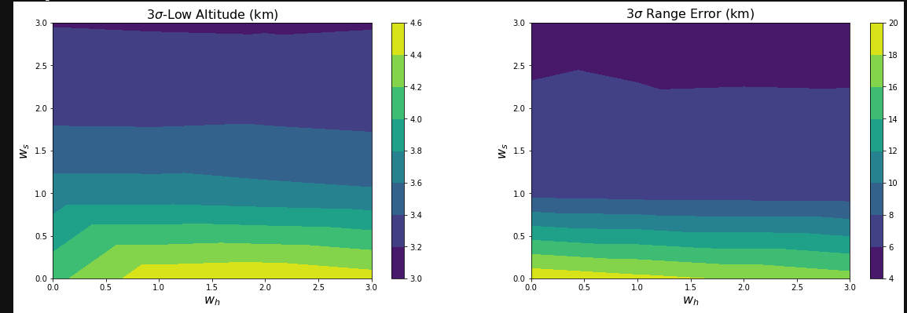

Slide 8
Quantity | Unscented Transform | Monte Carlo
Mean Altitude (km) | 4.81 | 4.70
3σ Low Altitude (km) | 2.50 | 2.46
Mean Range Error (km) | -0.20 | 0
3σ Range Error (km) | 1.09 | 1.79
1% Altitude (km) | - | 2.92
99% Range Error (km) | - | 1.93
Quantity | Unscented Transform | Monte Carlo
Mean Altitude (km) | 4.81 | 4.70
3σ Low Altitude (km) | 2.50 | 2.46
Mean Range Error (km) | -0.20 | 0
3σ Range Error (km) | 1.09 | 1.79

