Slide 1
Modernizing the eChallan Ecosystem
DIGIT-OSS Java to Go Architectural Migration
Centre for Digital Public Infrastructure (CDPI)
Internship Final Demonstration

Slide 2
The DIGIT-OSS Ecosystem
DIGIT Platform: Open-source civic tech platform powering municipal governance.
Microservices Architecture: Highly decoupled, domain-driven services.
Why Go? Transitioning to Upgraded Go Template (UGT) to reduce cloud costs.
Massively scales throughput while avoiding Out of Memory (OOM) crashes.

Slide 3
The Legacy Architecture Bottlenecks
Heavy Memory Footprint: Spring Boot JVM required massive memory overhead.
Data Integrity Risks: 32-bit integer overflow vulnerability in UserInfo.Id.
Pointer Mutation: Shallow-copy issues caused cross-request data bleed.
Hardcoded Infrastructure: Kafka topics were hardcoded (Non-12-Factor compliant).

Slide 4
Migration & Hardening Objectives
Complete UGT Migration: Port echallan-services and calculator to Go.
100% API Parity: Zero disruption to upstream UI and downstream consumers.
Resolve Architectural Debt: Fix integer overflows and pointer mutations.
Infrastructure Decoupling: Implement dynamic env-variable injection for Kafka.

Slide 5
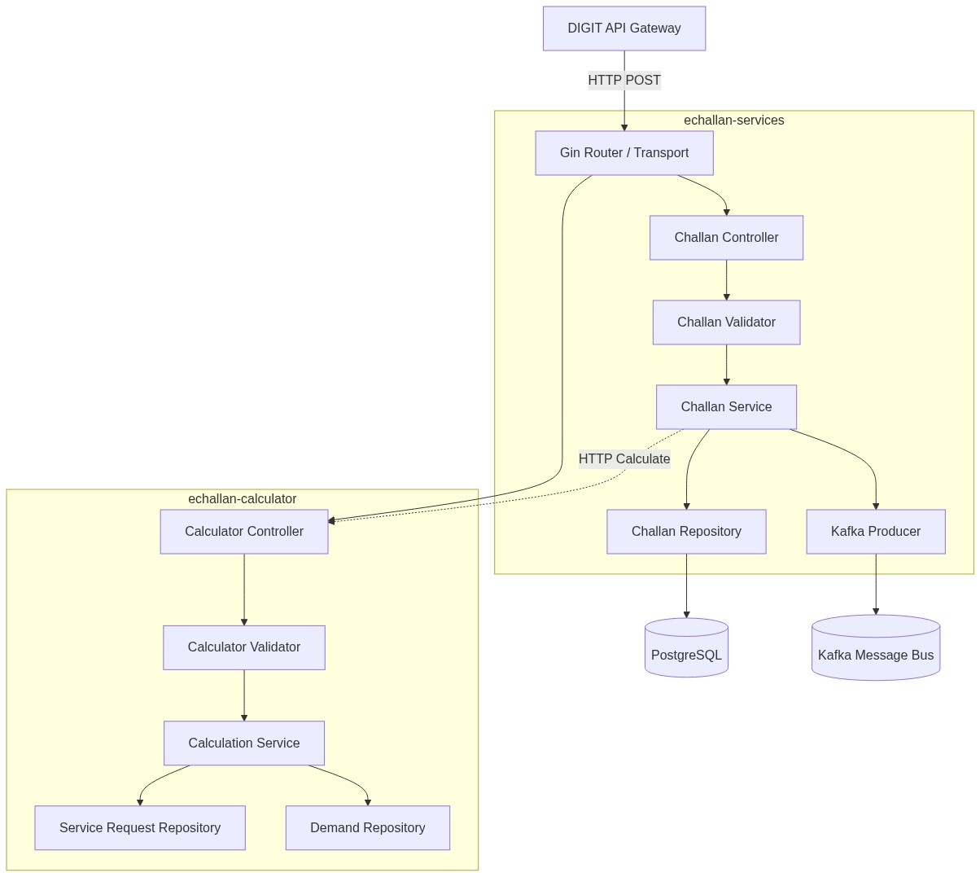
Upgraded Go Template (UGT) Architecture

Slide 6
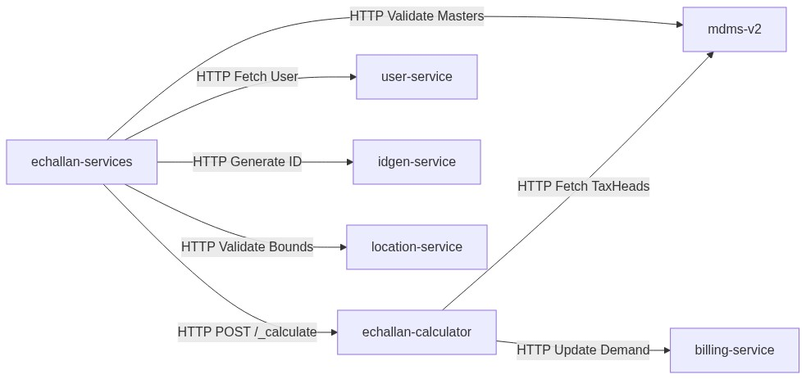
Microservice Dependency Orchestration

Slide 7
The Go Engineering Stack
Routing / HTTP: Go + Gin (High-performance transport)
Database ORM: SQLX (Explicit row-mapping, zero reflection overhead)
Message Bus: Kafka (Asynchronous event-driven persistence)
Logging: Uber Zap (High-throughput structured JSON logging)
Deployment: Docker (Containerization & environment parity)

Slide 8
Engineering Execution Workflow
Audit & Blueprinting: Analyzed Java domain logic & database schema.
Structural Wiring: Created cmd/main.go, configs, and dependencies.
Domain Migration: Ported entities, applying int64 overflow fixes.
Logic Translation: Rebuilt penalty formulas and validations.
Integration: Re-linked mdms-v2 master data lookups.
E2E Testing: Executed edge-case payloads via Postman against a live VM.

Slide 9
Critical Engineering Fixes
Problem: 32-bit Integer Overflow in User ID.
Solution: Structurally migrated UserInfo.Id to int64 across models/DB.
Problem: Shallow-copy object mutations during concurrent calculation.
Solution: Implemented explicit deep-copy logic inside ToCommonUser().
Problem: Ignored directories failing to push to Git.
Solution: Corrected overly aggressive .gitignore regex patterns.

Slide 10
API Contract Parity (Calculator)
Endpoint: POST /echallan-calculator/v1/_calculate
Purpose: Computes tax heads, late penalties, and early rebates.
Failover Logic: Validates taxHeadCode against mdms-v2.
Safely blocks invalid payloads with 400 Bad Request.
Protects against DoS with 413 Payload Too Large limits.

Slide 11
Inside the Go Service
Graceful Shutdown: main.go listens for OS signals (SIGINT/SIGTERM).
Drains active HTTP requests before exiting cleanly.
Configuration: config.go maps environment variables dynamically.
Validation Layer: challan_validator.go isolates business rules from HTTP.

Slide 12
Technical Takeaways
Go Concurrency: Understanding lightweight goroutines vs. heavy Java threads.
Pointers & Memory: Explicit memory management prevents shallow-copy bugs.
12-Factor Methodology: Configuration must live in the environment.
API Orchestration: How microservices safely degrade or fail-closed.

Slide 13
Roadmap for Scaling
Caching: Implement Redis for mdms-v2 lookups to reduce network hops.
Connection Pooling: Optimize SQLX pools for high-traffic municipal instances.
Metrics: Integrate Prometheus middleware for real-time latency tracking.

Slide 14
Project Conclusion
Achieved: Full migration of the eChallan ecosystem to Go.
Learned: How to audit, restructure, and deploy production distributed systems.
Takeaway: True software engineering is identifying technical debt and designing systems that fail gracefully at scale.

Slide 15
Thank You
Centre for Digital Public Infrastructure (CDPI)
Questions?

