Slide 1
DIGIT-OSS | eChallan Migration
Modernizing the eChallan Ecosystem
Java to Go Architectural Migration | Audit, Deployment & Validation
Organisation:
Centre for Digital Public Infrastructure (CDPI)
Project:
echallan-services | echallan-calculator
Stack:
Go . Gin . SQLX . Docker . Kafka . PostgreSQL
Repository:
github.com/CDPI-HRSS/digit-echallan-go
Presenter:
[Your Name]
Guide:
[Guide Name]
Internship Final Demonstration | 2026
1 / 15

Slide 2
About CDPI & DIGIT-OSS
The Platform We Worked On
• DIGIT-OSS is India's open-source urban governance platform
• Powers property tax, water billing, trade licensing & municipal challans across 200+ cities
• Built on microservices — each domain service is independently deployable
• Services communicate via REST APIs (synchronous) and Kafka (asynchronous persistence)
• The Upgraded Go Template (UGT) is CDPI's initiative to migrate Java Spring Boot pods to Go:
- Reduces memory overhead by 60-80% per service
- Eliminates JVM startup lag and Out-of-Memory crash risks
- Scales concurrent throughput via lightweight goroutines (not OS threads)
[Screenshot] DIGIT Macro-Architecture Diagram (API Gateway -> Domain Services -> Databases)
2 / 15

Slide 3
Project Context: The eChallan Module
Scope, Responsibilities & Migration Goal
• eChallan is the enforcement & fine management system for DIGIT municipalities
• A field officer identifies a violation -> raises a challan (fine) against a citizen
• Challan flows through a lifecycle: Demand -> Payment -> Receipt
• Both services were written in Java Spring Boot with JVM overhead & hidden data bugs
• Mission: Migrate both services to Go with zero API contract breakage
- Fix all architectural debt discovered during migration
Service | Port | Responsibility | Migration Status
echallan-services | 8082 | Challan lifecycle: create, search, update | Complete
echallan-calculator | 8078 | Tax computation, penalty & rebate engine | Complete
Lifecycle: Officer raises challan -> System validates -> Demand created -> Citizen pays -> Receipt generated
3 / 15

Slide 4
Phase 1 — Azure VM Environment Setup
Phase 1: Infrastructure
Building the Foundation Before Writing a Single Line
• Azure Ubuntu VM (percy@20.244.110.170) -- SSH key-based authentication
• Go installed at /usr/local/go/bin/go (v1.21) -- path explicitly set in every build command
• Docker + Docker Compose for orchestrating all DIGIT dependency services
• PostgreSQL containerized -- schema pre-seeded from DIGIT SQL migration scripts
• Kafka + Zookeeper containerized -- initial tests used a Kafka Mock in producer.go
[Screenshot] Screenshot: docker ps All 6 containers running healthy on Azure VM
Container | Port | Role
PostgreSQL | 5432 | Challan data persistence
Kafka + Zookeeper | 9092 | Async event bus
egov-mdms-service | 8094 | Master data: TaxHeads, FinancialYear
egov-location | 8080 | Boundary / locality validation
egov-user | 8081 | Citizen & employee info
egov-idgen | 8088 | Unique ChallanNo generation
4 / 15

Slide 5
Phase 2 — Understanding the Java Codebase
Phase 2: Analysis
Mapping Every Java Pattern to Its Go Equivalent Before Touching Code
Java Concept | Go Equivalent (UGT)
@RestController | gin.Context handler function
@Service (interface) | Interface + struct impl
@Repository | sqlx.DB with explicit query functions
@Autowired | Constructor injection via New...()
application.properties | configs/config.go via os.Getenv()
@Value("${kafka.topic}") | KAFKA_SAVE_CHALLAN_TOPIC env var
Hibernate JPA | SQLX -- explicit row-mapper functions
RestTemplate (HTTP) | net/http client with explicit error handling
• Cloned Java repo and traced every RestTemplate call to map external dependencies
• Identified 6 downstream service calls per challan creation
• Mapped all DB entities to Go structs and PostgreSQL tables
• Key insight: Java uses reflection & annotations to hide complexity
- Go forces you to be explicit -- every dependency wired by hand
- This makes production debugging dramatically easier
5 / 15

Slide 6
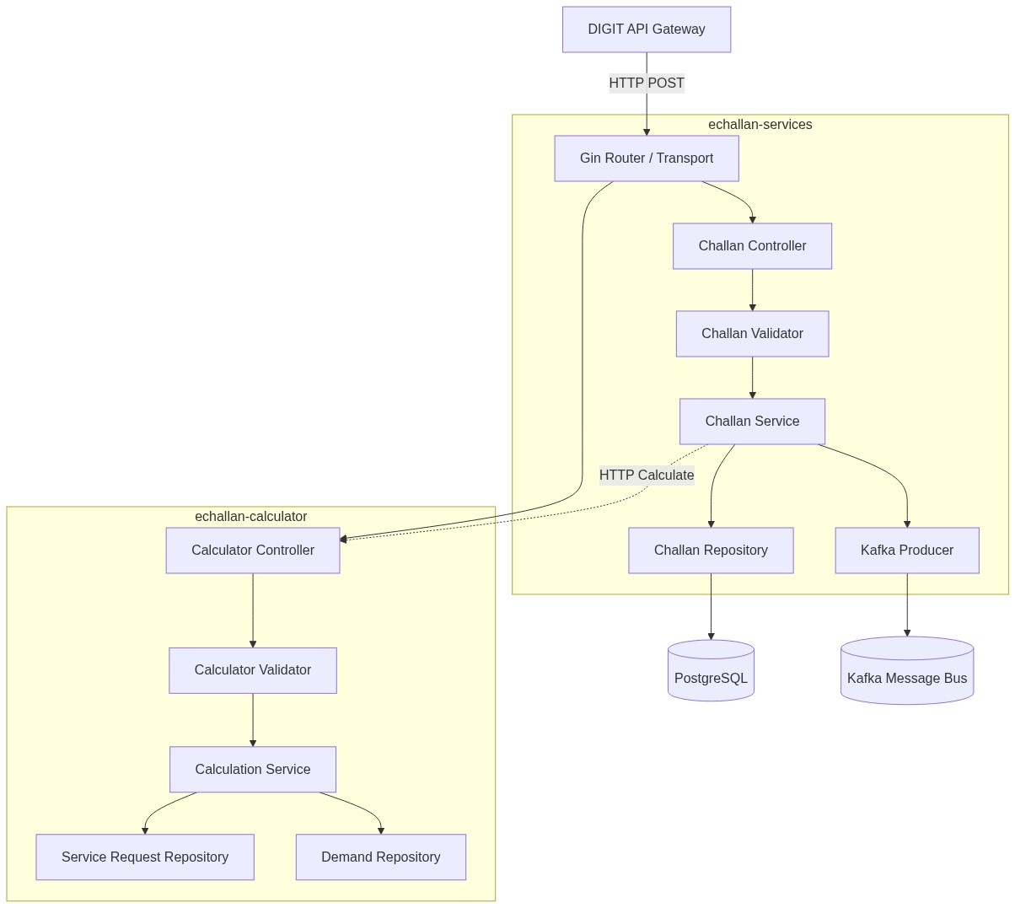
Phase 3 — Implementing the UGT Architecture
Phase 3: Implementation
Strict Layered Design -- No Magic, No Reflection
• Project layout: cmd/ -> configs/ -> internal/ -> pkg/
• Every request follows a fixed pipeline -- no shortcuts:
- Gin Router -> Controller (JSON bind)
- -> Validator (MDMS + location checks)
- -> Service (business logic + HTTP calls)
- -> Repository (SQLX SQL queries)
- -> PostgreSQL / Kafka Producer
• Graceful Shutdown implemented in main.go:
- Traps SIGINT / SIGTERM OS signals
- Drains active requests with 10-second timeout
- No payment request is dropped on restart
6 / 15

Slide 7
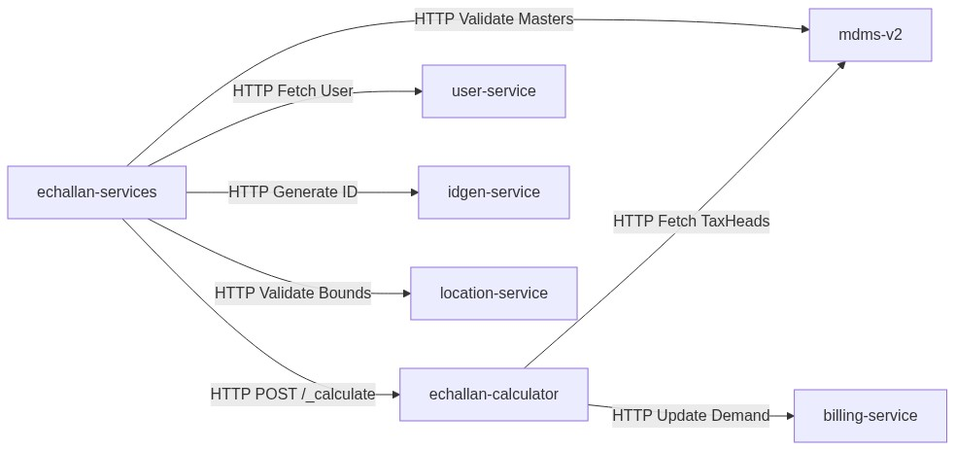
Phase 3 -- Multi-Service Dependency Orchestration
Phase 3: Integration
6 Synchronous REST Calls Per Single Challan Creation
Call # | Target Service | Purpose
1 | mdms-v2 | Validate financial year & TaxHead master
2 | location-service | Validate locality boundary code
3 | idgen-service | Generate unique challanNo
4 | user-service | Fetch citizen user info
5 | echallan-calculator | Compute tax demand (POST /_calculate)
6 | billing-service | Persist the demand bill
If any of these 6 calls fails -> the entire create request fails (Fail-Closed design)
7 / 15

Slide 8
Phase 4 -- Audit: 3 Critical Bugs Found & Fixed
Phase 4: Audit & Fix
The Migration Was Not Just a Port -- It Was a Stability Audit
Bug 1: 32-bit Integer Overflow (UserInfo.Id)
Problem:
int (32-bit) in Java -> crashes above 2.1 billion user records
Fix:
Migrated ALL User ID fields to int64 across domain models & DB mappers
Bug 2: Shallow Copy Pointer Mutation (ToCommonUser)
Problem:
u := ui.User was a shallow copy -> concurrent requests shared pointer -> Potential billing data corruption under concurrent load
Fix:
Rewrote as explicit field-by-field deep copy + make([]Role, len(...)) for all slice fields
Bug 3: Hardcoded Kafka Topics
Problem:
Topics like 'save-challan' hardcoded -> breaks 12-Factor App compliance -> Cannot change topics without recompiling the binary
Fix:
Decoupled into environment variables: KAFKA_SAVE_CHALLAN_TOPIC, KAFKA_UPDATE_CHALLAN_TOPIC
All three fixes committed to feature/updated-go-echallan and verified on Azure VM
8 / 15

Slide 9
Phase 5 -- API Contracts: Java vs. Go
Phase 5: API Parity
100% Endpoint Parity -- Frontend Has No Idea the Backend Changed
Endpoint | Java (Spring Boot) | Go (Gin Router) | Port | Status
/_create | @PostMapping("/_create") | router.POST("/_create", ctrl.Create) | 8082 | Complete
/_search | @PostMapping("/_search") | router.POST("/_search", ctrl.Search) | 8082 | Complete
/_update | @PostMapping("/_update") | router.POST("/_update", ctrl.Update) | 8082 | Complete
/_calculate | @PostMapping("/_calculate") | router.POST("/_calculate", ctrl.Calc) | 8078 | Complete
/_getbill | @PostMapping("/_getbill") | router.POST("/_getbill", ctrl.GetBill) | 8078 | Complete
Sample POST /_create Request (from Postman Collection):
{ "RequestInfo": { "authToken": "e1bb30fb-96bc-...", "userInfo": { "id": 1, "tenantId": "pb.amritsar", "type": "EMPLOYEE" } }, "Challan": { "tenantId": "pb.amritsar", "businessService": "CHALLAN", "taxPeriodFrom": 1618204200000, "taxPeriodTo": 1649740199000, "amount": [{ "taxHeadCode": "CHALLAN_FEE", "amount": 1500.0 }], "address": { "locality": { "code": "SUN11" } } } }
[Screenshot] Screenshot: Postman showing 200 OK on POST /_create
9 / 15

Slide 10
Phase 5 -- Validator: Fail-Closed Architecture
Phase 5: Validation
Every Request Is Validated Against Live Services Before Reaching Business Logic
Validation Check | Source of Truth | Failure Response
Financial Year existence | mdms-v2 -> EGF-Master -> FinancialYear | 400 -- Invalid Financial Year
Locality boundary code | location-service -> boundary lookup | 400 -- Invalid Locality Code
TaxHead code validity | mdms-v2 -> BillingService -> TaxHeadMaster | 400 -- Invalid TaxHeadCode
Mandatory fields (tenantId) | Internal struct nil-check | 400 -- Missing required field
Nil nested objects | Go panic recovery middleware | 400 -- Safely caught & returned
Why Fail-Closed?
• A challan referencing a non-existent Financial Year is legally meaningless
• A challan with an invalid locality cannot be assigned to a ward officer
• Allowing dirty data into the system corrupts demand bills and payment records
• The validator acts as a firewall -- clean data in, clean data persisted
10 / 15

Slide 11
Phase 6 -- E2E Testing on Azure VM
Phase 6: Testing
9 Test Cases Executed Against Live Go Services -- All Passed
# | Test Case | Input | Expected | Result
1 | Happy Path Create | Valid full payload | 200 OK + challanNo | PASS
2 | Missing tenantId | No tenantId in body | 400 Bad Request | PASS
3 | Invalid TaxHeadCode | 'INVALID_TAX' | 400 Bad Request | PASS
4 | Bad Locality Code | Non-existent boundary | 400 Bad Request | PASS
5 | Missing Financial Year | Unmapped year in MDMS | 400 Bad Request | PASS
6 | Search by Mobile | Valid mobileNumber query | 200 OK + list | PASS
7 | Calculate Demands | Valid CalculationCriteria | 200 OK + demand | PASS
8 | DoS Large Payload | 50MB+ request body | 413 Too Large | PASS
9 | Nil Nested Object | null inside amount array | 400 Bad Request | PASS
11 / 15

Slide 12
Phase 6 -- Asynchronous Persistence (DIGIT Persister Pattern)
Phase 6: Kafka
Services Never Write to DB Directly -- Kafka Decouples HTTP from Persistence
• DIGIT's event-driven model: Go service publishes a Kafka event
- egov-persister consumes the event and writes to PostgreSQL
- HTTP response returned instantly -- DB write happens in background
• 12-Factor Compliance: All Kafka topic names are environment variables
- KAFKA_SAVE_CHALLAN_TOPIC -> save-challan
- KAFKA_UPDATE_CHALLAN_TOPIC -> update-challan
- KAFKA_PAYMENT_UPDATE_TOPIC -> payment-create
• During testing: Kafka Mock in producer.go simulated message production
- Enabled full HTTP pipeline testing without a live broker on the VM
Async Flow
Go Service | v (Kafka Produce) Kafka: save-challan | v (Consumer) egov-persister | v (SQL INSERT) PostgreSQL: eg_echallan
Mock Producer (used during VM testing):
func (p *Producer) Push( topic string, v interface{}) { // Mock: log only, no broker log.Printf("[MOCK] %s", topic) }
12 / 15

Slide 13
Phase 7 -- Documentation & Final Deliverables
Phase 7: Deliverables
Everything Committed to GitHub on feature/updated-go-echallan
Deliverable | File Location | Purpose
OpenAPI 3.0 Spec | docs/echallan-swagger.yaml | Swagger UI / API portal
Postman Collection | docs/echallan-postman-collection.json | Import & test APIs instantly
Architecture PNG | docs/high_level_architecture.png | UGT internal routing diagram
Dependency PNG | docs/component_dependencies.png | Cross-service orchestration
Migration Report | docs/final_migration_report.md | Engineering handover document
Go Source -- Services | echallan-services/ | Production-ready Go service
Go Source -- Calc | echallan-calculator/ | Production-ready Go calculator
Postman Collection Endpoints
• Create Challan -- Full payload with MDMS-valid TaxHead codes (Port 8082)
• Search Challan -- Parameterised by tenantId + mobileNumber (Port 8082)
• Calculate Demands -- With CalculationCriteria structure (Port 8078)
13 / 15

Slide 14
Key Learnings & Future Improvements
What This Internship Actually Taught Us
Technical Learnings
Future Improvements
• Go Memory Model: Explicit pointers -- no GC surprises, no shallow-copy accidents
• Concurrency Safety: Goroutines are cheap; shared pointers across them are dangerous
• 12-Factor Principles: Config must be env-driven, never hardcoded in source
• Fail-Closed Design: Validate at boundaries -- prevents corrupt data propagation
• Microservice Debugging: 6-call chains need structured logging and tracing
• DIGIT Persister Pattern: Kafka async writes keep HTTP fast under DB load
• Interface-Driven Design: Go interfaces allow mock injection without live services
• Redis Caching for mdms-v2 master data (fetched on every request currently)
- Eliminate redundant network hops on every calculation
• Prometheus Metrics middleware on the Gin router
- Real-time p95/p99 endpoint latency tracking
• SQLX Connection Pool tuning for peak load
- SetMaxOpenConns / SetMaxIdleConns configuration
• Horizontal Scaling via Kubernetes HPA
- Go's low memory footprint makes this cost-effective
"True software engineering is identifying hidden debt and designing systems that fail gracefully at scale."
14 / 15

Slide 15
Thank You
Questions?
Centre for Digital Public Infrastructure (CDPI)
github.com/CDPI-HRSS/digit-echallan-go | Branch: feature/updated-go-echallan
docs/echallan-swagger.yaml | docs/echallan-postman-collection.json
15 / 15

