Slide 1
DIGIT-OSS | eChallan Service Migration
Modernizing the eChallan Ecosystem
Java to Go Architectural Migration & Technical Debt Resolution
Organisation:
Centre for Digital Public Infrastructure (CDPI)
Project:
echallan-services | echallan-calculator
Stack:
Go . Gin . SQLX . Docker . Kafka . PostgreSQL
Repository:
github.com/CDPI-HRSS/digit-echallan-go
Presenter:
[Your Name]
Guide:
[Guide Name]
Internship Final Demonstration | 2026
1 / 15

Slide 2
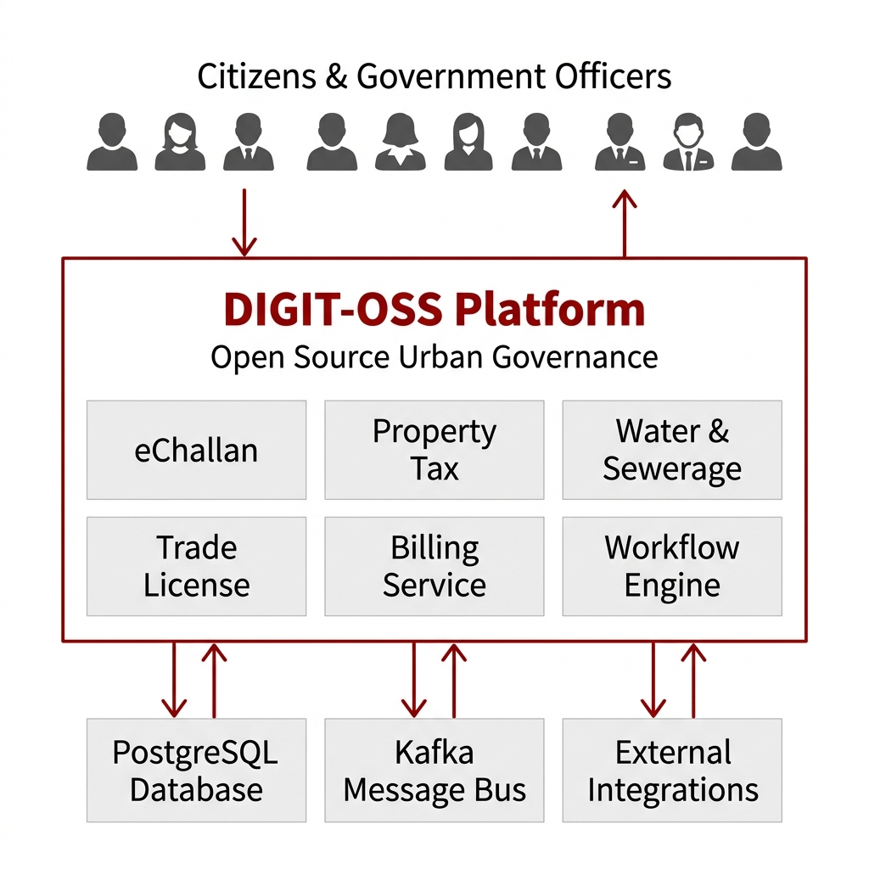
The DIGIT-OSS Ecosystem
The Platform We Worked On
• DIGIT-OSS is India's open-source urban governance platform
• Powers property tax, water billing, trade licensing & municipal challans across 200+ cities
• Built on microservices -- each domain service is independently deployable
• Services communicate via REST APIs (synchronous) and Kafka (asynchronous persistence)
• Why Go? DIGIT is transitioning legacy Java pods to the Upgraded Go Template (UGT):
- Reduces memory overhead by 60-80% per service
- Eliminates JVM startup lag and Out-of-Memory crash risks
- Scales concurrent throughput via lightweight goroutines (not OS threads)
DIGIT-OSS Platform Ecosystem Overview
2 / 15

Slide 3
The Legacy Architecture Bottlenecks
What We Found When We Audited the Java Codebase
Heavy Memory Footprint
Problem:
Spring Boot JVM required massive memory overhead just to idle. Every pod consumed 400-600MB RAM at rest -- unsustainable at scale.
Fix:
Replaced with a Go binary that starts in <100ms and idles at ~20MB RAM.
32-bit Integer Overflow
Problem:
UserInfo.Id was typed as int (32-bit) in Java. Systems with >2.1 billion records would silently overflow and crash.
Fix:
Migrated ALL User ID fields to int64 across domain models and DB mappers.
Shallow Copy Pointer Mutation
Problem:
ToCommonUser() did u := ui.User -- a shallow copy. Concurrent billing requests shared the same pointer, risking data corruption.
Fix:
Rewrote as explicit field-by-field deep copy with make([]Role, len(...)).
Hardcoded Kafka Topics
Problem:
Topics like 'save-challan' hardcoded as strings. Breaks 12-Factor App compliance -- cannot change without recompiling.
Fix:
Decoupled into env vars: KAFKA_SAVE_CHALLAN_TOPIC, KAFKA_UPDATE_CHALLAN_TOPIC.
3 / 15

Slide 4
Migration & Hardening Objectives
What We Set Out to Achieve
1
Complete UGT Migration
Port both echallan-services and echallan-calculator to Go using Gin and SQLX. Follow the strict Upgraded Go Template (UGT) directory layout.
2
100% API Parity
Ensure zero disruption to upstream UI and downstream service consumers. Every endpoint, every request/response shape -- identical to the Java version.
3
Resolve Architectural Debt
Eradicate the integer overflow, fix pointer mutations, and standardize JSON serialization tags across all domain models.
4
Infrastructure Decoupling
Implement dynamic environment-variable injection for Kafka topics. Make the service fully 12-Factor App compliant.
Timeline: Azure VM Setup -> Codebase Audit -> Migration -> Integration -> E2E Testing -> Documentation
4 / 15

Slide 5
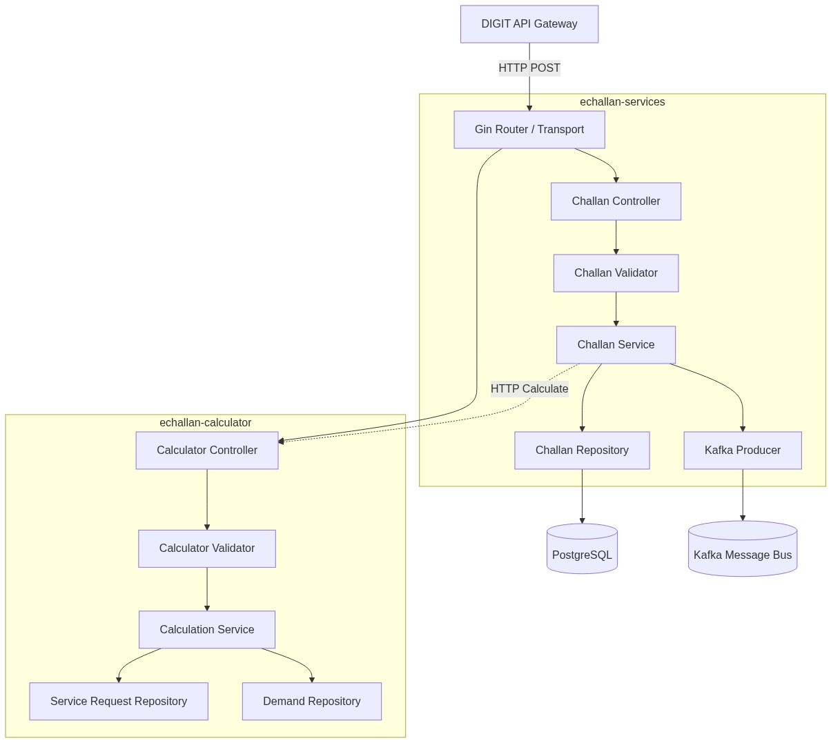
Upgraded Go Template (UGT) Architecture
Phase 3: Implementation
Strict Layered Design -- No Magic, No Reflection, No Annotations
• Project layout: cmd/ configs/ internal/ pkg/
• Request pipeline (no shortcuts):
- Gin Router -> Controller (JSON bind & auth)
- -> Validator (MDMS + location live checks)
- -> Service (business logic + HTTP orchestration)
- -> Repository (SQLX explicit SQL)
- -> PostgreSQL / Kafka Producer
• Graceful Shutdown implemented in main.go:
- Traps OS signals: SIGINT / SIGTERM
- Drains active requests with 10-second timeout
- No payment request dropped on pod restart
• Configuration via config.go -- all env-var driven
Go Microservice Internal Routing & Bounded Contexts
5 / 15

Slide 6
Phase 1 -- Azure VM Infrastructure Setup
Phase 1: Infrastructure
Building the Deployment Environment Before Writing a Line of Go
• Azure Ubuntu VM (percy@20.244.110.170) -- SSH key-based authentication
• Go installed at /usr/local/go/bin/go (v1.21) -- explicitly set in every build cmd
• Docker + Docker Compose orchestrating all DIGIT dependency services
• PostgreSQL containerized -- schema pre-seeded from DIGIT SQL migration scripts
• Kafka + Zookeeper containerized -- Kafka Mock used during initial pipeline testing
[Screenshot] Screenshot: docker ps output All 6 containers running healthy on Azure VM
Container | Port | Role
PostgreSQL | 5432 | Challan data persistence
Kafka + Zookeeper | 9092 | Async event bus
egov-mdms-service | 8094 | Master data: TaxHeads, FinancialYear
egov-location | 8080 | Boundary / locality validation
egov-user | 8081 | Citizen & employee user info
egov-idgen | 8088 | Unique ChallanNo generation
6 / 15

Slide 7
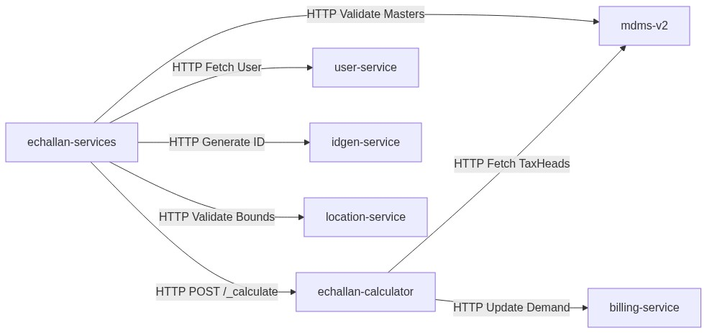
Microservice Dependency Orchestration
Phase 3: Integration
6 Synchronous REST Calls Are Made Per Single Challan Creation
Call # | Target Service | Purpose
1 | mdms-v2 | Validate financial year & TaxHead master
2 | location-service | Validate locality boundary code
3 | idgen-service | Generate unique challanNo
4 | user-service | Fetch citizen user info
5 | echallan-calculator | Compute tax demand (POST /_calculate)
6 | billing-service | Persist the demand bill
Async: Go service produces Kafka event -> egov-persister writes to PostgreSQL HTTP response returned instantly -- DB write happens in the background
Synchronous API Orchestration Flow
If any of the 6 calls fails -> entire request is rejected (Fail-Closed)
7 / 15

Slide 8
The Go Engineering Stack
Every Technology Chosen for a Specific Reason -- Not Default Framework Choices
Component | Technology | Replaces (Java) | Why
Routing / HTTP | Go + Gin | @RestController + Tomcat | Lightweight, ~10x faster startup, no JVM
Database ORM | SQLX | Hibernate / JPA | Explicit row-mapping, zero reflection overhead
Message Bus | Kafka | Spring Kafka | Async persistence, decouples HTTP from DB writes
Logging | Uber Zap | Logback / SLF4J | Structured JSON logs, no CPU bottleneck under load
Config Mgmt | os.Getenv() | @Value / properties files | 12-Factor compliant, env-var driven
Containerisation | Docker | Maven WAR / JAR deploy | Environment parity across dev, staging, production
API Testing | Postman + cURL | Postman + Swagger UI | Auto-generated collection from Swagger spec
8 / 15

Slide 9
Engineering Execution Workflow
We Followed a Strict Phase-by-Phase Approach -- No Ad-Hoc Coding
1
1. Audit & Blueprinting
4
4. Domain Migration
Analyzed Java domain logic, DB schema, and all external RestTemplate calls. Mapped every Java class, annotation, and entity to its Go UGT equivalent.
Ported all entities applying int64 overflow fix. Fixed shallow-copy bug in ToCommonUser() with explicit deep copy logic.
2
2. Infrastructure Setup
5
5. Logic Translation & Integration
Provisioned Azure VM. Installed Go, Docker, Docker Compose. Brought up all 6 dependency containers and verified connectivity.
Rebuilt boundary checks, penalty formulas, MDMS validations. Re-linked mdms-v2, location-service, idgen-service, billing-service.
3
3. Structural Wiring
6
6. E2E Testing & Documentation
Created cmd/main.go entry points for both services. Wired all dependencies explicitly: repos -> services -> controllers.
Deployed Go binaries to Azure VM. Executed 9 edge-case test payloads, generated Swagger + Postman collection.
[Screenshot] Screenshot: Successful Go build on Azure VM (go build ./cmd/echallan-services)
9 / 15

Slide 10
Critical Engineering Fixes
Phase 4: Audit & Fix
These Were Not Simple Bugs -- They Were Architecture-Level Risks
Bug 1: 32-bit Integer Overflow (UserInfo.Id)
Problem:
Java used int (32-bit) for User IDs. Systems with >2.1 billion records crash silently -- a ticking time bomb.
Fix:
Migrated ALL User ID fields to int64 across domain models & DB mappers.
Bug 2: Shallow Copy Pointer Mutation (ToCommonUser)
Problem:
u := ui.User was a shallow copy. Concurrent billing requests shared the same pointer -> data corruption risk.
Fix:
Explicit field-by-field deep copy. + make([]Role, len(...)) for all slice fields.
Bug 3: Hardcoded Kafka Topics
Problem:
Topics like 'save-challan' hardcoded as strings in source code. Breaks 12-Factor compliance -- env parity impossible.
Fix:
Decoupled to env vars: KAFKA_SAVE_CHALLAN_TOPIC KAFKA_UPDATE_CHALLAN_TOPIC
Bug 4: Incorrect .gitignore Pattern
Problem:
'.gitignore' entry 'echallan-calculator' (without leading /) was silently excluding the entire cmd/echallan-calculator/ directory from Git.
Fix:
Fixed to '/echallan-calculator' (root-only). cmd/main.go now correctly tracked and pushed.
10 / 15

Slide 11
API Contract Parity: Java vs. Go
Phase 5: API Parity
100% Endpoint Parity -- Frontend Has No Idea the Backend Language Changed
Endpoint | Java (Spring Boot) | Go (Gin Router) | Port | Status
/_create | @PostMapping("/_create") | router.POST("/_create", ctrl.Create) | 8082 | Complete
/_search | @PostMapping("/_search") | router.POST("/_search", ctrl.Search) | 8082 | Complete
/_update | @PostMapping("/_update") | router.POST("/_update", ctrl.Update) | 8082 | Complete
/_calculate | @PostMapping("/_calculate") | router.POST("/_calculate", ctrl.Calc) | 8078 | Complete
/_getbill | @PostMapping("/_getbill") | router.POST("/_getbill", ctrl.GetBill) | 8078 | Complete
Sample POST /echallan-calculator/v1/_calculate (Postman Collection):
{ "RequestInfo": { "userInfo": { "id": 1, "tenantId": "pb.amritsar", "type": "EMPLOYEE" } }, "CalculationCriteria": [{ "tenantId": "pb.amritsar", "challan": { "businessService": "CHALLAN", "taxPeriodFrom": 1618204200000, "taxPeriodTo": 1649740199000, "amount": [{ "taxHeadCode": "CHALLAN_FEE", "amount": 1500.0 }] } }] }
[Screenshot] Screenshot: Postman 200 OK on POST /_calculate
11 / 15

Slide 12
Phase 6 -- E2E Testing on Azure VM
Phase 6: Testing
9 Test Cases Executed Against Live Go Services -- All Passed
# | Test Case | Input | Expected | Result
1 | Happy Path Create | Valid full payload | 200 OK + challanNo | PASS
2 | Missing tenantId | No tenantId in body | 400 Bad Request | PASS
3 | Invalid TaxHeadCode | 'INVALID_TAX' | 400 Bad Request | PASS
4 | Bad Locality Code | Non-existent boundary | 400 Bad Request | PASS
5 | Missing Financial Year | Unmapped year in MDMS | 400 Bad Request | PASS
6 | Search by Mobile | Valid mobileNumber query | 200 OK + list | PASS
7 | Calculate Demands | Valid CalculationCriteria | 200 OK + demand | PASS
8 | DoS Large Payload | 50MB+ request body | 413 Too Large | PASS
9 | Nil Nested Object | null inside amount array | 400 Bad Request | PASS
12 / 15

Slide 13
Technical Takeaways
What This Internship Actually Taught Us
Engineering Learnings
What Changed in Our Thinking
• Go Memory Model: Explicit pointers -- no GC surprises, no shallow-copy accidents
• Concurrency Safety: Goroutines are cheap; shared pointers across them are dangerous
• 12-Factor Principles: Config must be env-driven, never hardcoded in source
• Fail-Closed Design: Validate at service boundaries -- prevents corrupt data entry
• Microservice Debugging: 6-call chains need structured logging at every hop
• DIGIT Persister Pattern: Kafka async writes keep HTTP fast under any DB load
• Interface-Driven Design: Go interfaces allow mock injection without live services
• Java hides complexity -- Go forces you to understand every dependency
• Production bugs are silent -- auditing code is as important as writing it
• A service that fails loudly is better than one that silently corrupts data
• Good engineering is about the decisions you make, not just the code you write
• Enterprise microservices are 20% code and 80% orchestration, config & ops
"True engineering is identifying hidden debt and building systems that fail gracefully at scale."
13 / 15

Slide 14
Future Improvements & Conclusion
Production-Ready Today -- Here Is What We Would Do Next
Roadmap for Scaling
Project Conclusion
• Redis Caching for mdms-v2 master data (fetched live on every request today)
- Eliminate redundant network hops on every single calculation
• Prometheus Metrics middleware on the Gin router
- Real-time p95 / p99 endpoint latency dashboards
• SQLX Connection Pool tuning: SetMaxOpenConns / SetMaxIdleConns
• Horizontal Scaling via Kubernetes HPA
- Go's ~20MB idle footprint makes this dramatically cost-effective vs Java
• Achieved: Full migration of both eChallan services to production-ready Go
• Delivered: Swagger spec, Postman collection, architecture docs, migration report
• Fixed: 4 architectural vulnerabilities that existed silently in the Java codebase
• Learned: How to audit, restructure, and deploy enterprise distributed systems
Final Takeaway
We did not simply clone and run a repository. We understood the architecture, identified critical flaws, rebuilt the services in Go, and proved correctness against 9 real edge-case test scenarios on a live VM.
14 / 15

Slide 15
Thank You
Questions?
Centre for Digital Public Infrastructure (CDPI)
github.com/CDPI-HRSS/digit-echallan-go | Branch: feature/updated-go-echallan
docs/echallan-swagger.yaml | docs/echallan-postman-collection.json
15 / 15

