Slide 1
eChallan Service Migration
Java to Go Engineering Report & Guide
DIGIT-OSS Ecosystem

Slide 2
Overview & Paradigm Shift
Migration of DIGIT-OSS eChallan Ecosystem from Java (Spring Boot) to Go (Gin/SQLX)
Microservices:
eChallan-services: Core state-machine and persistence layer
eChallan-calculator: Mathematical engine for tax & penalties
The Paradigm Shift (Upgraded Go Template):
Explicit dependency injection & layered routing
Prevents OOM crashes & scales massively via goroutines

Slide 3
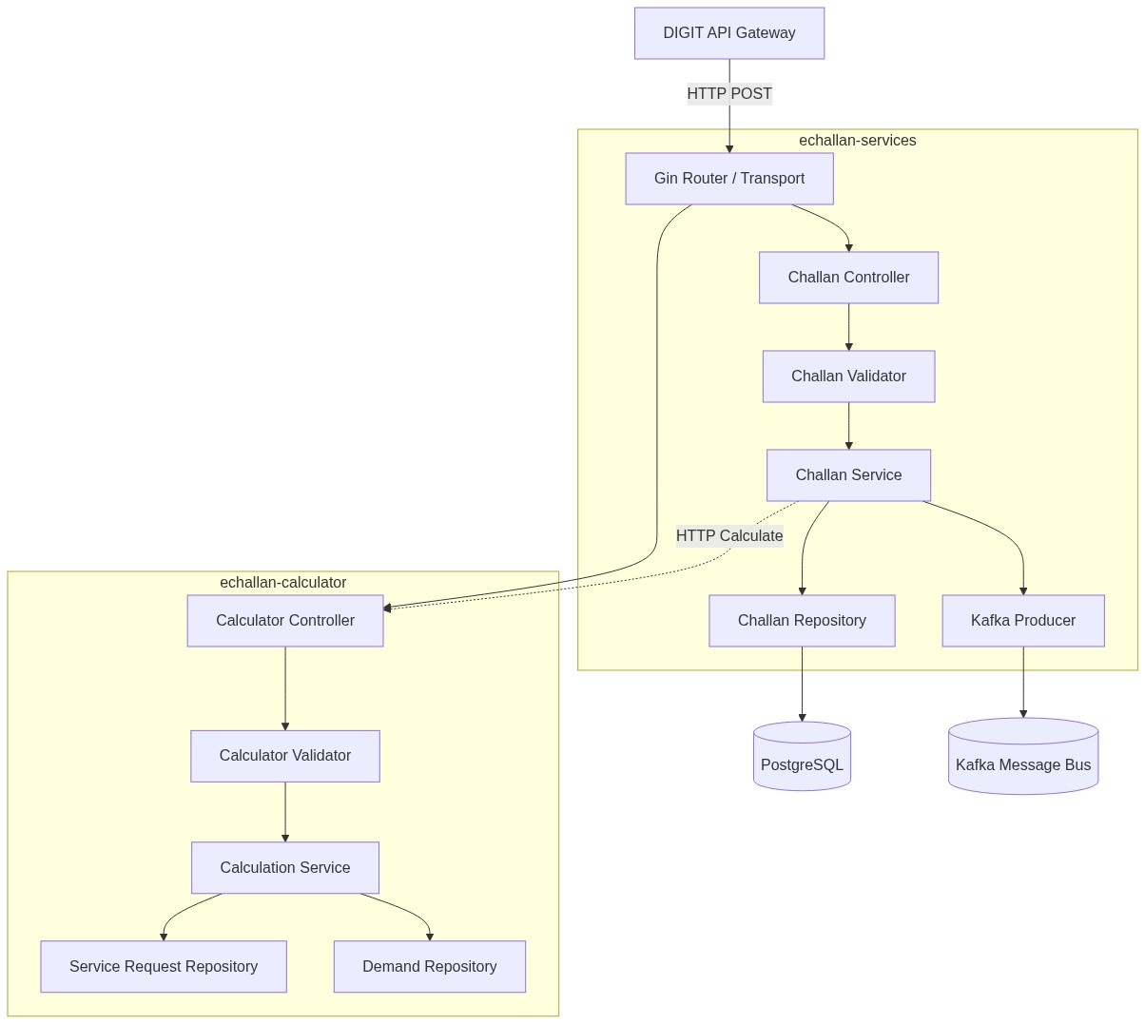
High-Level Architectural Flow

Slide 4
Database ER Model & Migrations
Replaced Hibernate (JPA) with strict explicit SQLX mapping.
Key Table Mappings:
Challan -> eg_echallan
ChallanDescription -> eg_echallan_desc
CRITICAL: Data Integrity Upgrade
Fixed 32-bit integer overflow vulnerability in Java entity modeling
Go models now explicitly map UserInfo.Id as int64
Ensures stability past 2.1 billion user records

Slide 5
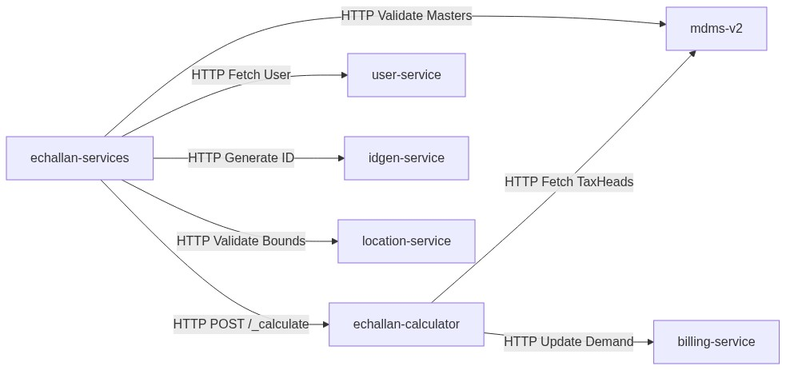
Component & Dependency Integration

Slide 6
Asynchronous Data Flow (Kafka)
DIGIT-OSS Persister Pattern Implementation
Go services produce events to Kafka, consumed by egov-persister
12-Factor App Compliance:
Hardcoded Kafka topics removed
Dynamic injection via Environment Variables
KAFKA_SAVE_CHALLAN_TOPIC, KAFKA_UPDATE_CHALLAN_TOPIC

Slide 7
Quality Assurance & Deliverables
Migration completely certified based on UGT compliance
Swap and Test Parity verified across all edge cases
Code Structure aligns with strict Go layered architecture
API Contracts (Swagger/Postman) auto-generated in docs/
Architectural Debt Resolved
Deep-copy pointer mutations patched
Integer overflow boundaries secured

