Slide 1
CDS-M
Tooling

Slide 2
How to specify a data exchange?
Start investigating your data need – with use cases
Use cases relate to usable standards
Select technical items:
Standards & Authentication
Transport requirements
Processing requirements
Archiving requirements
Select process items:
Contracts
Terms and conditions

Slide 3
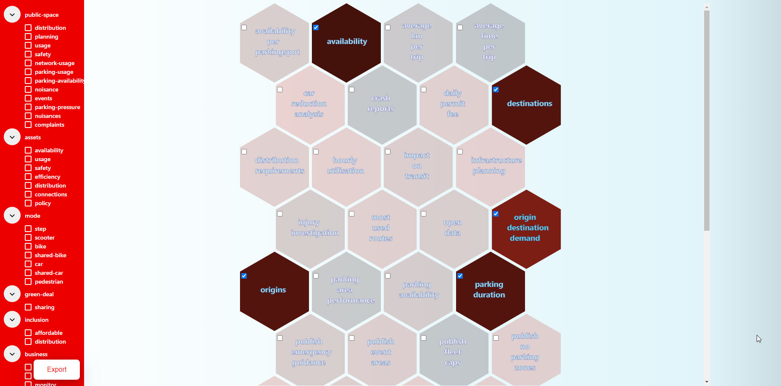
Determine data need: use cases

Slide 4
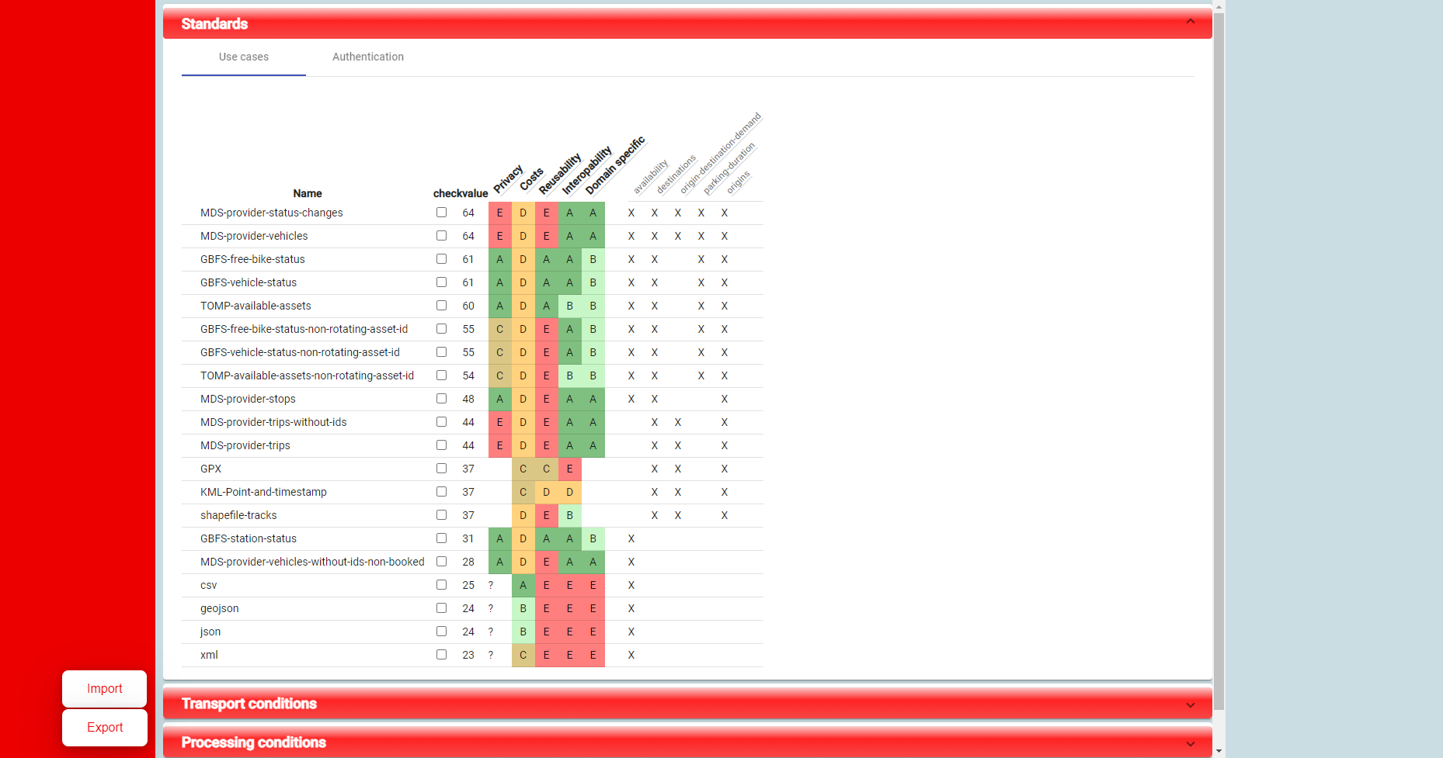
Select appropriate standards

Slide 5
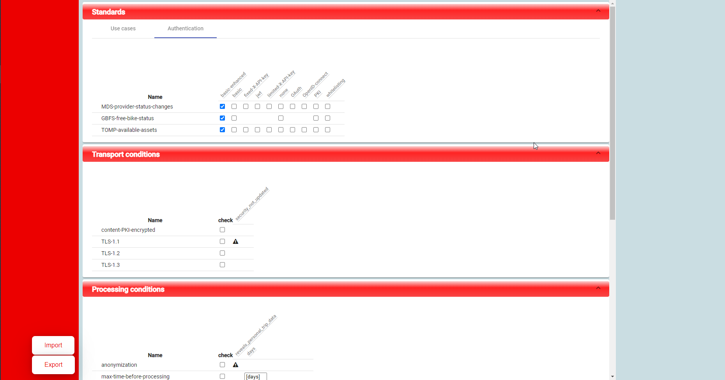
Other technical items

Slide 6
Process items
Contractual
Terms & conditions
TO DO

Slide 7
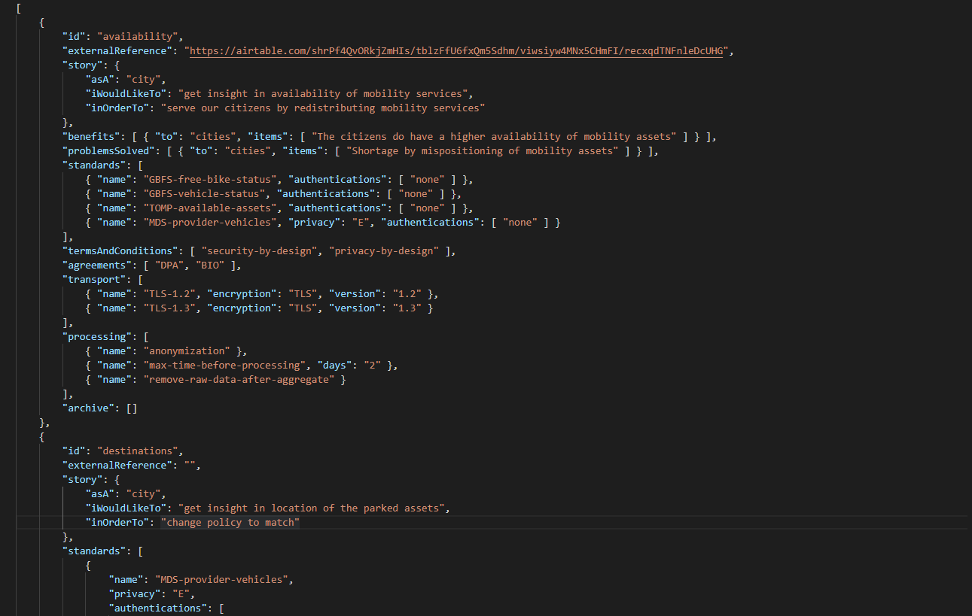
Export – specified

Slide 8
Next steps
Merging specifications from TO side and city side

