Slide 1
User-Centric Design Affinity Diagramming
Sorting data into large groups

Slide 2
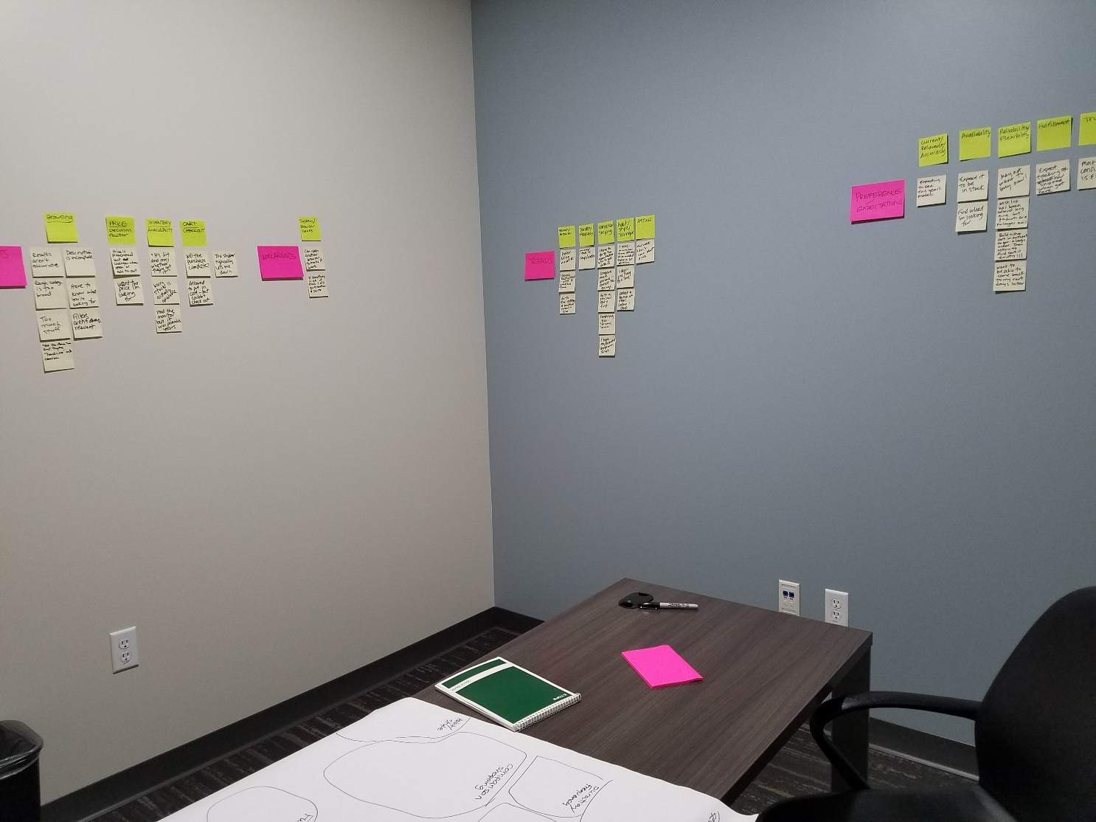
Affinity Session Room

Slide 3
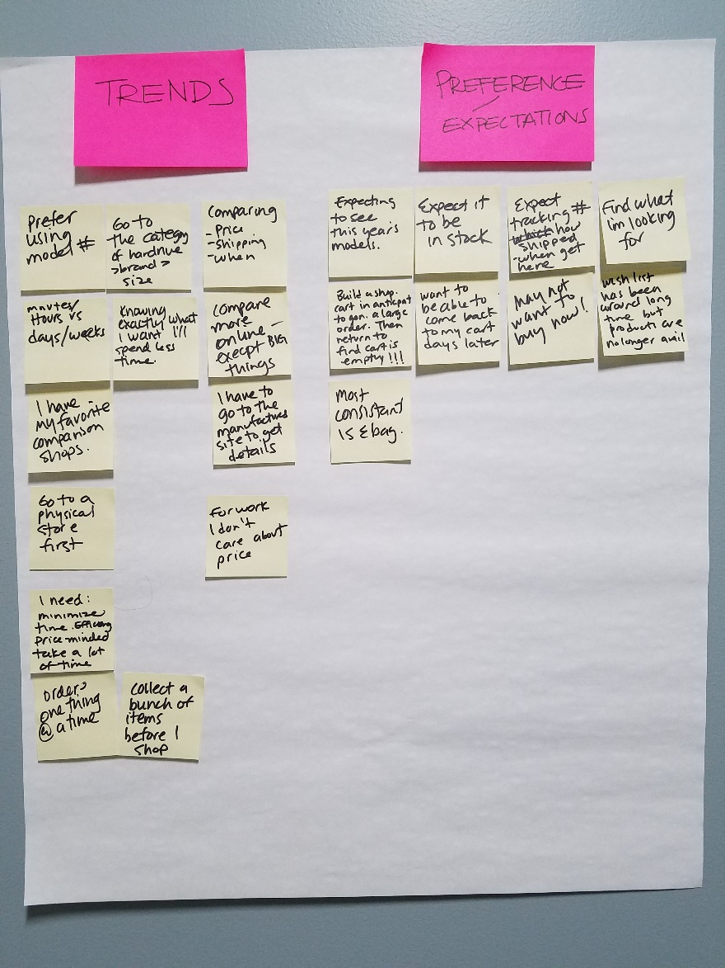
Round 1 Categorization

Slide 4
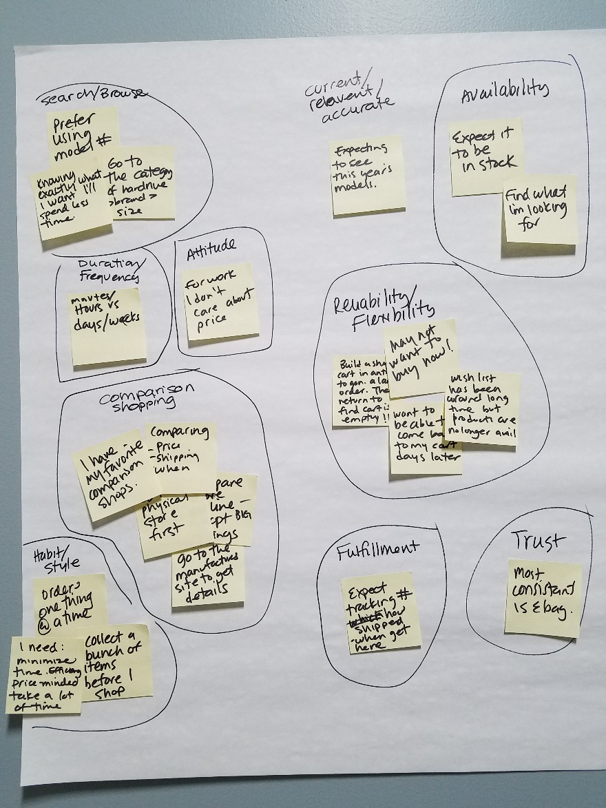
Round 2 Categorization

Slide 5
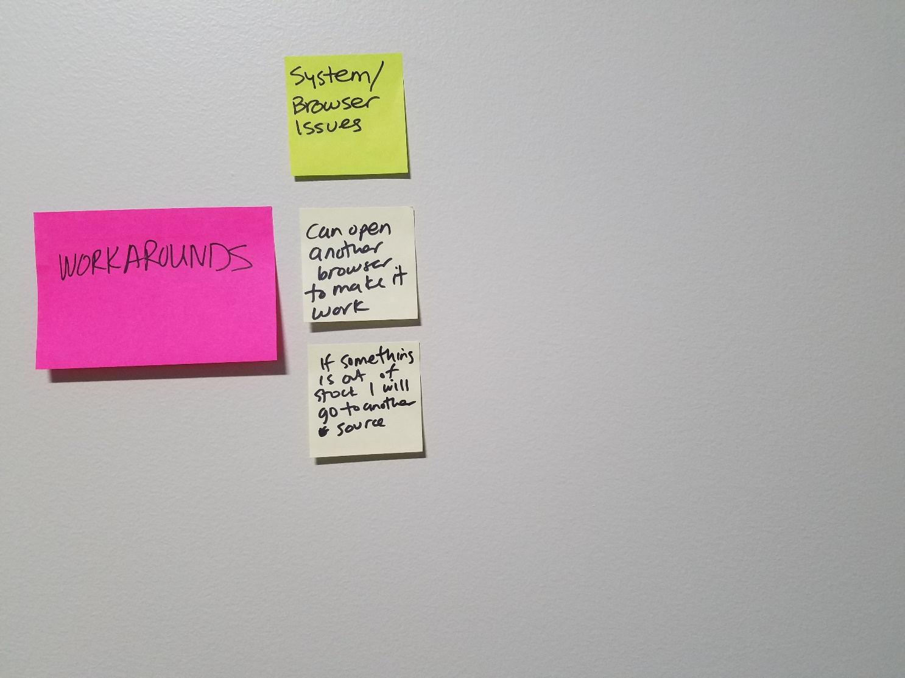
Outcome Workarounds

Slide 6
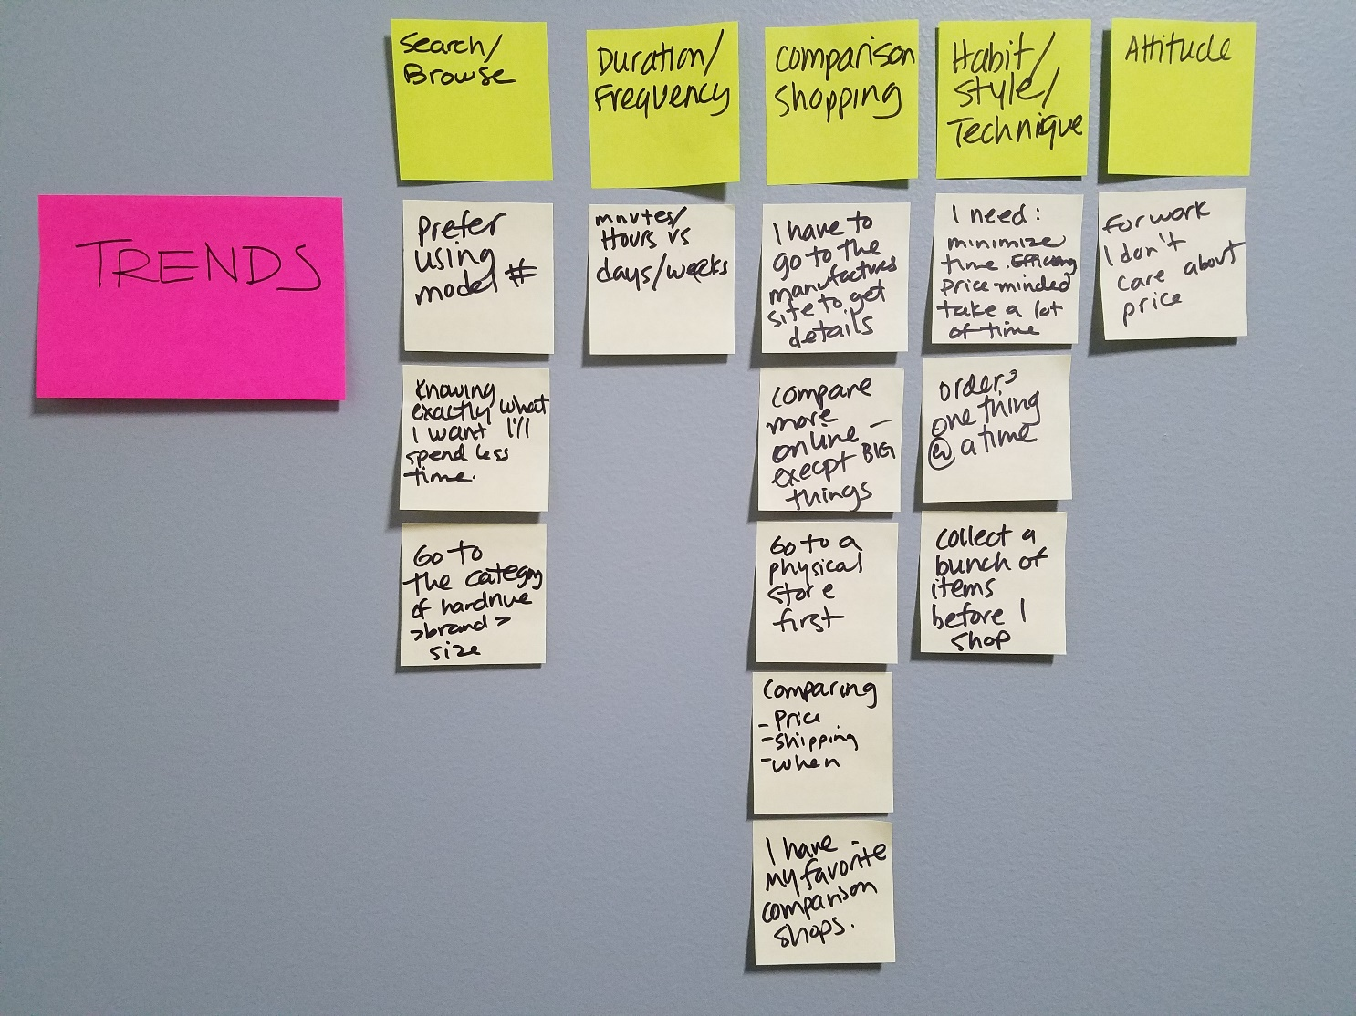
Outcome Trends

Slide 7
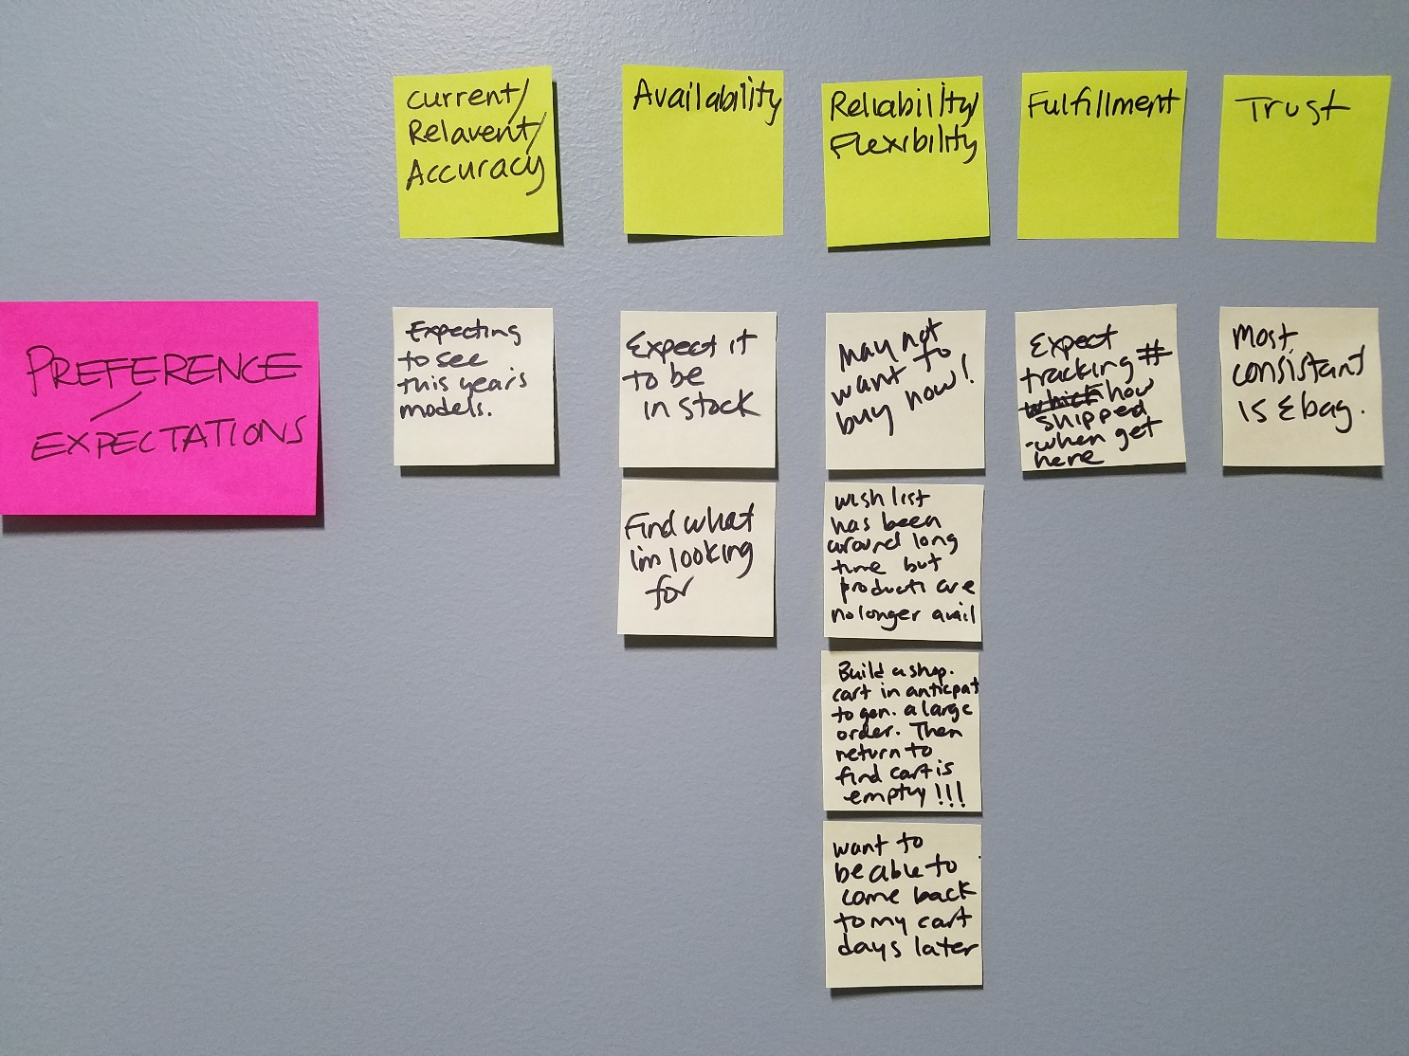
Outcome Preference and Expectations

Slide 8
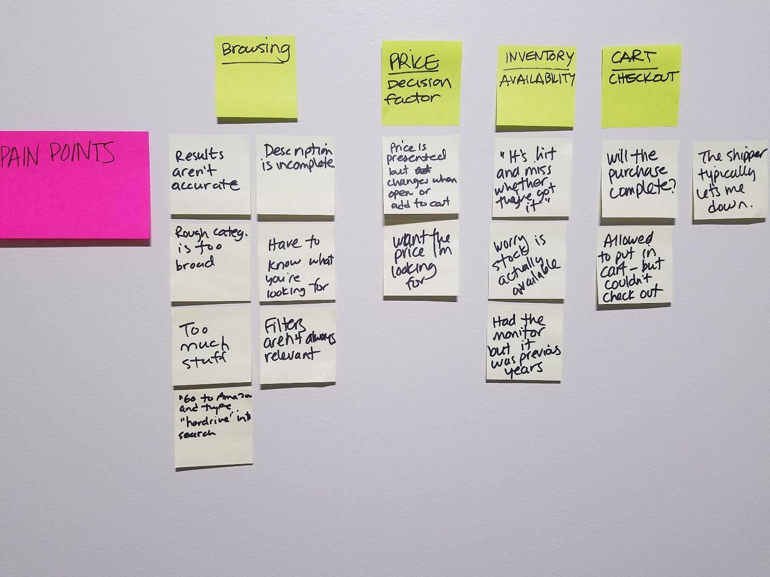
Outcome Pain Points

