Slide 1
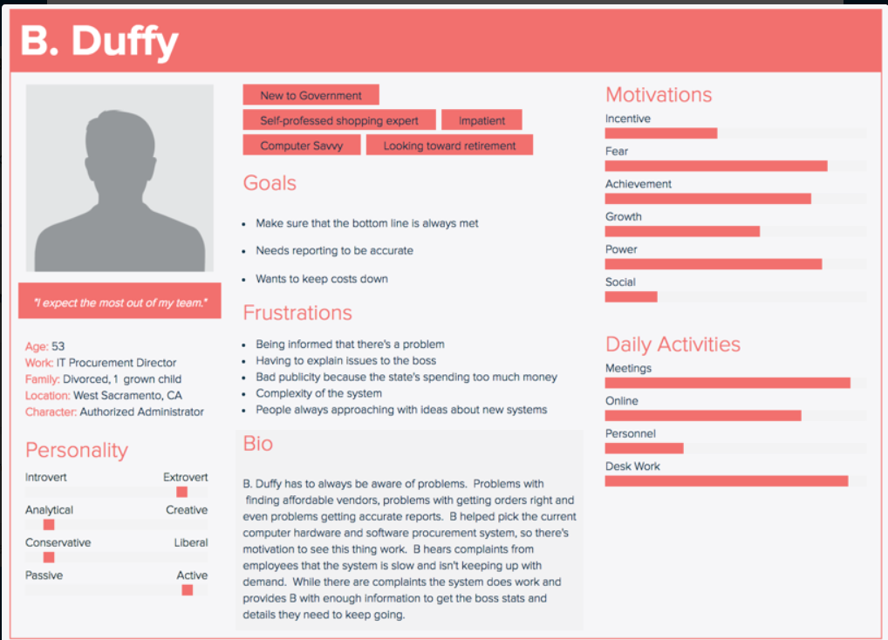
Persona – Authorized Admin

Slide 2
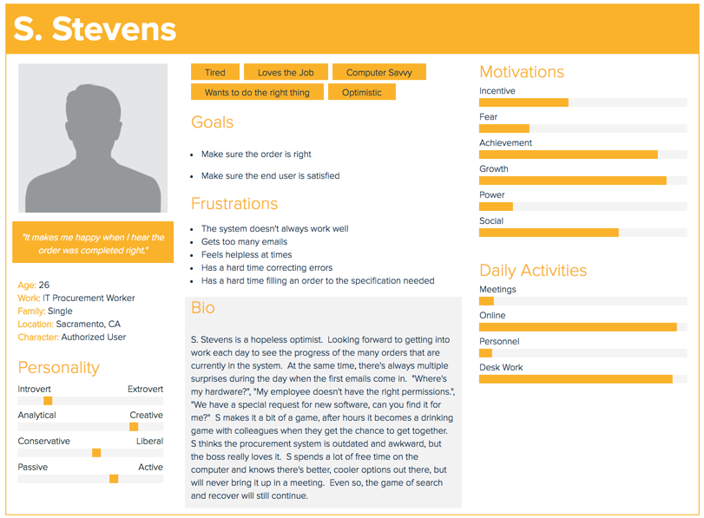
Persona – Authorized User

Slide 3
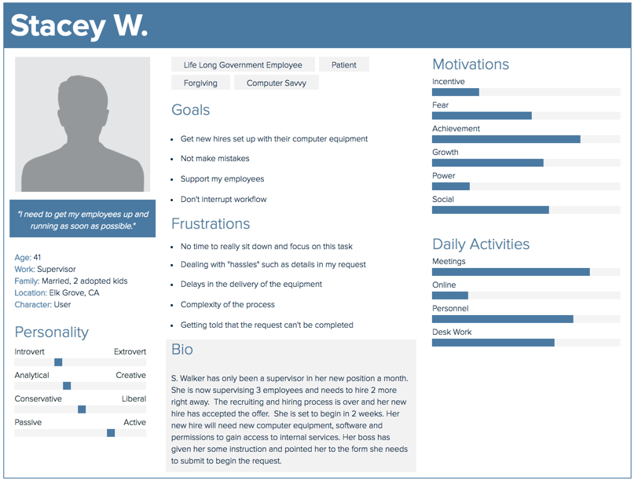
Persona – End User

