Slide 1








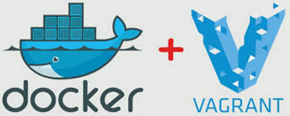




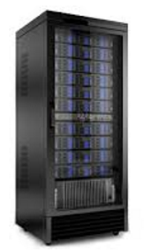

Cal-eStore - DevOps Architecture
Commit changes
SCM
Feedback
Security/Vulnerability Scan
Continuous Integration (CI)
Build
Static Code Analysis
Artifactory
Feedback
Continuous Delivery (CD)
Feedback
Dev
Staging
Production
Continuous Monitoring (CO)
Application, system monitoring and self-healing

