Slide 1
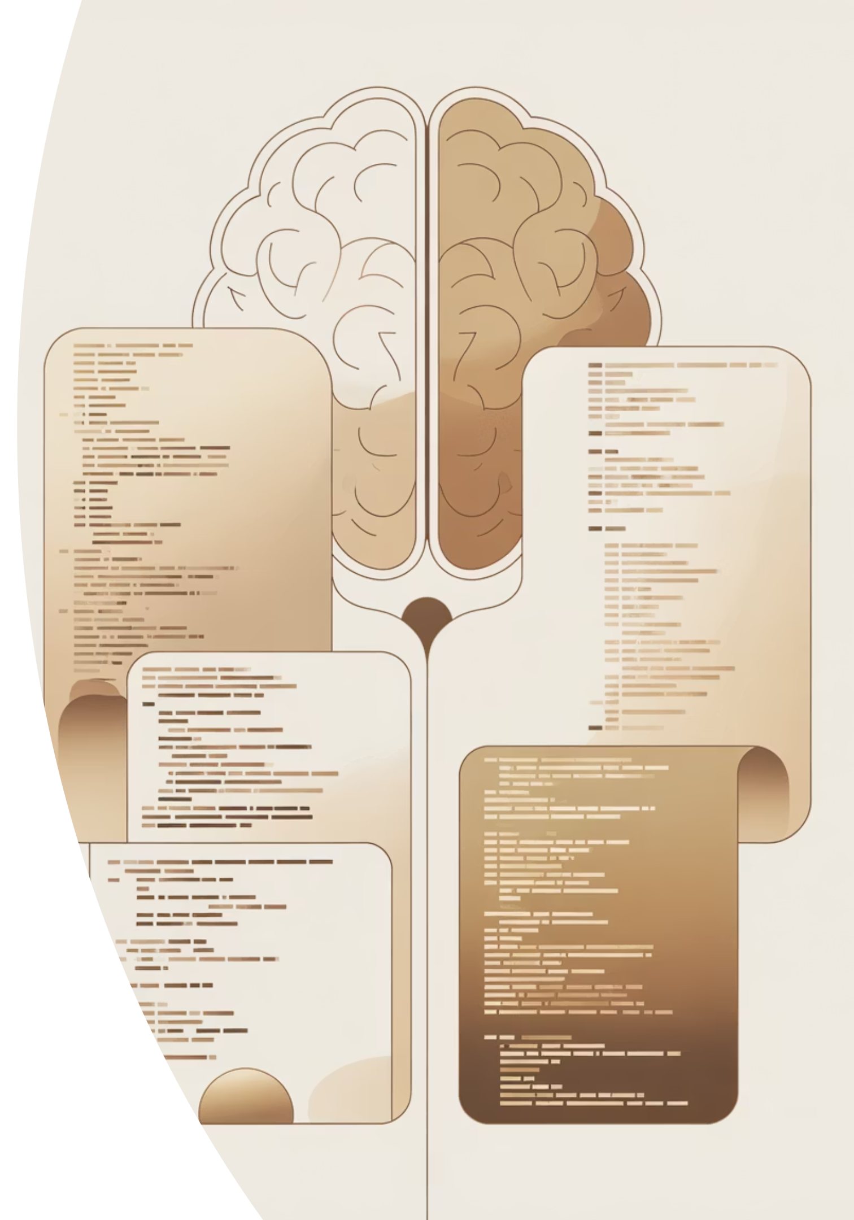
LLM-Driven Halide Code Generation and Automated Validation
Goal → Use large language models to generate correct Halide (Python) image-processing programs and auto-validate results on numerical & image-based test cases.

Slide 2
Why automate Halide code generation:
Writing Halide programs is powerful but difficult — its functional style, declarative scheduling, and multi-stage pipelines make even simple image operations verbose.
Small mistakes (e.g., wrong bounds, transposition, or scheduling) often lead to runtime errors or subtle performance bugs.
Developers and researchers waste time manually writing boilerplate for:
  Declaring Func, Var, and ImageParam
  Managing transpositions (CHW ↔ HWC)
  Compiling and running small test cases
Goal: Automate this process using an LLM that can:
  Understand a natural-language description (e.g., “apply a 3×3 blur”),
  Generate correct, runnable Halide + Python code,
  And produce test cases with expected outputs for verification.

Slide 3






System Architecture
The system employs a continuous feedback loop to refine the generated Halide code, leveraging specialized modules for
reasoning and validation.
User Prompt
Halide
Code + Tests
Validator
Execute &
Pipeline
Loop
Feedback
HalidePipeline
HalideValidatorLoop
React Loop
Responsible for generating the initial code and test cases, incorporating Chain-of-Thought reasoning for better accuracy.
Manages the execution of the generated code and the comparison of results against expected outputs.
Enables adaptive correction by feeding Pass/Fail results back to the LLM for iterative improvement.

Slide 4

Validation Process
The validation process is rigorous, ensuring both numerical and visual correctness of the generated image processing programs.
01
02
03
Generate Code + Test Cases
Save Test Assets
Run Halide Code
The LLM produces the Halide code along with necessary test inputs and expected outputs.
Input.png and expected_output.png are saved for the current validation round.
The generated Halide code is executed, producing the actual output.png.
04
05
Compare Pixel-Wise
Feedback Loop
Numerical comparison is performed using mean and max difference metrics.
Pass/fail feedback and error messages are sent back to the LLM to guide the next generation attempt.
Example metrics:
Expected mean: 0.85
Actual mean: 0.846
Max diff: 0.078
Visualization: show side-by-side input / expected / actual image thumbnails.

Slide 5
Key Findings & Challenges
While the LLM-driven approach showed significant promise, several technical hurdles were identified during the validation phase.
Successes
Challenges
LLM produced valid Halide code for multiple ops
Occasional truncation & syntax drift
Feedback loop improved reliability
JSON outputs sometimes malformed
Test-image pipeline proved useful
Unclamped expected values caused test mismatch
LLM sometimes switched to C++
Auto-execution validated correctness

Slide 6


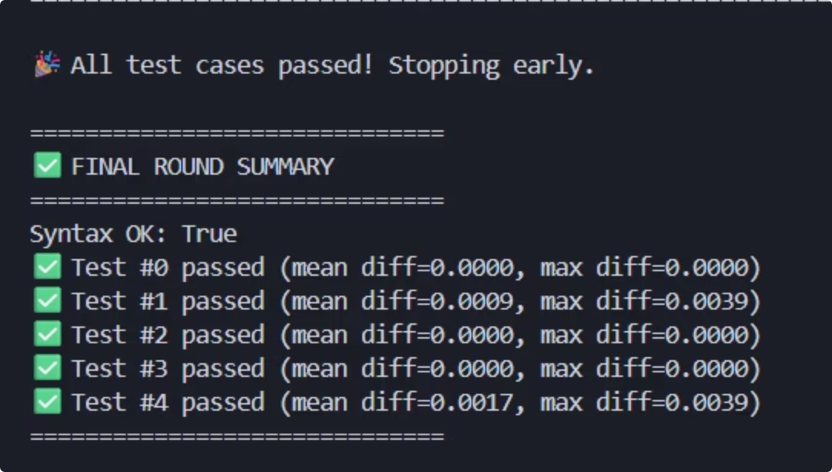
Future Work
The next phase of development will focus on performance optimization, real-world benchmarking, and enhancing the feedback mechanism.
Performance Testing
Add scheduling optimizations (Halide vectorize, tile, parallel) to test performance.
Real-Image Benchmarks
Introduce real-image benchmarks (blur, sharpen, tone-map) to evaluate practical utility.
Multi-Agent Feedback
Explore multi-agent feedback: validator + static analyzer for more comprehensive code review.
Web Deployment
Deploy pipeline as a web demo with visual diff viewer for accessibility and demonstration.

