Slide 1

What it is, how it can help you, and how to get involved
AnalystX, 11th October 2022

Slide 2
Summary
What is R?
The Goldacre review, RAP, and the future
What is NHS-R?
What NHS-R can do for you
What can you do for NHS-R

Slide 3
What is R
R is a free and open source implementation of S
S, and R, are designed for statistical computing
R developed in 1997 by statisticians
At first it was used in universities for statistics
Increasing adoption in industry
Pfizer
The BBC
Google
Amazon
The NHS!

Slide 4
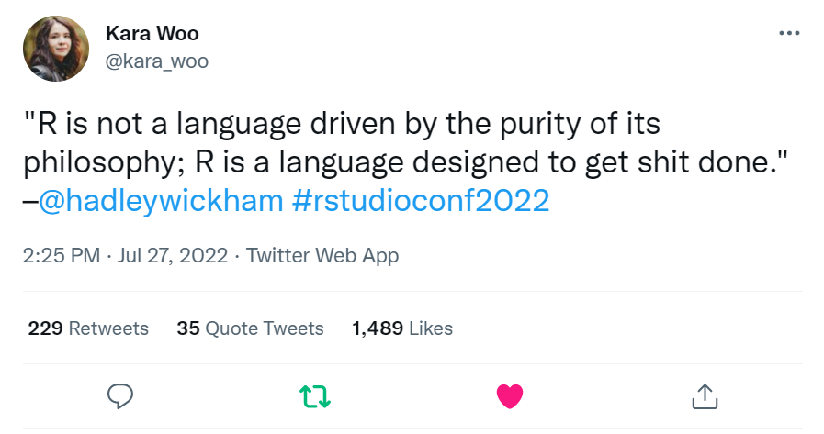


Slide 5
What do people do with R
Statistics
Visualisation
Dashboards
Machine learning
Text mining
Reporting

Slide 6
Goldacre, RAP, and R (and Python)
Summary recommendation 17
“Embrace modern, open working methods for NHS data analysis by committing to Reproducible Analytical Pipelines (RAP) as the core working practice that must be supported by all platforms and teams; make this a core focus of NHS analyst training”

Slide 7
Reproducible analytic pipelines
“Reproducible analytical pipelines [edited for length]:
minimise manual steps, for example copy-paste, point-click or drag-drop operations. Where it is absolutely necessary to include a manual step in the process this must be documented
be built using open source software for data management, analysis and visualisation which is available to anyone, preferably R or python
be open to anyone for review and re-use, with all code shared openly through open standard file and code sharing platforms such as GitHub (sharing data itself is a separate issue from sharing code, as discussed below, and should be handled very differently)
guarantee an audit trail using version control software (such as Git, or in services such as GitHub) which systematically track exactly who has made which changes or contributions to the code, which characters and lines were modified, when, and – as appropriate – why
contain well-commented code and have documentation embedded and version controlled within the work, rather than saved elsewhere”

Slide 8
Other recommendations
“Create and maintain a curated national open library of NHS analyst code”
“Ensure all training is open by default”
“Support an NHS analyst community”
“Oversee funding and delivery of training, both open online and one-to-one”

Slide 9
Everything open, all the time
Everything NHS-R does is open
(except Slack 🙁)
Everything NHS-R produces has an open licence
We teach the skills of open
Git, GitHub, how to write reusable code

Slide 10
What does NHS-R do already?
Training
NHS-R academy
NHS-R solutions
Conference
Webinars
Slack
Podcast
Blogs
GitHub and collaboration

Slide 11
How can NHS-R help you?
Training, and open training resources
Online, (often instant) help
Join the academy
Community and belonging
Hear about (and copy 😉) best practice
Permission and visibility

Slide 12
Ask not what NHS-R can do for you…
We need you!
Most of what we do is voluntary. Your organisation can release you to:
Train analysts (intro, reporting, Shiny dashboards, and others)
Work on NHS-R solutions (like NHSRplotthedots)
Host and run webinars
Contribute to shared policy and practice documents
Give help to others
Blog
This is all helpful for developing your skills and looks great on your CV! 😉

Slide 13
Force multipliers
If you want to go fast, go alone
If you want to go far, go together
African Proverb
Code is a force multiplier
Wickham, 2014 https://bit.ly/3jQ5SuJ
So is a community
One minute NHS-R > One minute of writing code

Slide 14
Conference!
“…the NHS-R community – which is hosted by the Strategy Unit and now also has support from the NHSX Analytics Unit – runs the premier data science conference in the NHS” (Goldacre)
NHS-R/ NHS Pycom conference
R: in person and online 16th and 17th November
Python: in person and online 17th
Online workshops and talks
8th – 10th November
Website https://nhsrcommunity.com/events/nhs-r-community-conference-2022/

