Slide 1
LEVERAGING TECHNOLOGY TO IMPROVE CUSTOMER EXPERIENCE
Batch Number:
Roll Number | Student Name
20211CDV0032 | Rishi Anand
20211CDV0031 | Rashmi Joshi
20211CDV0015 | Eshan V Shettennavar
Under the Supervision of,
Dr. Meena Kumari K.S
Professor
School of Computer Science & Engineering
Presidency University

Slide 2
Introduction
This project aims to enhance customer experience by integrating cutting-edge technology, such as QR codes, audio, and video, into the product features, offering users seamless and engaging interactions.
Using Next.js for building a fast, scalable, and SEO-friendly web application, ensuring a responsive and dynamic user interface.
UI graphics will be incorporated for an aesthetically pleasing and intuitive user journey.
By leveraging these technologies, the project prioritizes creating a personalized and efficient experience for customers, allowing them to engage with product features in more interactive and meaningful ways.
The Role of QR Codes in Enhancing Customer Experience: QR codes have revolutionized the way businesses bridge the gap between the physical and digital worlds.
Increasing Involvement by Audio Experiences: Voice assistants like Amazon Alexa, Google Assistant, and Apple Siri have changed the way customers interact with brands.
Including Video for improved understanding: Video has become an indispensable medium for engaging audiences and conveying information effectively.

Slide 3
Literature Review
Sl No | Title | Description | Advantages | Limitations
1 | Towards the Customers' Intention to Use QR Codes in Mobile Payments, Journal for Global information Management, Qianwne Xu Victor Chang,2021 | This research studies the motivation of customers to choose the QR code as a payment tool by developing an integrated model based on UTAUT. Four hundred twenty-four valid responses were collected from diversified socio-economic backgrounds to validate the proposed framework. | Enhanced Understanding of Adoption Factors Strategic implications for Service providers Comprehensive model development | Broaden the demographic scope Incorporate real-world usage data Address Evolving security concerns Focus on emerging technologies
2 | QoE in Video Transmission: A User Experience-Driven Strategy, Tiesong Zhao, Member, IEEE, Qian Liu, Member, IEEE, and Chang Wen Chen, Fellow, IEEE,2017 | The increasing popularity of video (i.e., audio-visual) applications or services over both wired and wireless links has prompted recent growing interests in the investigations of quality of experience (QoE) in online video transmission. Conventional video quality metrics, such as peak-signal-to-noise-ratio and quality of service, only focus on the reception quality from the systematic perspective. As a result, they cannot represent the true visual experience of an individual user. | User-Centric Focus Incorporation of Human and Contextual Factors Dynamic Adjustment Based on Real-Time Feedback | Advanced Personalization Enhanced Real-Time Monitoring Context-Aware Adaptation Cross-Layer Optimization

Slide 4
Literature Review
Sl No | Title | Description | Advantages | Limitations
3 | The Role of Artificial Intelligence on Enhancing Customer Experience, Mohannad A. M. Abu Daqar1 *, Ahmad K. A. Smoudy2,International Review of Management and Marketing, 2019, 9(4), 22-31. | The main aim of the study is to examine the role of artificial intelligence (AI) on Enhancing Customer Experience in Palestine through different industries, such as banks and telecommunication companies. The results of the study revealed that there is a positive significant relationship between AI and Customer Experience. | Advanced Personalization Enhanced Real-Time Monitoring Context-Aware Adaptation Cross-Layer Optimization | AI-Powered Personalization Improved Predictive Analytics Multi-Sensory Feedback Integration Hybrid Streaming Techniques
4 | Digital Transformation for Improving Customer Experience, Bahman Huseynli June 2022,Azerbaijan State University of Economics, Azerbaijan. | Customer experience is defined as the customer’s perceived overall quality of all interactions and relationships that the customer has with a company’s products and services. Business leaders have increasingly begun to attach importance to the role of customer experience in helping companies gain competitive advantage. Also, the advantages and disadvantages of digitalization affect the customer experience process. | AI-Powered Personalization Improved Predictive Analytics Multi-Sensory Feedback Integration Hybrid Streaming Techniques | Advanced Personalization with AI Increased Use of Data Analytics Enhanced Customer Engagement via Virtual Prototypes Integration of Disruptive Technologies
5 | Video Analytics for Customer Emotion and Satisfaction at Contact Centers, Kah Phooi Seng , Member, IEEE, and Li-Minn Ang, Senior Member, IEEE.June 2018 | Due to the high levels of competition in a global mar- ket, companies have put more emphasis on building strong cus- tomer relationships and increasing customer satisfaction levels. With technological improvements in information and communication technologies, a highly anticipated key contributor to improve the customer experience and satisfaction in service episodes is through the application of video analytics | Enhanced Customer Satisfaction Monitoring Multimodal Emotion Recognition Improved Service Quality Real-Time and Continuous Monitoring | Enhanced Emotion Categories Integration with Multichannel Analytics Advanced Data Fusion Techniques Real-Time Feedback Loop

Slide 5
Literature Review
Sl No | Title | Description | Advantages | Limitations
6 | Improving Software Quality as Customers Perceive It Randy Hackbarth, Audris Mockus, John Palframan, and Ravi Sethi, Avaya Labs Research,2016 | This method has been adopted company-wide at Avaya, a global pro- vider of business communication and collaboration systems. Avaya already had a strong commitment to qual- ity when it faced quality issues with some of its products in 2011. | Customer-Centric Approach Prioritization of Critical Issues Correlation Between Practices and Customer Impact Data-Driven Risk Mitigation | Broaden Customer Feedback Channels Real-Time Quality Monitoring AI-Driven Defect Prediction Granular Insights on User Impact
7 | Building high-performance web applications with NextJS, Harrison Oke Ekpobimi1 1 Foschini Group, Stanley Lewis Centre, Cape Town, South Africa | Building high-performance web applications is crucial in today's fast-paced digital landscape, where user experience and speed are paramount. NextJS, a popular React framework, offers a robust solution for developing scalable and efficient web applications. This paper explores the key strategies and techniques for optimizing performance using NextJS, emphasizing its capabilities in static site generation (SSG), server-side rendering (SSR), and incremental static regeneration (ISR). | Server-Side Rendering (SSR) and Static Site Generation (SSG) Improved SEO Automatic Code Splitting API Routes TypeScript Support | Better Real-Time Data Handling Improved Developer Tooling Improved Static Site Generation (SSG) Enhanced Routing Features
8 | A Room With an Overview: Toward Meaningful Transparency for the Consumer Internet of Things, Chris Norval and Jatinder Singh, IEEE INTERNET OF THINGS JOURNAL, VOL. 11, NO. 5, 1 MARCH 2024 | Our environments are becoming increasingly connected, instrumented, and automated, amid an ever-growing myriad of network-enabled consumer Internet of Things (IoT) devices claiming to offer convenience, comfort, safety, and control [1, 2, 3, 4]. From lighting, heating, and appliances to home security and beyond, surveys indicate that the average US household has eleven connected devices, with 28% of households having at least one home automation device [5]. In this way, the IoT is already impacting the lives of many. | Increased Understanding Enhanced Control Support for Accountability Improved Privacy and Security User-Centric Design | Transparency Paradox Complexity in Implementation Varied User Needs Potential for Misinterpretation Resource Intensive

Slide 6
RESEARCH GAPS IDENTIFIED
Limited investigation of demographic differences in QR code adoption across regions or age groups.
Lack of integration with emerging technologies like blockchain for enhanced security.
Insufficient exploration of long-term customer retention post-adoption.
Underexplored impact of personalization on QoE for diverse user groups.
Lack of comparative analysis of traditional and AI-driven strategies for video enhancement
Inadequate consideration of ethical implications and biases in AI algorithms.
Limited studies on cross-cultural adaptability of AI-enhanced solutions.
Missing exploration of the long-term cost-effectiveness of AI-based customer experience enhancements.
Lack of analysis on employee adaptation challenges during digital transformation.
Limited focus on multi-platform software environments (e.g., mobile, web).
Minimal exploration of user-friendly interfaces for diverse consumer groups.
Insufficient frameworks for real-time transparency and user interaction with IoT data.

Slide 7
Proposed Method
Dynamic QR Code Creation : Implement QRCode.react in Next.js to dynamically generate QR codes for each product feature.
Audio and Video Integration : Host audio and video content on platforms like Amazon S3, Vimeo, or YouTube, and embed them on product pages using HTML5 <audio> and <video> elements in Next.js.
Interactive and Custom UI Design : Use Tailwind CSS or Styled-Components to create responsive, visually appealing, and easy-to-navigate UIs.
Next.js API Routes for Content Fetching : Set up API routes in Next.js to dynamically serve product-specific content such as QR codes, media, and UI elements
Enhanced Customer Journey : Create a seamless flow where users scan a QR code, view multimedia content (e.g., product videos or audio guides), and interact with a visually appealing UI. This enhances customer experience by offering rich, interactive content with minimal effort on the user’s part.

Slide 8
Objectives
Enhance Customer Engagement
Streamline Access to Information
Improve User Experience
Personalize Customer Interactions
Optimize Content Delivery
Facilitate Easy Content Management

Slide 9
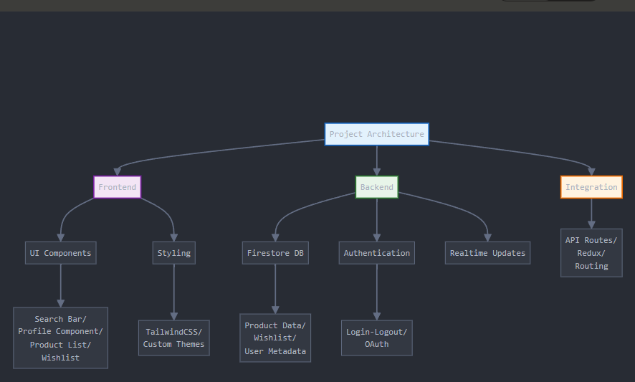
SYSTEM DESIGN AND IMPLEMENTATION

Slide 10
SYSTEM DESIGN AND IMPLEMENTATION
The system leverages the following components to provide an enhanced customer experience:
QR Code Generation & Scanning: Allows customers to scan a code and access relevant content.
Audio Content: Provides narration or descriptions for users through audio.
Video Content: Offers interactive product demos or service videos.
Next.js Framework: Acts as the main backend and frontend, facilitating server-side rendering (SSR), static site generation (SSG), and dynamic routing for content.

Slide 11
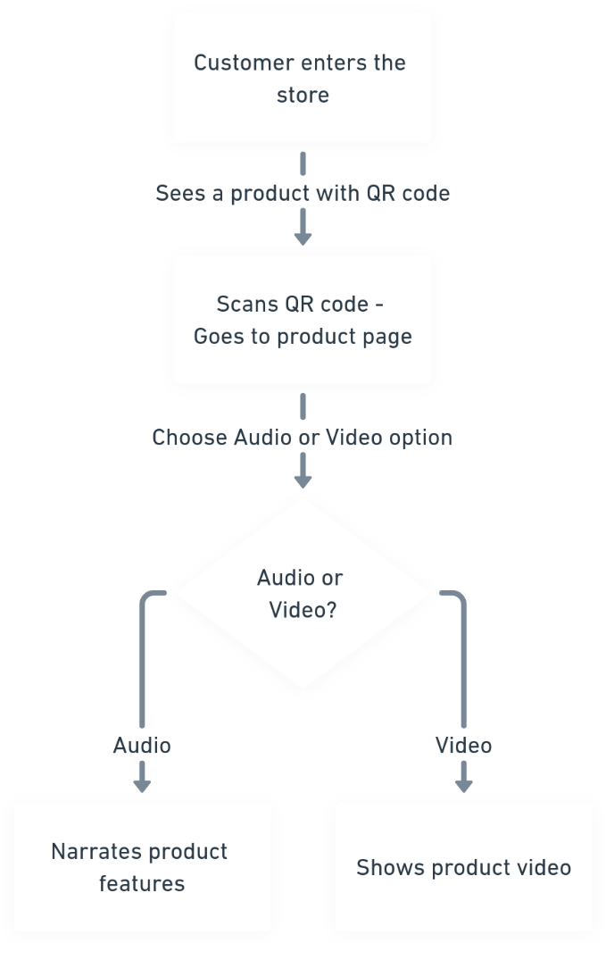
SYSTEM DESIGN AND IMPLEMENTATION

Slide 12
SYSTEM DESIGN AND IMPLEMENTATION
This flowchart illustrates the process of how a customer interacts with a product that has a QR code in a store. Here's the explanation of the flow:
Customer enters the store: The process begins with the customer physically entering the retail store.
Sees a product with a QR code: The customer notices a product that has a QR code attached to it.
Scans the QR code:
The customer uses their smartphone or device to scan the QR code.
Scanning the code takes the customer to a webpage dedicated to the product.
Chooses an audio or video option:
On the product page, the customer is presented with two options: to access information about the product either through audio narration or a video.
Decision point: Audio or Video?
If the customer selects Audio, the system provides a narration of the product's features.
If the customer selects Video, the system displays a video demonstrating or showcasing the product.
This flowchart effectively maps out the customer experience of engaging with a product's QR code and accessing additional information to aid their purchasing decision.

Slide 13
Timeline of Project

Slide 14
Expected Outcomes
1.Enhanced Customer Engagement:
Increased interaction with product features through engaging multimedia content (QR codes, audio, and video).
2.Improved Understanding of Product Features:
Clear and detailed explanations help customers understand the product's features better
3.Higher Customer Satisfaction:
Positive feedback and higher satisfaction due to the ease of access to informative and interactive content.
4.Increased Website Traffic:
More visitors to the website as a result of engaging content and improved SEO through multimedia elements.
5.Better Conversion Rates:
Higher likelihood of converting visitors into customers due to improved product understanding and satisfaction.
6.Positive Brand Perception:
Enhanced perception of the brand as innovative and customer-centric.

Slide 15
Conclusion
To conclude, our project will have,
Enhanced Engagement: By integrating QR codes, audio, and video, the project successfully delivers an interactive and personalized customer experience.
Improved Accessibility: The use of QR codes simplifies access to product information and multimedia content, offering customers a more convenient and efficient way to explore features.
Seamless User Experience: The implementation of a visually appealing and responsive UI using Next.js ensures an intuitive and smooth user journey, improving overall satisfaction.
Dynamic Content Management: Leveraging a headless CMS allows easy updates to product information and multimedia, ensuring content remains relevant and up-to-date without requiring code changes.
Scalable and Future-Ready: The project's architecture using Next.js is scalable and optimized for future enhancements, enabling continuous improvements to the customer experience.

Slide 16
References
Towards the Customers' Intention to Use QR Codes in Mobile Payments, Journal for Global information Management, Qianwne Xu Victor Chang
QoE in Video Transmission: A User Experience-Driven Strategy, Tiesong Zhao, Member, IEEE, Qian Liu, Member, IEEE, and Chang Wen Chen, Fellow, IEEE
The Role of Artificial Intelligence on Enhancing Customer Experience, Mohannad A. M. Abu Daqar1 *, Ahmad K. A. Smoudy2,International Review of Management and Marketing, 2019, 9(4), 22-31.
Digital Transformation for Improving Customer Experience, Bahman Huseynli June 2022,Azerbaijan State University of Economics, Azerbaijan.
Video Analytics for Customer Emotion and Satisfaction at Contact Centers, Kah Phooi Seng , Member, IEEE, and Li-Minn Ang, Senior Member, IEEE.
Improving Software Quality as Customers Perceive It Randy Hackbarth, Audris Mockus, John Palframan, and Ravi Sethi, Avaya Labs Research
Building high-performance web applications with NextJS, Harrison Oke Ekpobimi1 1 Foschini Group, Stanley Lewis Centre, Cape Town, South Africa
A Room With an Overview: Toward Meaningful Transparency for the Consumer Internet of Things, Chris Norval andJatinder Singh,IEEE INTERNET OF THINGS JOURNAL, VOL. 11, NO. 5, 1 MARCH 2024

Slide 17
References
Natural Language Processing in Customer Service: A Systematic Review by Malak Mashaabi, Areej Alotaibi, Hala Qudaih, and Raghad Alnashwan (2022)
Leveraging Technology to Enhance Customer Experience and Gain Competitive Advantage in Pakistan's Textile Industry by Hafiz Usman Mohyudin (2022).
A Room With an Overview: Toward Meaningful Transparency for the Consumer Internet of Things by Chris Norval and Jatinder Singh (2024).
Using Tech Innovations to Enhance Customer Engagements by the American Marketing Association (2022).
Automating Customer Service using LangChain: Building Custom Open-Source GPT Chatbot for Organizations by Keivalya Pandya and Mehfuza Holia (2023).
Improving Customer Experience in Call Centers with Intelligent Customer-Agent Pairing by S. Filippou et al. (2023).
Using Tech Innovations to Enhance Customer Engagements by the American Marketing Association (2022).
Improving Customer Experience in Call Centers with Intelligent Customer-Agent Pairing by S. Filippou, A. Tsiartas, P. Hadjineophytou, S. Christofides, K. Malialis, and C. G. Panayiotou (2023).

Slide 18
PUBLICATION DETAILS
The paper has been accepted at the International Journal of Research and Analytical Reviews.
It has not yet been published.

Slide 19
Thank You

