Slide 1
TLS
Transport layer security

Slide 2
contents
What is Network Security?
Principles of Cryptography
Message Integrity and Digital Signatures
End-Point Authentication
Securing TCP Connections: TLS

Slide 3



1. What is network security?
EXAMPLE Alice and Bob are two lovers who want to communicate securely.
What does that mean?

Slide 4
Principles of network security
Confidentiality
Message integrity
End-point authentication
Operational security

Slide 5
Confidentiality
Only the sender and intended receiver should be able to understand the contents of the transmitted message. Because eavesdroppers may intercept the message, this necessarily requires that the message be somehow encrypted so that an intercepted message cannot be understood by an interceptor. This aspect of confidentiality is probably the most commonly perceived meaning of the term secure communication.

Slide 6
Message integrity
Alice and Bob want to ensure that the content of their communication is not altered, either maliciously or by accident, in transit. Extensions to the checksumming techniques that have been encountered in reliable transport and data link protocols can be used to provide such message integrity.

Slide 7
End-point authentication
Both the sender and receiver should be able to confirm the identity of the other party involved in the communication—to confirm that the other party is indeed who or what they claim to be. Face-to-face human communication solves this problem easily by visual recognition. When communicating entities exchange messages over a medium where they cannot see the other party, authentication is not so simple.

Slide 8
Operational security
Almost all organizations (companies, universities, and so on) today have networks that are attached to the public Internet. These networks therefore can potentially be compromised. Attackers can attempt to deposit worms into the hosts in the network, obtain corporate secrets, map the internal network configurations, and launch DoS attacks. operational devices such as firewalls and intrusion detection systems are used to counter attacks against an organization’s network. A firewall sits between the organization’s network and the public network, controlling packet access to and from the network. An intrusion detection system performs “deep packet inspection,” alerting the network administrators about suspicious activity.

Slide 9
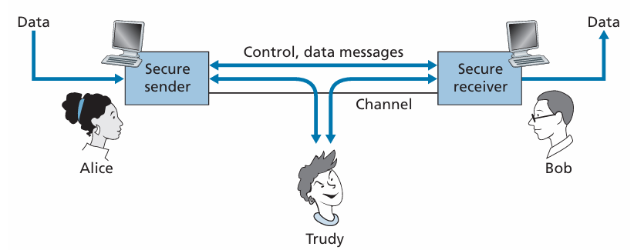
Information and actions an intruder can have access to
eavesdropping—sniffing and recording control and data messages on the channel.
modification, insertion, or deletion of messages or message content.

Slide 10
1. Principles of cryptography
Cryptographic techniques allow a sender to disguise data so that an intruder can gain no information from the intercepted data. The receiver, of course, must be able to recover the original data from the disguised data.
cryptographic techniques are inextricably woven into authentication, message integrity, nonrepudiation, and more.

Slide 11
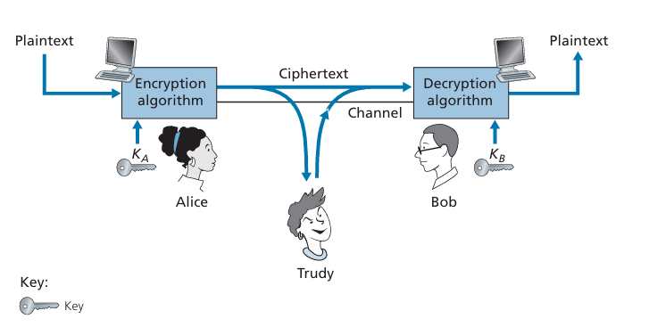

Cryptographic expressions
Plaintext or cleartext: “Bob, I love you. Alice”
Alice encrypts the plaintext using an encryption algorithm.
the encrypted plaintext is called the ciphertext.
The ciphertext will look unintelligible to any intruder.
In the figure Alice provides a key say $K_{A}$ which is a string of numbers and characters. She gives the plaintext $M$ and $K_{A}$ to the encryption algorithm as inputs and the algorithm returns the ciphertext $K_{A}(M)$ which is the plaintext encrypted by $K_{A}$. Bob also provides a decryption key say $K_{B}$ and gives the ciphertext $K_{A}(M)$ and $K_{B}$ as inputs to the decryption algorithm which produces the original plaintext which is $K_{B}\left(K_{A}\left(M\right)\right)=M$. In symmetric key systems, Alice’s and Bob’s keys are identical and are secret. In public key systems, a pair of keys is used. One of the keys is known to both Bob and Alice (indeed, it is known to the whole world). The other key is known only by either Bob or Alice (but not both).

Slide 12
Symmetric Key Cryptography
Caeser Cipher
Monoalphabetic Cipher
polyalphabetic Encryption
Block Ciphers
Cipher Block-Chaining

Slide 13
Caeser cipher
A very old and simple symmetric key algorithm attributed to Julius Caeser
For English text, the Caesar cipher would work by taking each letter in the plain text message and substituting the letter that is k letters later (allowing wraparound; that is, having the letter z followed by the letter a) in the alphabet. In this encryption method k is the serves as the key.
EXAMPLE k = 3
plaintext: “bob, I love you. Alice” becomes ciphertext: “ere, l oryh brx. dolfh”
It wouldn’t take long to break the code if you know the Caeser cipher was being used, as there are only 25 possible key values.

Slide 14
Monoalphabetic cipher
An improvement on the Caesar cipher
also substitutes one letter of the alphabet with another letter of the alphabet. However, rather than substituting according to a regular pattern (e.g., substitution with an offset of k for all letters), any letter can be substituted for any other letter, as long as each letter has a unique substitute letter, and vice versa.
EXAMPLE
plaintext: “bob, I love you. Alice” becomes ciphertext: “nkn, s gktc wky. Mgsbc”
However, by statistical analysis of the plain text the code can be broken easily.

Slide 15
Polyalphabetic cipher
Five hundred years ago, techniques improving on monoalphabetic encryption, known as polyalphabetic encryption, were invented. The idea behind polyalphabetic encryption is to use multiple monoalphabetic ciphers, with a specific monoalphabetic cipher to encode a letter in a specific position in the plaintext message. Thus, the same letter, appearing in different positions in the plaintext message, might be encoded differently.

Slide 16

EXAMPLE
It has two Caesar ciphers (with k = 5 and k = 19), shown as rows. We might choose to use these two Caesar ciphers, C1 and C2, in the repeating pattern C1, C2, C2, C1, C2. That is, the first letter of plaintext is to be encoded using C1, the second and third using C2, the fourth using C1, and the fifth using C2. The pattern then repeats, with the sixth letter being encoded using C1, the seventh with C2, and so on. The plaintext message “bob, i love you.” is thus encrypted “ghu, n etox dhz.” Note that the first b in the plaintext message is encrypted using C1, while the second b is encrypted using C2. In this example, the encryption and decryption “key” is the knowledge of the two Caesar keys (k = 5, k = 19) and the pattern C1, C2, C2, C1, C2.

Slide 17
Block ciphers
In a block cipher, the message to be encrypted is processed in blocks of k bits. For example, if k = 64, then the message is broken into 64-bit blocks, and each block is encrypted independently. To encode a block, the cipher uses a one-to-one mapping to map the k-bit block of cleartext to a k-bit block of ciphertext

Slide 18
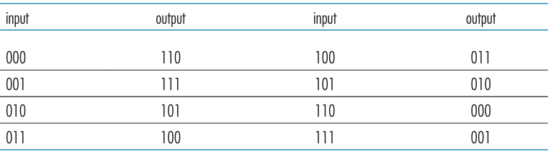
EXAMPLE
Suppose that k = 3, so that the block cipher maps 3-bit inputs (cleartext) to 3-bit outputs (ciphertext). One possible mapping is given below. Notice that this is a one-to-one mapping; that is, there is a different output for each input. This block cipher breaks the message up into 3-bit blocks and encrypts each block according to the mapping. Using this mapping the message 010110001111 gets encrypted into 101000111001.

Slide 19

Problems and limits of full table block ciphers
for small k like the previous example the number of total inputs is $2^{3}$ = 8 so the number of all possible mappings is 8! = 40320 which using a normal PC and lunching a brute-force algorithm the ciphertext can be broken easily.
So should we use a value of K that is big? Like k = 64 ?

Slide 20
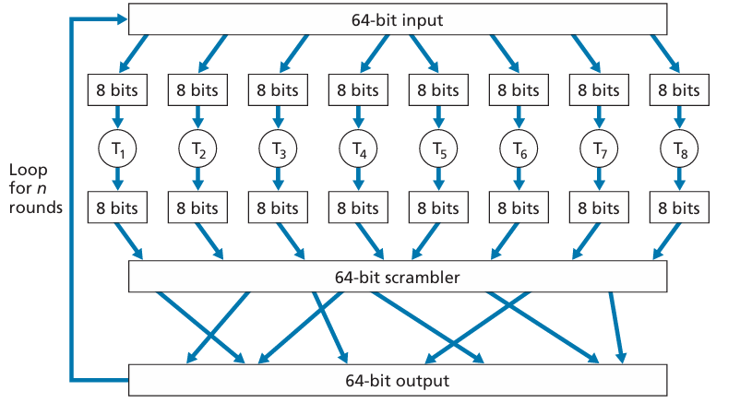
THE typical and Alternative approach
block ciphers typically use functions that simulate randomly permuted tables.

Slide 21
Cipher block chaining
In computer networking applications, we typically need to encrypt long messages or long streams of data. If we apply a block cipher as described by simply chopping up the message into k-bit blocks and independently encrypting each block, a subtle but important problem occurs. To see this, observe that two or more of the cleartext blocks can be identical. For example, the cleartext in two or more blocks could be “HTTP/1.1”. For these identical blocks, a block cipher would, of course, produce the same ciphertext. An attacker could potentially guess the cleartext when it sees identical ciphertext blocks and may even be able to decrypt the entire message by identifying identical ciphertext blocks and using knowledge about the underlying protocol structure

Slide 22

Add some randomness !!
M(i): ith plaintext block C(i): ith ciphertext block a xor b: Exclusive-OR (XOR)
$K_{s}$: the encryption algorithm with key S
The sender creates a random k-bit number say R(i) and then calculates
M(i) xor R(i) then encrypts it using $K_{s}$, C(i) = $K_{s}\left(\text{M}\text{(}\text{i}\text{) }\text{xor} \text{R}\text{(}\text{i}\text{)}\right).$ The sender then sends C(1) R(1) C(2) R(2) C(3) R(3) … . the receiver then recovers the original blocks by computing M(i) = ($K_{s}(\text{C}\text{(}\text{i}\text{)}\text{)}$) xor R(i) .
Is it good enough?

Slide 23

even better !!
Before encrypting the message (or the stream of data), the sender generates a random k-bit string, called the Initialization Vector (IV). Denote this initialization vector by C(0). The sender sends the IV to the receiver in cleartext.
For the first block, the sender calculates M(1) xor C(0), that is, calculates the exclusive-or of the first block of cleartext with the IV. It then runs the result through the block-cipher algorithm to get the corresponding ciphertext block; that is, C(1) = $K_{s}(\text{M}\text{(}\text{1}\text{)}$xor C(0)). The sender sends the encrypted block C(1) to the receiver.
For the ith block, the sender generates the ith ciphertext block from c(i) = $K_{s}(\text{M}\text{(}\text{i}\text{)}$xor C(i-1)).

Slide 24
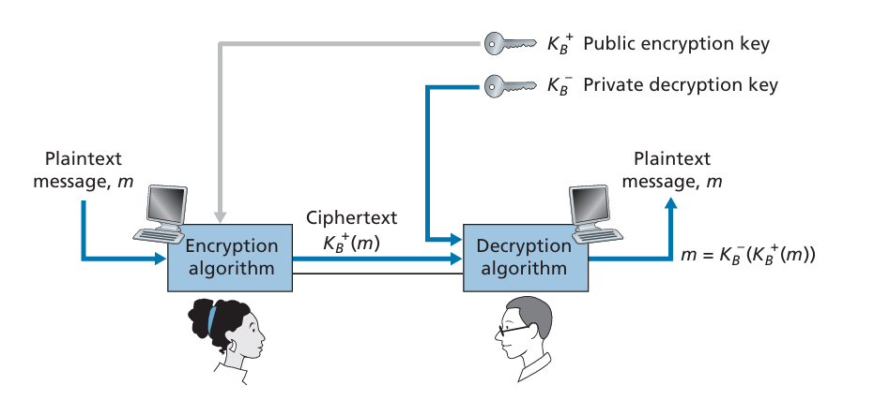

Public key encryption
Bob has two keys : $K_{B}^{+}$ (public key) and $K_{B}^{−}$ (public key)
Alice encrypts the message using Bob’s public key $K_{B}^{+}$(M)
Bob decrypts the message using his private key $K_{B}^{−}$ $K_{B}^{−}$($K_{B}^{+}$(M)) = M
There are encryption/decryption algorithms and techniques for choosing public and private keys such that:
$K_{B}^{−}$($K_{B}^{+}$(M)) = M
But a problem would arise !! THE NEED FOR DIGITAL SIGNATURE BECOMES CRUCIAL

Slide 25

RSA Obeying PUBLIC ENCRYPTION KEY
Choose two large prime numbers, p and q.
Compute n = pq and z = (p - 1)(q - 1).
Choose a number, e (used for encryption), less than n that is relatively prime to z.
Find a number, d (used for decryption), such that ed mod z = 1
$K_{B}^{+}$ = ( n , e ) is the public key and $K_{B}^{−}$ = ( n , d )
How does it work?
Suppose m is the number of the bit string to be transmitted (with m < n).
Alice Computes c = $m^{e}$ mod n and sends it to Bob.
Then bob decrypts the message using the property $m^{ed}$ mod n = $m^{\text{(}\text{ed} \text{mod} \text{z}\text{)}}$ mod n
m = $c^{d}$ mod n = $m^{ed}$ mod n = $m^{\text{(}\text{ed} \text{mod} \text{z}\text{)}}$ mod n = m mod n = m

Slide 26
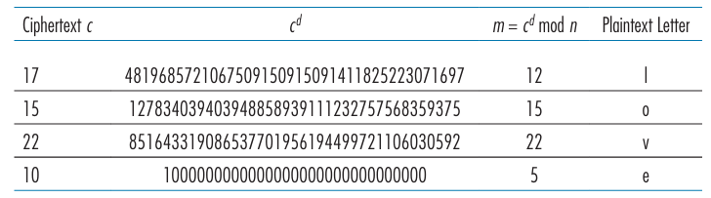

Session keys
We note here that the exponentiation required by RSA is a rather time-consuming process. As a result, RSA is often used in practice in combination with symmetric key cryptography. For example, if Alice wants to send Bob a large amount of encrypted data, she could do the following. First Alice chooses a key that will be used to encode the data itself; this key is referred to as a session key, and is denoted by $K_{S}$. Alice must inform Bob of the session key, since this is the shared symmetric key they will use with a symmetric key cipher (e.g., with DES or AES). Alice encrypts the session key using Bob’s public key, that is, computes C = ${\text{(}K_{S}\text{)}}^{e}$ mod n. Bob receives the RSA-encrypted session key, c, and decrypts it to obtain the session key, $K_{S}$. Bob now knows the session key that Alice will use for her encrypted data transfer.
Bob’s RSA decryption, d = 29, n = 35

Slide 27
3. Message Integrity and Digital Signatures
We define the message integrity problem using, once again, Alice and Bob. Suppose Bob receives a message (which may be encrypted or may be in plaintext) and he believes this message was sent by Alice. To authenticate this message, Bob needs to verify:
The message indeed originated from Alice.
The message was not tampered with on its way to Bob.

Slide 28
Message Authentication Code
The first approach:
Alice creates message m and calculates the hash H(m) (for example, with SHA-1).
Alice then appends H(m) to the message m, creating an extended message (m, H(m)), and sends the extended message to Bob.
Bob receives an extended message (m, h) and calculates H(m). If H(m) = h, Bob concludes that everything is fine.
What’s wrong with this approach?

Slide 29
Alternative approach
To perform message integrity, in addition to using cryptographic hash functions, Alice and Bob will need a shared secret s. This shared secret, which is nothing more than a string of bits, is called the authentication key. Using this shared secret, message integrity can be performed as follows:
Alice creates message m, concatenates s with m to create m + s, and calculates the hash H(m + s) (for example, with SHA-1). H(m + s) is called the message authentication code (MAC).
Alice then appends the MAC to the message m, creating an extended message (m, H(m + s)), and sends the extended message to Bob.
Bob receives an extended message (m, h) and knowing s, calculates the MAC H(m + s). If H(m + s) = h, Bob concludes that everything is fine.

Slide 30
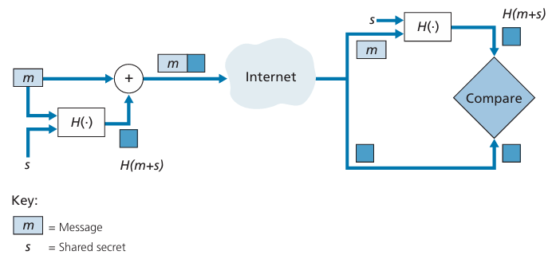
As you might expect, a number of different standards for MACs have been pro posed over the years. The most popular standard today is HMAC, which can be used either with MD5 or SHA-1. HMAC actually runs data and the authentication key through the hash function twice

Slide 31
Digital signatures
In a digital world, one often wants to indicate the owner or creator of a document, or to signify one’s agreement with a document’s content. A digital signature is a cryptographic technique for achieving these goals in a digital world.
How do we design a digital signature scheme? Is MAC a good choice?
What about public key encryption?

Slide 32
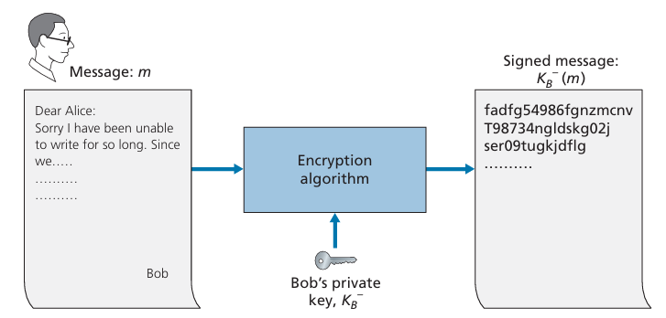

Does the digital signature $K_{B}^{−}$(m) meet our requirements of being verifiable and nonforgeable? Suppose Alice has m and $K_{B}^{−}$(m). She wants to prove in court (being litigious) that Bob had indeed signed the document and was the only person who could have possibly signed the document. Alice takes Bob’s public key, $K_{B}^{+}$, and applies it to the digital signature, $K_{B}^{−}$(m) , associated with the document, m. That is, she computes $K_{B}^{+}$($K_{B}^{−}$(m)), and voilà, with a dramatic flurry, she produces m, which exactly matches the original document! Alice then argues that only Bob could have signed the document, for the following reasons:

Slide 33

Whoever signed the message must have used the private key, $K_{B}^{−}$ , in computing the signature $K_{B}^{−}$ , such that $K_{B}^{+}$($K_{B}^{−}$(m)) = m.
The only person who could have known the private key, $K_{B}^{−}$, is Bob. Recall from our discussion of RSA that knowing the public key, $K_{B}^{+}$, is of no help in learning the private key, $K_{B}^{−}$. Therefore, the only person who could know $K_{B}^{−}$ is the person who generated the pair of keys, ($K_{B}^{+}$ , $K_{B}^{−}$), in the first place, Bob. (Note that this assumes, though, that Bob has not given $K_{B}^{−}$ to anyone, nor has anyone stolen $K_{B}^{−}$ from Bob.)

Slide 34
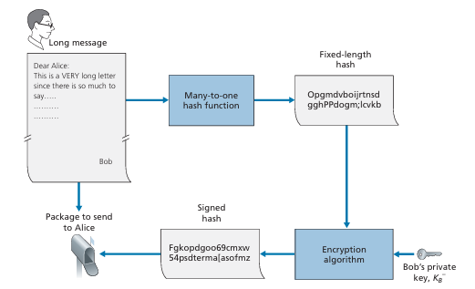
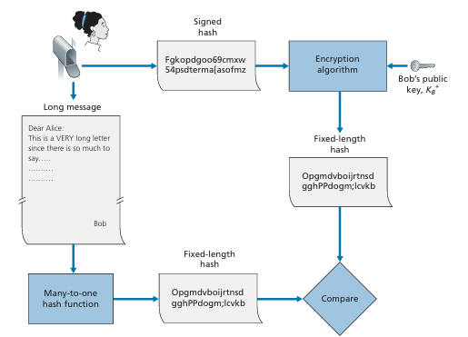
One concern with signing data by encryption is that encryption and decryption are computationally expensive. Given the overheads of encryption and decryption, signing data via complete encryption/decryption can be overkill. A more efficient approach is to introduce hash functions into the digital signature.

Slide 35
Public key certification
An important application of digital signatures is public key certification, that is, certifying that a public key belongs to a specific entity. Public key certification is used in many popular secure networking protocols like TLS.
AN EXAMPLE
Alice works in a pizza delivery business and accepts orders and processes them.
Bob is a pizza lover and orders his favorite pizza.
Trudy is the intruder which seems to be quite a clever one!!.

Slide 36
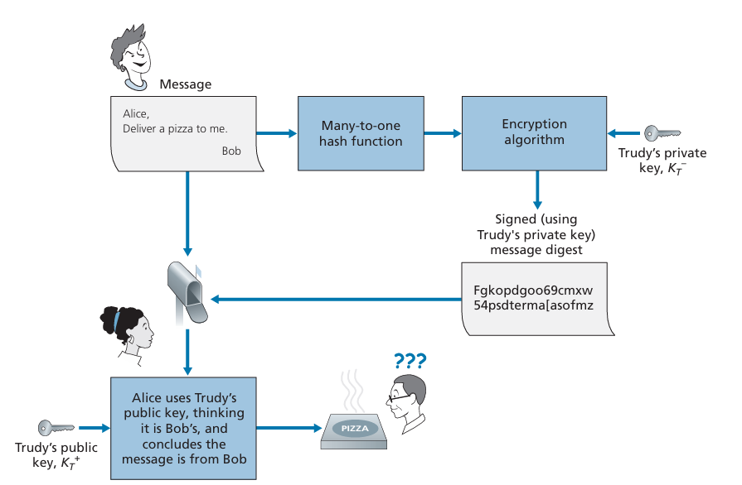

Slide 37
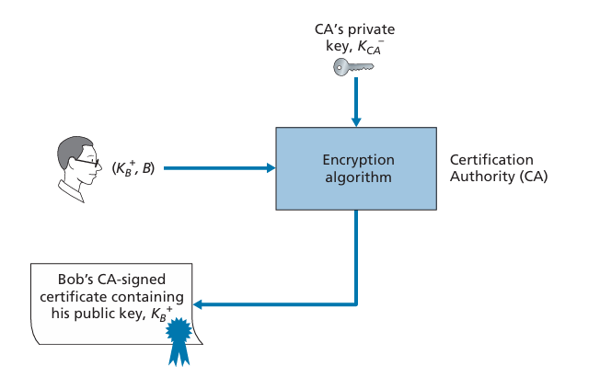
certification authority (CA)
Binding a public key to a particular entity is typically done by a Certification Authority (CA), whose job is to validate identities and issue certificates.
Once the CA verifies the identity of the entity, the CA creates a certificate that binds the public key of the entity to the identity. The certificate contains the public key and globally unique identifying information about the owner of the public key (for example, a human name or an IP address). The certificate is digitally signed by the CA.

Slide 38
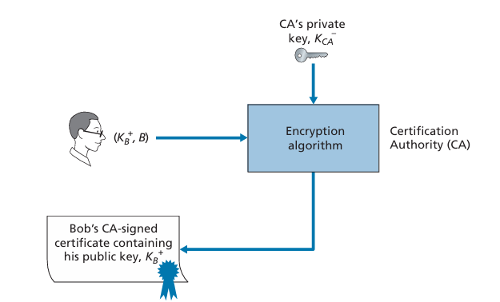
When Bob places his order he also sends his CA-signed certificate. Alice uses the CA’s public key to check the validity of Bob’s certificate and extract Bob’s public key.

