Slide 1

Object Oriented Analysis and Design
Introduction
August 15th, 2014
Department of Computer Engineering, KMITL
Dr. Akkarit Sangpetch & Dr. Orathai Sangpetch
Notes:
To replace this picture, just select and delete it. Then use the Insert Picture icon to replace it with one of your own!

Slide 2
About the Course
Design & Implement Robust, Extensible Software
Modularity
Extensibility
Robustness
Maintainability
Team development
Object Oriented Analysis & Design
This is NOT a programming course, but you are expected to be able to build software

Slide 3
Administration
LMS: https://canvas.instructure.com/enroll/NYAC6H
Register a Canvas account
Lectures, resources, grades, discussion boards
Classes/Quizzes starts at 9am / 1pm
Office hours
Monday 4-5pm @ ECC 901, or by appointment
Post your questions on Canvas discussion board
Instructors
Dr. Akkarit Sangpetch (ksakkari@kmitl.ac.th)
Dr. Orathai Sangpetch (kuoratha@kmitl.ac.th)

Slide 4
Textbooks
Primary Textbook (Required reading)
Booch, et.al. 2007. Object-Oriented Analysis and Design with Applications, Third Edition. Addison-Wesley. (Bible)
Recommended books
Gamma, Helm, Johnson, and Vlissides. 1995. Design Patterns: Elements of Reusable Object-Oriented Software. Addison-Wesley (Gang of Four)
McLaughlin, Pollice, West. 2006. Head First Object-Oriented Analysis and Design: A Brain Friendly Guide to OOA&D. O'Reilly (Head First)

Slide 5
Grading Criteria
2 Exams 40%
2 Quizzes 20%
Design & Implementation Project 40%
Scoring
≥ 90% → at least A
≥ 85% → at least B+
≥ 80% → at least B
≥ 75% → at least C+
≥ 70% → at least C
≥ 65% → at least D+
≥ 60% → at least D

Slide 6
Late Submission Policy
Late submission for project milestones, reports, presentations, deliverables will NOT be graded (i.e. get zero points for the work), unless both you AND your partner have university’s documented approval or medical statement
Plan your work wisely, and do the work early !!!

Slide 7
Academic Integrity
If you cheat on a quiz or an exam
For the first time, you’ll get zero points on the quiz or exam and will be reported to the department
For the second time, you’ll be reported and get an F for the course
This course will NOT be offered during Summer
For project submissions,
Copying your friends’ code partially or fully will result in an F
Copying code from the Internet without proper attribution will result in an F
Anything else that could considered plagiarism will get you zero or F
We don’t give permission for emergency drops

Slide 8
Class Project
One semester-long project
Group of two people
OO Analysis & Design a software system (of your choice)
Implement the software
Backend and Front-end (Web and Mobile)
Support multiple users & persistence
You’ll get a Microsoft Azure pass!

Slide 9
Possible Project Topics
Health app
Dietary Intake log
Daily Exercise log
Education
Real-time collaboration / editing
Social network / study group
Programming assignment grading
Online library book catalog
Financial
Personal banking / accounting
Stock analysis
Accessibilities
Text-to-speech book or sign reader
Personal assistant
Entertainment
Live content/event streaming
Online multi-player games
KMITL event bulletins
Any other ideas?
Come talk / email us

Slide 10
Project Registration
Project Registration due by Thu, Aug 21st
Group members (2 people per group)
Propose a project topic
If you haven’t registered by Aug 21st, you’ll be randomly assigned a partner and a topic

Slide 11
Inherent Complexity of Software
Industrial-strength software
Long life-span: Air traffic routing, hospital records, telecommunication network
Many users depends on it
Cannot be abruptly taken down without disrupting daily life
Difficult for a single developer to fully comprehend
Linux kernel 2.4 (2001) → 2.4 M lines of code
Linux kernel 3.6 (2012) → 15.9 M lines of code
How many lines of code have you ever written?
We can master complexity, but it will never go away

Slide 12
Why software is complex?
The complexity of the problem domain
Functional requirements: How does the system work?
Non-functional requirements: Usability, performance, cost, reliability
Requirement changes over time
System evolves
Maintenance: error correction
Evolution: changing requirement
Preservation: keep ancient software in operation
The complexity of managing development process
Millions line of code, Thousands of developers
Software engineering / management problem

Slide 13
Why software is complex? (cont)
The flexibility of development
Developer can use frameworks, libraries, or re-write existing functionalities
Behavior of discrete systems
Continuous system: small input changes → small output changes
Discrete system: small input changes → exponentially possible outputs

Slide 14
The Five Attributes of Complex System
Hierarchic Structure
A complex system is composed of interrelated subsystems that in turn have its own subsystems, until some lowest level of elementary components is reached.
Relative Primitives
The choice of which system’s components are primitive is relatively up to the observer of the system.
Separation of Concerns
Inter-component linkages have low frequency dynamics (inter-component behaviors don’t usually change)
Can study each part in relative isolation

Slide 15
The Five Attributes of Complex System (cont)
Common Patterns
Complex systems consists of a few kind of subsystems in different combinations
Small components can be re-use across the system
Stable Intermediate Form
A complex system that works always evolve from a simple system that works

Slide 16
Canonical Form of a Complex System
“Part of” hierarchy – Object structure
An aircraft can be decomposed to a propulsion system, a flight-control system, passenger cabin,…
“Is a” hierarchy – Class structure
A Dell Latitude E6530 is a laptop → E6530 is a specialization of a laptop
A laptop is a kind of personal computer → A personal computer is a generalization of a laptop

Slide 17
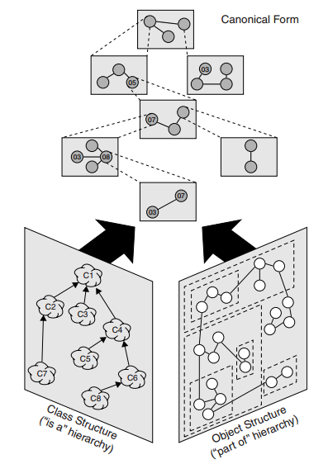
System Architecture
Class and Object structure are System Architecture
Each object represents an instance of a class
Class structure captures common properties in one place
Designing a system architecture = balancing system structures to take care of the needs of system users + satisfying the attributes of complex system
We (human) need to deal with complexity

Slide 18
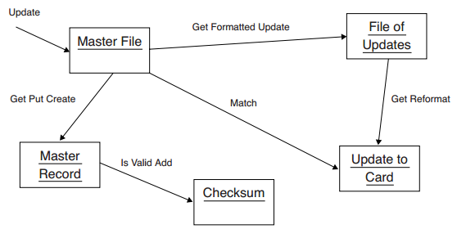
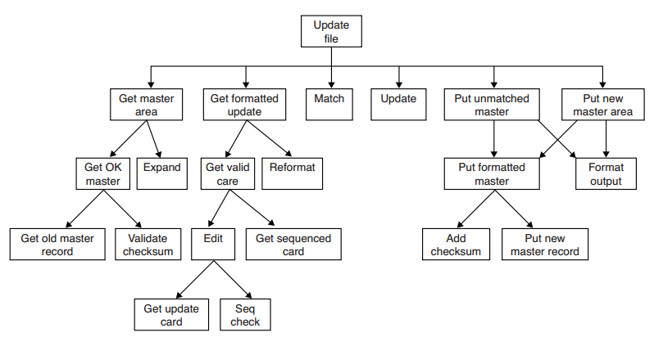
Decomposition
Algorithmic Decomposition
Object Oriented Decomposition
Top-down structured design
Systems are separated into multiple modules. Then we define the functionality of each module.
A set of collaborated autonomous agents (objects)
Objects do something when receiving messages

Slide 19
The Role of Abstraction
An individual can comprehend 7 ± 2 chunks of information at the same time
We cannot comprehend the entire system at once
Abstraction is a technique used to deal with complexity, by ignoring inessential details and dealing with a generalized or an ideal model of an object.
Focus only on the parts that matters
An object represents a dense, cohesive cluster of information

Slide 20
The Role of Hierarchy
Hierarchy helps us recognize related concepts
Object structure illustrates how objects interact with one another through patterns of interaction (also called mechanism)
Class structure highlights common structure and behavior within the system
Objects in the same class should have the same behaviors

Slide 21
Designing a Complex System
Purpose of design
Satisfies a given functional specification
Conforms to limitation of the target medium
Meets implicit/explicit requirements on performance and resource usage
Satisfies implicit or explicit design criteria on the form of the artifact
Satisfies restriction on the design process (length, cost, available tools)
“The purpose of design is to create a clean and relatively simple internal structure, sometimes also called an architecture”
Need to use multiple types of models to express the system

Slide 22
Elements of Software Design Methodologies
Notation: Language for expressing each model
Process: Activities leading to the construction of models
Tools: Artifacts that eliminate tedium and enforce the rules on the model to prevent inconsistency

Slide 23
Analysis & Design Methods
Top-down Structured Design
Also known as Composite Design
A program is a tree of subprograms
Each subprogram solves a smaller problem
Most popular and well-known, but usually breaks down for large system
Data-driven Design
Derive system structure by mapping system inputs to outputs
Each component represents an intermediate transformation of the input
Object-Oriented Design
Models software systems as collections of co-operating objects
Each object is an instance of a class within a hierarchy of classes
An object represents both behaviors (processes) and states (data)
Notes:
Compared to traditional design, we may have ER (Entity Relationship) diagram for data and then flow-chart for workflow.
With OOAD, each object contains both behavior and state and must considered

Slide 24
Is there a best design method?
No, but OOAD gives you
Software that is resilience to change
Software written with economy of expression (reusability)
Better correctness by separating the software’s state spaces
Reduce inherent risks in complex systems

Slide 25
The Evolution of the Object Model
Software engineering trends
The shift from programming-in-the-small to programming-in-the-large
The evolution of high-order programming languages
Growth of development team (a single coder to geo-distributed teams of developers)
Growth in complexity of software
Need programming languages with more expressive power (can do more with less code)

Slide 26
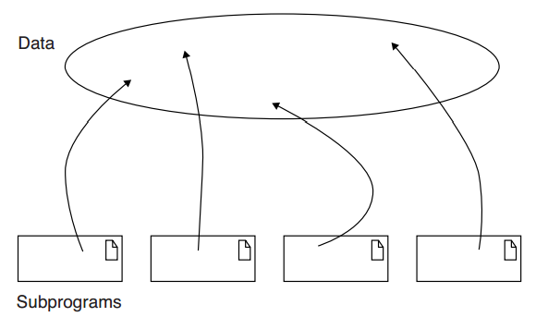
First-generation Languages (1954-1958)
Scientific and engineering, entirely for mathematics (Fortran I, ALGOL 58, Flowmatic, IPL V)
Global data and subprograms

Slide 27
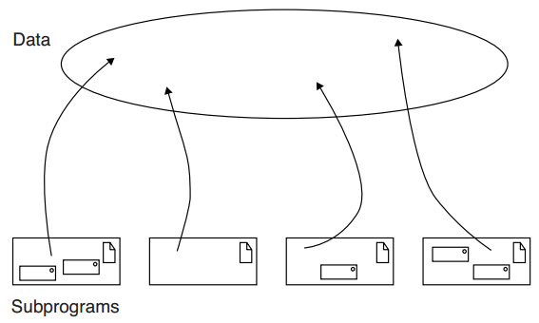
Second-generation Language (1959-1961)
Business applications (Fortan II, ALGOL 60, COBOL, Lisp)
Foundation of structured design and algorithmic decomposition
Subroutine, block and control structures, separate compilations, garbage collections, data types, scope and visibility

Slide 28
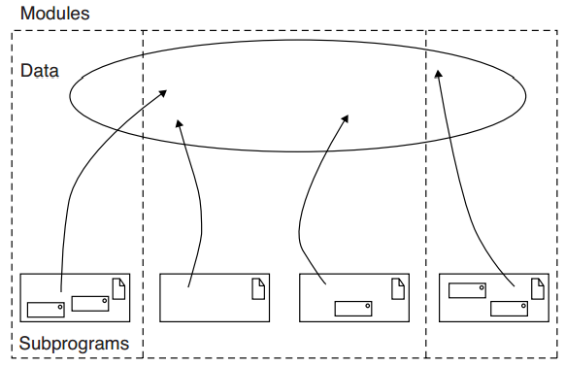
Third-generation Language (1962-1970) and the Generation Gap (1970-1980)
We had transistors! Larger problems and dataset (PL/1, ALGOL 68, Pascal, Simula)
Data abstractions, modular structure, recursion, typed-parameters but without consistency checks
Many languages proposed to address the limitations, only a few endures: C, Fortran 77

Slide 29
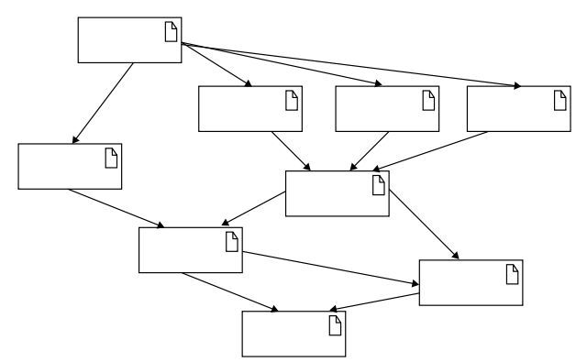
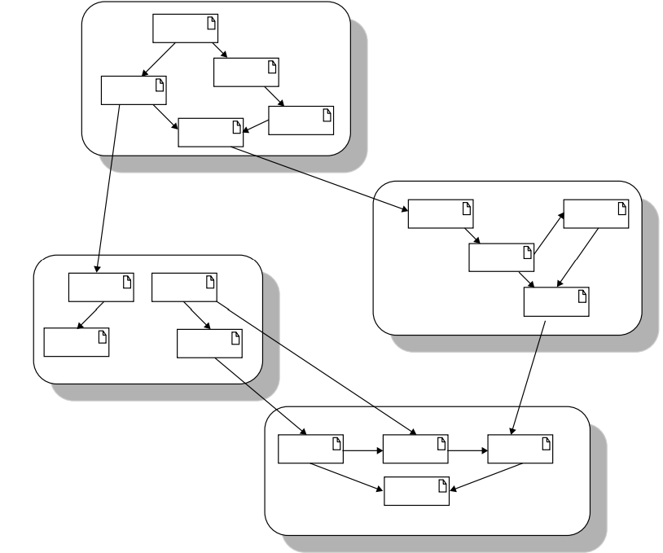
Object-Orientation boom (1980-1990) and the emergence of frameworks (1990-present)
Strong typing, OO-supported (Smalltalk 80, C++, Ada 83, Eiffel)
Revisions and standardization leads to programming frameworks (Visual Basic, Java/Java EE, Python, C#/.Net )
Graph structure, information hiding, no global data, classes and objects as building blocks

Slide 30
Object-Oriented Programming
“OOP is a method of implementation in which programs are organized as cooperative collections of objects, each of which represents an instance of some class, and whose classes are all members of a hierarchy of classes united via inheritance relationships”
OOP fundamentals
Uses objects (not algorithm) as its building blocks -“part of” hierarchy
Each object is an instance of some class
Classes are related via inheritance relationships - “is a” hierarchy

Slide 31
Object-Oriented Languages
A language is object-oriented if and only if [Cardelli & Wagner‘85]
It supports objects that are data abstractions with an interface of named operations and a hidden local state.
Objects have an associated class.
Classes may inherit attributes from superclasses.
Examples
Smalltalk, Object Pascal, C++, C#, Java, Python, PHP, …

Slide 32
Object-Oriented Design [Booch’07]
Object-oriented design is a method of design encompassing the process of object-oriented decomposition and a notation for depicting both logical and physical as well as static and dynamic models of the system under design
Object-Oriented Design
Leads to an object-oriented decomposition
Uses different notations to express different models of the logical (class & object structure) and physical design (module & process architecture) of a system, in addition to the static and dynamic aspects of the system
Comparing to structured design
OOD uses class and object abstraction to describe the system
Structured design uses algorithmic abstraction to describe the system

Slide 33
Object-Oriented Analysis
Object-Oriented Analysis is a method of analysis that examine requirements from the perspective of the classes and objects found in the vocabulary of the problem domain.
OOA emphasizes the building of real-world models using an object-oriented view of the world

Slide 34
Reminders
No class next week!
Next class will be on Aug 29th
Reading: Booch, Chapter 1-3
Project Registration due by Thu, Aug 21st
http://goo.gl/hCkNux
Group members
Propose a project topic
If you haven’t registered by Aug 21st, you’ll be randomly assigned a partner and a topic
You’ll design (use UML notation) and implement your project using OO languages

