Slide 1

Object Oriented Analysis and Design
Fundamental of Object-Oriented Programming
August 29th, 2014
Department of Computer Engineering, KMITL
Dr. Akkarit Sangpetch & Dr. Orathai Sangpetch

Slide 2
Announcement
Change the office hour
Friday 4-5 pm @ ECC 901
If your name for the Canvas account is in Thai, please change it to English!

Slide 3
What’ll we cover today?
Fundamental of Object-Oriented Programming (Chapter 2, 3)
Object Model
Objects
Classes and Class hierarchies
Methods/Operations
Inheritance
OO Analysis (Chapter 4)
Domain Analysis
Use Case Analysis
Structured Analysis

Slide 4
The Object Model
Major elements (a model is not an OO model without these elements)
Abstraction
Encapsulation
Modularity
Hierarchy
Minor elements (useful, but not essential)
Typing
Concurrency
Persistence

Slide 5
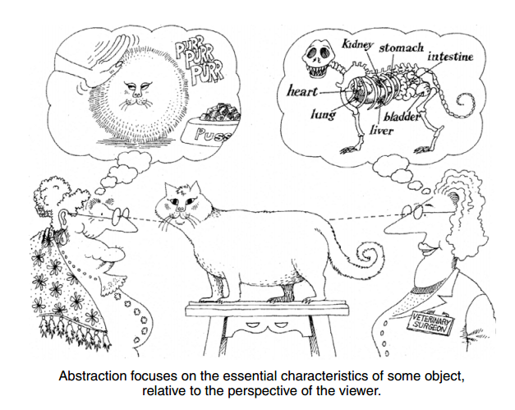
Abstraction
An abstraction denotes the essential characteristics of an object that distinguish it from all other kinds of objects and thus provide crisply defined conceptual boundaries, relative to the perspective of the viewer.
An abstraction focuses on the outside view of an object (aka. interface)
Behavior, not implementation
During analysis, we need to find the right set of abstraction for a given domain
We’ll implement the abstraction using classes & interfaces

Slide 6
Abstraction and Related Concepts
A client is an object that uses the resources of another object (a server, which provides services)
Contract model of programming: characterize object behavior by considering
The services provided to another object
The operations performed on another object
A protocol is a set of operations (including arguments & return types) + ordering in which they may be invoked
An invariant is some truth that must be preserved as part of the contract
Preconditions = invariants assumed by an operation
Postconditions = invariants satisfied by the operation
An exception indicates that some invariant has not been satisfied
Operation (Ada) = Method (Smalltalk/Java) = Member Function (C++)

Slide 7
Examples of Abstraction
We want to implement a control system for an automated gardener to carry out growing plans for the production of multiple crops in a greenhouse environment.
Abstraction: Growing Plan
Important Characteristics: name
Responsibilities: establish plan modify plan clear plan
Abstraction: Active Temperature Sensor
Important Characteristics: temperature location setpoint
Responsibilities: report current temperature calibrate establish setpoint
Related Candidate Abstractions: Crop, Conditions, Plan Controller

Slide 8
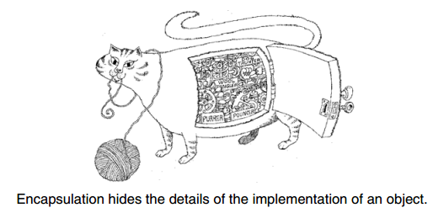
Encapsulation
Encapsulation is the process of compartmentalizing the elements of an abstraction that constitute its structure and behavior
Encapsulation serves to separate the contractual interface of an abstraction and its implementation

Slide 9
Examples of Encapsulation
Abstraction: Heater
Important Characteristics: location status
Responsibilities: turn on turn off provide status
Clients can only turn on/off, or ask for the heater’s status
Clients don’t care how the heater was implemented.
Can change internal implementation of Heater without affecting Clients
Related Candidate Abstractions: Heater Controller, Temperature Sensor

Slide 10
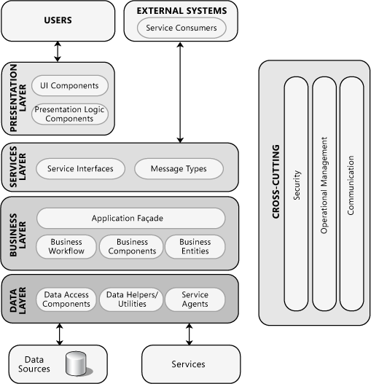
Separation of Concerns
Separate the abstractions for different area of concerns.
Heater controllers collaborate with a temperature sensors and heaters to control the heater.
Heater Controller
Temperature Sensor
Heater

Slide 11
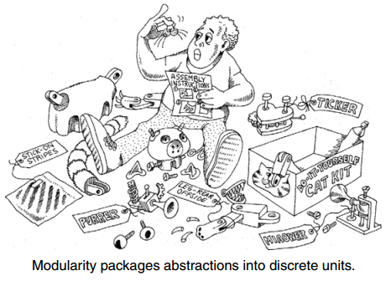
Modularity
Modularity is the property of a system that has been decomposed into a set of cohesive and loosely coupled modules.
Example
A module which collects all of the classes associated with individual growing plans (e.g, FruitGrowingPlan, GrainGrowingPlan)

Slide 12
Hierarchy
Hierarchy is a ranking or ordering of abstractions
Important hierarchies
Class structure (“is a” hierarchy)
Object structure (“part of” hierarchy)
Example:
Single inheritance
GrainGrowingPlan is a kind of GrowingPlan
Multiple inheritance
Rose is a Plant and a FlowerMixin
Aggregation
A Garden contains many Plant

Slide 13



Hierarchy: Single Inheritance
“is a” relationship
Each subclass has exactly one superclass
A Bear is a kind of Mammal
Bear inherits from Mammal
A bear is a specialization (subclass) of mammal
A mammal is a generalization (superclass) of a bear
Other examples
Quicksort is a …… of SortingAlgorithm
GrowingPlan is a ….. of CropGrowingPlan
ArrayList is a ….. of Collection
Mammal
Fox
Bear

Slide 14
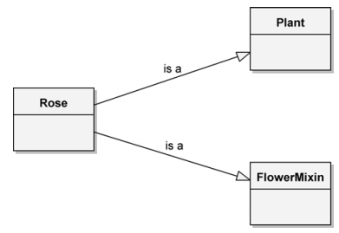
Hierarchy: Multiple Inheritance
Also “is-a” hierarchy
Each subclass has more than one superclass
A subclass contains properties and behaviors from all of its superclasses
A Rose is
A kind of Plant
A kind of FlowerMixin

Slide 15
Hierarchy: Aggregation
“part-of” hierarchy
A garden consists of a collection of plants together with a growing plan
Plants are part of the garden
Ownership issues
The plants may exist without a garden → independent
A GrowingPlan does not exist without a garden -> containment

Slide 16
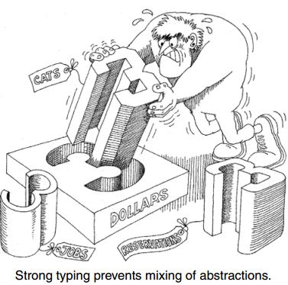
Typing
Typing is the enforcement of the class of an object, such that objects of different types may not be interchanged, or at the most, they may be interchanged only in very restricted ways.
Strong & Weak typing
Strong typing: Cannot call operations on an object unless its signature is defined in the object’s class or super class
Type consistency
Dynamic & Static typing
Static typing (static/early binding) types of all variables and expressions can be determined at compile time
Dynamic typing (late binding) variable types are not known until runtime
Example - Strong & Dynamic Typing: C++, Java

Slide 17
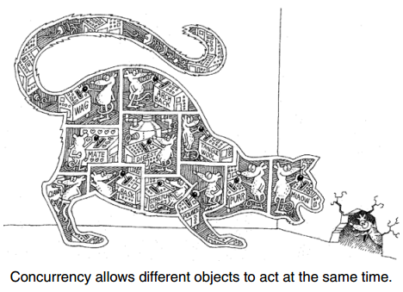
Concurrency
Concurrency is the property that distinguishes an active object from one that is not active
Each object may represent a separate thread of control (active)
Focus on process abstraction and synchronization
Dealing with concurrency
Intrinsic feature of certain programming languages
Use class library to implement lightweight processes
Use interrupts to give the illusion of concurrency

Slide 18
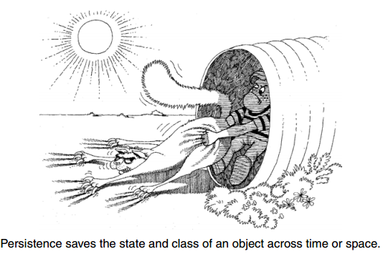
Persistence
Persistence is the property of an object through which its existence transcends time (i.e., the object continues to exist after its creator ceases to exist) and/or space (i.e., the object’s location moves from the address space in which it was created).
An object takes up some amount of space and exists for some amount of time
Transient results in an expression
Local variables in procedure
Global variables and heap items
Data that exists between executions of a program
Data that exists between different versions of a program
Data that outlives the program

Slide 19
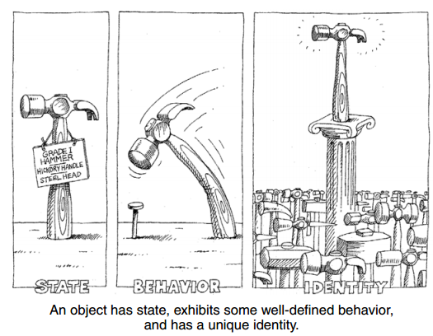
Object
An object is an entity that has
State
Behavior
Identity
The structure and behavior of similar objects are defined in their common class.
The terms instance and object are interchangeable

Slide 20
State
“The state of an object encompasses all of the (usually static) properties of the object plus the current (usually dynamic) values of each of these properties”
Example: vending machine
Static property – can accept the money (essential/fundamental characteristic)
Dynamic property – the actual quantity of money accepted at any given moment
All objects within a system encapsulate some state and that all of the state within a system is encapsulated by objects.
Encapsulating the state of an object is a start, but it is not enough to allow us to capture the full intent of the abstraction
The state of an object represents the cumulative results of its behavior.

Slide 21
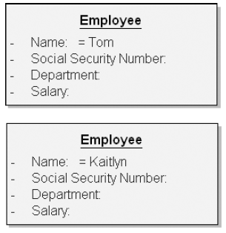
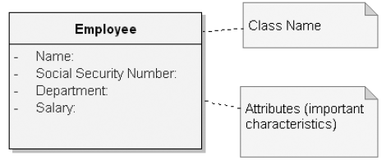
Example: State of an Object
It is good engineering practice to encapsulate the state of an object rather than expose it.

Slide 22
Behavior
“Behavior is how an object acts and reacts, in terms of its state changes and message passing”
Examples
Java – method
C++ - function
Smalltalk – message passing
The terms operation and message are interchangeable.

Slide 23
Behavior: Operations
An operation denotes a service that a class offers to its clients
Modifier: an operation that alters the state of an object
Selector: an operation that accesses the state of an object but does not alter the state
Iterator: an operation that permits all parts of an object to be accessed in some well-defined order
Constructor: an operation that creates an object and/or initializes its state
Destructor: an operation that frees the state of an object and/or destroys the object itself

Slide 24
Behavior: Roles and Responsibilities
“The responsibilities of an object are all the services it provides for all of the contracts it supports”
The state and behavior of an object collectively define the roles that an object may play
The role that an object play in turn fulfills the abstraction’s responsibilities

Slide 25
Behavior: Objects as Machines
Each object is like a tiny machine
Behavior may be defined in an equivalent finite state machine
2 Types
Active object
Autonomous
Exhibit some behavior without being operated on by another object
Root of control
Passive object
Change a state only when explicitly acted on
Sequential system has only one active object. Other objects are passive
E.g. a main object responsible for managing an event loop that dispatches messages
Transaction processing system may have active objects distributed throughout the system’s passive objects

Slide 26
Identity
“Identity is that property of an object which distinguishes it from all other objects”
Examples
Programming languages use variable names to distinguish temporary objects, mixing addressability and identity.
Database systems use identifier keys to distinguish persistent objects, mixing data value and identity.

Slide 27
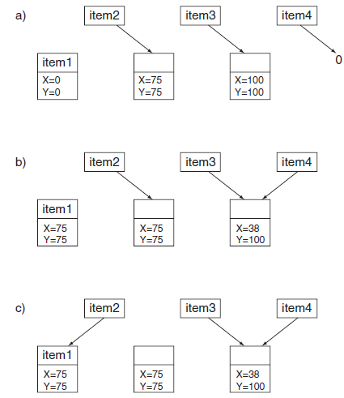
Example: Object Identity
Case B
item1, item2 have the same states but represent distinct objects
item3, item4 have structural sharing (aliases)
Can lead to memory leaks, memory access violation, unexpected state change, dangling reference
Case C
Change the value of the item2 pointer to point to item1
Memory leak
Identity of item2 is lost
Java & Smalltalk have garbage collection to reclaim the storage automatically
C++ cannot reclaim the storage until the program that created it finishes

Slide 28
Object Relationship: Links
An object collaborates with one another thru links
Roles of objects in a link
Controller: This object (active object) can operate on other objects
Server: This object is only operated on by other objects
Proxy: This object can both operate on other objects and be operated on by other objects (a proxy is usually created to represent a real-world object)
Visibility
In order for object A to send a message to B, B must be visible to A
Not important during analysis, but required for design & implementation
What happen if B and A are on different machines?

Slide 29
Synchronization
When an object passes a message to another, the two objects are synchronized
Need to consider a link from an active to a passive object
Sequential: The semantics of the passive object are guaranteed only in the presence of a single active object at a time
Guarded: Guaranteed semantics with multiple threads, but active clients(controller) must collaborate for mutual exclusion
Concurrent: Guaranteed semantics with multiple threads, but the supplier(server) guarantees mutual exclusion

Slide 30
Aggregation
Links – peer-to-peer, client/server relationship
Aggregation – whole/part hierarchy
Can navigate from the whole (“the aggregate”) to its parts
An object that is a part of another object has a link to its aggregate
The aggregate may send messages to its parts
The parts can navigate to its enclosing object (“container” or aggregate) only if it keeps the container as a part of its state

Slide 31
Classes
A class is a set of objects that share a common structure, common behavior, and common semantics
A class represents an abstraction, the essence of an object
A single object is an instance of a class
A class with no instances are called an abstract class

Slide 32
Interface and Implementation
The interface provides the outside view of a class
Operations applicable to an instance of a class
Public: accessible to all clients
Protected: accessible only to the class and its subclasses
Private: accessible only to the class itself
Package: accessible only to classes in the same package (C++, Java, not PHP)
May include declaration of other classes, constants, variables, exceptions as needed to complete the abstraction
The implementation is the inside view of a class
Holds the secrets of the class’ behaviors
Consists of the implementation (code) of the operations defined in the interface

Slide 33
Class / Interface
public interface MovableItem { void move(int newX, int newY); }
class Rectangle implements MovableItem { int x,y; int getX() { return x; } int getY() { return x; } public void move(int newX, int newY) { …move the rectangle… } void draw() { …draw a rectangle… } }

Slide 34
Abstract Class
abstract class DisplayItem implements MovableItem { int x,y; abstract void draw(); public void move(int newX, int newY) { …move the object… } int getX() { return x; } int getY() { return x; } }

Slide 35
Subclass / Superclass
class Rectangle extends DisplayItem { public void move(int newX, int newY) { …move the rectangle… } void draw() { …draw a rectangle… } }

Slide 36
Class Relationships
Associations
Inheritance: Generalization / Specialization
Aggregation: Whole / part

Slide 37
Associations
Weak kind of relationships often found in early analysis and design
Usually refined into inheritance or aggregation later on
Semantic dependencies
Capture the participants in a semantic relationship, roles, and cardinality
Multiplicity
One-to-one
One-to-many
Many-to-many
Wheel
Vehicle
*
1

Slide 38
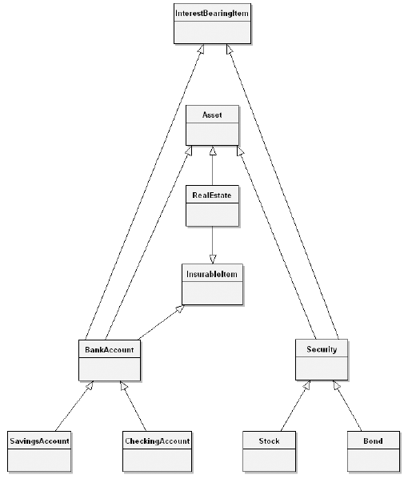
Inheritance
With inheritance, a subclass inherits the structure and behavior of its superclass
Single inheritance (C++, Java, PHP)
Each subclass has exactly one superclass
Multiple inheritance (C++)
Each subclass has more than one superclass
(alternative) use delegation instead. A delegator call a delegate to implement parts of its behaviors

Slide 39
Superclasses & Subclasses
A superclass is a class from which another class inherits
A subclass is a class that inherits from one or more classes
A subclass inherits the behavior from their superclasses
TelemetryData
# timestamp:
# id:
+ transmit()
+ currentTime()
ElectricalData
# fuelCell1Voltage:
# fuelCell2Voltage:
# fuelCell1Ampere:
# fuelCell2Ampere:
+ transmit()
+ currentPower()

Slide 40
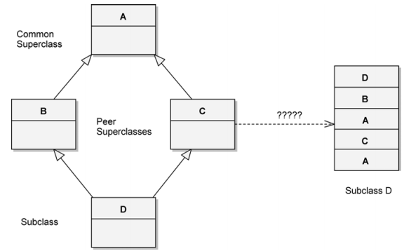
Problems with Multiple Inheritance
Issues
Name collisions are possible
Repeated inheritance
Shared properties or
Duplicate properties
Remedies
Use single inheritance with aggregation
Use mixins – combine little classes to build a class with more sophisticate behaviors
Traits (PHP)
Default methods (Java 8)

Slide 41
Polymorphism
A concept where a single name (such as a variable declaration) may denote instances of many different classes as long as they are still related by some common superclass
For example,
transmit() in TelemetryData may transmit the identifier of the data stream and timestamp
transmit() in ElectricalData may transmit its voltage and current values

Slide 42
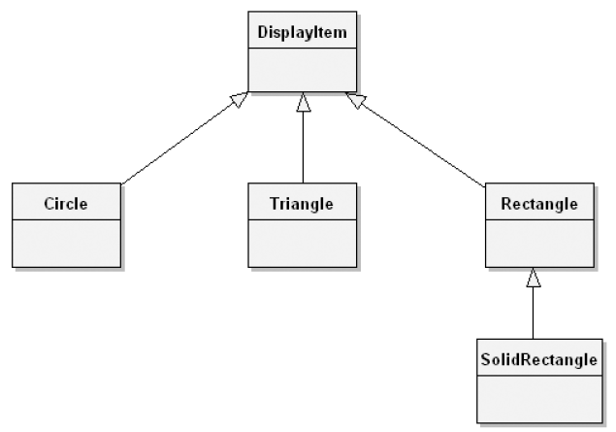
Polymorphism & Inheritance
Polymorphism exists when the features of dynamic typing and inheritance interact
For example,
DisplayItem may have the following operations
draw
move
location
DisplayItem x = new SolidRectangle(…)
DisplayItem y = new Circle(…)
x.draw()
y.draw()

Slide 43
Aggregation/Composition
Whole/part relationship (“part-of”)
A whole is made of its parts
Aggregation: The whole and its parts could be created/destroyed independently
Composition: The whole is solely responsible for the creation/destruction of its parts
Garden
Plant

Slide 44
Dependencies
An element depends on the element on the other end of the relationship
Change in one of the element could impact the other
Example: A Cart class depends on the Product class because the Cart uses the Product class as parameter for its add operation
Cart
Product

Slide 45
Choosing Operations
Functional semantics
Reusability
Complexity
Applicability
Implementation knowledge
Time and Space semantics
The amount of time and storage required to complete the operation: worst case (O), average case (Θ), best case (Ω)
Synchronization requirements

Slide 46
Choosing Relationship
Law of Demeter
The methods of a class should not depend in any way on the structure of any class, except the immediate (top-level) structure of their own class. Each method should send messages to object belonging to a very limited set of classes only
A method m of object o may only invoke the methods of the following objects
o itself
Parameters of m
Any objects created within m
o’s direct component objects
A global variable, accessible by o, in the scope of m
Mechanism and Visibility
Where does certain knowledge go?
In a manufacturing plant, materials (lots) enter a manufacturing cells to be processed. We have to notify the room’s manager
Is the entry of a lot into a room an operation on the lot? or on the room? Both?

Slide 47
Choosing Implementation
Representation
The representation should be encapsulated
Depends on the pattern of operations upon the data
Consider a class whose object denotes a set of flight-plan
Do we optimize it for fast searching?
Or optimize for fast insertion/deletion?
We can’t do both → families of classes with identical interfaces, different implementations
Should we compute the value of an object’s state or storing it in a field?
Packaging
Where to declare classes and objects?
Visibility and information hiding
Strives for cohesive, loosely coupled module

Slide 48
Quality of abstractions
Coupling
What is the strength of the association amongst different classes and objects?
Weakly coupled classes are desirable
Inheritance tightly couples superclass and subclass – exploit commonality
Cohesion
Do the elements inside the same class closely related?
Sufficiency
Does the class capture enough characteristics of the abstraction to permit meaningful and efficient interaction? – design a minimal interface
Completeness:
Does the interface capture all meaningful characteristics of the abstraction? – design a complete interface
Primitiveness
Does the operation can be implemented only by accessing the underlying implementation?
Can the operation be implemented on top of existing primitive operations, but at the cost of significantly more resource?

Slide 49
Object-oriented Analysis
Classical Analysis
Behavior Analysis
Domain Analysis
Use Case Analysis
Structured Analysis

Slide 50
Classical Approach
An approach proposes various sources of classes and objects, derived from the requirements of the problem domain or the principles of classical categorization
Sources of potential objects
Tangible things, roles, events, interactions, people, places, things, organizations, concepts, events, structure, devices, locations, organizational units

Slide 51
Behavior Analysis
Focus on dynamic behavior, system functions as the primary source of classes and objects
Conceptual clustering
Form classes based on groups of objects that exhibit similar behavior.
Example
Understanding what takes place in the system.
Assign these behaviors to parts of the system
Understand who initiates and who participates in these behaviors
Initiators and participants that play significant roles are recognized as objects, and are assigned the behavioral responsibilities for these roles

Slide 52
Domain Analysis
Identify the classes, objects, operations and relationships that are common to all applications within a given domain
Consulting with domain experts => users
Vertical domain analysis – applied across similar applications
Horizontal domain analysis – applied to related parts of the same application
Example: an accounting system
Understand the key abstractions and mechanisms that serve all the different kinds of reports.
The resulting classes and objects reflect a set of key abstractions and mechanisms generalized to the immediate report generation problem
the resulting design is likely to be simpler than if each report had been analyzed and designed separately

Slide 53
Use case analysis
Classical, behavior, domain analysis depend heavily on personal experiences. The process is neither deterministic nor predictably successful.
Use case analysis can be coupled with these three approaches.
A use case is “a behaviorally related sequence of transactions performed by an actor in a dialogue with the system to provide some measurable value to the actor”
Apply use case analysis as early as requirements analysis
When end users, other domain experts, and the development team enumerate the scenarios that are fundamental to the system’s operation.
Identify
The objects that participate in the scenario
The responsibilities of each object
The ways those objects collaborate with other objects, in terms of the operations each invokes on the other

Slide 54
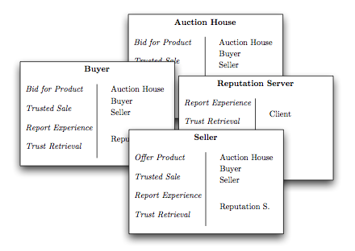
CRC Card
Class-responsibility-collaboration (CRC) card are brainstorming tools, originally developed for teaching OOP
Each card is a 3” x 5” (or 5” x 7”) index card which contains
The name of a class (on top)
Responsibilities (on one half of the card) – roles of the class
Collaborators (on second half of the card) –classes with which this class interacts to fulfill its responsibilities

Slide 55
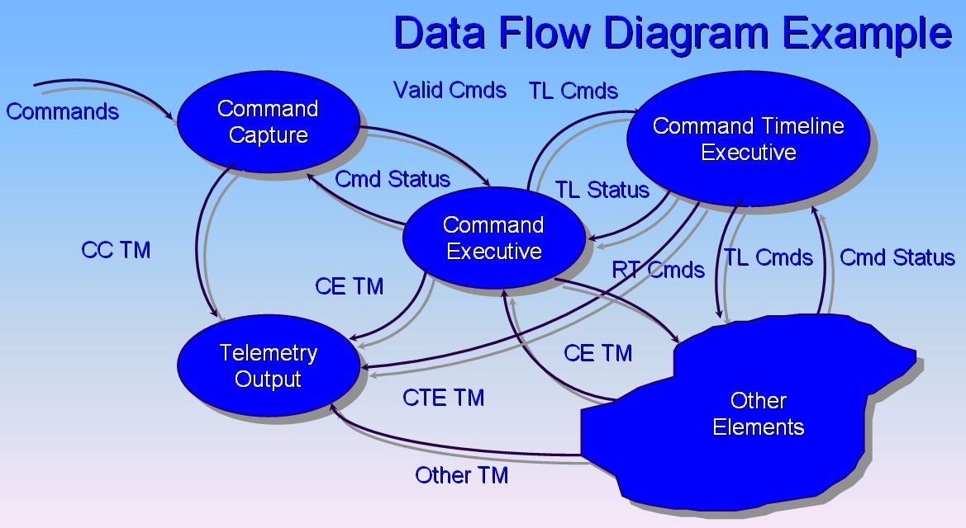
Structured Analysis
Describe data flow diagrams and the other products of structured analysis
Identify classes & objects in 3 ways
List candidate objects derived from the surrounding environment, the essential inputs and outputs, the products, services, and other resources managed by the system
Analyze individual data flow diagrams
Candidate object e.g. external entities, data stores, control stores, control transformations
Candidate classes e.g. data flows, control flows
Focus on the identification of central entities, which are similar in nature to central transforms in structured design => called Abstraction analysis (Difficult)
We discourage the use of structured analysis as a front end to object-oriented design.

Slide 56
Next week
Requirements
UML Notations (Booch, Chapter 5)

Slide 57
Reminder on Projects
Anyone still does NOT have a partner or have a project topic?
Project proposal document is due on September 4th by 6 pm !
Your proposal needs to have the following,
Selected topic
Group members
Abstract
Introduction & Motivation
Related work
Milestone 1: Requirements & Use Cases due on September 11th

