Slide 1

Object Oriented Analysis and Design
Requirement Gathering & UML
September 5th, 2014
Department of Computer Engineering, KMITL
Dr. Akkarit Sangpetch & Dr. Orathai Sangpetch

Slide 2
Reminder on Projects
Milestone 1: Requirements & Use Cases due 6 pm on September 11th
Proper language
If you decide to write the document in Thai, your entire doc has to be in Thai. If you have technical words in English, please translate it in Thai and put English words in parenthesis
What should be in your document?
At least 5 Functional requirements
At least 5 Non-functional requirements
At least 1 Use case diagram
Each project should have at least 4 use cases
Explain your use cases
Pick 2 use cases and write use case specifications
Pick other 2 use cases and write their activity diagrams
Submit it in your GitHub repository (doc/requirements.pdf or doc/requirements.md)

Slide 3
Great Software
Make sure your software does what the customers want it to do
Apply basic OO principles to add flexibility
Strive for a maintainable and reusable design
Great software, great design come from great designers, not from great tools!

Slide 4
Requirements
Specific things that your system has to do/work correctly
A requirements specification is a “logical” model of the system to be built
Scope
System objectives
It specifies what but not how.
Measurable criteria for success
Understandable by both the developer and the client
The basis for design

Slide 5
Typical Contents
Scope, goals, objectives
Data flows and a data model
An object model with interactions
Queries and other user interactions (use cases)
Interfaces w/ other systems
Sample reports and screen layouts
Performance parameters
Criteria for judging acceptable performance

Slide 6
Example: Chess Playing
Build a system to play chess with the user.
Provide a visual display of the chess board and the chess pieces.
Provide a simple means for the user to move her chess pieces.
Both the system and the user will be restricted to legal moves.
The system will recognize when a player has won.

Slide 7
Functional Requirements
“What the system is supposed to do, but not how to do it.”
Establish essential behaviors for any correct implementation (legal moves, etc.).
True for every implementation, on every machine, in every language, in any operating environment.
But there is more...

Slide 8
Nonfunctional Requirements
Operational properties of the delivered system.
Response time, ease of use, “ilities.”
Understandability, usability, modifiability, inter-operability, reliability, portability, dependability, flexibility, availability, maintainability, ..
Difficult to describe logically
Convenience, comfort, accuracy, precision, slim, performance
Difficult to check in advance of an implementation.
Every bit as important as functional requirements.

Slide 9
Eliciting Requirements
Interviews
Joint Application Design
Prototypes
Questionnaires
Observation
Sampling

Slide 10
Abstracting a Logical Model
Ignore how things are done; eliminate
how to perform a task
the data medium
duplication of data
temporary data storage
technology dependencies
Database schema
processes that could be changed without affecting the overall outcome
Focus on what it does
Roles & Responsibility
Relationships & Collaborators

Slide 11
Identifying Deficiencies
Where are the bottlenecks in the current system?
Where can inconsistencies occur?
Are there better processing schemes?
What new features?
Drop old features?
Document again.
Design new system.

Slide 12
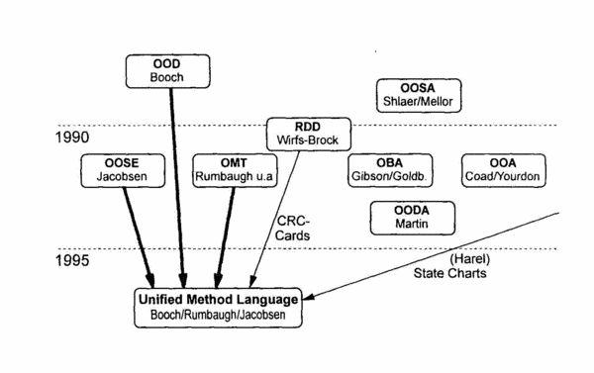
Unified Modeling Language (UML)
Unified development model from Booch (OOD), Jacobsen (OOSE) and Rumbaugh (OMT)
Primary modeling language used to analyze, specify, and design systems
Software systems
Business systems
Standardized by Object Management Group (OMG)
Each diagram represents a view of the system

Slide 13
Use of Diagrams
A notation is only a vehicle for capturing the reasoning about the behavior and architecture of a system; a notation is not an end in itself
It is dangerous to over-specify a set of requirements
Some diagrams are used only early in the development lifecycle. Some are used, at varying levels of detail, throughout the lifecycle.

Slide 14
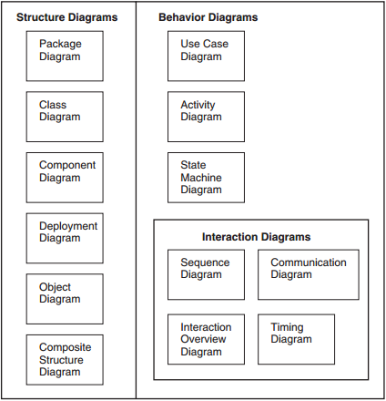
UML Diagrams

Slide 15
Use Cases
A use case represents a complete flow of activity of what the actor wants your system to do from the actor’s point of view that provides value to the actor
Represent what the actors want the system to do
Must be a complete flow of activity
Consider an ATM machine
Withdraw cash is a use case, which requires a lot of interaction
Swipe card
Enter Pin
Choose withdraw
Enter amount
Dispense money
… these interactions by themselves are NOT use cases

Slide 16
Success/Alternate Scenarios
A success scenario (or a primary scenario) is a flow of activity when the user gets what they want
Example use case: ATM Withdraw cash
A user can successfully withdraw cash without any problems
A user swipes ATM card
The user enters PIN
The user selects ‘withdraw cash’
The user enters amount of money
ATM gives cash to the user
Alternate scenarios (or secondary scenarios) deal with situations when we branch off the primary scenarios
Use case: ATM Withdraw cash
Condition triggered alternate scenario: The withdrawal amount entered is more than the daily limit
D1. The user enters an amount more than the daily limit
D2. The ATM system determines that the amount is more than the limit, and display the error message
D3. The user acknowledges the error message
D4. The system shows the screen to enter a different amount of money
D5. The primary scenario resumed at steps D
* During analysis, we must consider the success and alternate scenarios
* The amount of complex system functionality often found in alternate scenario

Slide 17
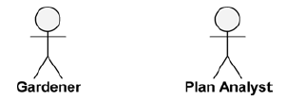
Use Case Diagram
Actor
Entities that interface with the system.
They can be people or other systems.
Use case
A use case must be a complete flow of activity, from the actor’s point of view, that provides value to the actor.
Each use case is a complete course of events in the system from a user’s perspective.
Manage Garden

Slide 18
Use Case Specification
Use case name
Use case purpose
Preconditions
Postconditions
Limitations
Assumptions
Primary Scenario
Alternate Scenario
Condition triggering an alternate scenario
Refer to Booch (p.377-387 for example)

Slide 19
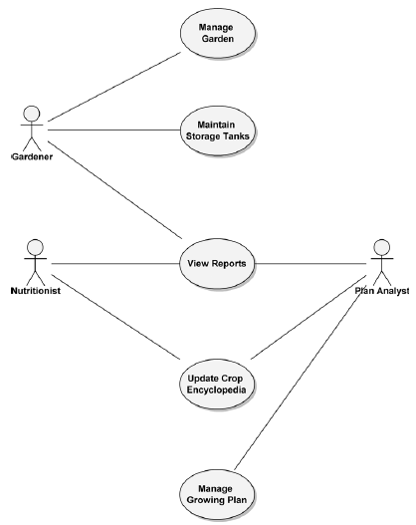
Example of a Use Case Specification & Diagram
Use case name: Maintain Storage Tanks
Use case purpose: This use case provides the ability to maintain the fill levels of the contents of the storage tanks. This use case allows the actor to maintain specific sets of water and nutrient tanks.
Primary Scenario:
Actor examines the levels of the storage tanks’ contents.
Actor determines that tanks need to be refilled.
Normal hydroponics system operation of storage tanks is suspended by the actor.
Actor selects tanks and sets fill levels. For each selected tank, steps E through G are performed.
If tank is heated, the system disables heaters.
Heaters reach safe temperature.
The system fills tank.
When tank is filled, if tank is heated, the system enables heaters.
Tank contents reach operating temperature.
Actor resumes normal hydroponics system operation.
Alternate Scenario:
Conditions triggering alternate flow:
Condition 1: There is insufficient material to fill tanks to the levels specified by the actor.
D1. Alert actor regarding insufficient material available to meet tank setting. Show amount of material available.
D2. Prompt actor to choose to end maintenance or reset fill levels.
D3. If reset chosen, perform step D.
D4. If end maintenance chosen, perform step H.
D5. Else, perform step D2.

Slide 20
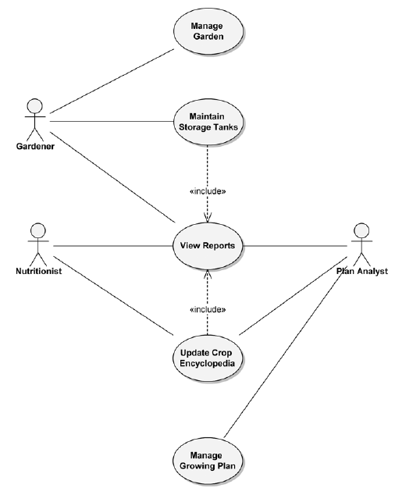
Use Case Diagram with <<include>> Relationship
The inclusion point specifies where, in the flow of the including use case, the included use case is to be executed
Mandatory (Must include)
Update Crop Encyclopedia would not be considered complete without View Reports.

Slide 21
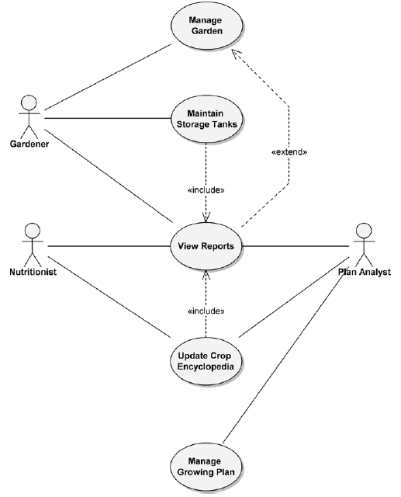
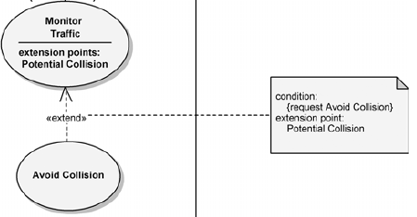
Use Case Diagram with <<extend>> Relationship
Certain activities might be performed as part of the use case but are not mandatory for that use case to run successfully
Optional (could extend) relationship
Note the direction of the arrow (compared to include)
View Reports is not required when Manage Garden is run.
Manage Garden is complete in and of itself
The Monitor Traffic use case may request the functionalities of the Avoid Collision use case at the Potential Collision extension points

Slide 22
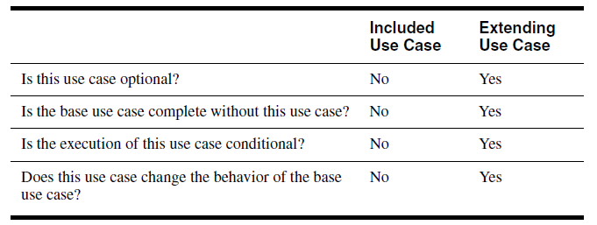
Key Differences between «include» & «extend» Relationships

Slide 23
Decomposing System Architecture
System
Segment
Subsystem
Component
Black-box analysis on each system use case to determine its actions
generate a use case diagram
White-box analysis of actions to allocate them across segments
generate an activity diagram
Define segment use cases from system actions
Black-box analysis on each segment use case to determine its actions
White-box analysis of segment use cases to allocate them across subsystems
Define subsystem use cases from allocated segment actions
…

Slide 24
Activity Diagram
Express the behavior of the system through scenarios
Provide visual depictions of the flow of activities, whether in a system, business, workflow, or other process.
Focus on the activities that are performed and who (or what) is responsible for the performance of those activities.
Can be used to analyze primary and alternate scenarios

Slide 25


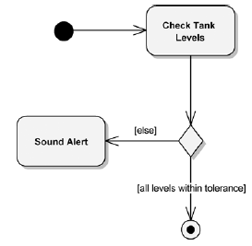
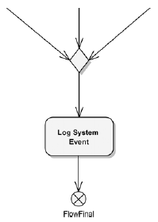
Elements of an Activity Diagram
Action Node
Initial and Activity Final Nodes
Decision Node (with guard conditions)
Action nodes
Control nodes
Initial and final (activity final and flow final)
Decision and merge
Fork and join
Object nodes
A Merge Node with a Flow Final Node

Slide 26
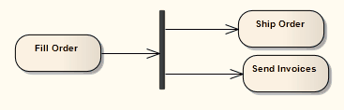
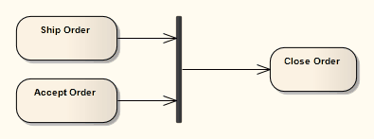
Fork / Join
A fork has one flow in and multiple flows out.
A join has multiple incoming flows and a single outbound flow (all the incoming flows must be completed before the outbound flow commences)

Slide 27
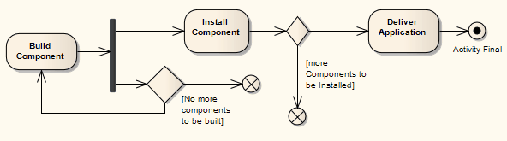
Flow and Activity Final Node
Only the flow entering the flow final node exits the activity, other flow continues undisturbed
An activity final node stops all flow in the activity
An activity may have more than one activity final node

Slide 28
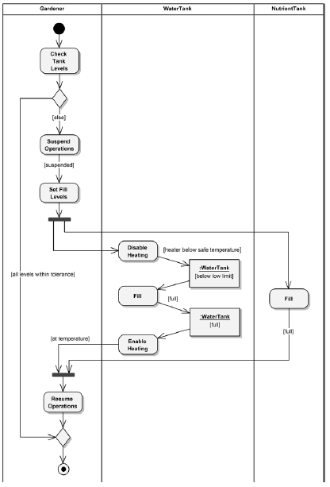
Partition
The elements in an activity diagram can be grouped by using partitions
The purpose of a partition is to indicate where the responsibility lies for performing specific activities
For examples
For systems, the partitions may be other systems, segments or subsystems.
In application modeling, the partitions may be objects in the application

Slide 29
So far …
You’ve got an initial set of requirements and solid use cases.
You need to go back to your requirements and make sure that they’ll cover everything your system has to do.
Requirements Change!
Be ready to update your application

Slide 30
Helpful Tips
The objects should do what their names indicate
Each object should represent a single concept
Unused properties are a dead giveaway

Slide 31
Drawing diagrams
Practice!
Don’t make a diagram for everything – use it where it matters
Overall architecture / relationships
Document complex behaviors
Capture design decisions
We’ll take any UML 2.0+
Pencil & Paper or scribble on a whiteboard then take a picture! (but make sure it’s readable)
Applications
Microsoft Visio (use your DreamSpark account)
GenMyModel.com (use your GitHub account)
Eclipse Papyrus
Short Codes
Use cases, activity, class diagrams: http://yuml.me/
Sequence diagram: http://www.ckwnc.com/

Slide 32
Next week …
Requirements & Use Cases Document is due by 6 pm on September 11th (next Thursday)
At least 5 Functional requirements
At least 5 Non-functional requirements
At least 1 Use case diagram
Each project should have at least 4 use cases
Explain your use cases
Pick 2 use cases and write use case specifications
Pick other 2 use cases and write their activity diagrams
Submit it in your Github repository (doc/requirements.pdf)
Readings
Requirement: Booch, Chapter 5 (5.5, 5.6), Chapter 9 (Requirements)
Architecture: Booch, Chapter 5 (5.7, 5.8), Chapter 8 (Architecture)

