Slide 1
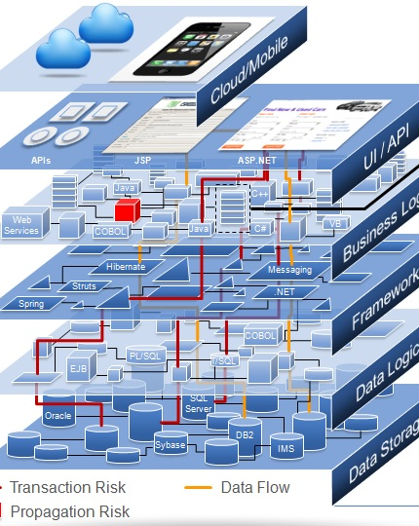
Object Oriented Analysis and Design
Class & Sequence Diagram Web Architecture & Development Framework
September 12th, 2014
Department of Computer Engineering, KMITL
Dr. Akkarit Sangpetch & Dr. Orathai Sangpetch

Slide 2
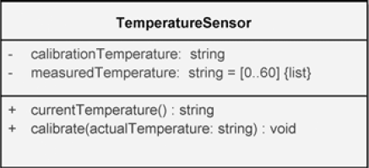
Class Diagrams
Show the existence of classes and their relationships
Class Notation
Attribute specification format
visibility attributeName : Type [multiplicity] = DefaultValue {property string}
Operation specification format
visibility operationName (parameterName : Type) : ReturnType {property string}

Slide 3
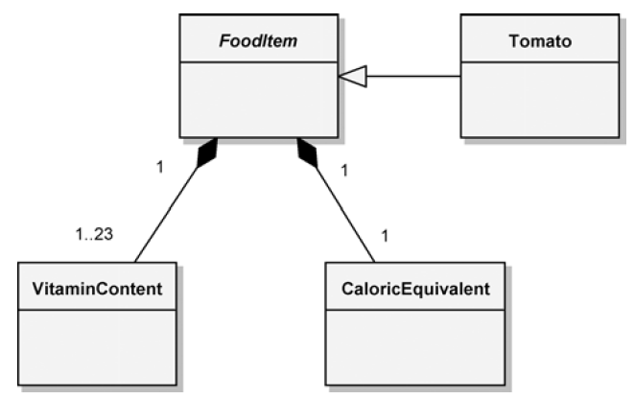
Abstract Class
Abstract class name is shown in italic
We cannot directly instantiate an object from an abstract class
Abstract operation name is also shown in italic

Slide 4
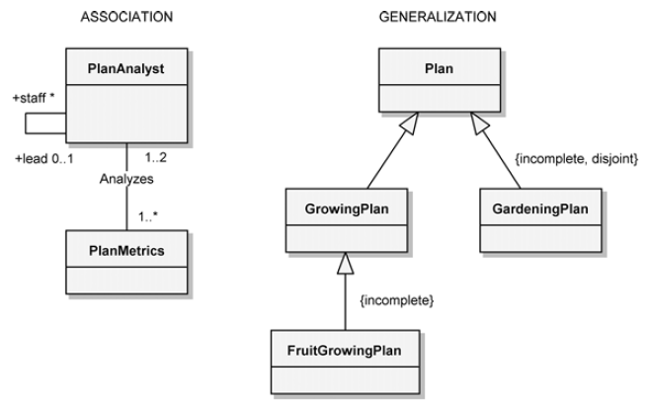
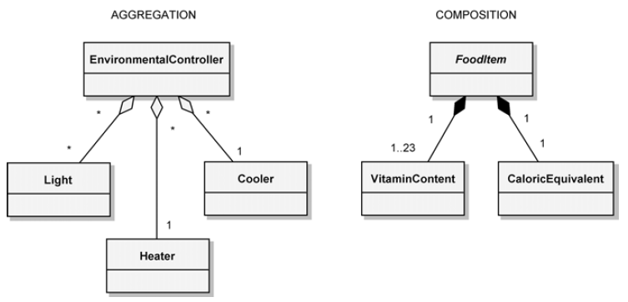
Class Relationships & Multiplicities

Slide 5
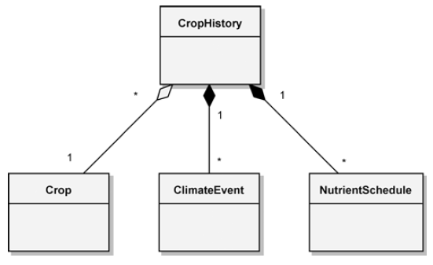
Containment
Aggregation – independent lifecycle
Composition – The aggregate controls the life-cycle of its parts

Slide 6
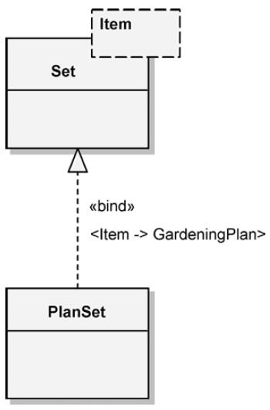
Template (Parameterized) Classes
A template class represents a family of classes whose structure and behavior are defined independent of the formal class parameters
Examples
C++ Template class
Java Generics
Template Class
Bound Class

Slide 7
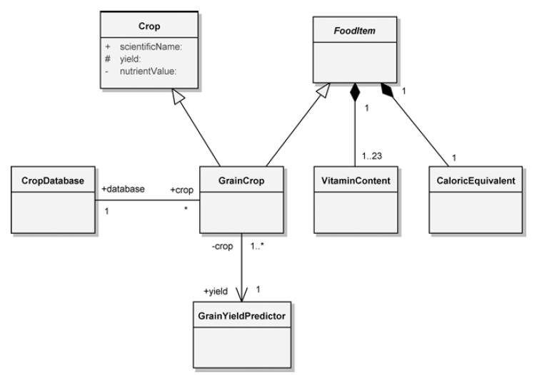
Visibility
Public ( + )
Protected ( # )
Private ( - )
Package ( ~ )

Slide 8
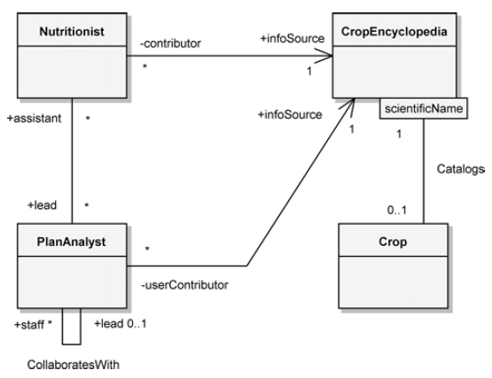
Association End Names and Qualifiers
An association end name depicts the role of the class in the association.
A qualifier is an attribute whose value uniquely identifies a single target object.

Slide 9
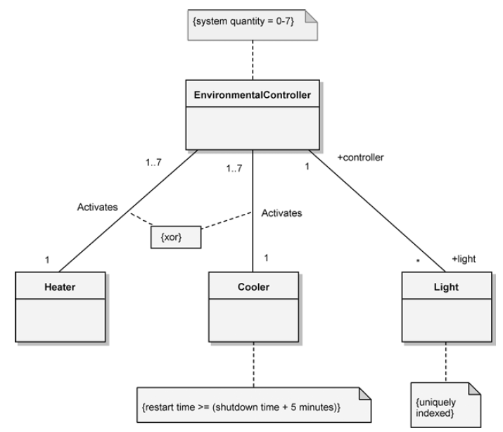
Constraints
A constraint is the expression of some semantic condition that must be preserved during steady-state

Slide 10
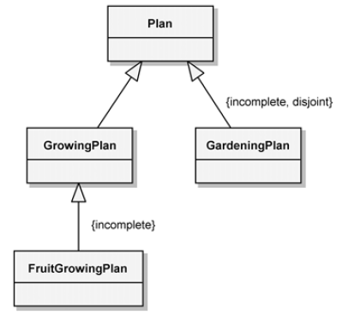
Constraints for Generalization Association
Possible constraints for generalization
Complete: an instance of the supertype is an instance of at least one of the subtypes
Incomplete: an instance of the supertype is not an instance of at least one of the subtypes
Disjoint: There are no common instances among the classifiers
Overlapping: There are common instances among the classifiers
{incomplete} There are more types of plan than just the growing or gardening plan
{disjoint} A plan can’t be both growing and gardening plan

Slide 11
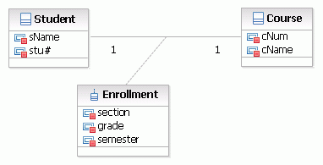
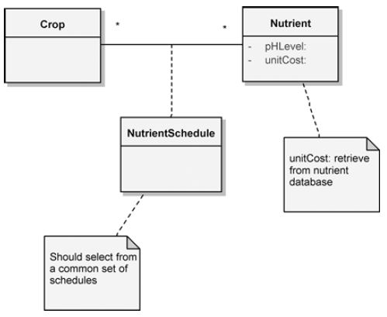
Association Classes and Notes
An association class is a class that is a property of an association relationship between two other classes
Provide additional information about the association
We can attach a note to arbitrary elements in a diagram

Slide 12
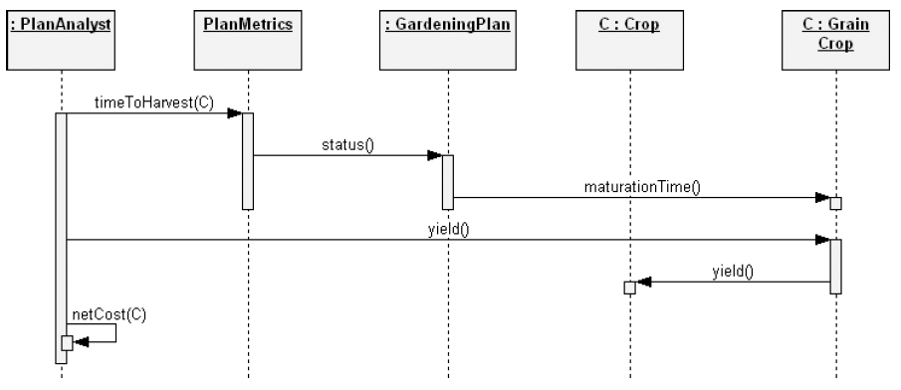
Sequence Diagram
A sequence diagram is used to trace the execution of a scenario

Slide 13
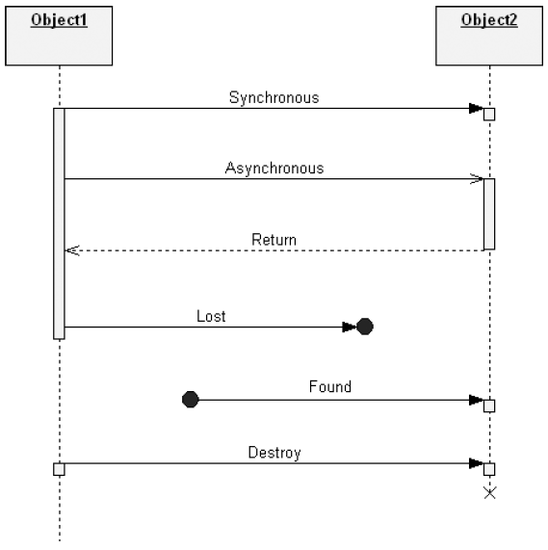
Objects, Lifelines, Messages and Destruction events

Slide 14
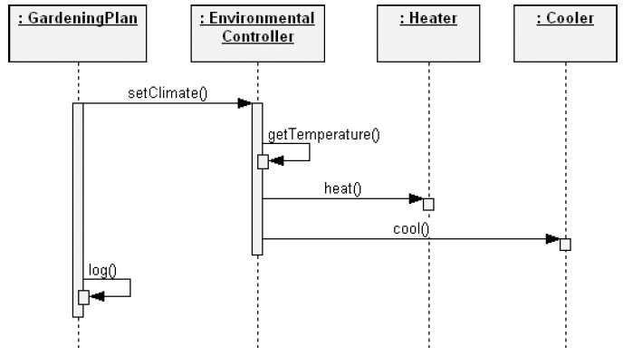
Execution Specification

Slide 15
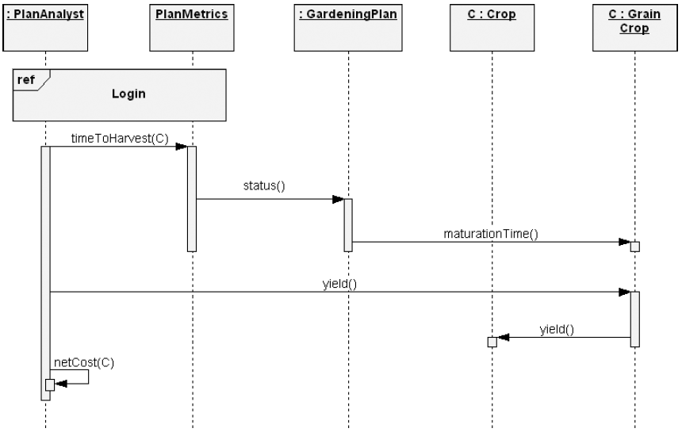
Interaction Use
Refer to the previously defined “Login” sequence diagram

Slide 16
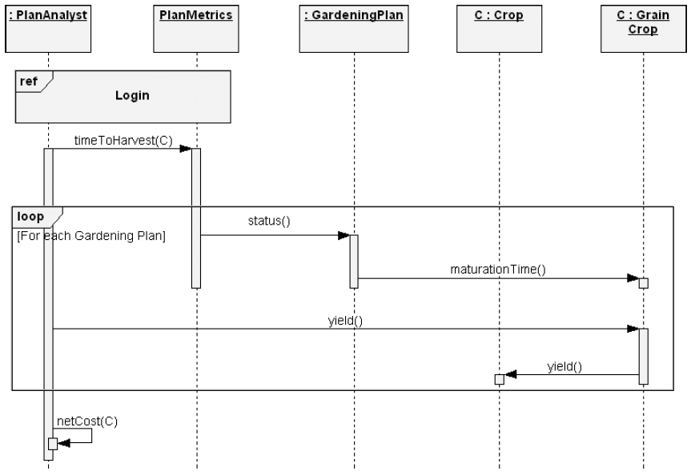
Control Construct: Loop

Slide 17
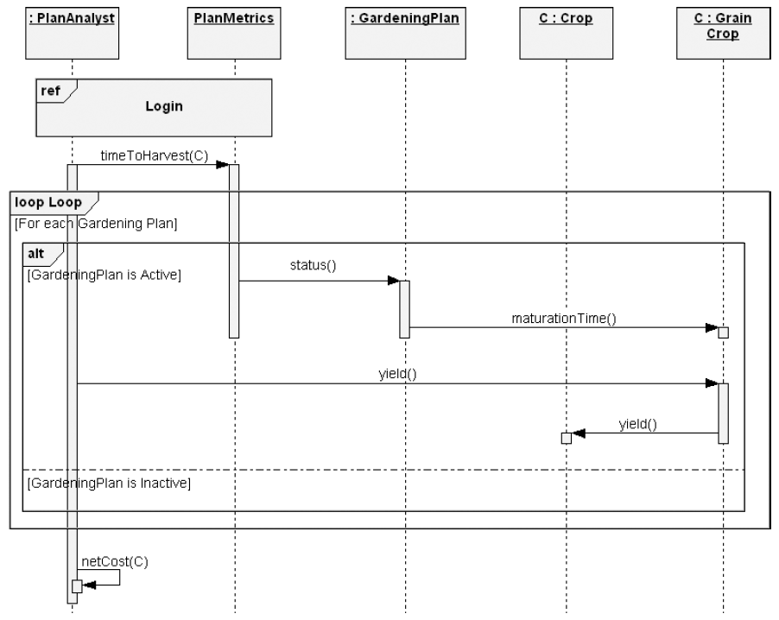
Control Construct: Alternatives (alt)

Slide 18
End-of-diagrams: Reminder
UML Diagrams are just notations
Primarily used for communication, documentation
Don’t try to write every diagram
Or you won’t have time to deliver the actual code
Spend time to analyze the problem and think about the design
Write some diagrams along the way to help you remember
Use diagrams to discuss your ideas with friends, co-workers

Slide 19
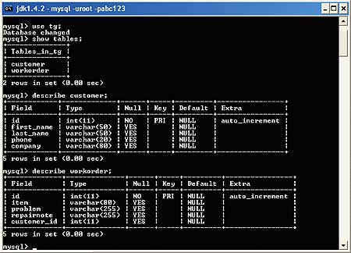
Application
“Trivial” application
Command line
Console
Input
Output

Slide 20
Client-Server Model
A server provides services
Clients use the services provided by the server
Clients may reside on the same machine as the server or across the network
Client A
Port
Server
Client B

Slide 21


Web Application
A web browser communicates with a web server using HTTP (Hypertext Transfer Protocol)
A web server provides
Standard HTTP implementation
Manage network connections (socket)
An application (server-side) may run on the web server, or on a dedicate application server
Implement business logic
Access data (uses database)
The web browser provides
Output rendering (HTML/CSS)
Client application logic (using JavaScript)
Web Browser
Web Server

Slide 22
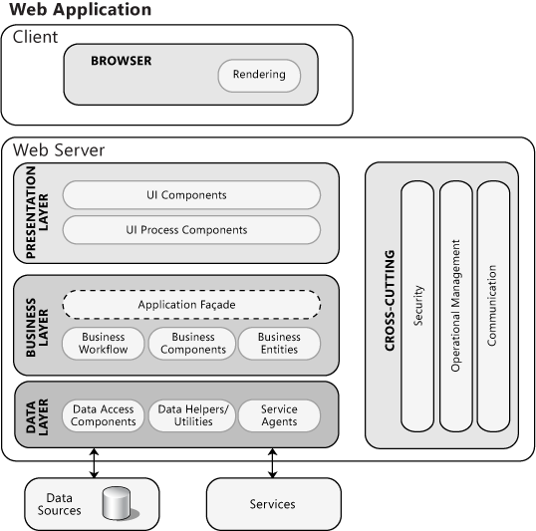
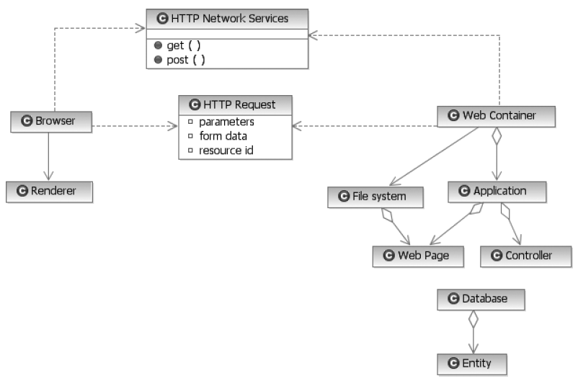
Typical Web Application Structure

Slide 23
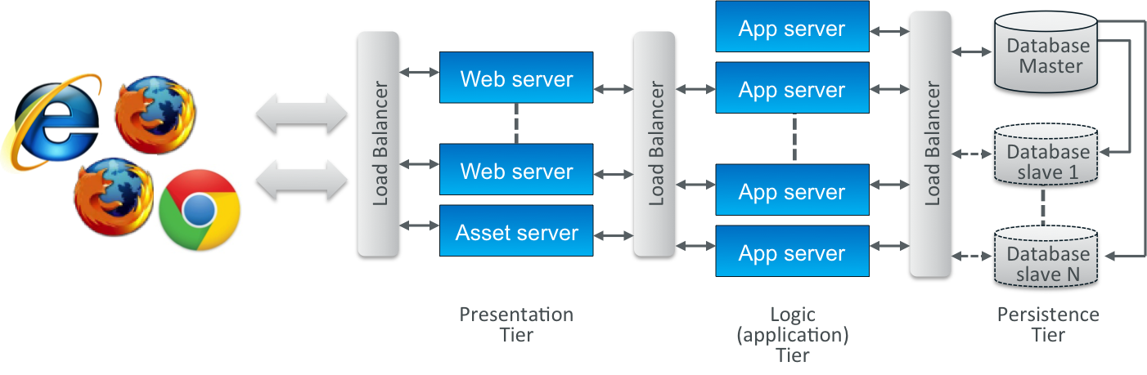
Classical 3-tier Web Application Architecture

Slide 24






Server Technologies
Web Servers
Apache
Nginx
Application Servers
Java: Tomcat, Jetty (can behave as a web server)
PHP: mod_php (co-located with web server)
Databases
MySQL
Microsoft SQL Server
Oracle
MongoDB

Slide 25
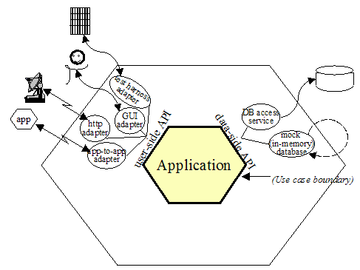
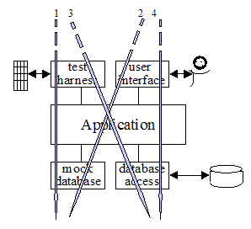
Hexagonal Architecture (Ports & Adapters)
Proposed in 2005, by Alistair Cockburn
Identify the ‘core’ of the application and the ‘ports’ used to interface with external entities (database, web, …)
“Allow an application to equally be driven by users, programs, automated test or batch scripts, and to be developed and tested in isolation from its eventual run-time devices and databases.”

Slide 26
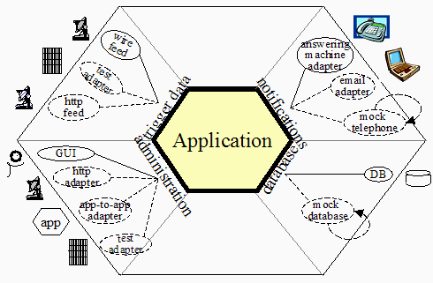
Supporting Multiple Interfaces
Architect system’s interfaces “by purpose” rather than technology

Slide 27
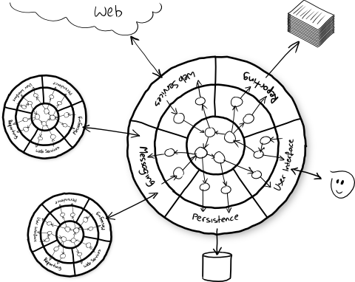
Domain Logic (Business Logic)
Part of the software that encodes the real-world business rules
Independent of frameworks, tools, technologies
Pick the tools to facilitate your design (not the other way around)

Slide 28
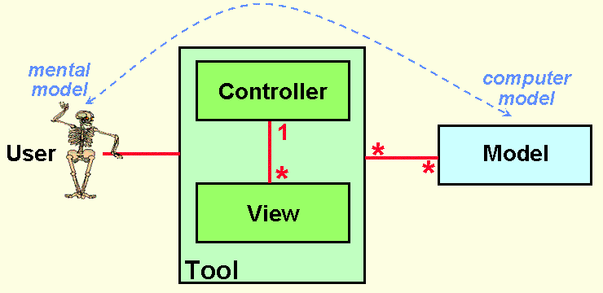
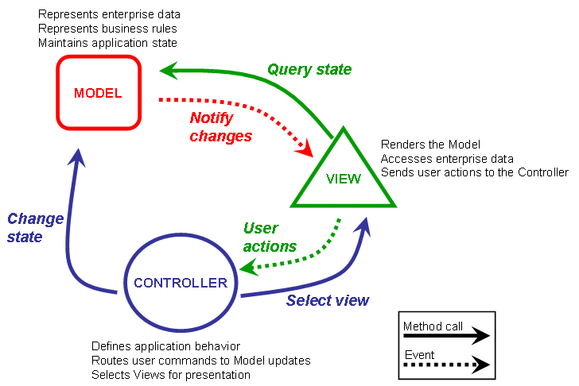
Model-View-Controller
Invented by Trygve Reenskaug in 1979 for controlling a large and complex data set
Models
Represent knowledge
Could be a single or some structure of objects
Views
A (visual) representation of its model
Ask model for presented information
Controllers
Arrange relevant views to present themselves on the screen
Receive user inputs, translate into appropriate messages and pass them to one or more views

Slide 29
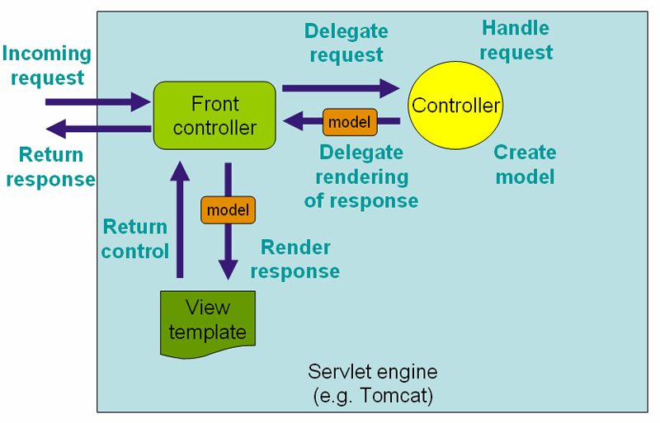
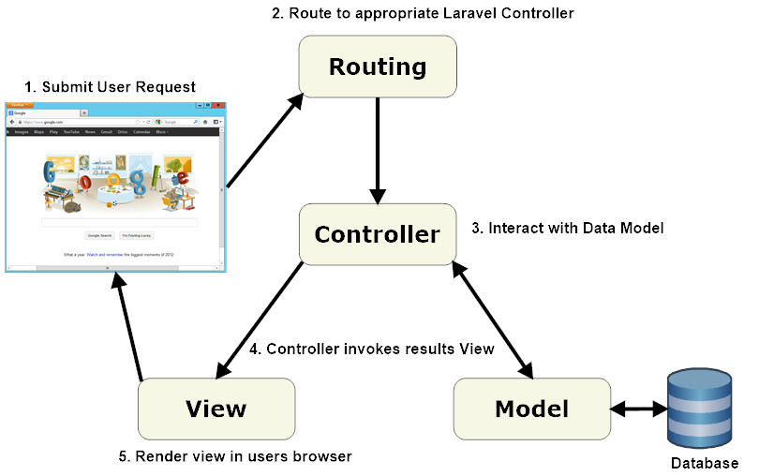
Model-View-Controller (Web App Framework)
Models
Classes which are used to store and manipulate state
Views
The user interface (HTML or templates) necessary for rendering model
Controllers
Decide what the user input’s was, how should the model change, and select the resulting views to be used

Slide 30





Frameworks
Java
Spring MVC / Spring Boot: http://spring.io/guides
Play Framework: https://www.playframework.com/
PHP
Laravel: http://laravel.com/
Symfony: http://symfony.com/doc/current/quick_tour/the_big_picture.html
Node.js (JavaScript)
Express: http://expressjs.com/
Sails: http://sailsjs.org/
Template Engine
Thymeleaf (Java): http://www.thymeleaf.org/
Blade (Laravel): http://laravel.com/docs/templates
Handlebars (Javascript): http://handlebarsjs.com/

Slide 31



Client-side (Browsers)
Client-side JavaScript Framework
AngularJS: https://angularjs.org/
Ember: http://emberjs.com/
Front-end framework (UI)
Bootstrap: http://getboostrap.com/
Foundation: http://foundation.zurb.com/

Slide 32
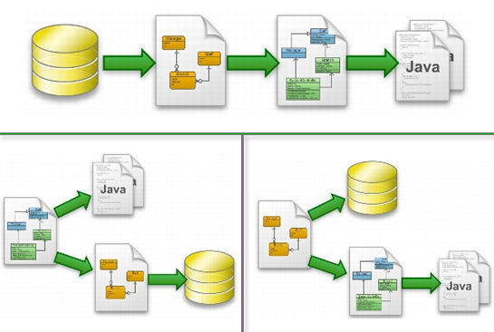
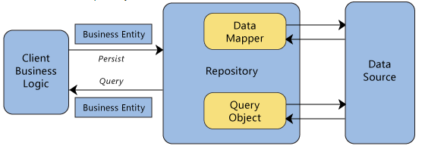
Dealing with Persistence
Do not initially focus on database, schema, …
Analyze your object structures and behaviors
Usual approaches
Object-relational mapping: map schemas to classes/objects
Repository pattern: use a repository to load / save objects

Slide 33



Persistence/Data Abstraction
Java
Spring Data: http://projects.spring.io/spring-data/
Hibernate: http://hibernate.org/
PHP
Eloquent (Laravel): http://laravel.com/docs/eloquent
Doctrine: http://www.doctrine-project.org/projects.html

Slide 34
Coming up…
Quiz 1 next week (Sep 19, 2014 - 9am / 1pm)
Everything up to this slide
Project M2 in 2 weeks (Thu Sep 25, 6pm)
Architectural design
Tell us your analysis of the project
Application architecture
Subsystems / Components
Domain classes
Deployment
Related UML diagrams – Class diagrams, Sequence diagrams
Implementation Plan
Related Readings
Booch, Chapter 12 – web application design
Hexagonal Architecture: http://fideloper.com/hexagonal-architecture

