Slide 1

Object Oriented Analysis and Design
Management, Planning & Practical Development
September 23rd, 2014
Department of Computer Engineering, KMITL Dr. Akkarit Sangpetch & Dr. Orathai Sangpetch

Slide 2
Software Development Lifecycle: The Macro Process
The purpose of the macro process is to guide the overall development of the system, ultimately leading to the production system
The macro process can be described in terms of two dimensions
Content: what is done
Time: when it is done

Slide 3
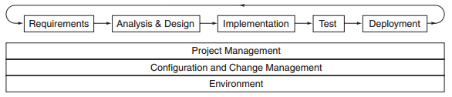
Macro Process: Content
การจัดการโปรเจค วางแผน มองหาความเสี่ยง
การปรับเปรี่ยนให้เหมาะสม
ทรัพยากร
These disciplines are executed in the following orders
Requirements: Define the system boundaries
Analysis and design: Transform the requirements into a design of the system
Implementation: Implement, unit test, and integrate the design
Test: Test the implementation that it fulfills the requirements
Deployment: Ensure that the software is available for its end users
These disciplines are executed throughout the process
Project management: Planning, staffing, monitoring, managing risks and resources
Configuration and change management: identify configuration items and manage their changes
Environment: provide the development environment to support the team

Slide 4
Macro Process: Time
Inception
Ensure the feasibility and the value of the project คุ้มค่าต้องทำไรบ้าง
Establish requirements, identify risks ความเสี่ยง
Identify tools and development environments ต้องใช้ทูลไร
Milestone: Scope is understood สิ่งที่ได้
Elaboration ช่วงเวลาดีไซ ได้โครงสร้างที่นิ่งแล้ว
Develop the overall architectural framework, identify flaws and a simpler architecture
Driven by mitigating the highest risks and satisfy the requirements with highest priorities
Generate an architectural release which becomes the foundation of the production system
Milestone: Architecture is stable

Slide 5
Macro Process: Time
Construction ช่วงเขียนโคต ได้ตัวที่นำไปเทส
Develop a deployable product based on the architecture
Generate series of releases which evolve into the production system
Milestone: System is ready for end-user testing
Transition ช่วงเทสระบบ หาจุดบกพร่อง แล้วแก้ไข ได้ ผลิตภัณ
Ensure that the software is acceptable to its end users
Provide the product to the user community for testing and incorporate feedback
Fine-tuning configuration, installation, usability
Generate packaged products, supporting documentation, training, marketing materials
Milestone: System is ready to be deployed สิ่งที่ได้คืองาน

Slide 6
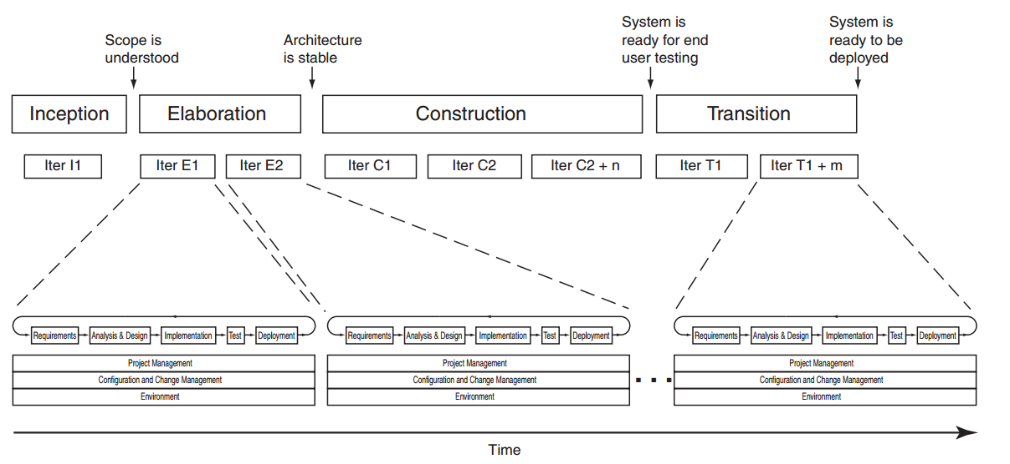
Macro Process Milestones, Phases and Iterations แสดงช่วงทำงาน

Slide 7
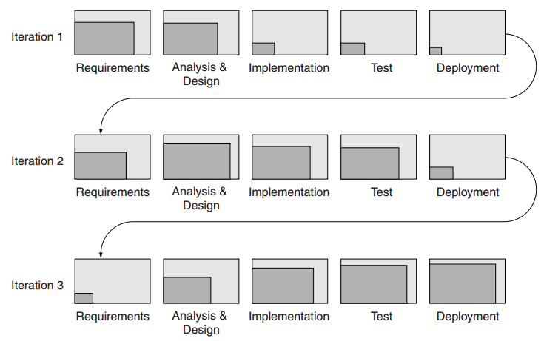
Shifting Focus across iterations แต่ละไอเทเล ไม่จำเป็นต้องใช้เท่ากัน

Slide 8
Continuous development ต่อเนื่อง
Continuous Integration พัฒนาโดยเอาอันใหม่ไปรวมกับอันเก่า
Keep merging your code to the mainline
The code can always be integrated, built and tested in development environment
Continuous Delivery ส่งให้ลูกค้าดูเรื่อยๆ
Your software can be released to production at any time
The executables are tested on production-like environments
Continuous Deployment ส่งทีละซิสเตม
Every change goes through the pipeline and automatically gets into production
Multiple production deployments per day

Slide 9
Requirements for Continuous Integration
Revision Control เป็นเวอชั่นๆ
Automated Building & Testing ผ่านออโต้เทส
Do not break the build
Watch the build time
Deployment Automation ติดตั้งบนอุปกร อัตโนมัติ
Make your system deployable in multiple environments
Run commit tests
Run secondary tests
Automated rollback
Rolling deployment on cluster (one node at a time)
Multi-versioned production on public website to test users’ responses

Slide 10
Revision Control System
Revision Control ใช้เวอเก่า / Source Control / Version Control
Manage changes to document, source code, web sites, etc.
Keep history of your software
Old versions
Previous approaches
Share source codes amongst different people / teams

Slide 11
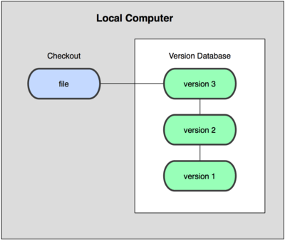
Local Revision Control
Keep a database in a local computer ใช้ได้คนเดวไม่แช
Checkout files into a working directory
Example: rcs

Slide 12

Centralized Revision Control
Every client checks out a version of the code from a centralized server and commits code to the server
Pros
Access control กำหนดว่าใครใช้ได้
Central backup มีแบลกอัพส่วนกลาง
Cons
Single point-of-failure ล่มก็หายหมด
Connectivity required for checking-in ต้องเชื่อต่อตลอด
Merge ต้องรวม
Example: CVS, Subversion (SVN), Perforce

Slide 13
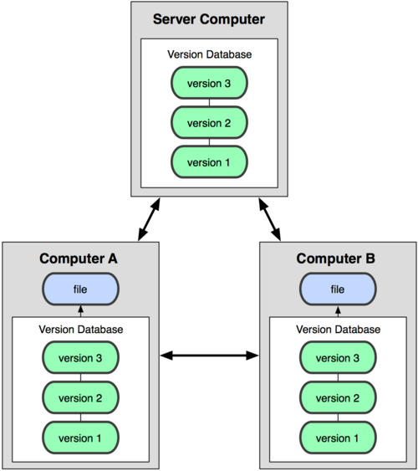
Distributed Revision Control
Peer-to-peer model: Everyone has a repository and usually work with the local repository
Pros
Every clone is a fork and a backup เอาจากของคนอื่นได้ และ มีแบกอัพ
No connectivity requirement ไม่ต้องต่อตลอด
Fast เร็ว
Cons
Not good for large binary files ไฟใหญ่ๆ
Example: Git, Mercurial, Bazaar, Fossil

Slide 14
Git
Initially developed in 2005
Used to maintain the Linux kernel
Speed
Strong support for parallel branches
Fully distributed
Ensure integrity of the code

Slide 15

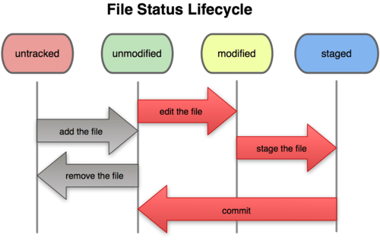
Workflow

Slide 16
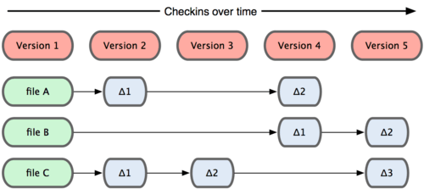
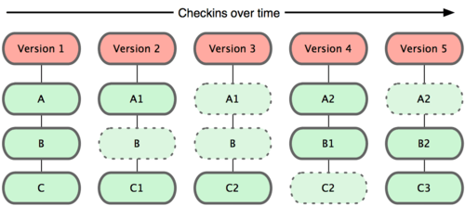
Tracking Changes vs Snapshots
Tracking Changes (most VCS)
Tracking Snapshots (git)

Slide 17
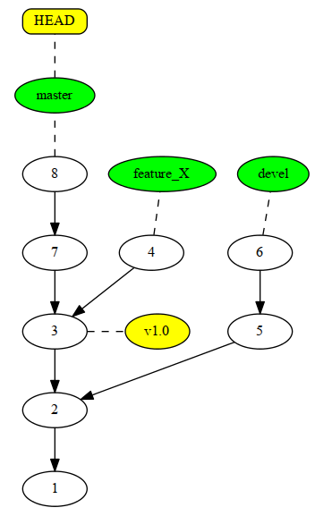
Git Repository
Git repository is a content-addressable file system (located in .git/ directory)
Git knows about 4 types of objects
Blob – each committed file is a blob (referenced by its content hash)
Tree – each directory is a tree object (may contain blobs or other trees)
Commit – each commit is a snapshot of the working tree
A commit is uniquely identified by 160-bit hash value (SHA-1) For example: 604c9bb8d9045c628ca2298855631b823d961bbc
Tag – contains a reference to another object along with metadata
A git repository is a graph of commits

Slide 18
Installing & Configuration
Download & install: http://git-scm.com/
Configure identity
$ git config --global user.name “John Doe”
$ git config --global user.email johndoe@example.com
Configure editor
$ git config --global core.editor vim

Slide 19
Create / Clone a repository
Creating a repository (generate a new repository in .git/)
$ git init
Clone a repository (download the repository from other machines)
$ git clone https://github.com/abcd/repo

Slide 20
Staging (Add) Changes & Creating a Commit
Commit specific changes
$ git add *.php $ git add README.md $ git commit -m ‘Message about the first commit’
Commit all changes
$ git commit -am ‘Message about the first commit’
Head
master
1

Slide 21
Removing files
From staging area
$ git rm --cached uselessfile.php
From index and file system
$ git rm uselessfile.php

Slide 22
Moving Files
Git tracks content (using hash), not files
There is a move command
$ git mv fileA fileB
The above command is the same as
$ mv fileA fileB $ git rm fileA $ git add fileB

Slide 23
Show
Show status
$ git status
Show logs
$ git log $ git log --since=2.weeks $ git log --since=“3 years 1 day 3 minutes ago”
Show diffs
Unstaged changes: $ git diff
Staged changes: $ git diff –cached
Relative to specific version
$ git diff 1776f5 $ git dfif HEAD^
Show Commits
Last commit: $ git show
Specific commit: $ git show 1776f5

Slide 24
Undoing things
Change last commit message
$ git commit –amend
Unstage staged file
$ git reset HEAD file.php
Unmodify modified file
$ git checkout -- file.php
Revert a commit
$ git revert 1776f5

Slide 25
.gitignore
Exclude files from repository (binary builds, runtime cache, temporary files, …)
.env.*.php *.class hs_err_pid* /build/
End pattern with slash( / ) to specify a directory
Negate pattern with the exclamation point ( ! )

Slide 26
Remote repositories
Other clones of the same repository
Can be local (another checkout) or remote (co-worker, central server)
There are default remotes for push and pull (fetch)
$ git remote -v origin https://github.com/myrepo/repo.git (fetch) origin https://github.com/myrepo/repo.git (push)

Slide 27
Push and Pull
Pushing to remote repository
Pulling from remote repository
Without default
$ git push <remote> <branch>
Setting a default
$ git push -u <remote> <branch>
Then…
$ git push
Fetch & Merge
$ git pull [<remote> <rbranch>]
Fetch & Rebase (can be dangerous)
$ git pull --rebase [<remote> <rbranch>]

Slide 28
Create Tags
Lightweight Tags
$ git tag v0.1.0
Annotated Tags
$ git tag -a v0.1.0 -m ‘Version 0.1.0’
GPG-signed Tags
$ git tag -s v0.1.0 -m ‘Signed Version 0.1.0’
$ git tag -v v0.1.0

Slide 29
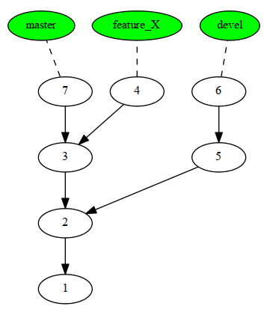
Branches
The repository is a graph
New branch can be created (to develop new feature)
$ git checkout -b [new_branch]
You can switch between branches
$ git checkout devel
The default (main) branch is called ‘master’

Slide 30
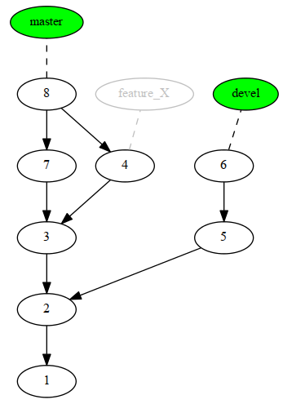
Merging Branches
We have to merge the branch back at some point
These commands will merge feature_X commits back to master
$ git checkout master
$ git merge feature_X

Slide 31
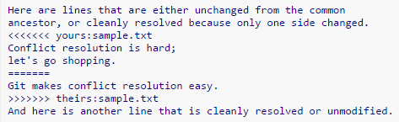
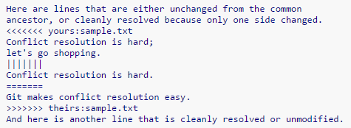
Merge Conflicts
Different merge strategies
Fast-forward
3-way merge
$ git merge devel Auto-merging sample.txt CONFLICT (content): Merge conflict in sample.txt Automatic merge failed; fix conflicts and then commit the result.
After the fix, mark as resolved and trigger commit
$ git add sample.txt $ git commit

Slide 32
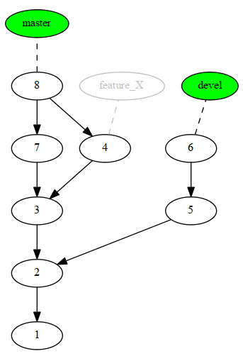
Removing Branches
Once merged, branches can be removed
$ git branch –d feature_X

Slide 33
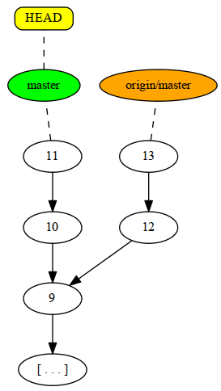
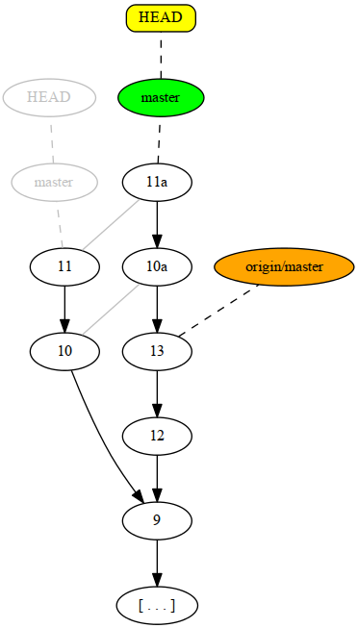
Rebase
Rewrite the commit history to make it linear
Do not rebase published code!
Example: rebasing origin/master branch onto master branch
$ git fetch origin $ git rebase origin/master

Slide 34
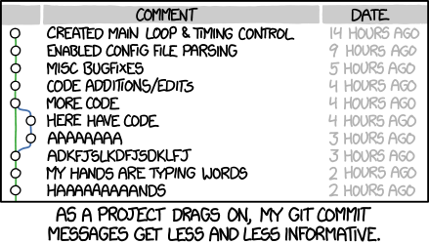
Commit often!
Keep committing your code to track your work

Slide 35
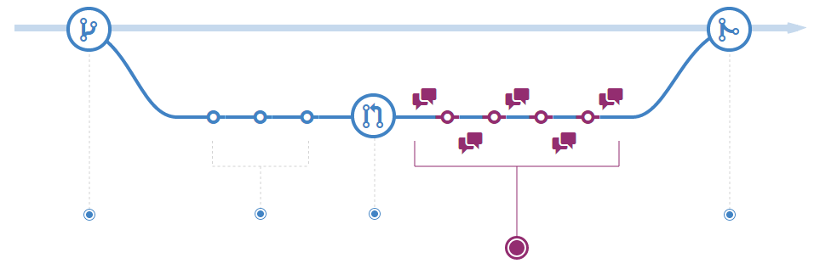
GitHub Flow
Add commits
Create a branch
Create a pull request
Merge and deploy
Discussion and updates
Keep an always-deployable master branch

Slide 36
Continuous Integration
Integrate often (to mainline / master branch)
Merge your branch into the central repository
Your code should be built, tested and verified by automated agents

Slide 37

Continuous Integration System
Use a build server to implement continuous quality control process
Example: Jenkins CI
Jobs – instructions to carry out a set of build activities
A typical job
Is triggered by an event (e.g. a push commit)
Builds the project (create a deployable package – jar, zip)
Verifies the project through automated tests
And publishes the build to a repository
Others: Travis CI, PHPCI

Slide 38


Jobs / Tasks
Each job or task is executed by a job runner
The task runner usually depends on your preferred development languages
Java: Maven, Ant, Gradle
JavaScript: Grunt (gruntjs.com)
These runners can actually run any executable

Slide 39
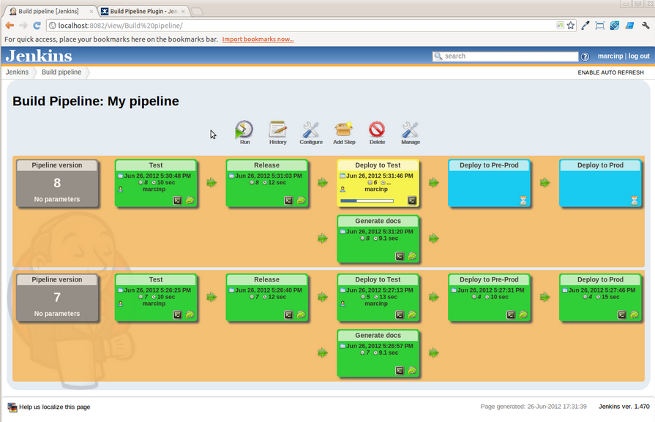
Pipelines
Pipeline is a sequence of connected jobs to ensure a quality build

Slide 40
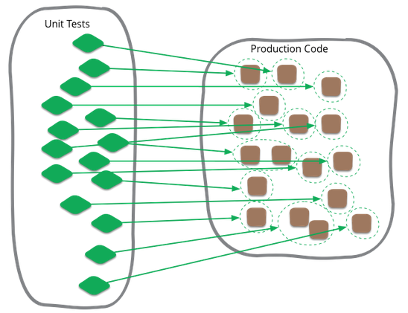
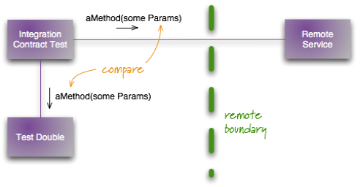
Writing Automated Tests
Write tests and run them as a job in your CI system
Unit Testing
Verify functionality at a specific section of the code
Test functionalities of your class (do the implemented methods behave as expected?)
Integration Testing
Verify interfaces and interactions between components

Slide 41
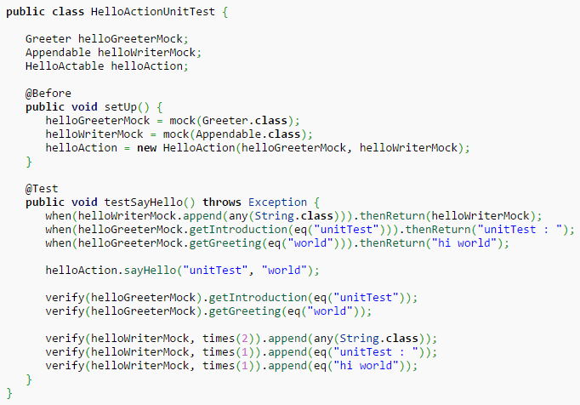
Testing Frameworks
Facilitates the test implementation & test fixture (fixed state of the system under test)
Set up: Set up the states of test fixture
Exercise: Interact with the system under test
Verify: Determine the expected out come
Tear down: Return the test fixture to the original state
PHP: PHPUnit
Java: JUnit, TestNG
Notes:
http://en.wikipedia.org/wiki/Mockito

Slide 42
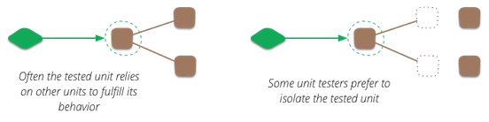
Test Double
Test double is a pretend object used in place of the real object for testing purpose
Dummy objects are passed around, but not actually use. These objects are used to just fill the parameter lists. แทนให้ครบ
Fake objects have a working implementations, but is not a production quality (e.g. in-memory database) ปลอม ใช้ได้ตามรีไค ใช้ช่วยเทส
Stubs provide previously filled answers to calls made during the test เทสว่าผ่านอะไรบ้าง
Mocks are pre-programmed with expectations which form a specification of the calls they are expected to receive (Mockito, EasyMock) กำหนดรีเทินได้ตามกำหนด
Notes:
http://martinfowler.com/articles/mocksArentStubs.html

Slide 43
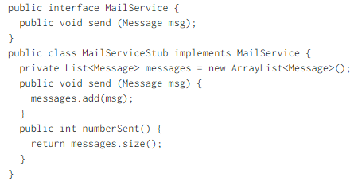
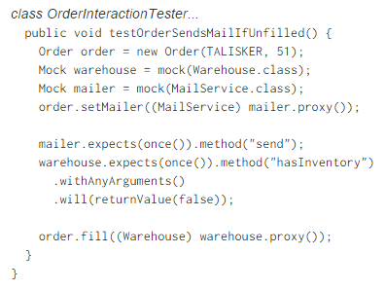
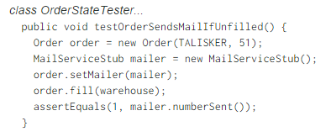
Stubs vs Mocks
Using Mock to verify Order interaction
Using MailService test stub

