Slide 1

A Large-Volume Stable Atmospheric Air
Microwave Plasma Based on Inductive
Coupling Window—Rectangular Resonator

Slide 2

จัดทำโดย
นายจารุวัฒน์ นพคุณ 55010156 3A/1
นายจิรายุ มณฑลจินดา 55010178 3A/1
นายชวัล พูลอิทธินันท์ 55010256 3A/1
นายชวัลวิทย์ อุรเคนท์ 55010257 3A/1
อาจารย์ที่ปรึกษา
ดร.สถาพร พรหมวงศ์

Slide 3

I. INTRODUCTION
Microwave plasma has been widely applied to many
industrial fields due to its many unique advantages over other plasmas.
A large-volume steady microwave plasma especially at atmospheric pressure is preferential to many practical applications.
For example
expand the plasma size.
improve the plasma stability
increase the plasma pressure.

Slide 4
DISADVANTAGE OF THE OTHER PLASMA
The SLot ANtenna plasma source can produce a certain-volume steady atmospheric argon microwave plasma, and the plasma only distributes near the inner wall of the quartz tube.
The CYlindrical Resonator ANNUlar Slots plasma source can generate relatively
large-volume steady atmospheric argon and argon/oxygen microwave plasmas.
The Atmospheric Pressure Microwave Plasma System plasma source can only initiate a certain-volume argon microwave plasma at atmospheric pressure.
The plasma source can produce a comparatively voluminous open argon/air microwave plasma but the plasma is unstable.

Slide 5
Why a novel microwave plasma source based on inductive
coupling window—rectangular resonator is designed?
None microwave plasma sources can generate a relatively large-volume stable atmospheric air microwave plasma under the input of several kilowatts of microwave power with the frequency of 2450 MHz.
To produce a relatively voluminous steady atmospheric air microwave plasma.
This presentation focuses on
The design of this source.
The research of microwave reflection characteristic.
The basic characteristics of corresponding atmospheric air microwave plasma.

Slide 6
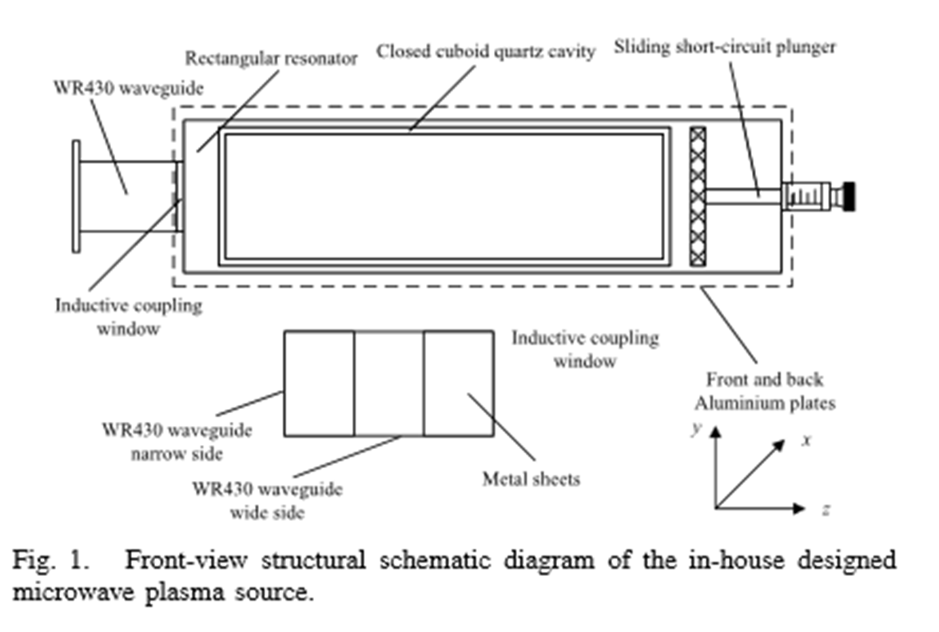
the design of this source
It consists of
a WR430 waveguide
an inductive coupling window
a rectangular resonator
a closed cuboid quartz cavity
a sliding short-circuit plunger

Slide 7

the inductive coupling window is formed by inserting a metal sheet through each of the narrow walls of the waveguide. The rectangular resonator is composed of several metal plates, including front and back aluminum plates served as its narrow walls. Equipped in the rectangular resonator is the quartz cavity. The wide walls of the quartz cavity,
the waveguide, and the rectangular resonator are parallel to
each other.
There is a quartz breather tube in each of the narrow walls of
the quartz cavity. The breather tubes go through the through-holes in
the front and back aluminum plates to connect with outer gas circuit. The quartz cavity is removed to produce open microwave plasma. All the metallic materials of this microwave plasma source are aluminum alloys.

Slide 8
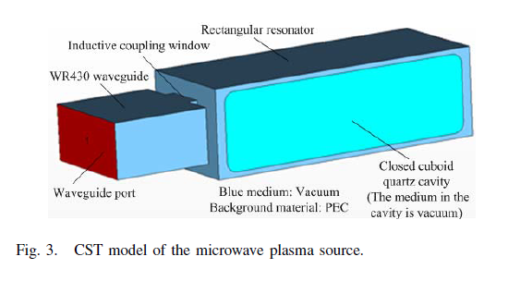
III. NUMERICAL CALCULATION OF ELECTRIC INTENSITY
The CST model of the plasma source is shown in Fig. 3. The model is much simpler than the actual structure. The optimization of the electric field intensity indicates that: the width, height, and thickness of the inductive coupling window are separately 35.5, 54.61, and 2 mm; the dimensions of the internal cross section of the rectangular resonator are
113.22 mm × 77 mm; the inside dimensions of the cuboid quartz cavity are 224 mm × 96 mm × 60 mm, and the wall thickness is 8 mm; the sliding range of the short-circuit plunger is from 0 to 90 mm; and the electric field intensity in the quartz cavity maximizes when the length of the rectangular resonator is 260 mm.

Slide 9
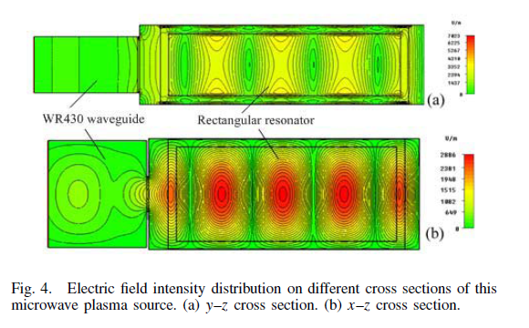
The electric field intensity distribution on different cross sections of this microwave plasma source. This figure shows that the microwave energy reserves in the rectangular resonator in the form of microwave standing wave. There are several large high-electric-field regions periodically (the period of about 63 mm) distributed along the rectangular resonator in the quartz cavity. The electric intensity along the height direction of the quartz cavity is roughly the same, and the electric field near its internal wide wall is slightly stronger than that in its middle. The peak electric intensity of the standing wave within the quartz cavity is approximately 3400 V/m for per watt of input microwave power at the microwave frequency f = 2.450 GHz.

Slide 10
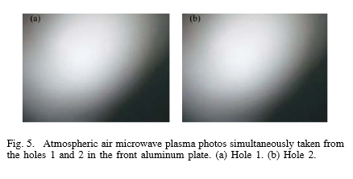
IV. PRODUCTION OF ATMOSPHERIC AIR MICROWAVE PLASMA
An atmospheric air microwave plasma cannot be directly excited in the quartz cavity even under the input of microwave power of 8.0 kW, the maximum safe output microwave power of the generator. Considering that the maintain microwave power of microwave plasma is evidently lower than its excitation
microwave power, an atmospheric air microwave plasma is produced according to the following procedure: a low pressure air microwave plasma is first excited in the quartz cavity at the input microwave power of 5.0 kW, and then the air in the quartz cavity is made open to the atmosphere. The atmospheric air microwave plasma photos simultaneously taken from the holes 1 and 2 in the front aluminum plate. The two holes (diameter = 5 mm) are located in the middle of the narrow side of the front aluminum plate, and they have a distance of 63 mm along the resonator length direction.

Slide 11
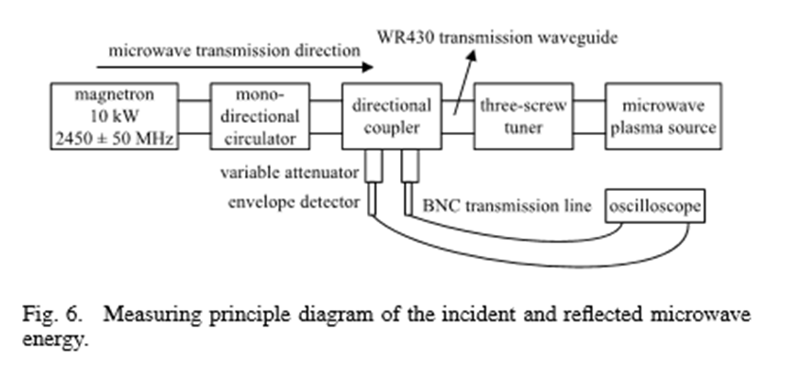
The research of microwave reflection characteristic.
The measuring principle diagram of the incident and reflected microwave energy. The incident and reflected microwave energies are first coupled by the directional coupler, and then successively attenuated by the variable attenuators and measured by the envelope detectors, and finally displayed by the oscilloscope in the form of voltage signal. Before the microwave reflectance characteristic of the plasma source is measured, the three-screw tuner is tuned using a standard
microwave load, and the screw positions of the tuner are kept fixed in the subsequent measurement. The purpose of doing so is to evaluate the deviation degree of the impedance of the microwave plasma source from the standard impedance.

Slide 12
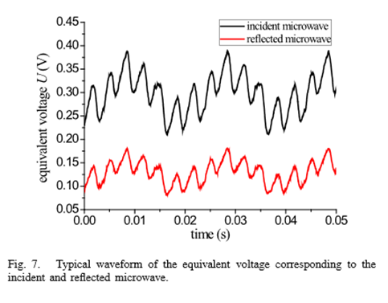
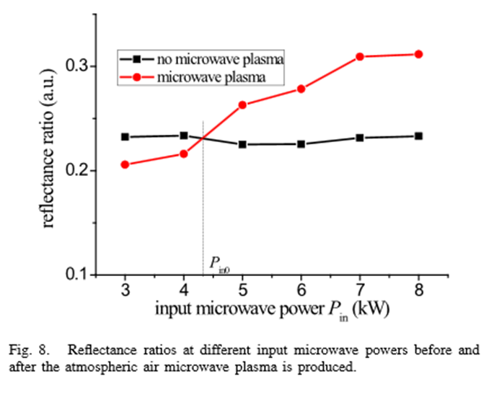
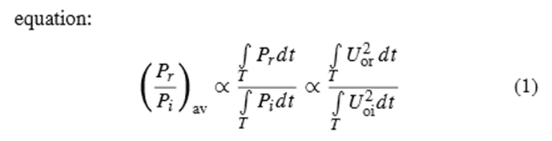
A typical waveform of the equivalent voltage
corresponding to the incident and reflected microwave.
The reflectance ratios of the microwave energy
at different input microwave powers before and after the atmospheric air microwave plasma is produced. The reflectance ratios are calculated using the following

Slide 13
where Uor and Uoi are separately the equivalent voltages corresponding to the incident and reflected microwave. T is the monitoring time length of the microwave The proportionality coefficient is only related to the coupling coefficients of the directional coupler, the attenuation multiples of these two variable attenuators, and the detection coefficients of these two envelope detectors, but these values are all unknown at present.
For an ideal entirely lossless one-port microwave plasma source, the absolute reflectance ratio should be equal to one. the microwave energy inside it maybe radiate out through the two through-holes (diameter = 20 mm) in the front and back aluminum plates instead of being reflected back to the magnetron microwave generator and being due to ohmic losses.

Slide 14
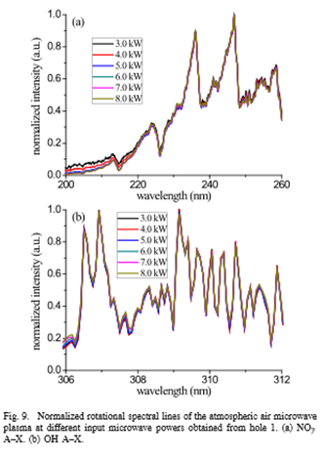
CHARACTERISTICS OF ATMOSPHERIC AIR MICROWAVE PLASMA
A. Gas Temperature of Atmospheric Air Plasma
The emission spectra of the atmospheric air microwave plasma are measured from hole 1 using a four-channel fiber optic spectrometer (Avaspec-USB2-DT, wavelength range 200–820 nm, and resolution 0.10 nm). There are Noγ A–X and OH A–X rotational spectral lines and some unknown atomic spectral lines in the emission spectrum. These rotational spectral lines are both applied to diagnose the rotational temperature considered equal to the gas temperature of the plasma
Every rotational line is obtained by averaging five spectral
lines measured at an interval of tens of seconds. As shown
in the figure, the rotational spectral lines corresponding to
different input microwave powers roughly overlap ,regardless of NOγ A–X and OH A–X lines. This overlap indicates that the rotational temperature of the atmospheric air microwave plasma is approximately unrelated to the input microwave power. In addition, it is found that the intensities of these five measured rotational lines are roughly equal. This means that the emission spectrum is relatively stable, and then the atmospheric air microwave plasma is comparatively stable at least in the range of measuring time.

Slide 15
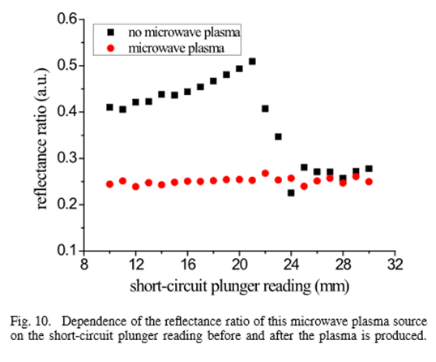
B. Microwave Cutoff by Atmospheric Air Plasma
The short-circuit plane position of the sliding short-circuit plunger completely determines the length of the rectangular resonator, thereby determining the reflectance ratio of this microwave plasma source. There is a one-to-one correlation between the short plane position and the plunger reading. Its reflectance ratios corresponding to different short-circuit plunger readings before and after the atmospheric air microwave plasma is produced are studied.

Slide 16
It is found that the reflectance ratio is roughly unrelated to the plunger reading after the microwave plasma is produced. This illustrates that the short-circuit plane of the plunger loses its short-circuit function. It is concluded that the atmospheric air microwave plasma cuts off the microwave.
For the microwave of 2.450 GHz, the cutoff electron density is about 7.46 × 1010 cm−3, and the electron density of an atmospheric microwave plasma is usually on the order of 1014 − 1015 cm−3, far greater than the cutoff electron density. Therefore, theoretically, an atmospheric microwave plasma cuts off the 2.450 GHz of microwaves. Thus, the conclusion that the atmospheric air microwave plasma cuts off the 2.450 GHz of microwaves from the independence of the reflectance ratio on the plunger reading is reasonable.

Slide 17
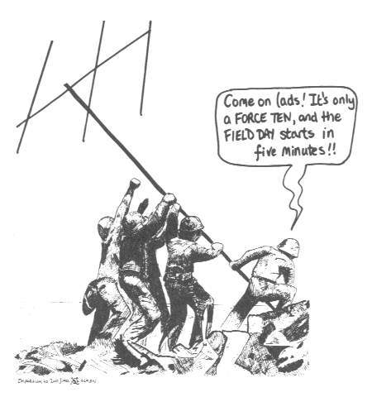
This microwave plasma source can produce a large-volume stable atmospheric air microwave plasma. The microwave reflectance ratio of the microwave plasma source exactly at higher power is roughly unrelated to the input microwave power before the plasma is produced.
After the plasma is generated, the reflectance ratio increases with the increase in the input microwave power and the ratio at lower power is even smaller than that before the plasma is produced. The gas temperature of the atmospheric air microwave plasma is approximately changeless with the input microwave power. The atmospheric air microwave plasma cuts off the microwave with the frequency of 2450 MHz.

Slide 18
CONCLUSION
In this paper, a novel microwave plasma source based on inductive coupling window—rectangular resonator is designed.
A relatively voluminous stable atmospheric air microwave plasma is produced in this microwave plasma source. In addition, the plasma volume is evaluated to be at least 63 mm × (40–50) mm × 30 mm.
Before the plasma is generated, this microwave plasma source is a linear microwave load. After the plasma is produced, its reflectance ratio increases with the increase in the input microwave power and the reflectance ratio at lower power is even smaller than that before the plasma is produced.
The gas temperature of this atmospheric air microwave plasma is roughly independent on the input microwave power.
The atmospheric air microwave plasma cuts off the microwave with the frequency of 2450 MHz.

Slide 19


