Slide 1

A Large-Volume Stable Atmospheric Air
Microwave Plasma Based on Inductive
Coupling Window—Rectangular Resonator

Slide 2

จัดทำโดย
นายจารุวัฒน์ นพคุณ 55010156 3A/1
นายจิรายุ มณฑลจินดา 55010178 3A/1
นายชวัล พูลอิทธินันท์ 55010256 3A/1
นายชวัลวิทย์ อุรเคนท์ 55010257 3A/1
อาจารย์ที่ปรึกษา
ดร.สถาพร พรหมวงศ์

Slide 3

I. INTRODUCTION
Microwave plasma has been widely applied to many
industrial fields due to its many unique advantages over other plasmas.
A large-volume steady microwave plasma especially at atmospheric pressure is preferential to many practical applications.
For example
expand the plasma size.
improve the plasma stability
increase the plasma pressure.

Slide 4
DISADVANTAGE OF THE OTHER PLASMA
The SLot ANtenna plasma source can produce a certain-volume steady atmospheric argon microwave plasma, and the plasma only distributes near the inner wall of the quartz tube.
The CYlindrical Resonator ANNUlar Slots plasma source can generate relatively
large-volume steady atmospheric argon and argon/oxygen microwave plasmas.
The Atmospheric Pressure Microwave Plasma System plasma source can only initiate a certain-volume argon microwave plasma at atmospheric pressure.
The plasma source can produce a comparatively voluminous open argon/air microwave plasma but the plasma is unstable.

Slide 5
Why a novel microwave plasma source based on inductive
coupling window—rectangular resonator is designed?
None microwave plasma sources can generate a relatively large-volume stable atmospheric air microwave plasma under the input of several kilowatts of microwave power with the frequency of 2450 MHz.
To produce a relatively voluminous steady atmospheric air microwave plasma.
This presentation focuses on
The design of this source.
The research of microwave reflection characteristic.
The basic characteristics of corresponding atmospheric air microwave plasma.

Slide 6
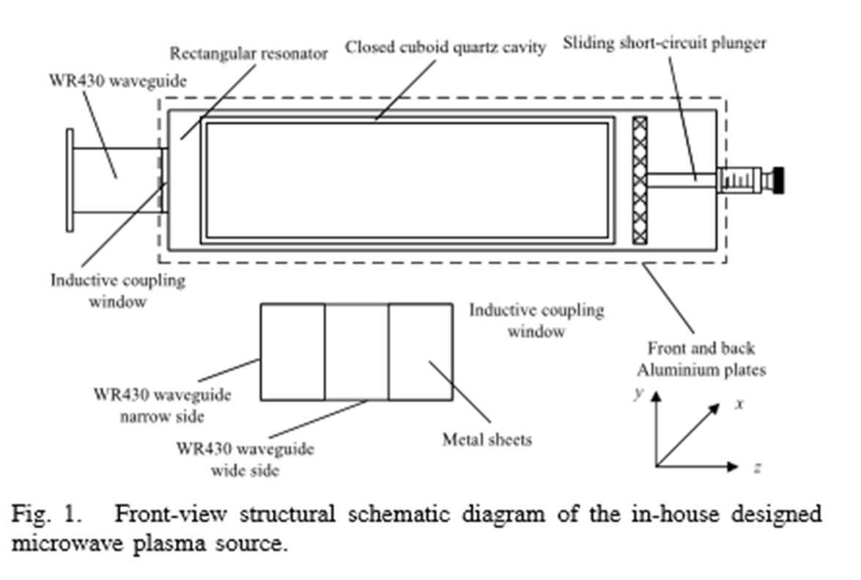
the design of this source
It consists of
a WR430 waveguide
an inductive coupling window
a rectangular resonator
a closed cuboid quartz cavity
a sliding short-circuit plunger

Slide 7
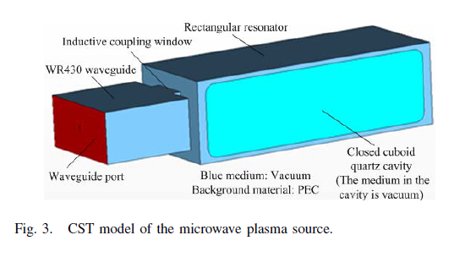
The CST model of the plasma source
The size of the inductive coupling window are
The width 35.5 mm.
The Height 54.61 mm.
The thickness 2 mm.
The dimensions of the internal cross section of the rectangular resonator are 113.22 mm × 77 mm.
The inside dimensions of the cuboid quartz cavity are 224 mm × 96 mm × 60 mm
The wall thickness is 8 mm.
The sliding range of the short-circuit plunger is from 0 to 90 mm.

Slide 8
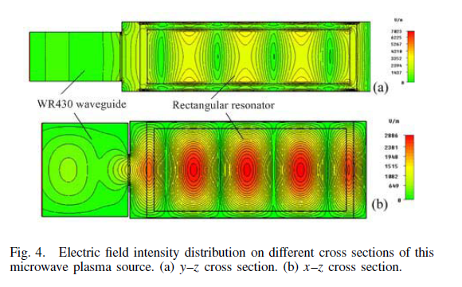
The electric field intensity in the quartz cavity maximizes when the length of the rectangular resonator is 260 mm.
The peak electric intensity of the standing wave within the quartz cavity is approximately 3400 V/m for per watt of input microwave power at the microwave frequency f = 2.450 GHz.

Slide 9
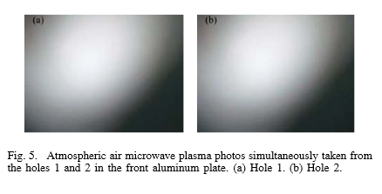
PRODUCTION OF ATMOSPHERIC AIR MICROWAVE PLASMA
An atmospheric air microwave plasma is produced according to the following procedure:
A low pressure air microwave plasma is first excited in the quartz cavity at the input microwave power of 5.0 kW
The air in the quartz cavity is made open to the atmosphere.
The atmospheric air microwave plasma photos simultaneously taken from the holes 1 and 2 in the front aluminum plate.
The two holes (diameter = 5 mm) are located in the middle of the narrow side of the front aluminum plate
They have a distance of 63 mm along the resonator length direction.

Slide 10
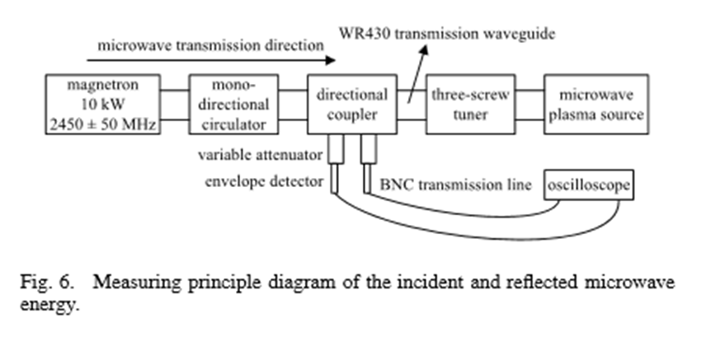
The research of microwave reflection characteristic.
The purpose of measuring principle diagram of the incident and reflected microwave energy is to evaluate the deviation degree of the impedance of the microwave plasma source from the standard impedance.

Slide 11
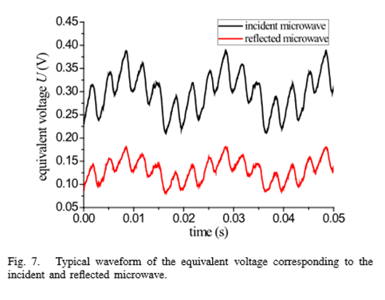
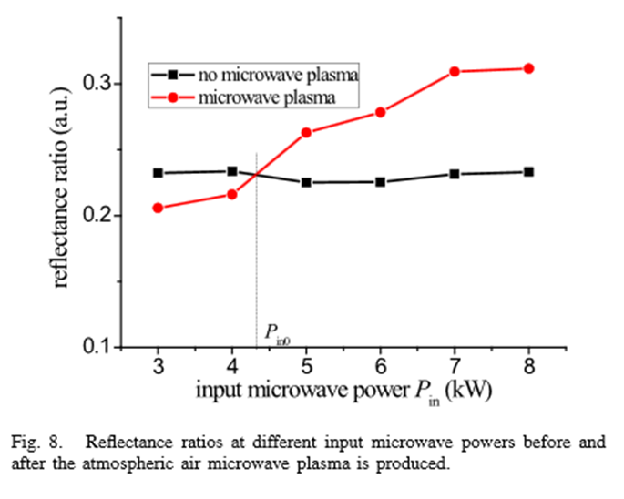
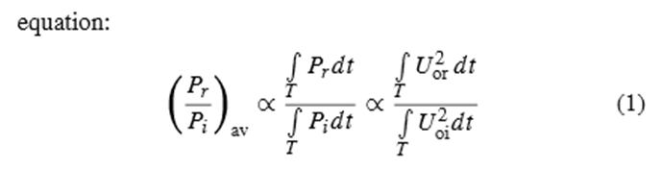
A typical waveform of the equivalent voltage
corresponding to the incident and reflected microwave.
The reflectance ratios of the microwave energy
at different input microwave powers before and after the atmospheric air microwave plasma is produced. The reflectance ratios are calculated using the following

Slide 12
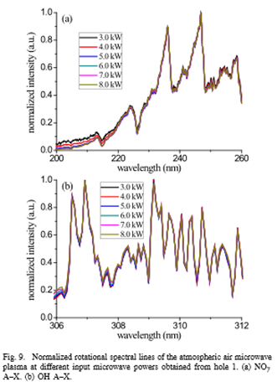
CHARACTERISTICS OF ATMOSPHERIC AIR MICROWAVE PLASMA
A. Gas Temperature of Atmospheric Air Plasma
The meaning of these normalized rotational spectral lines shows that
the emission spectrum is relatively stable
the atmospheric air microwave plasma is comparatively stable at least in the range of measuring time.

Slide 13
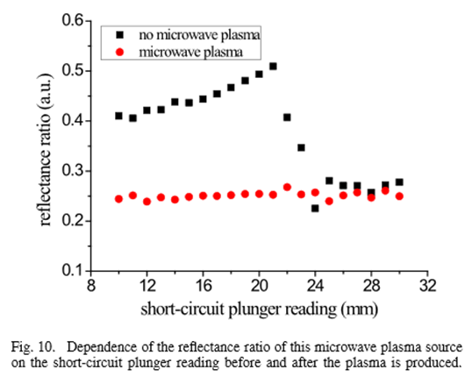
B. Microwave Cutoff by Atmospheric Air Plasma
The independence of the reflectance ratio on the plunger reading means that
the atmospheric air microwave plasma cuts off the 2.450 GHz of microwaves.

Slide 14
CONCLUSION
A novel microwave plasma source based on inductive coupling window—rectangular resonator is designed. Because it has many unique advantages over other plasmas, so it can apply to many industrial fields.
This microwave plasma source can produce a large-volume stable atmospheric air microwave plasma. In addition, the plasma volume is evaluated to be at least 63 mm × (40–50) mm × 30 mm.
Before the plasma is generated, this microwave plasma source is a linear microwave load. After the plasma is produced, its reflectance ratio increases with the increase in the input microwave power and the reflectance ratio at lower power is even smaller than that before the plasma is produced.
The gas temperature of this atmospheric air microwave plasma is roughly independent on the input microwave power.
The atmospheric air microwave plasma cuts off the microwave with the frequency of 2450 MHz.

Slide 15


