Slide 1
Verilog

Slide 2
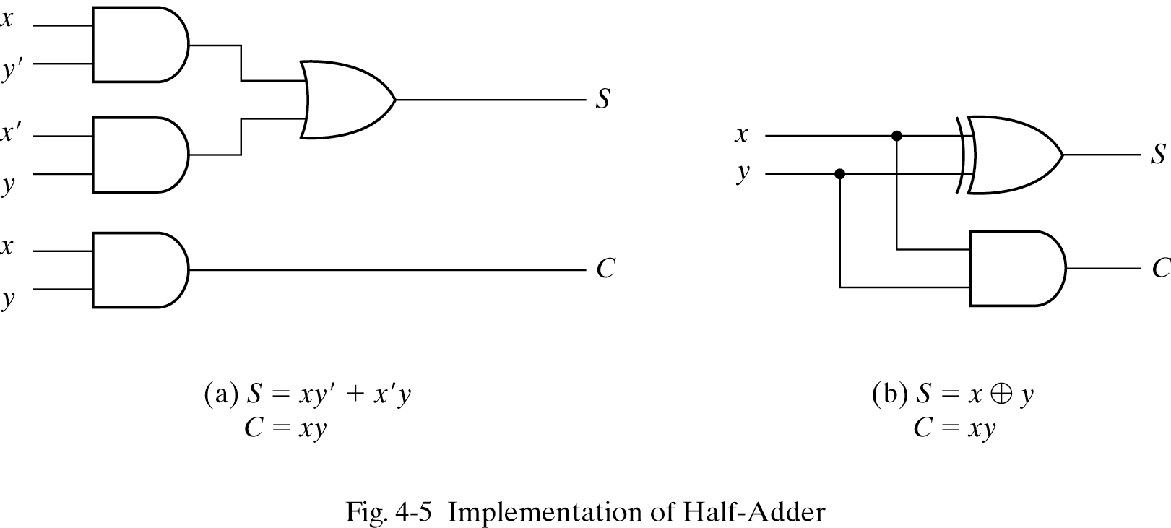
Hierarchical Design
4-bit adder in terms of full-adders
Full-adders in terms of half-adders
Half-adders in terms of gates.
//HDL Example 4-2
//-----------------------------------------------
//Gate-level hierarchical description of 4-bit adder
// Description of half adder (see Fig 4-5b)
module halfadder (S,C,x,y);
input x,y;
output S,C;
//Instantiate primitive gates
xor (S,x,y);
and (C,x,y);
endmodule

Slide 3
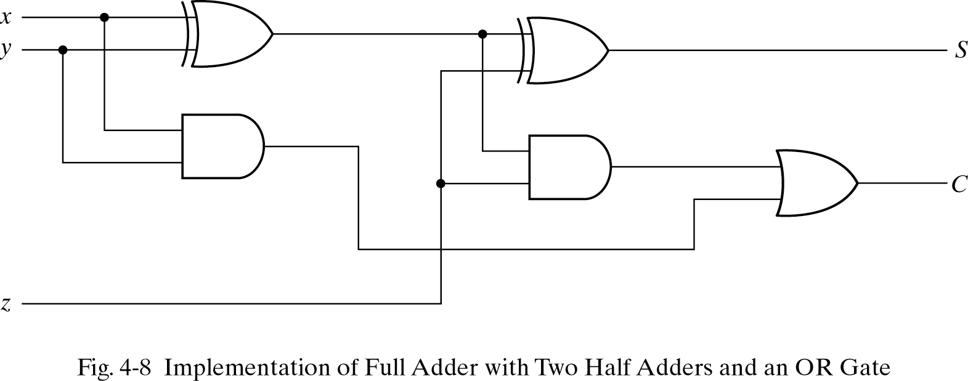
Hierarchical Design
//Description of full adder (see Fig 4-8)
module fulladder (S,C,x,y,z);
input x,y,z;
output S,C;
wire S1,D1,D2; //Outputs of first XOR and two AND gates
//Instantiate the halfadder
halfadder HA1 (S1,D1,x,y),
HA2 (S,D2,S1,z);
or g1(C,D2,D1);
endmodule
S1
D1
D2

Slide 4
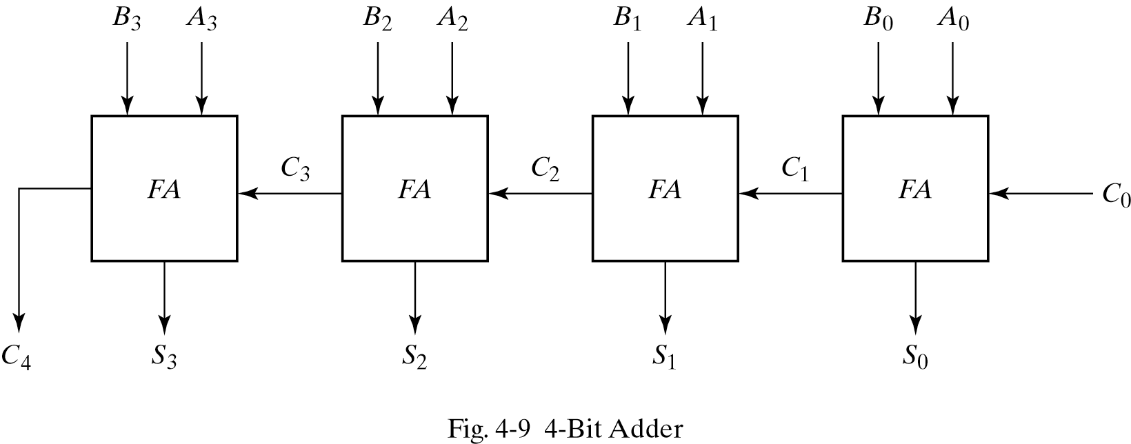
Hierarchical Design
//Description of 4-bit adder (see Fig 4-9)
module _4bit_adder (S,C4,A,B,C0);
input [3:0] A,B;
input C0;
output [3:0] S;
output C4;
wire C1,C2,C3; //Intermediate carries
//Instantiate the fulladder
fulladder FA0 (S[0],C1,A[0],B[0],C0),
FA1 (S[1],C2,A[1],B[1],C1),
FA2 (S[2],C3,A[2],B[2],C2),
FA3 (S[3],C4,A[3],B[3],C3);
endmodule

Slide 5
Dataflow Description
Using some operators and signal assignments
concat appends two operands and makes a larger one.
operator | Operation
+ | Binary addition
- | Binary subtraction
& | Bitwise and
| | Bitwise or
^ | Bitwise xor
~ | Bitwise not
== | Equality
> | Greater
< | Less
{ } | Concatenation
?: | Conditional

Slide 6
Decoder
//HDL Example 4-3
//----------------------------------------------
//Dataflow description of a 2-to-4-line decoder
//See Fig.4-19
module decoder_df (A,B,E,D);
input A,B,E;
output [0:3] D;
assign D[0] = ~(~A & ~B & ~E),
D[1] = ~(~A & B & ~E),
D[2] = ~(A & ~B & ~E),
D[3] = ~(A & B & ~E);
endmodule
continuous assignment:
assigns a value to a net (wire, output).

Slide 7
MUX
assign Y = (A & S) | (B & ~S);
//HDL Example 4-6
//----------------------------------------
//Dataflow description of 2-to-1-line multiplexer
module mux2x1_df (A,B,select,OUT);
input A,B,select;
output OUT;
assign OUT = select ? A : B;
endmodule

Slide 8
4-Bit Adder
//HDL Example 4-4
//----------------------------------------
//Dataflow description of 4-bit adder
module binary_adder (A,B,Cin,SUM,Cout);
input [3:0] A,B;
input Cin;
output [3:0] SUM;
output Cout;
assign {Cout,SUM} = A + B + Cin;
endmodule
+ can be used to add binary numbers.
Cout and SUM are concatenated.

Slide 9
4-Bit Comparator
//HDL Example 4-5
//-----------------------------------
//Dataflow description of a 4-bit comparator.
module magcomp (A,B,ALTB,AGTB,AEQB);
input [3:0] A,B;
output ALTB,AGTB,AEQB;
assign ALTB = (A < B),
AGTB = (A > B),
AEQB = (A == B);
endmodule
Comparison operators can be used to compare n-bit numbers.

Slide 10
Behavioral Modeling
//HDL Example 4-7
//---------------------------------
//Behavioral description of 2-to-1-line multiplexer
module mux2x1_bh(A,B,select,OUT);
input A,B,select;
output OUT;
reg OUT;
always @ (select or A or B)
if (select == 1) OUT = A;
else OUT = B;
endmodule
Uses always and an expression:
Change in any variable after @ → runs again
Statements within always: sequential
e.g. if else
Output of always construct must be reg.
A reg net keeps its value until a new value is assigned

Slide 11
4-1 MUX (Behavioral)
//HDL Example 4-8
//-------------------------------------
//Behavioral description of 4-to-1- line multiplexer
//Describes the function table of Fig. 4-25(b).
module mux4x1_bh (i0,i1,i2,i3,select,y);
input i0,i1,i2,i3;
input [1:0] select;
output y;
reg y;
always @ (i0 or i1 or i2 or i3 or select)
case (select)
2'b00: y = i0;
2'b01: y = i1;
2'b10: y = i2;
2'b11: y = i3;
endcase
endmodule
For combinational circuits, all variables to be read must be used in sensitivity list.

Slide 12
Simulation and Synthesis
Synthesis
Automatic design.
Software program takes design description and tries to find the circuit
برنامه نويسي
کامپايل
اجرا
ويرايش
ورود طرح
کامپايل
شبيه سازي
سنتز
شبيه سازي
ويرايش
ويرايش

Slide 13
Testbench
Testbench:
Applies inputs and is used to see the outputs.
Uses initial to drive the values.
runs once.
always runs many times
initial
begin
A = 1; B = 0;
#10 A = 0;
#20 A = 1; B = 1;
end

Slide 14
Testbench
001 is added to D seven times with 10 time units in between.
initial
begin
D = 3’b000;
repeat (7)
#10 D = D + 3’b001;
end

Slide 15
Testbench Structure
Testbench items:
test module name
reg and wire declarations
instantiation of circuit under test
initial/always statement
outputs display
No input/output ports:
Signals are applied through local regs.
Outputs to be displayed are declared as wires.

Slide 16
Testbench
You can see waveforms
Values can be displayed by Verilog system tasks:
$display: displays variable value once (with newline)
$display (format, argument list);
$write: as $display without newline,
$monitor: displays any variable that is changed during simulation.
$time: shows simulation time.
$finish: finishes simulation.
$display (“%d %b %b”, C, A, B);
$display (“time = %0d A = %b B = %b”, $time, A, B)

Slide 17
Testbench: Example
//HDL Example 4-9
//----------------------------
//Stimulus for mux2x1_df.
module testmux;
reg TA,TB,TS; //inputs for mux
wire Y; //output from mux
mux2x1_df mx (TA,TB,TS,Y);//instantiate mux
initial
begin
TS = 1; TA = 0; TB = 1;
#10 TA = 1; TB = 0;
#10 TS = 0;
#10 TA = 0; TB = 1;
end
initial
$monitor("select = %b A = %b B = %b OUT = %b time = %0d",
TS, TA, TB, Y, $time);
endmodule
//Dataflow description of 2-to-1-line multiplexer
//from Example 4-6
module mux2x1_df (A,B,select,OUT);
input A,B,select;
output OUT;
assign OUT = select ? A : B;
endmodule
Testbench items:
test module name,
reg and wire declarations,
instantiation of circuit under test,
initial/always statement,
outputs display,

Slide 18
Testbench
%0d is better for time because %d reserves 10 positions.
MUX inputs: reg,
MUX output: wire.

Slide 19
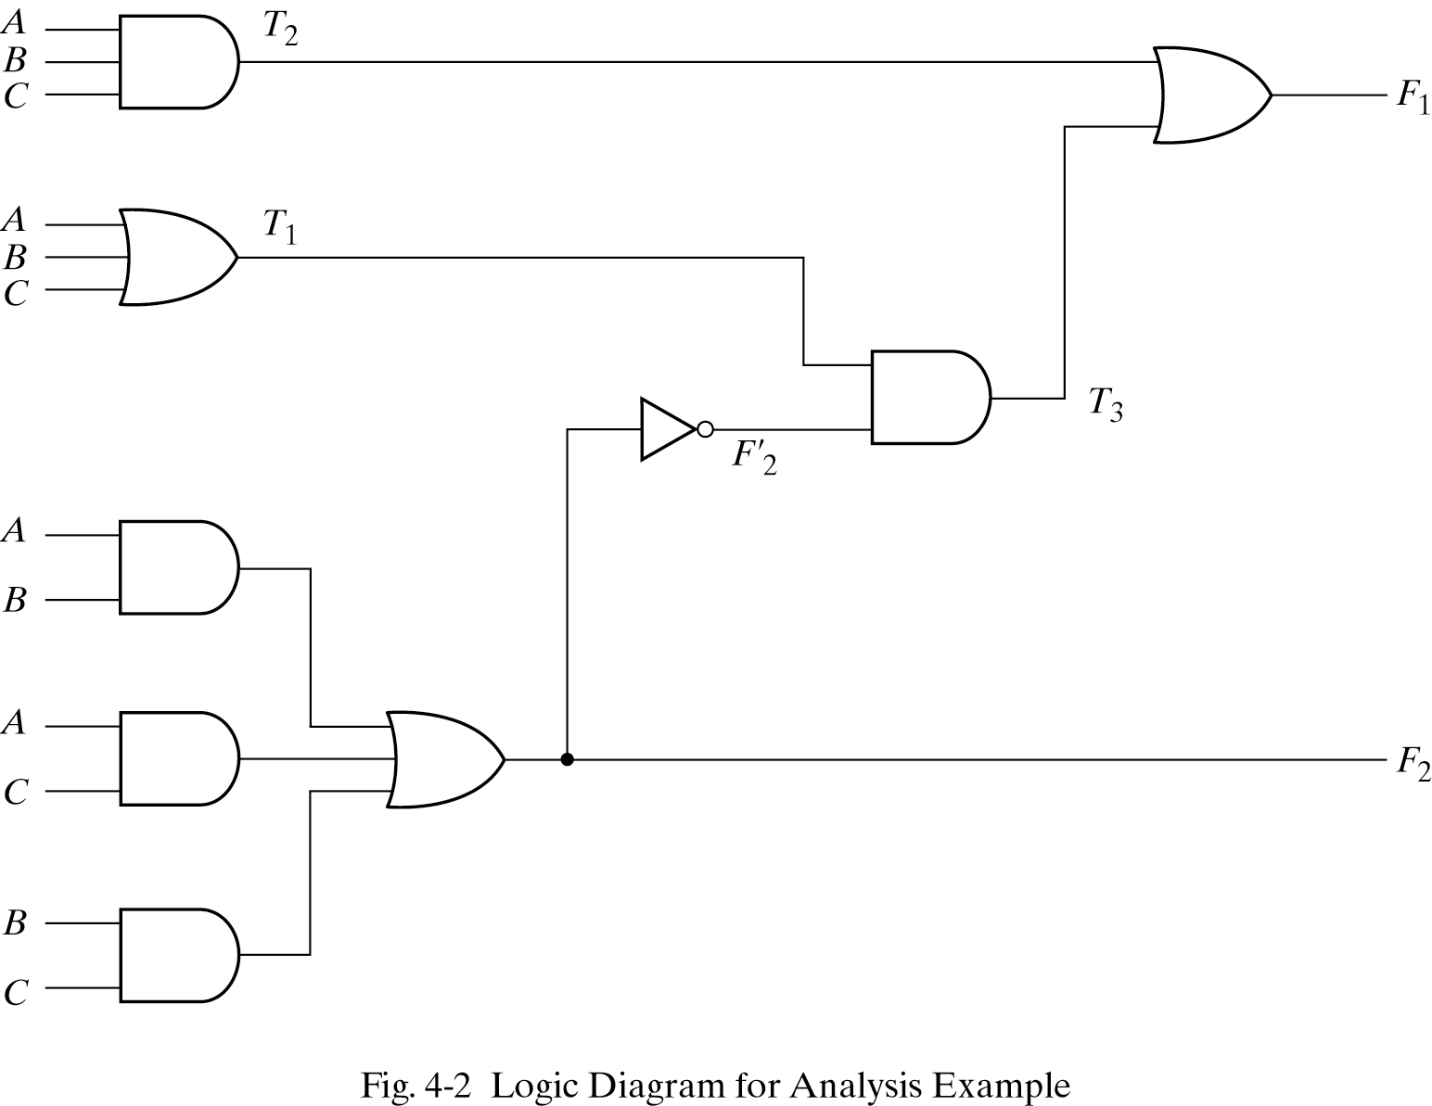
Testbench: Example 2

Slide 20
Testbench: Example2
//HDL Example 4-10
//------------------------------------------
//Gate-level description of circuit of Fig. 4-2
module analysis (A,B,C,F1,F2);
input A,B,C;
output F1,F2;
wire T1,T2,T3,F2not,E1,E2,E3;
or g1 (T1,A,B,C);
and g2 (T2,A,B,C);
and g3 (E1,A,B);
and g4 (E2,A,C);
and g5 (E3,B,C);
or g6 (F2,E1,E2,E3);
not g7 (F2not,F2);
and g8 (T3,T1,F2not);
or g9 (F1,T2,T3);
endmodule
//Stimulus to analyze the circuit
module test_circuit;
reg [2:0]D;
wire F1,F2;
analysis fig42(D[2],D[1],D[0],F1,F2);
initial
begin
D = 3'b000;
repeat(7)
#10 D = D + 1'b1;
end
initial
$monitor ("ABC = %b F1 = %b F2 =%b ",D, F1, F2);
endmodule
Simulation Log:
ABC = 000 F1 = 0 F2 =0
ABC = 001 F1 = 1 F2 =0
ABC = 010 F1 = 1 F2 =0
ABC = 011 F1 = 0 F2 =1
ABC = 100 F1 = 1 F2 =0
ABC = 101 F1 = 0 F2 =1
ABC = 110 F1 = 0 F2 =1
ABC = 111 F1 = 1 F2 =1

