Slide 1
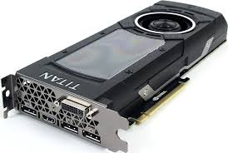
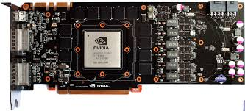

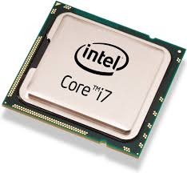
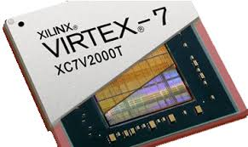
OpenMP
OpenCL
CUDA
HLS FPGA

Slide 2
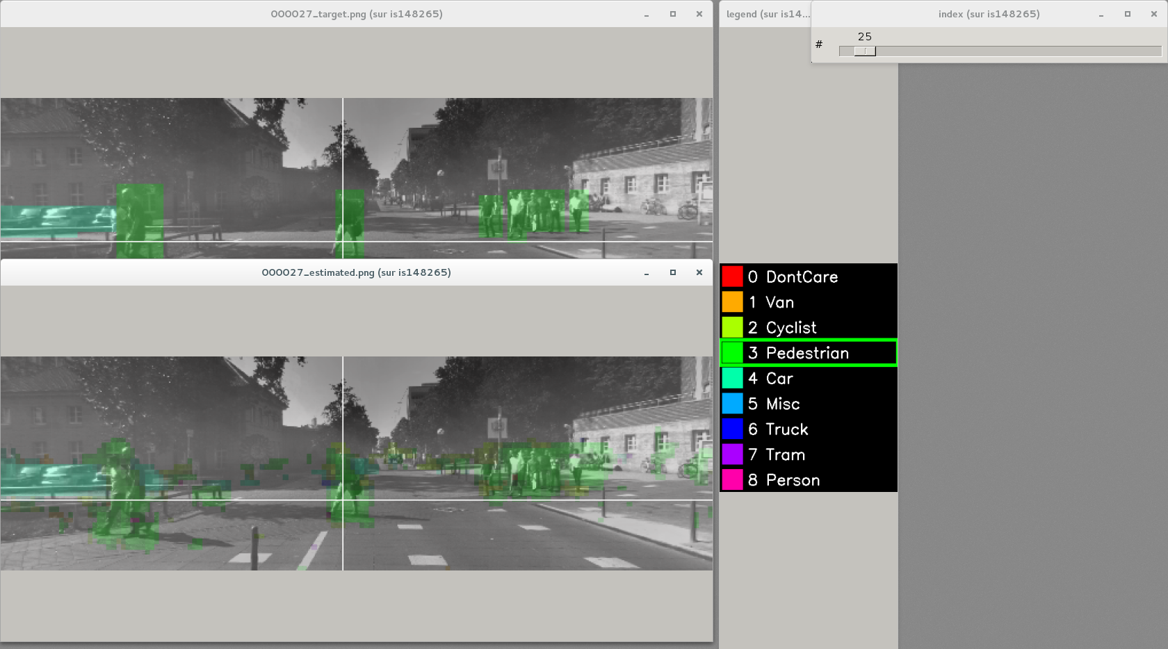
Pixels input label (dataset annotation)
Image selection
Network output estimation: pixels most probable object type
Labels legend
(object type)

Slide 3
Test set
Data channels
Validation set
Learn set
Channel Extract
Channel Extract
Channel Extract
DATA-BASE
Rescale
STATS
Affine
Op=-STATS .mean
Slice
Extract
DATA-BASE
Rescale
STATS
Affine
Op=-STATS .mean
Slice
Extract
Data-base
Rescale
STATS
Affine
Op=-STATS .mean
Slice
Extract
DL Core / Spike coding
Channel
Extract
STATS
Affine
Op/=STATS .stdDev
Channel
Extract
STATS
Affine
Op/=STATS .stdDev
Channel
Extract
STATS
Affine
Op=/STATS .stdDev
min
mean
Annotation data
(geometric
and pixel-wise)
Nb. of data (cumulative)
max
min
mean
Value
Nb. of data (cumulative)
Transformation module
max
Data analysis module
Value

Slide 4
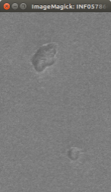
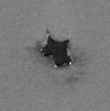
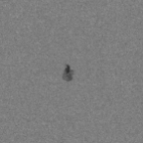
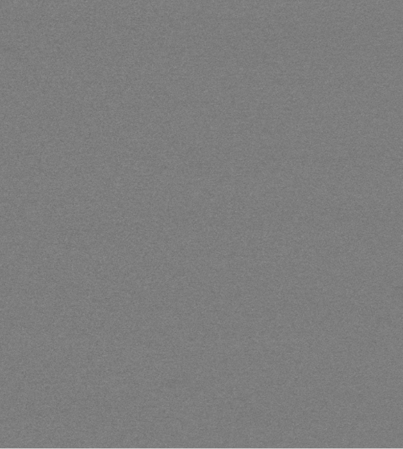
StimuliProvider
Data-base
Slice Extraction
Flip
ROI Extraction
Objects
database _objects
sp_objects
StimuliProvider
DL Core / Spike coding
Data-base
Rescale
…
Blending
database
sp
Images

Slide 5
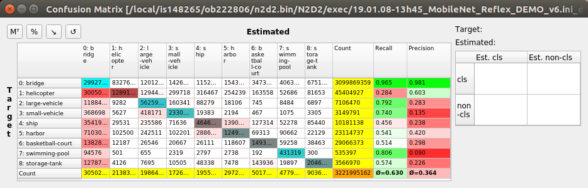
Average recall
Average precision

Slide 6
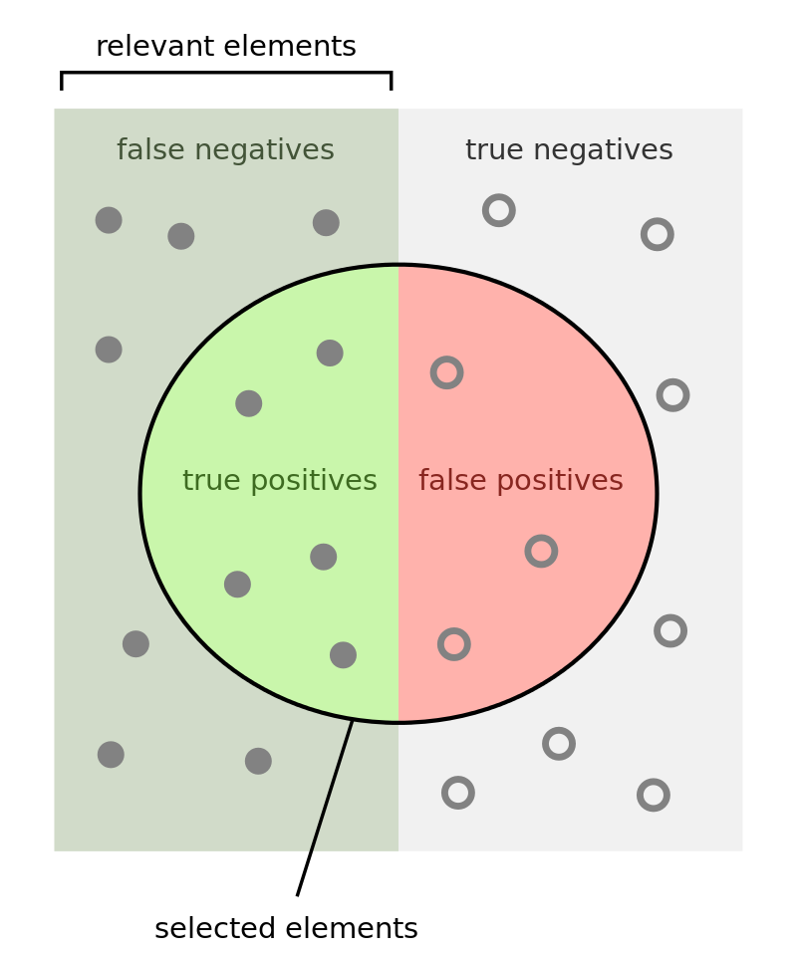
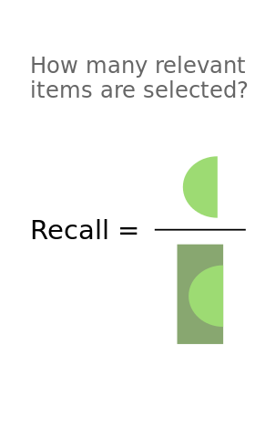
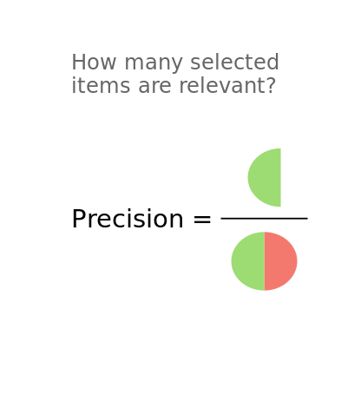



Accuracy =

Slide 7




Open source
Modeling & user interface:
Core modules (C++)
CEA IP under license
Partner IP under partner license
Database
(public dataset drivers)
Native INI API
Transformation
(data pre/post processing)
Export modules
Export specialization (compute kernels level) :
Cell
(NN layers modeling)
C++/OpenMP
Native Python API
Activation
TensorRT
/ CuDNN / CUDA
Générique MCU
Solver
PNeuro
STM32
Keras integration
Quantizer
DNeuro
STxP70/ASMP
Available soon
Filler
PyTorch integration
MPPA
Confidentiel
Target
(loss & score processing)
Export
(optimized code generation)
R-Car
HW Provider LIBs
Partner interfaces
Partner modules
HW Provider IPs

Slide 8
Coding model
Programming model (if several)
+ data precision (with template)
Cell_Frame _Top
Implementation
Cell_Frame <T>
ConvCell _Frame<T>
Cell_Frame _CUDA<T>
Cell
ConvCell _Frame_CUDA <T>
Cell_Spike
ConvCell _Spike
Mathematical model
ConvCell
FcCell

Slide 9
Inputs
Cell_Frame<T>
Cell_Frame<T>
Inputs
Interface<>
Tensor<T>
Output
Cell_Frame<T>
DiffOutputs
Interface<>
Tensor<T>
DiffInput
.
.
.
std::shared_ptr<Activation>
Reference
Value

Slide 10
Holds references to converted data types created by tensor_cast<T>()
BaseTensor
Wrapper around std::vector<T> with lazy allocation
Abstract class for
DataTensor
std::map<const std::type_info*,
std::shared_ptr<BaseDataTensor>>
DataTensor<T>
BaseData Tensor
≠ types
std::vector<T>
Tensor<T>
Reference
Value
std::shared_ptr<DataTensor<T>>

Slide 11
Cell
Return
Reference
Tensor
N2D2.Tensor
n2d2.Cell

Slide 12
Input
Backbone
Output
DataProvider
Tensor
Cell
Tensor
Classifier

Slide 13
Cell
Block
NeuralNetWorkCell
Iterable
…
Sequence
Layer
DeepNetCell

Slide 14
Torch Module
Torch Tensor
Torch Tensor
Torch autogradFunction
Forward pass
- Forward
Backward pass
- Backward
Torch
Torch Tensor
Torch Tensor
n2d2
n2d2 Tensor
n2d2 Block
- Parameters

