Slide 1
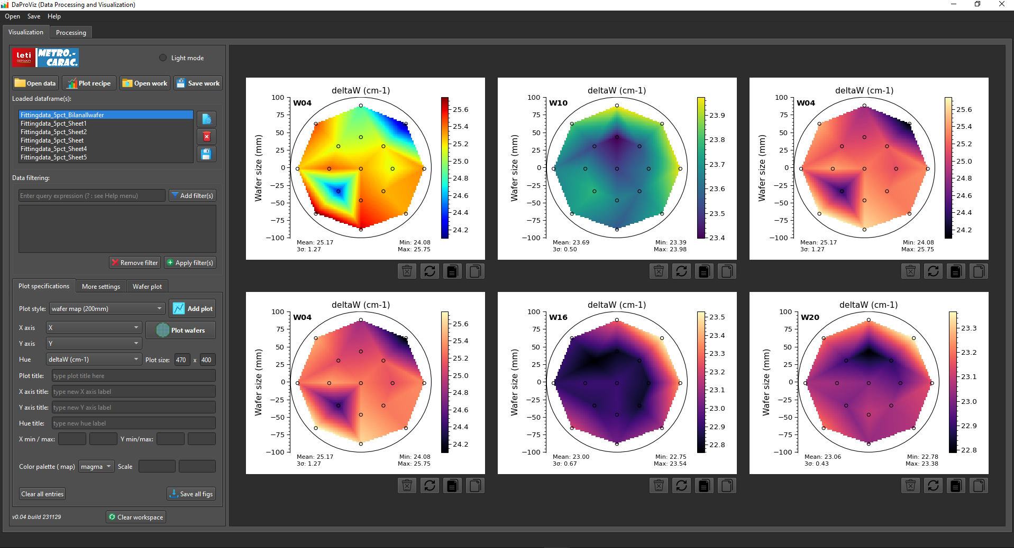
1
1bis
2
3
4
5
6
7
1. Open the datasheet (currently only Excel format is supported). 1bis. If your Excel file contains multiple sheets, select the sheet you want to work with.
2. Choose a plot style (box plot, wafer map (200mm, 300mm) etc.
3. Specify the columns containing X and Y coordinates.
4. Select the parameters you want to plot.
5. Click to “plot wafers” button to simultaneously visualize the selected data for all wafers.
6. Optionally, enter a new plot title.
7. Copy the plot and paste it directly into a PowerPoint (pptx) slide or save all figures in PNG format.

