Slide 1
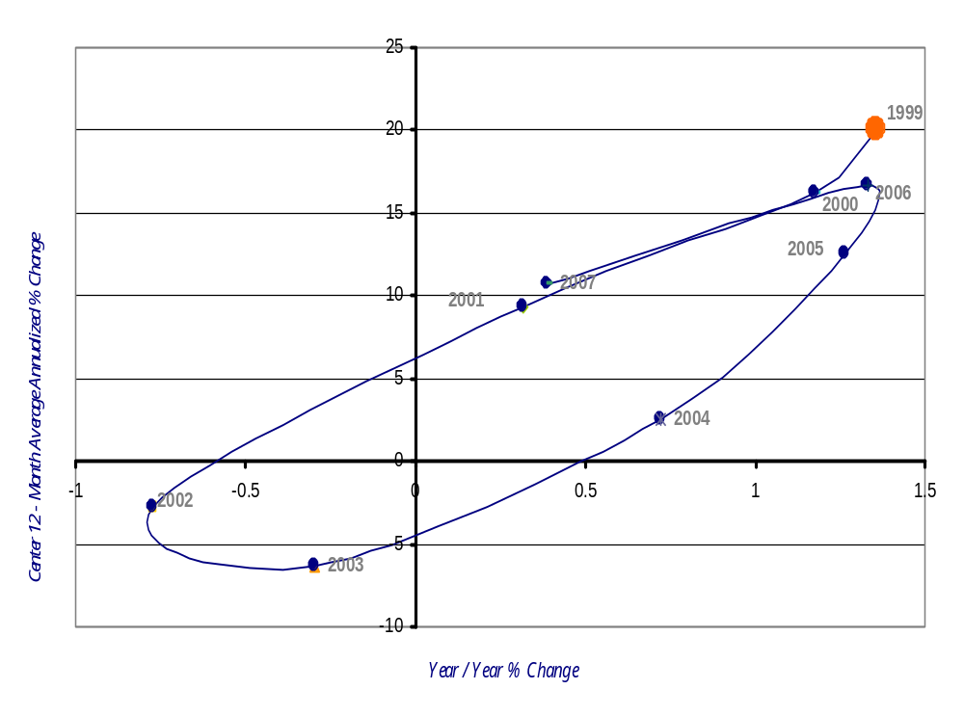
Oklahoma Employment Momentum Track
1999 - 2007
Improving
Leading
Lagging
Slipping
Source: Origins – Bureau of Labor Statistics Online Database

Slide 2
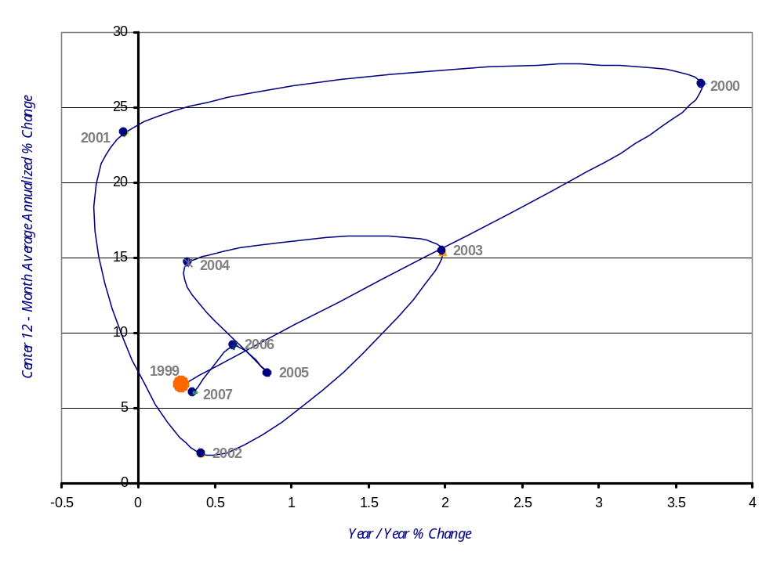
SOIC Region Employment Momentum Track
1999 - 2007
Improving
Leading
Lagging
Slipping
Source: Origins – Bureau of Labor Statistics Online Database

Slide 3
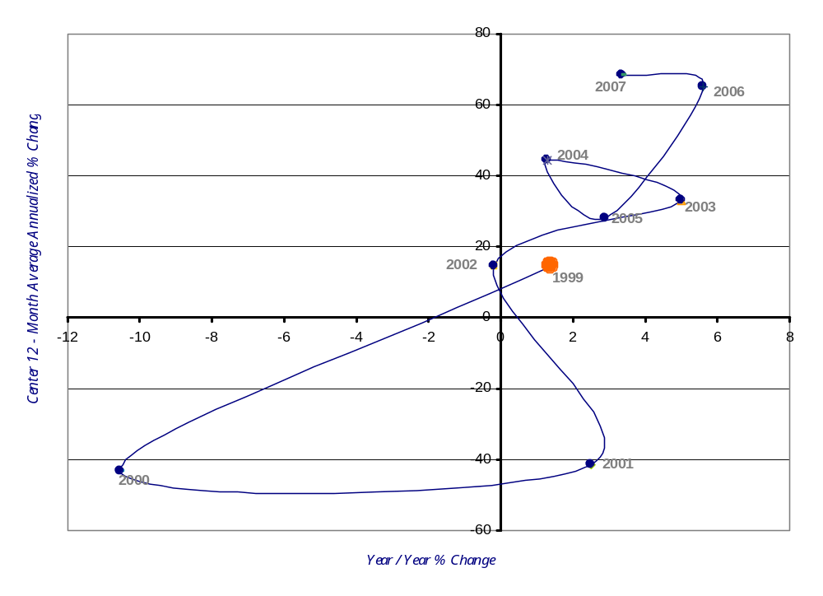
Beckham County Employment Momentum Track
1999 - 2007
Improving
Leading
Lagging
Slipping
Source: Origins – Bureau of Labor Statistics Online Database

Slide 4
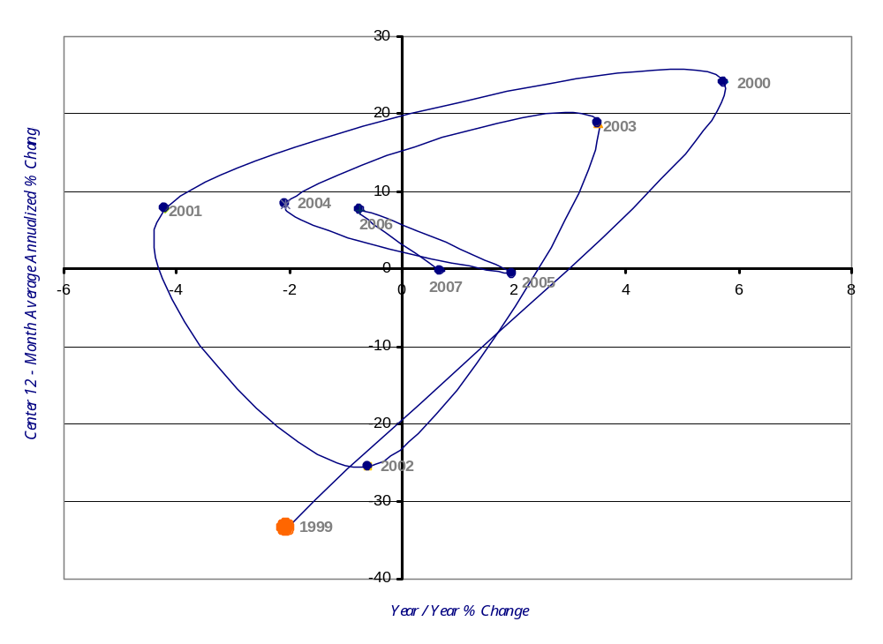
Blaine County Employment Momentum Track
1999 - 2007
Improving
Leading
Lagging
Slipping
Source: Origins – Bureau of Labor Statistics Online Database

Slide 5
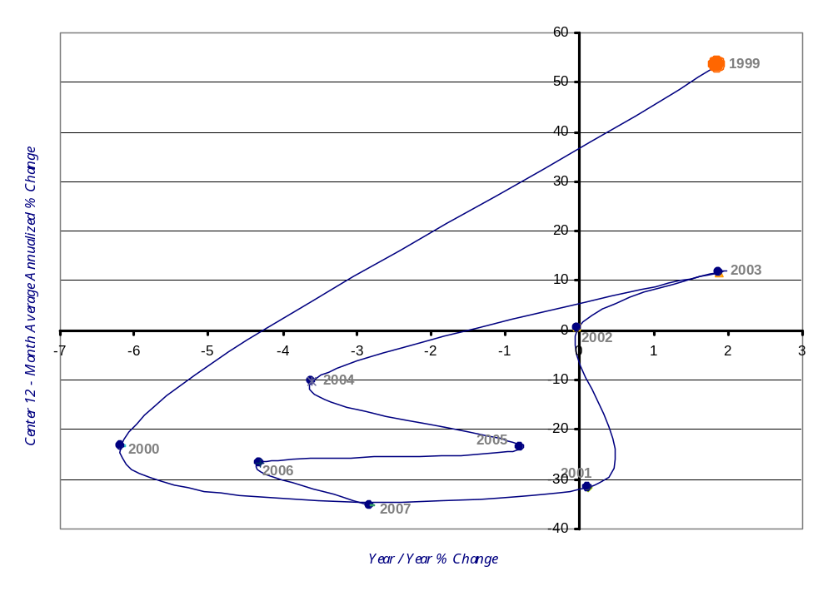
Caddo County Employment Momentum Track
1999 - 2007
Improving
Leading
Lagging
Slipping
Source: Origins – Bureau of Labor Statistics Online Database

Slide 6
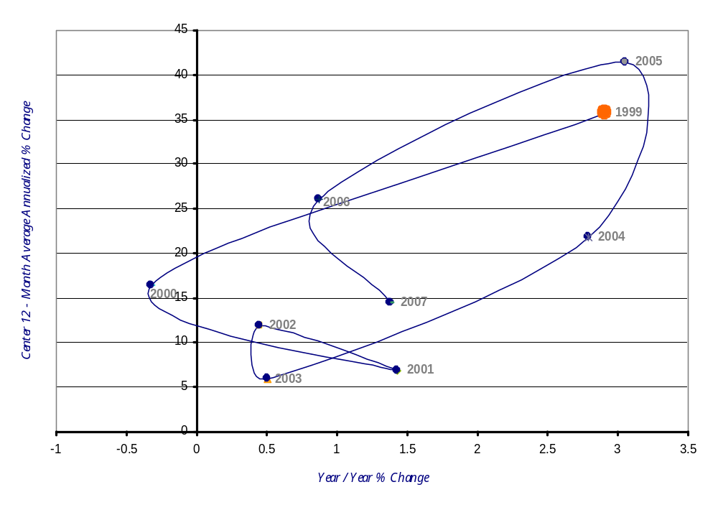
Canadian County Employment Momentum Track
1999 - 2007
Improving
Leading
Lagging
Slipping
Source: Origins – Bureau of Labor Statistics Online Database

Slide 7
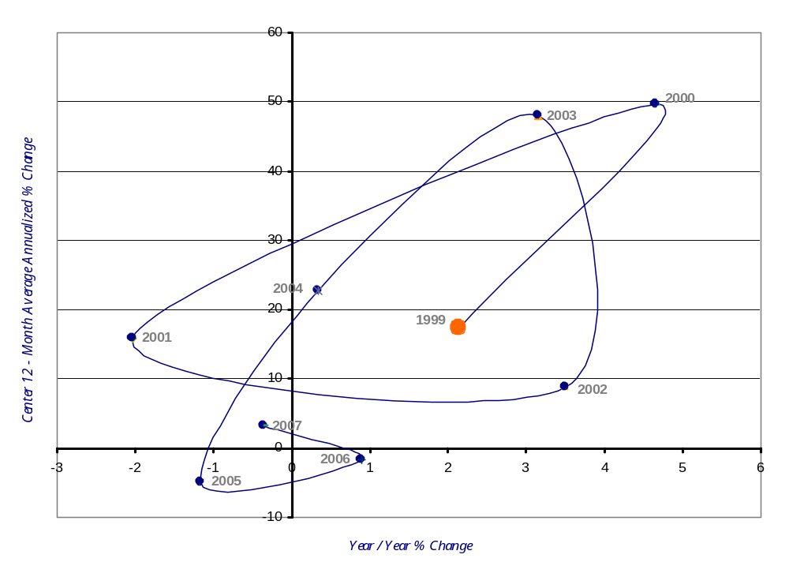
Comanche County Employment Momentum Track
1999 - 2007
Improving
Leading
Lagging
Slipping
Source: Origins – Bureau of Labor Statistics Online Database

Slide 8
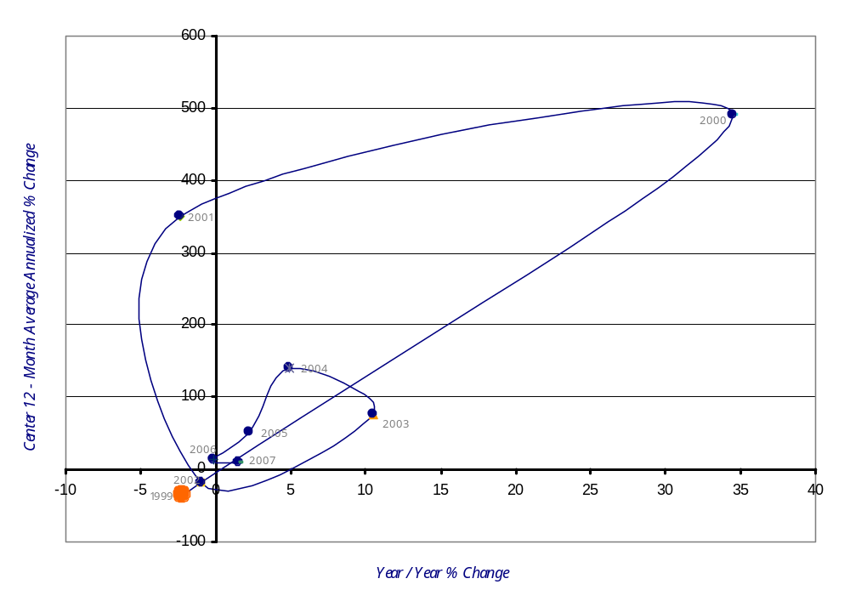
Cotton County Employment Momentum Track
1999 - 2007
Improving
Leading
Lagging
Slipping
Source: Origins – Bureau of Labor Statistics Online Database

Slide 9
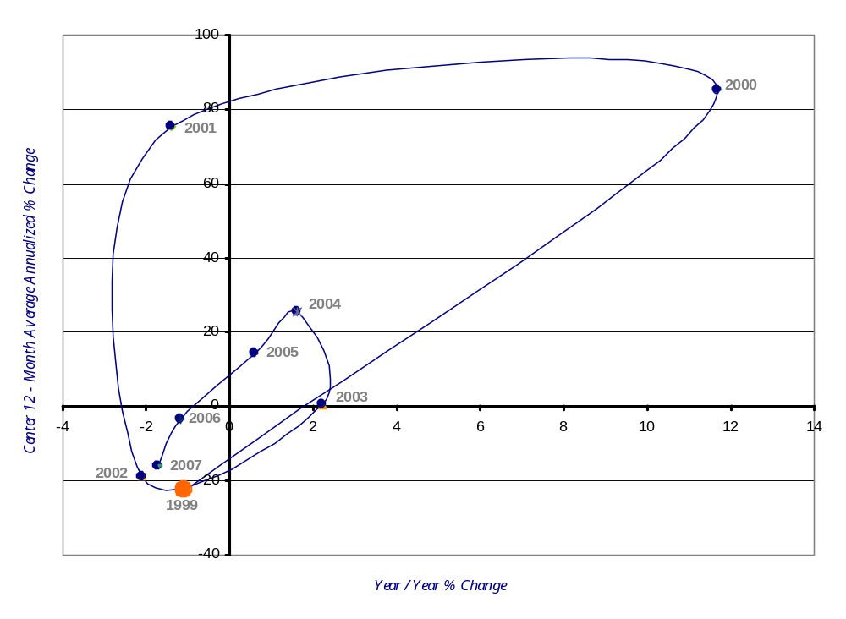
Custer County Employment Momentum Track
1999 - 2007
Improving
Leading
Lagging
Slipping
Source: Origins – Bureau of Labor Statistics Online Database

Slide 10
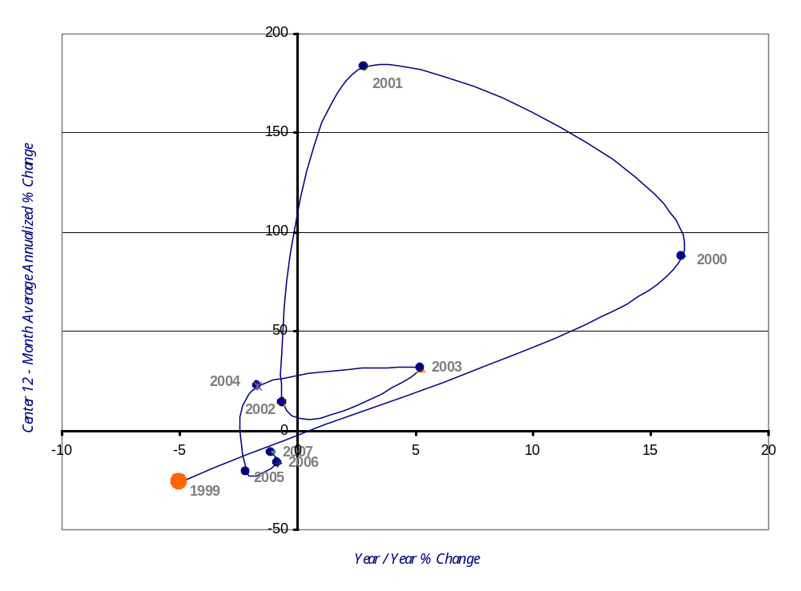
Dewey County Employment Momentum Track
1999 - 2007
Improving
Leading
Lagging
Slipping
Source: Origins – Bureau of Labor Statistics Online Database

Slide 11
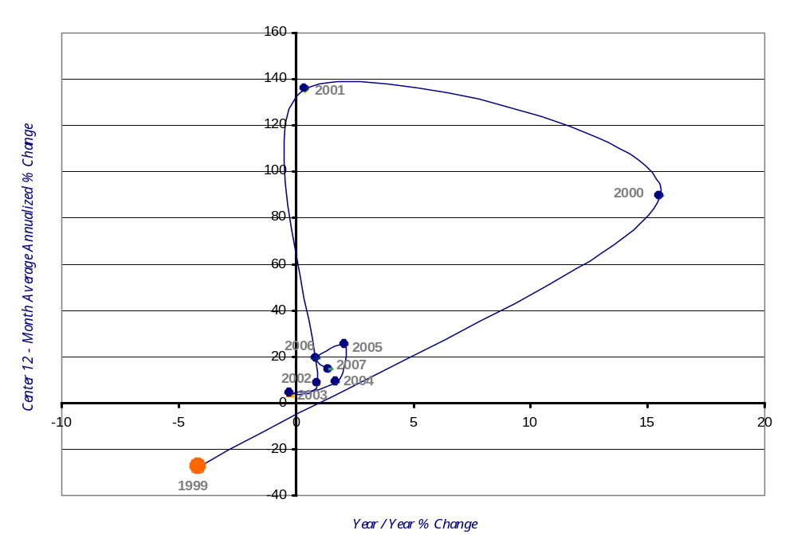
Grady County Employment Momentum Track
1999 - 2007
Improving
Leading
Lagging
Slipping
Source: Origins – Bureau of Labor Statistics Online Database

Slide 12
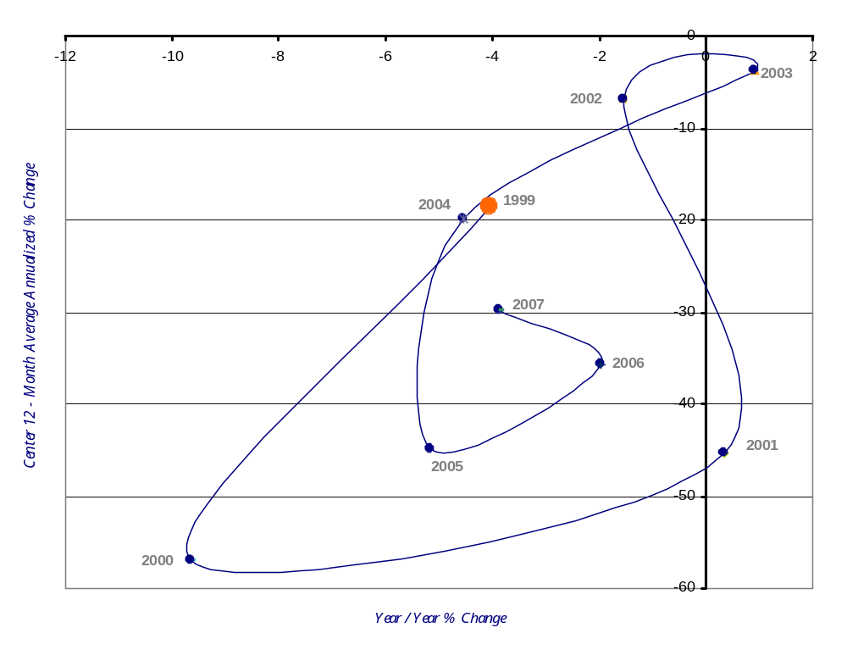
Greer County Employment Momentum Track
1999 - 2007
Improving
Leading
Lagging
Slipping
Source: Origins – Bureau of Labor Statistics Online Database

Slide 13
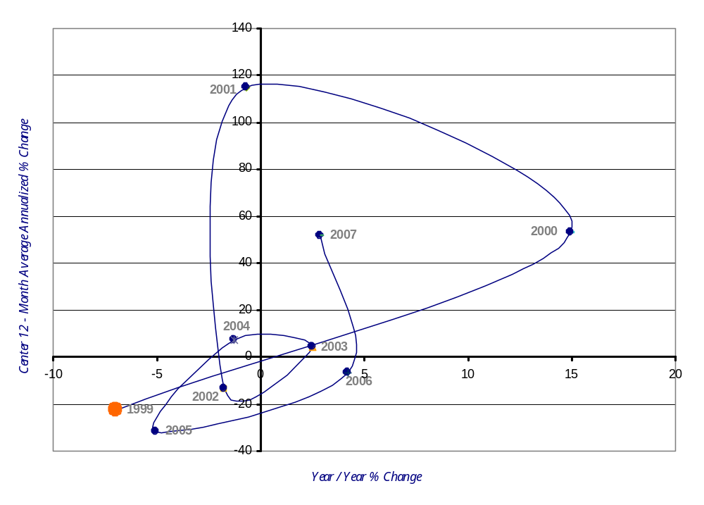
Harmon County Employment Momentum Track
1999 - 2007
Improving
Leading
Lagging
Slipping
Source: Origins – Bureau of Labor Statistics Online Database

Slide 14
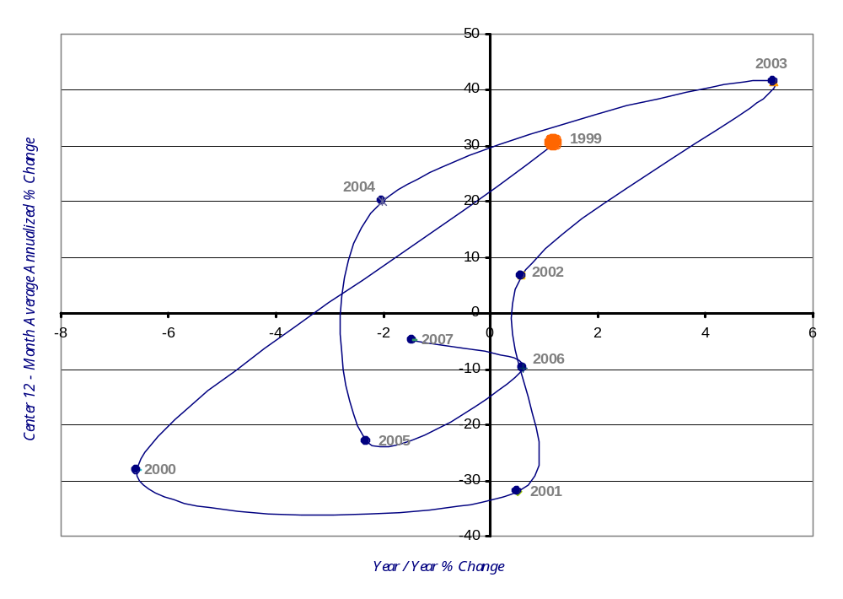
Jackson County Employment Momentum Track
1999 - 2007
Improving
Leading
Lagging
Slipping
Source: Origins – Bureau of Labor Statistics Online Database

Slide 15
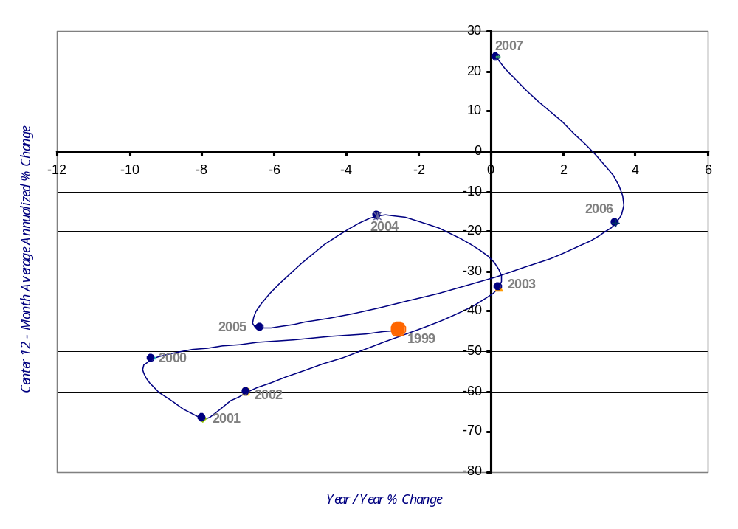
Jefferson County Employment Momentum Track
1999 - 2007
Improving
Leading
Lagging
Slipping
Source: Origins – Bureau of Labor Statistics Online Database

Slide 16
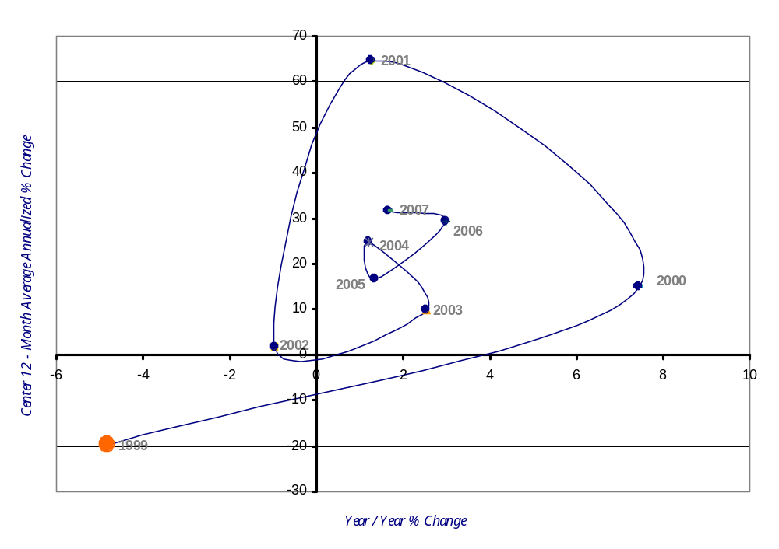
Kingfisher County Employment Momentum Track
1999 - 2007
Improving
Leading
Lagging
Slipping
Source: Origins – Bureau of Labor Statistics Online Database

Slide 17
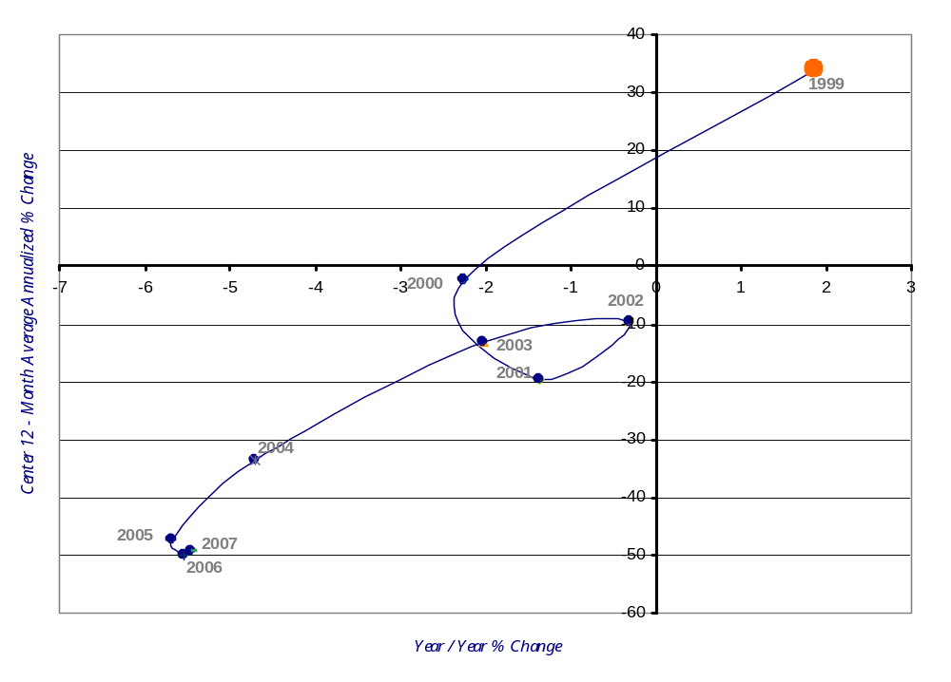
Kiowa County Employment Momentum Track
1999 - 2007
Improving
Leading
Lagging
Slipping
Source: Origins – Bureau of Labor Statistics Online Database

Slide 18
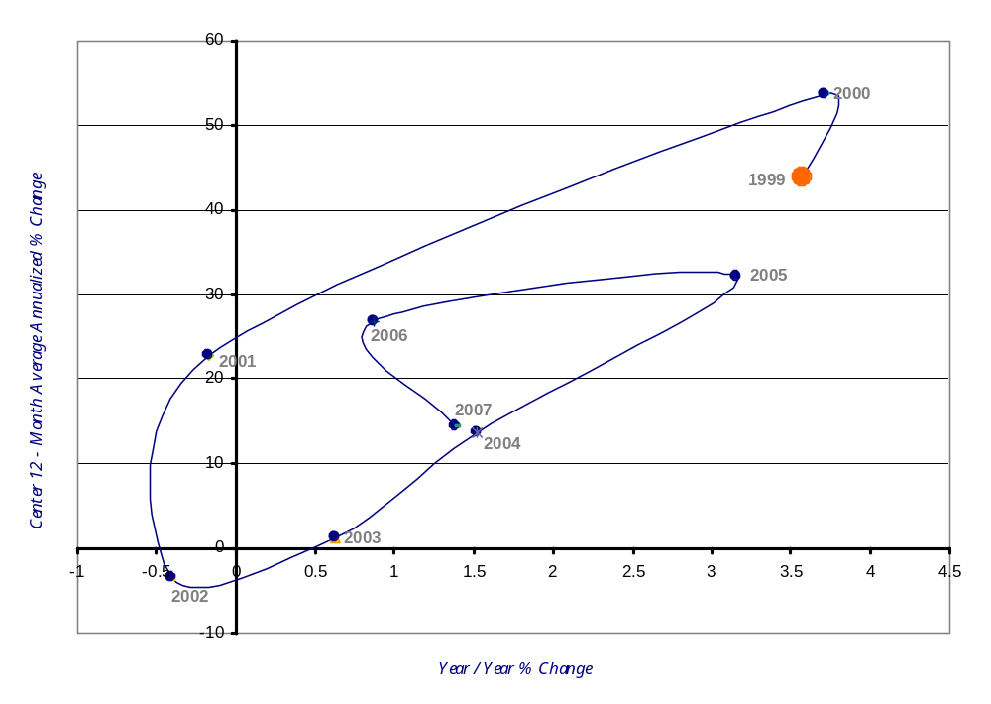
McClain County Employment Momentum Track
1999 - 2007
Improving
Leading
Lagging
Slipping
Source: Origins – Bureau of Labor Statistics Online Database

Slide 19
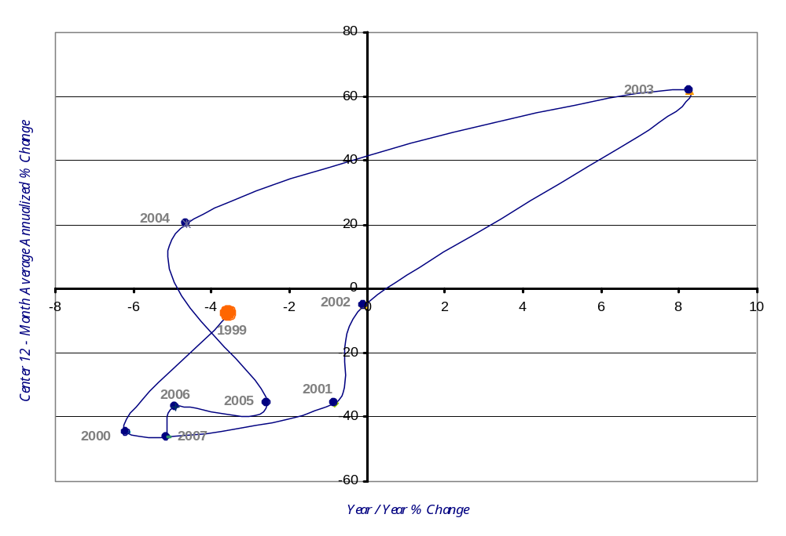
Roger Mills County Employment Momentum Track
1999 - 2007
Improving
Leading
Lagging
Slipping
Source: Origins – Bureau of Labor Statistics Online Database

Slide 20
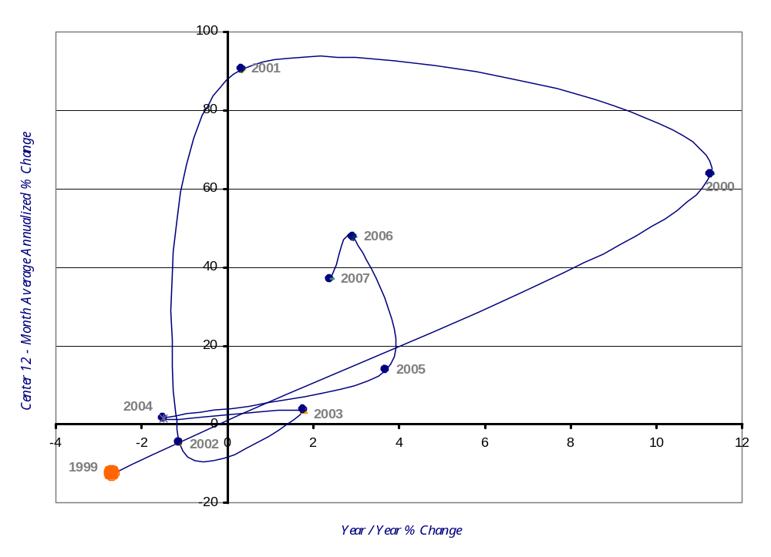
Stephens County Employment Momentum Track
1999 - 2007
Improving
Leading
Lagging
Slipping
Source: Origins – Bureau of Labor Statistics Online Database

Slide 21
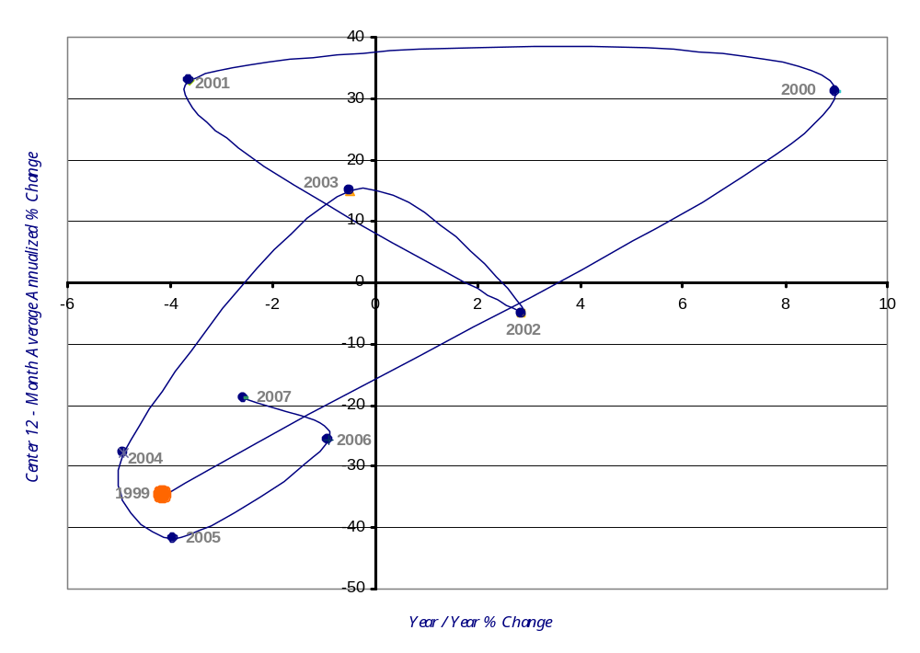
Tillman County Employment Momentum Track
1999 - 2007
Improving
Leading
Lagging
Slipping
Source: Origins – Bureau of Labor Statistics Online Database

Slide 22
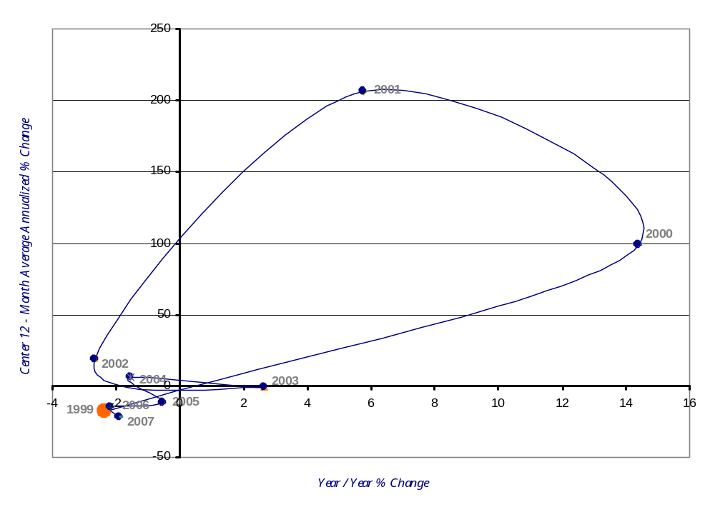
Washita County Employment Momentum Track
1999 - 2007
Improving
Leading
Lagging
Slipping
Source: Origins – Bureau of Labor Statistics Online Database

