Slide 1
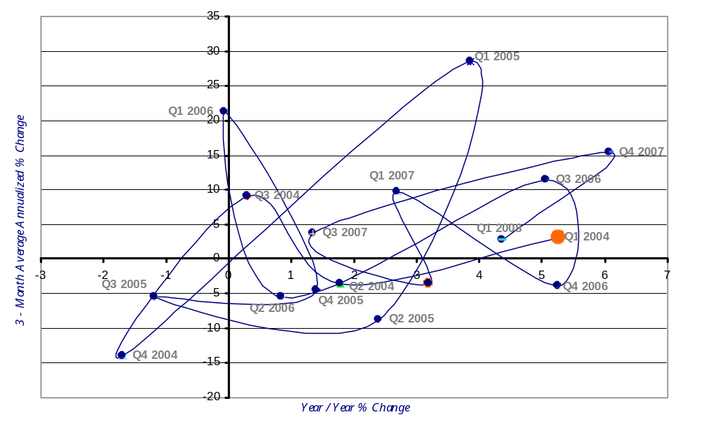
Altus City Sales Tax Collections Momentum Track
1st Qtr 2004 – 1st Qtr 2008
Improving
Leading
Lagging
Slipping
Source: Oklahoma Tax Commission (OTC)

Slide 2
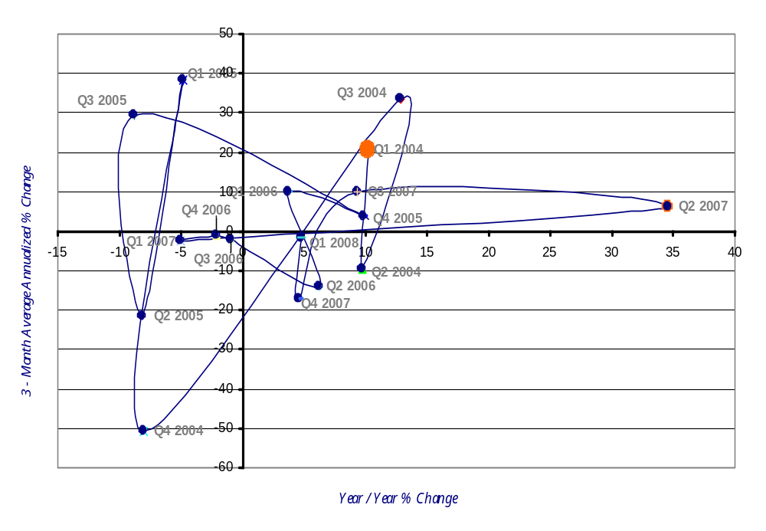
Anadarko City Sales Tax Collections Momentum Track
1st Qtr 2004 – 1st Qtr 2008
Improving
Leading
Lagging
Slipping
Source: Oklahoma Tax Commission (OTC)

Slide 3
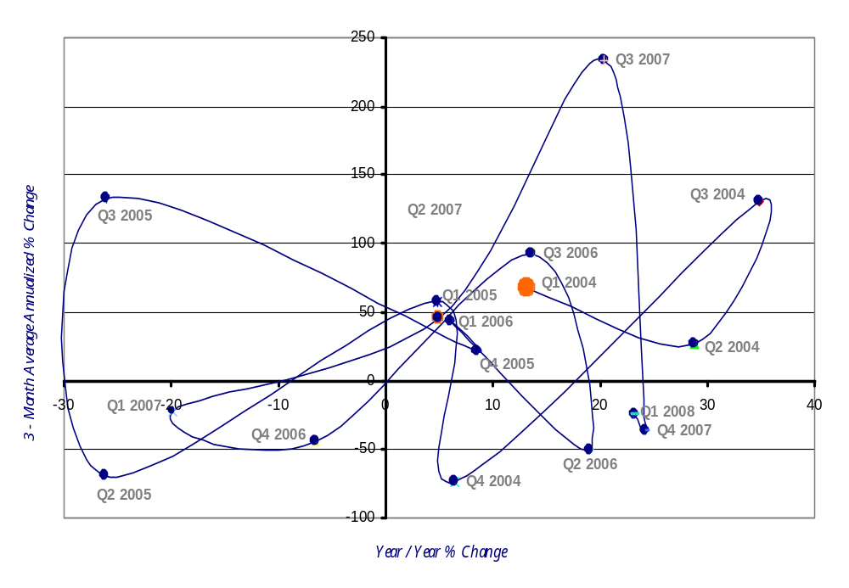
Burns Flat City Sales Tax Collections Momentum Track
1st Qtr 2004 – 1st Qtr 2008
Improving
Leading
Lagging
Slipping
Source: Oklahoma Tax Commission (OTC)

Slide 4
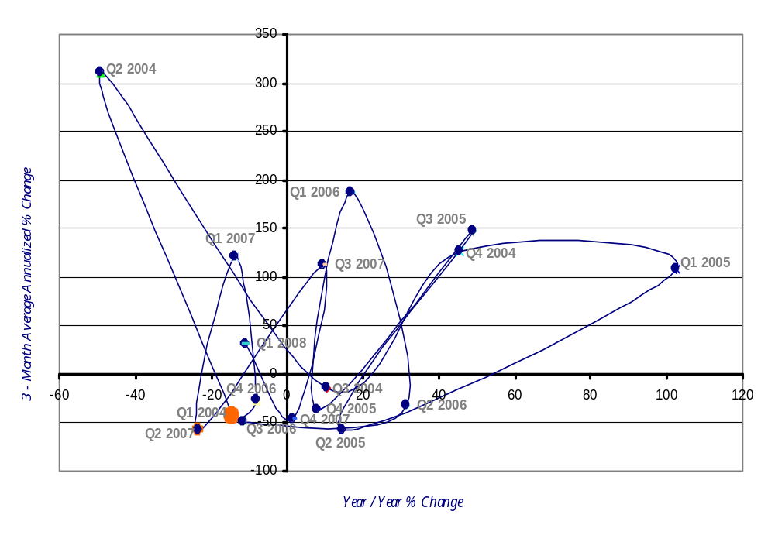
Cheyenne City Sales Tax Collections Momentum Track
1st Qtr 2004 – 1st Qtr 2008
Improving
Leading
Lagging
Slipping
Source: Oklahoma Tax Commission (OTC)

Slide 5
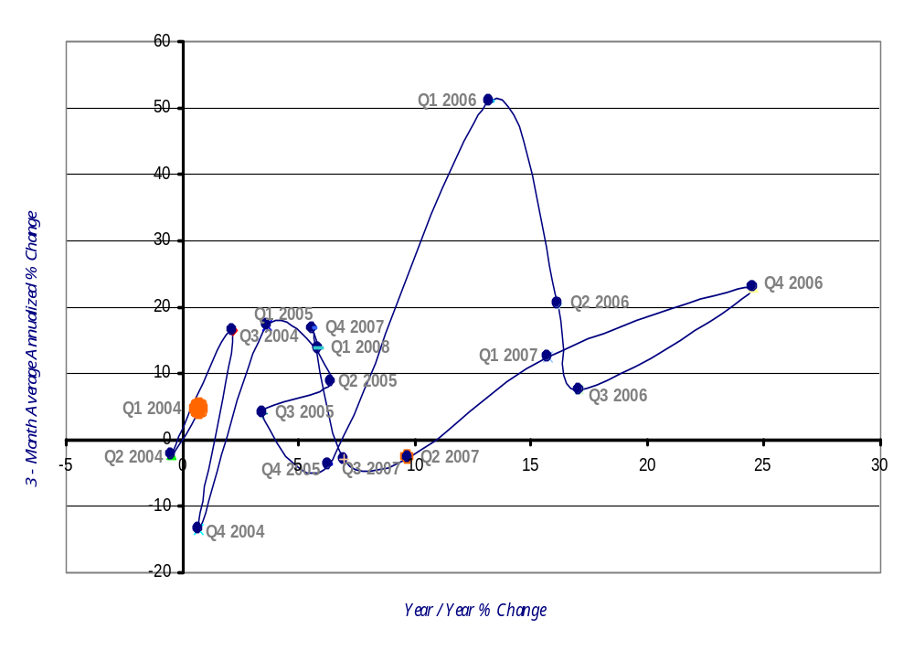
Chickasha City Sales Tax Collections Momentum Track
1st Qtr 2004 – 1st Qtr 2008
Improving
Leading
Lagging
Slipping
Source: Oklahoma Tax Commission (OTC)

Slide 6
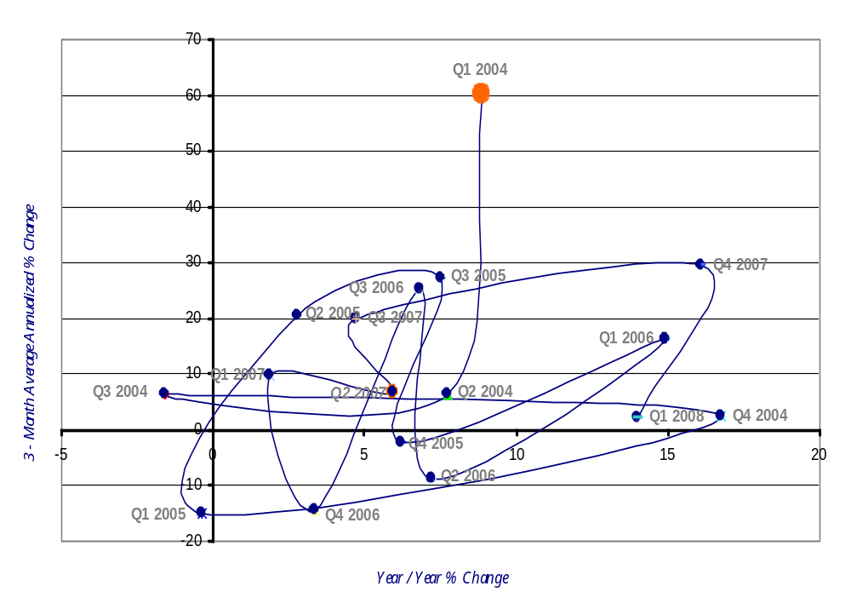
Clinton City Sales Tax Collections Momentum Track
1st Qtr 2004 – 1st Qtr 2008
Improving
Leading
Lagging
Slipping
Source: Oklahoma Tax Commission (OTC)

Slide 7
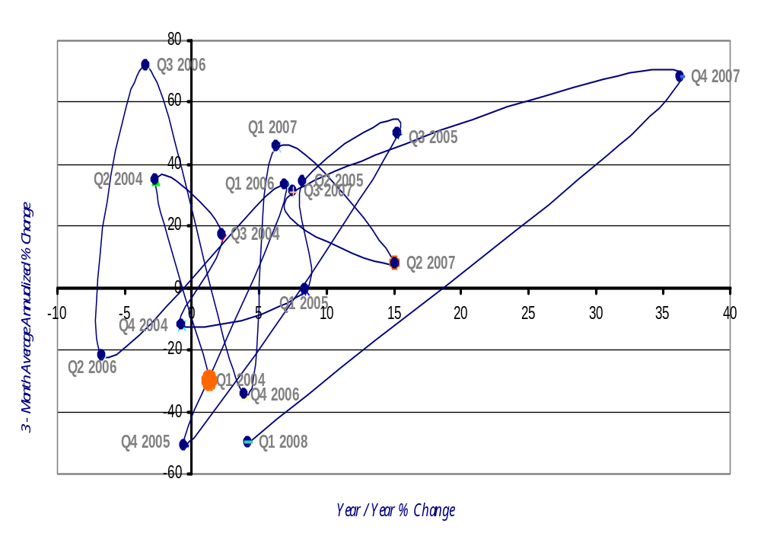
Cordell City Sales Tax Collections Momentum Track
1st Qtr 2004 – 1st Qtr 2008
Improving
Leading
Lagging
Slipping
Source: Oklahoma Tax Commission (OTC)

Slide 8
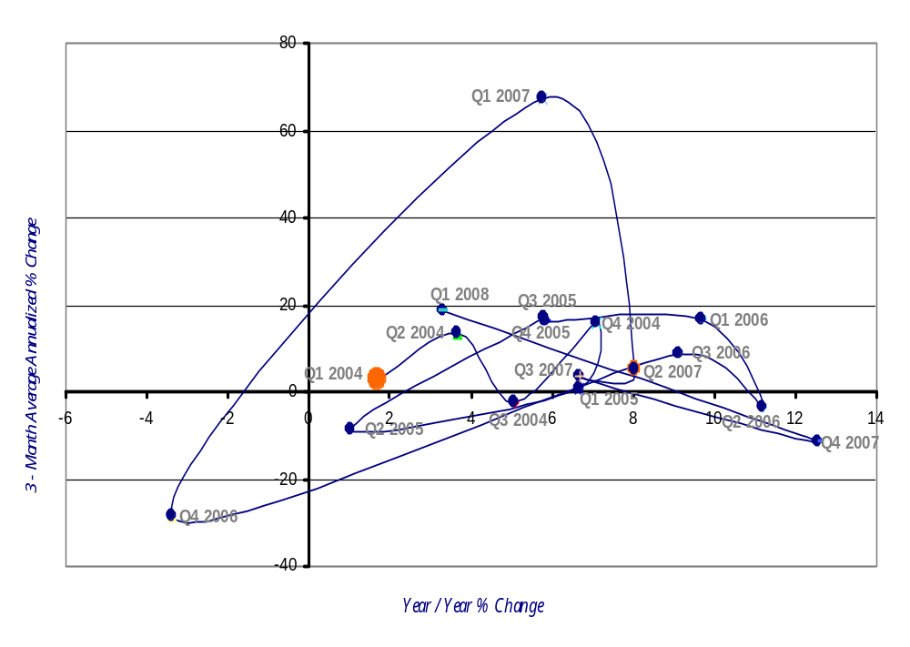
Duncan City Sales Tax Collections Momentum Track
1st Qtr 2004 – 1st Qtr 2008
Improving
Leading
Lagging
Slipping
Source: Oklahoma Tax Commission (OTC)

Slide 9
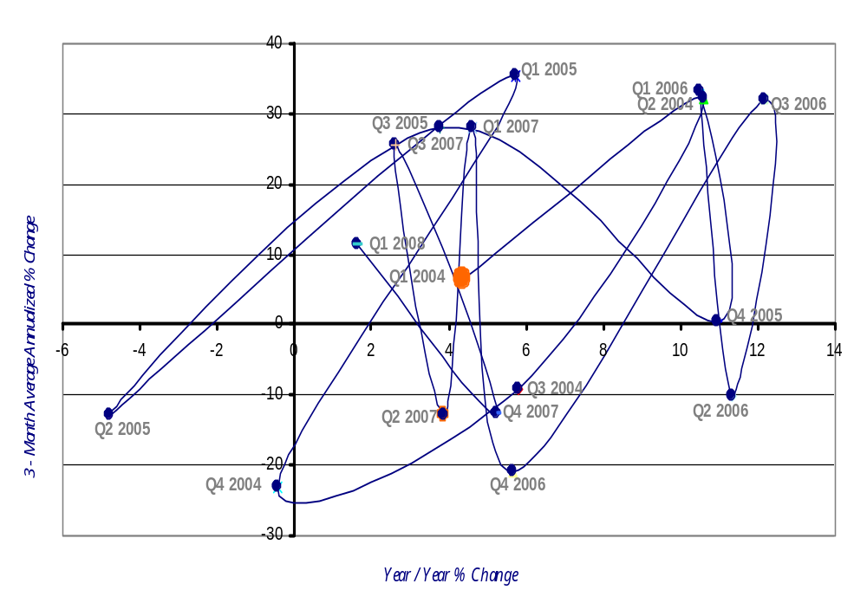
El Reno City Sales Tax Collections Momentum Track
1st Qtr 2004 – 1st Qtr 2008
Improving
Leading
Lagging
Slipping
Source: Oklahoma Tax Commission (OTC)

Slide 10
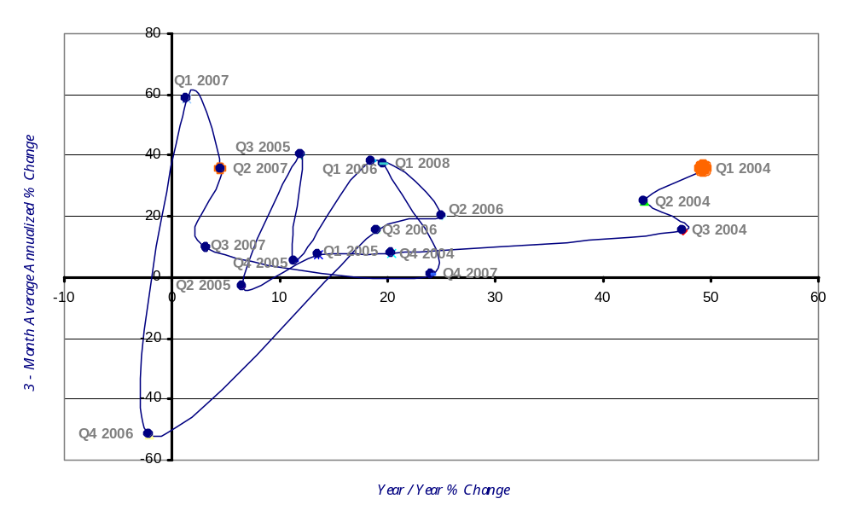
Elk City City Sales Tax Collections Momentum Track
1st Qtr 2004 – 1st Qtr 2008
Improving
Leading
Lagging
Slipping
Source: Oklahoma Tax Commission (OTC)

Slide 11
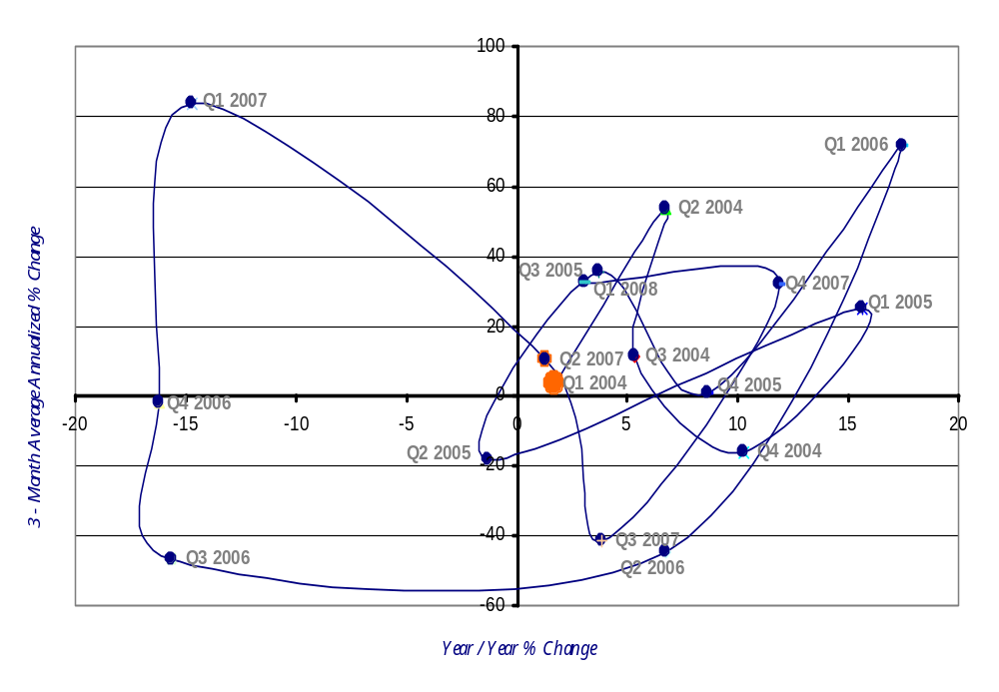
Frederick City Sales Tax Collections Momentum Track
1st Qtr 2004 – 1st Qtr 2008
Improving
Leading
Lagging
Slipping
Source: Oklahoma Tax Commission (OTC)

Slide 12
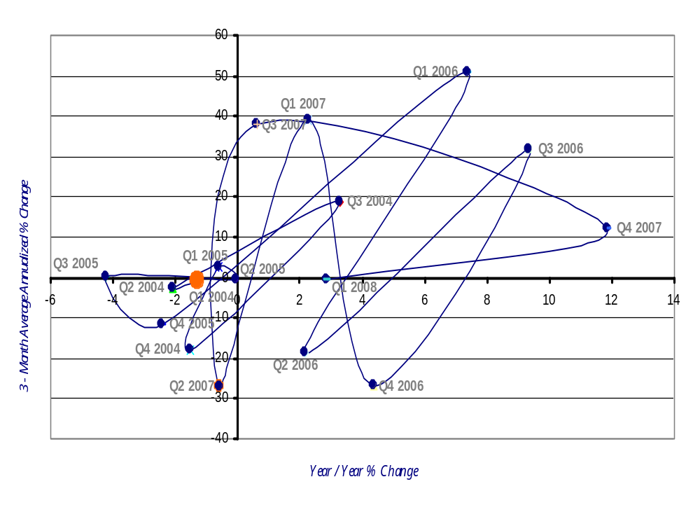
Hobart City Sales Tax Collections Momentum Track
1st Qtr 2004 – 1st Qtr 2008
Improving
Leading
Lagging
Slipping
Source: Oklahoma Tax Commission (OTC)

Slide 13
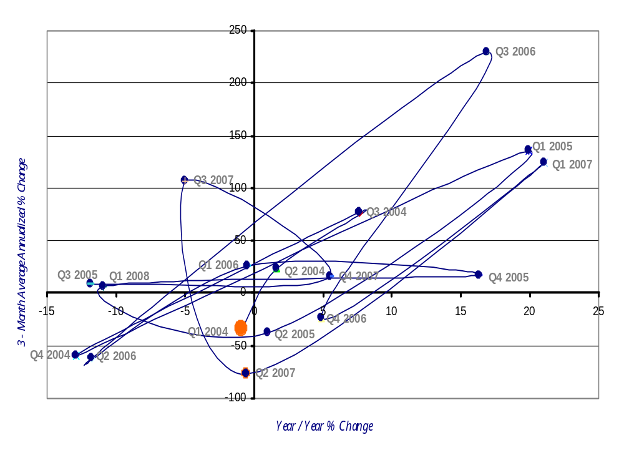
Hollis City Sales Tax Collections Momentum Track
1st Qtr 2004 – 1st Qtr 2008
Improving
Leading
Lagging
Slipping
Source: Oklahoma Tax Commission (OTC)

Slide 14
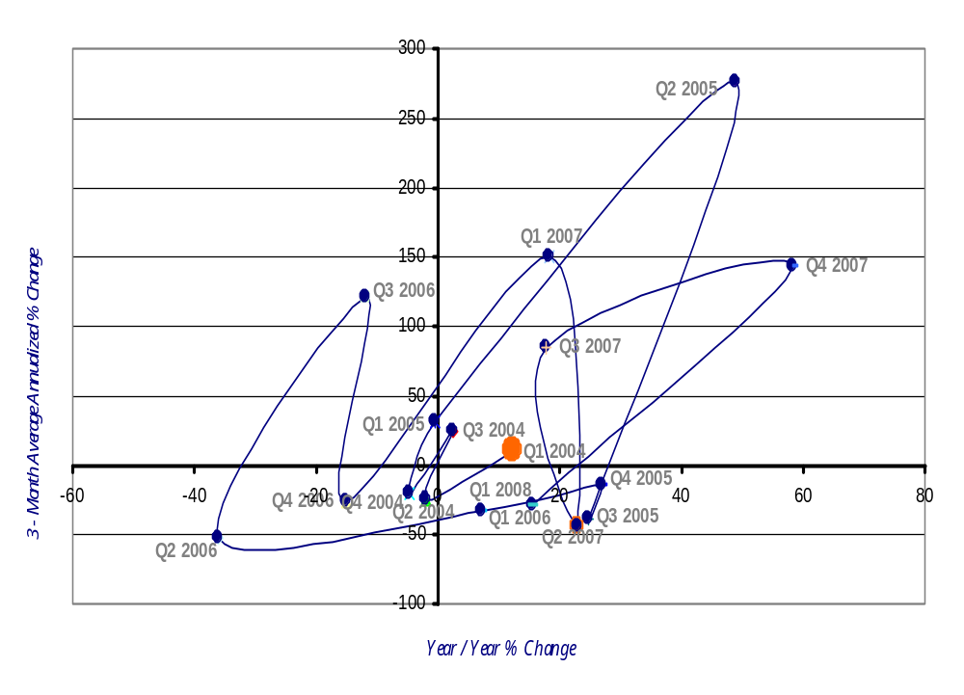
Kingfisher City Sales Tax Collections Momentum Track
1st Qtr 2004 – 1st Qtr 2008
Improving
Leading
Lagging
Slipping
Source: Oklahoma Tax Commission (OTC)

Slide 15
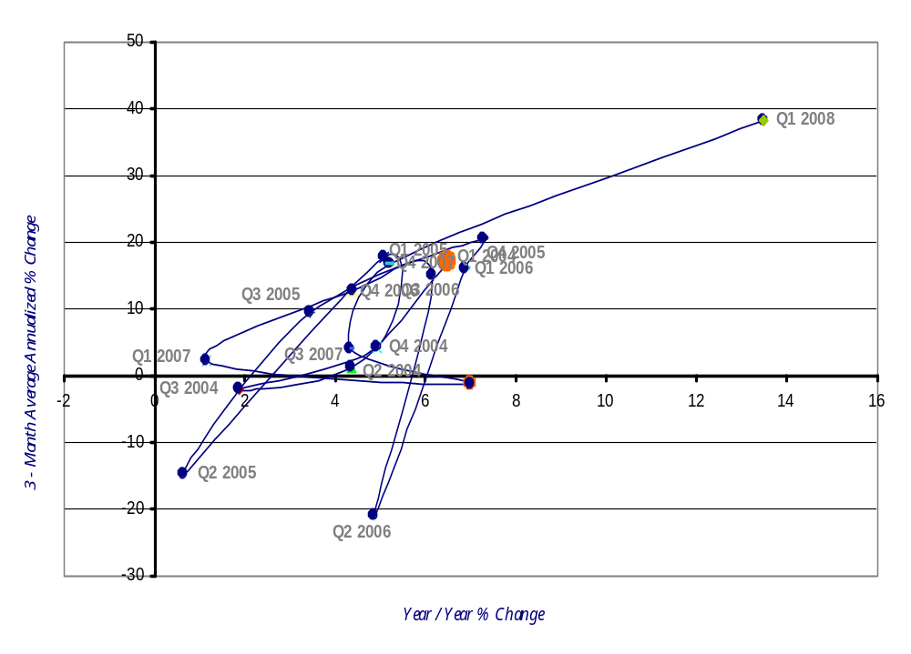
Lawton City Sales Tax Collections Momentum Track
1st Qtr 2004 – 1st Qtr 2008
Improving
Leading
Q2 2007
Lagging
Slipping
Source: Oklahoma Tax Commission (OTC)

Slide 16
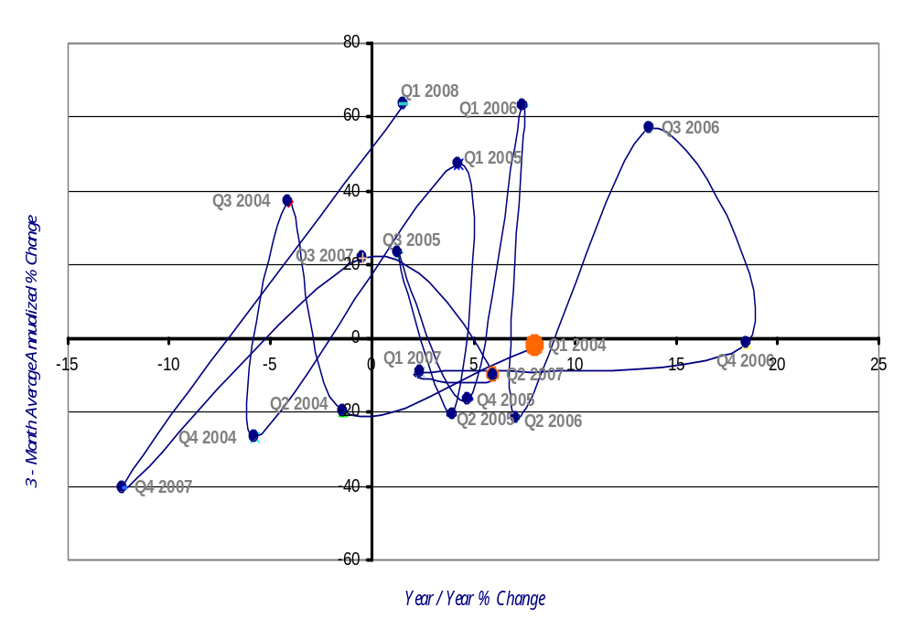
Mangum City Sales Tax Collections Momentum Track
1st Qtr 2004 – 1st Qtr 2008
Improving
Leading
Lagging
Slipping
Source: Oklahoma Tax Commission (OTC)

Slide 17
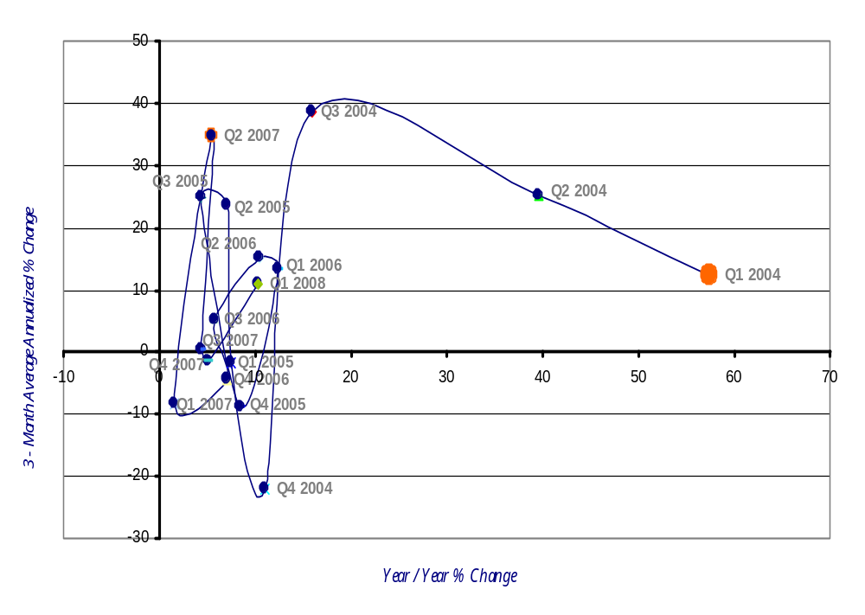
Mustang City Sales Tax Collections Momentum Track
1st Qtr 2004 – 1st Qtr 2008
Improving
Leading
Lagging
Slipping
Source: Oklahoma Tax Commission (OTC)

Slide 18
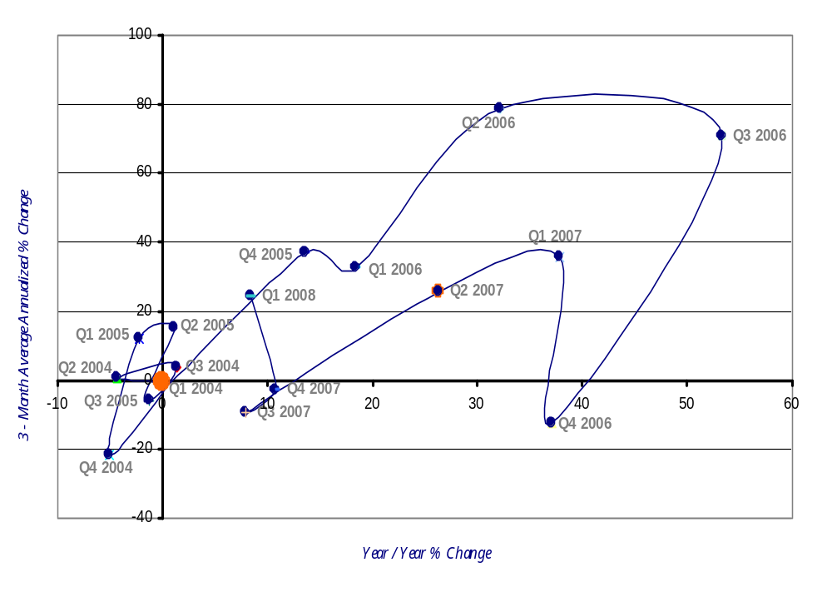
Purcell City Sales Tax Collections Momentum Track
1st Qtr 2004 – 1st Qtr 2008
Improving
Leading
Lagging
Slipping
Source: Oklahoma Tax Commission (OTC)

Slide 19
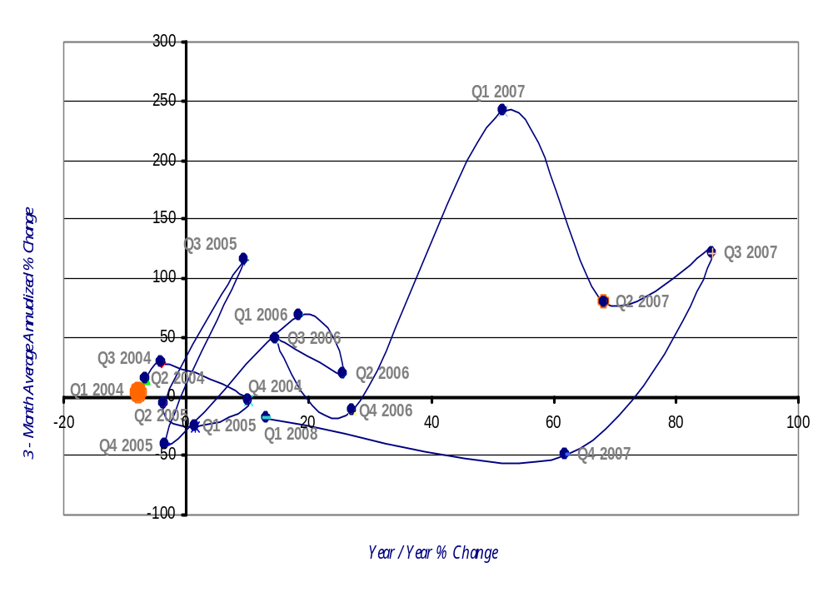
Sayre City Sales Tax Collections Momentum Track
1st Qtr 2004 – 1st Qtr 2008
Improving
Leading
Lagging
Slipping
Source: Oklahoma Tax Commission (OTC)

Slide 20
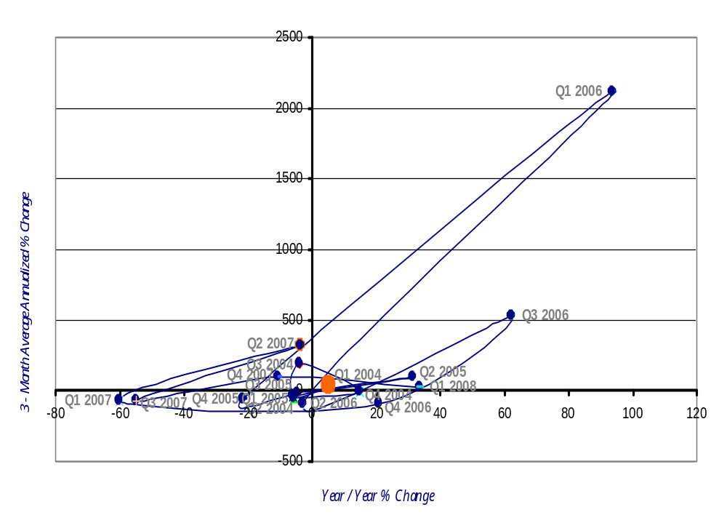
Taloga City Sales Tax Collections Momentum Track
1st Qtr 2004 – 1st Qtr 2008
Improving
Leading
Lagging
Slipping
Source: Oklahoma Tax Commission (OTC)

Slide 21
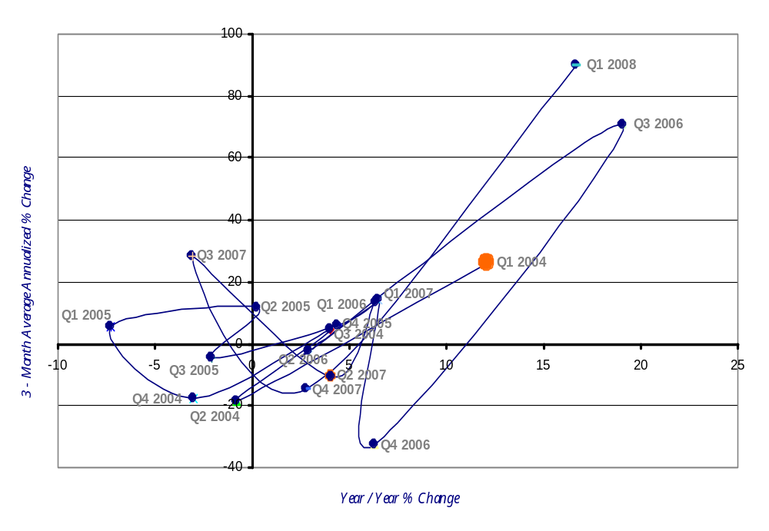
Walters City Sales Tax Collections Momentum Track
1st Qtr 2004 – 1st Qtr 2008
Improving
Leading
Lagging
Slipping
Source: Oklahoma Tax Commission (OTC)

Slide 22
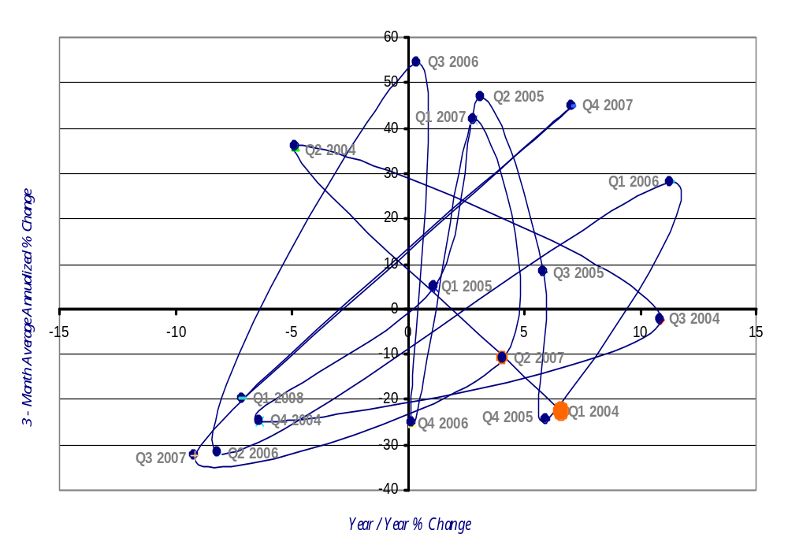
Watonga City Sales Tax Collections Momentum Track
1st Qtr 2004 – 1st Qtr 2008
Improving
Leading
Lagging
Slipping
Source: Oklahoma Tax Commission (OTC)

Slide 23
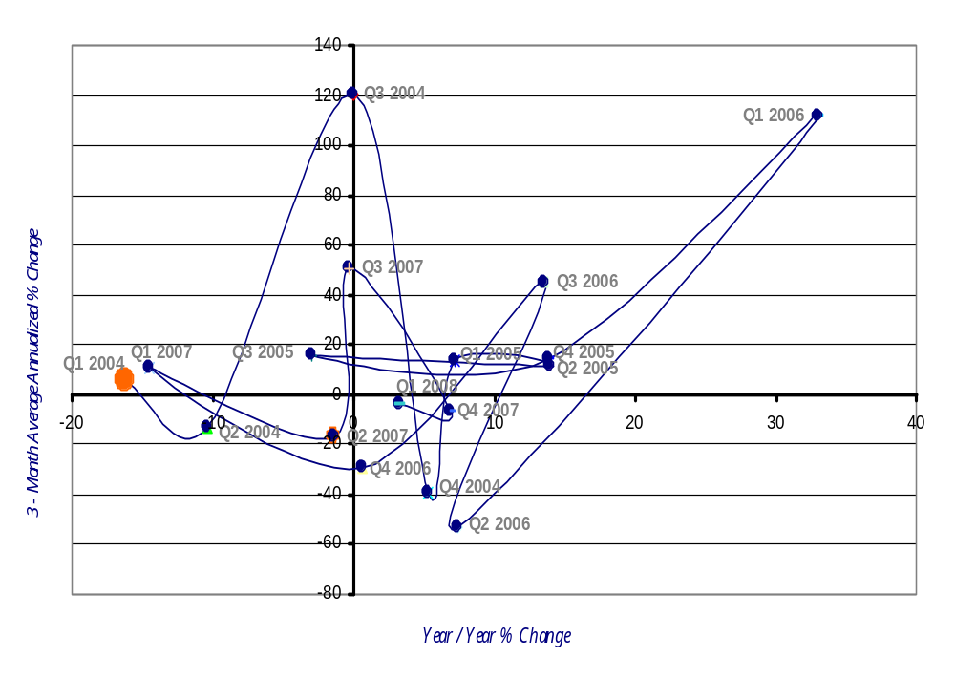
Waurika City Sales Tax Collections Momentum Track
1st Qtr 2004 – 1st Qtr 2008
Improving
Leading
Lagging
Slipping
Source: Oklahoma Tax Commission (OTC)

Slide 24
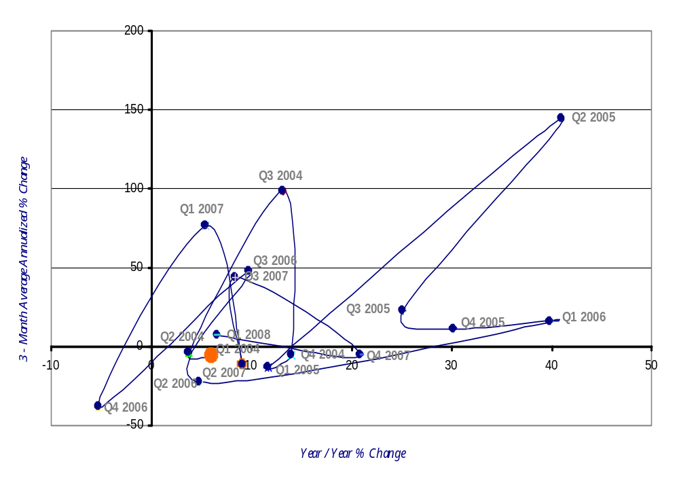
Weatherford City Sales Tax Collections Momentum Track
1st Qtr 2004 – 1st Qtr 2008
Improving
Leading
Lagging
Slipping
Source: Oklahoma Tax Commission (OTC)

Slide 25
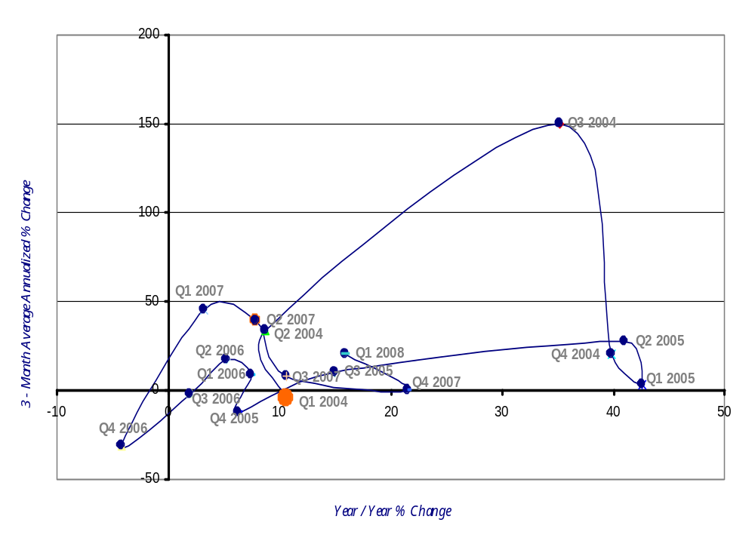
Yukon City Sales Tax Collections Momentum Track
1st Qtr 2004 – 1st Qtr 2008
Improving
Leading
Lagging
Slipping
Source: Oklahoma Tax Commission (OTC)

