Slide 1
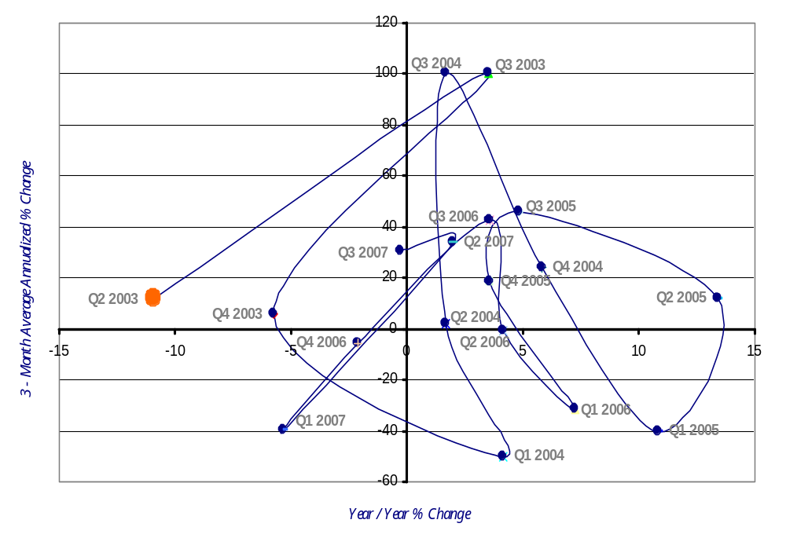
SOIC Agriculture, Forestry, Fishing & Hunting Sector Employment Momentum Track (NAICS 11)
2nd Qtr 2003 – 3rd Qtr 2007
Improving
Leading
Lagging
Slipping
Source: Oklahoma Employment Security Commission (OESC) & Bureau of Labor Statistics
Note: All information shown in the graph included non-disclosed data.

Slide 2
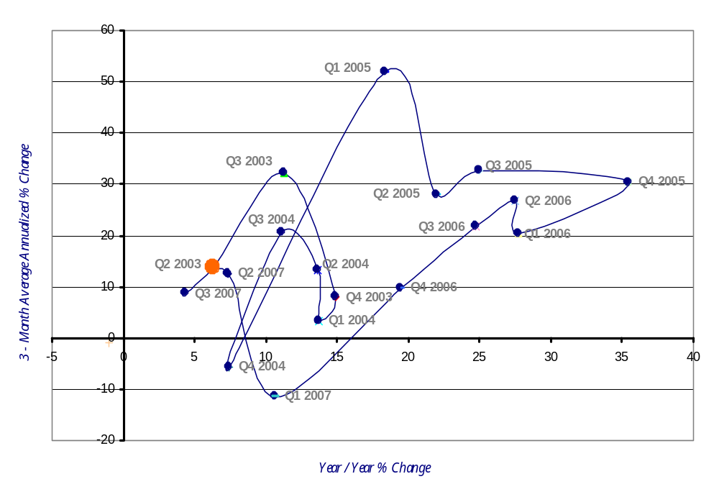
SOIC Mining Sector
Employment Momentum Track (NAICS 21)
2nd Qtr 2003 – 3rd Qtr 2007
Improving
Leading
Lagging
Slipping
Source: Oklahoma Employment Security Commission (OESC) & Bureau of Labor Statistics
Note: All information shown in the graph included non-disclosed data.

Slide 3
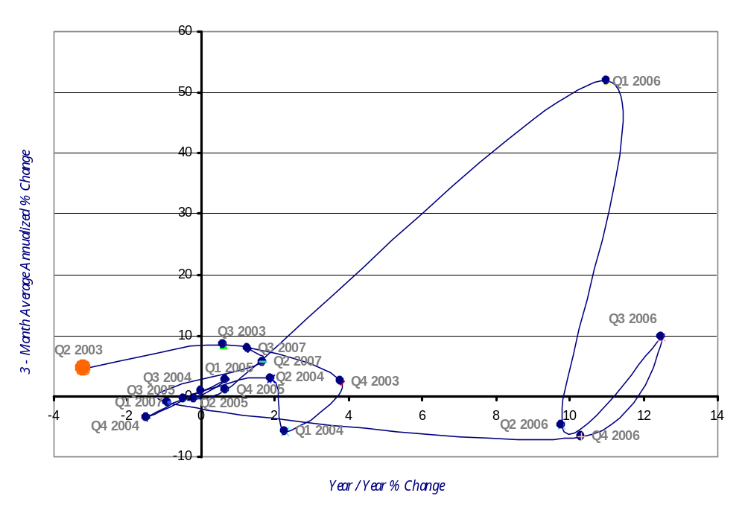
SOIC Utilities Sector
Employment Momentum Track (NAICS 22)
2nd Qtr 2003 – 3rd Qtr 2007
Improving
Leading
Lagging
Slipping
Source: Oklahoma Employment Security Commission (OESC) & Bureau of Labor Statistics
Note: All information shown in the graph included non-disclosed data.

Slide 4
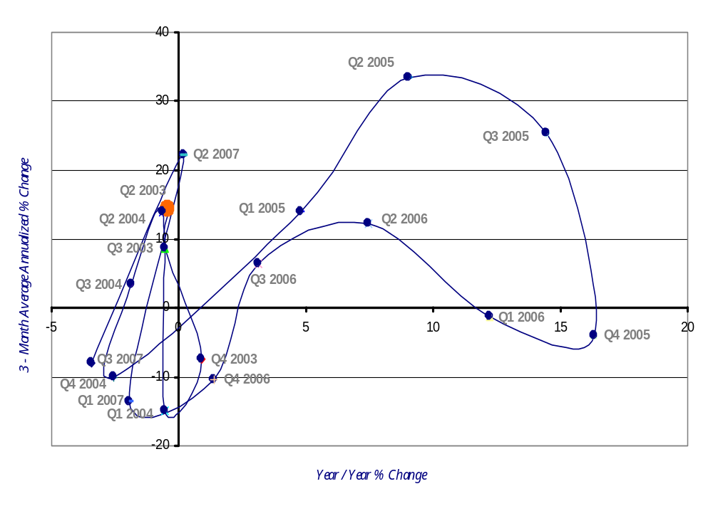
SOIC Construction Sector
Employment Momentum Track (NAICS 23)
2nd Qtr 2003 – 3rd Qtr 2007
Improving
Leading
Lagging
Slipping
Source: Oklahoma Employment Security Commission (OESC) & Bureau of Labor Statistics
Note: All information shown in the graph included non-disclosed data.

Slide 5
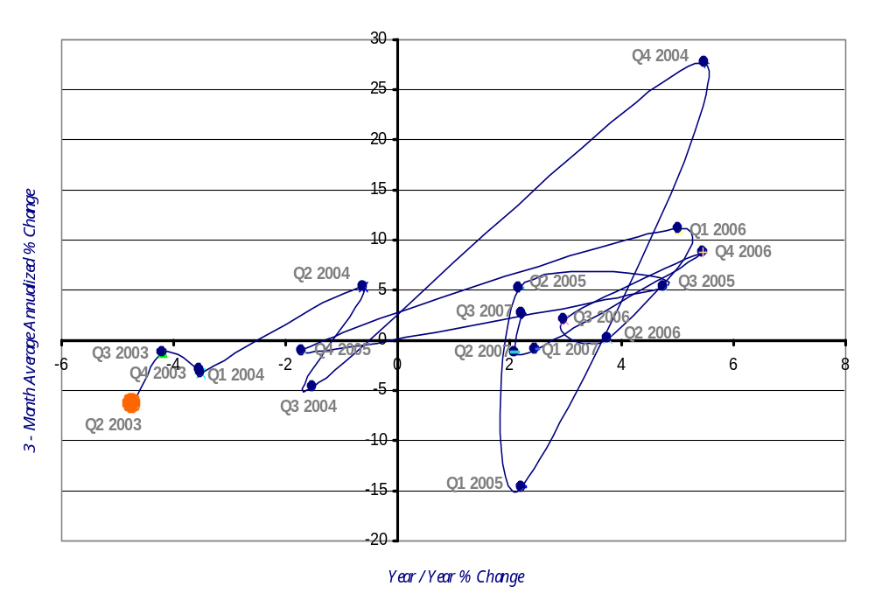
SOIC Manufacturing Sector
Employment Momentum Track (NAICS 31-33)
2nd Qtr 2003 – 3rd Qtr 2007
Improving
Leading
Lagging
Slipping
Source: Oklahoma Employment Security Commission (OESC) & Bureau of Labor Statistics
Note: All information shown in the graph included non-disclosed data.

Slide 6
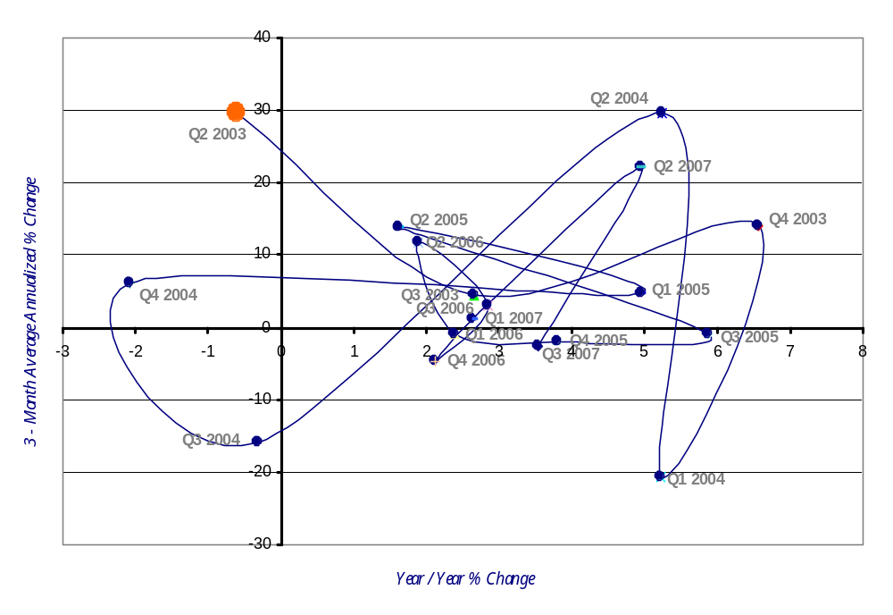
SOIC Wholesale Trade Sector
Employment Momentum Track (NAICS 42)
2nd Qtr 2003 – 3rd Qtr 2007
Improving
Leading
Lagging
Slipping
Source: Oklahoma Employment Security Commission (OESC) & Bureau of Labor Statistics
Note: All information shown in the graph included non-disclosed data.

Slide 7
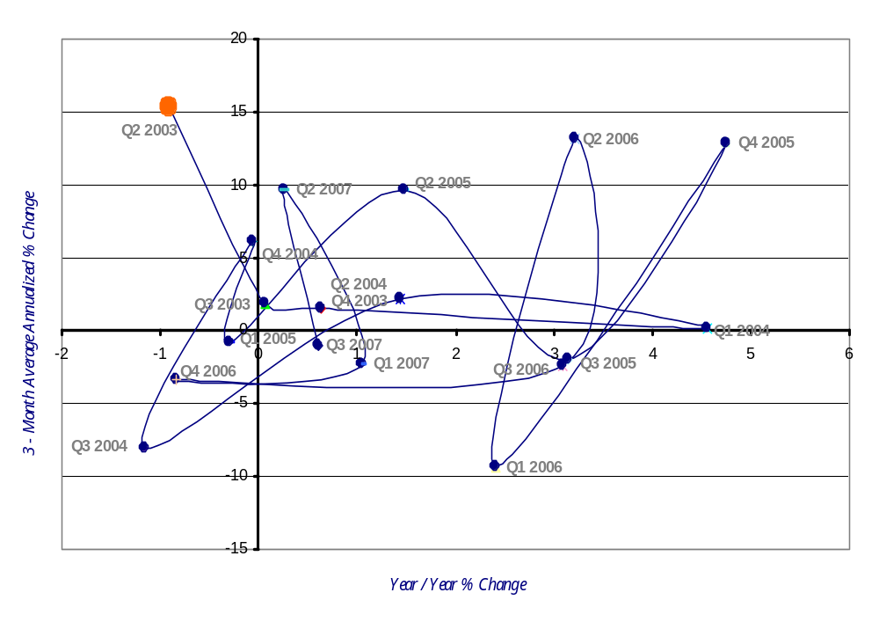
SOIC Retail Trade Sector
Employment Momentum Track (NAICS 44-45)
2nd Qtr 2003 – 3rd Qtr 2007
Improving
Leading
Lagging
Slipping
Source: Oklahoma Employment Security Commission (OESC) & Bureau of Labor Statistics
Note: All information shown in the graph included non-disclosed data.

Slide 8
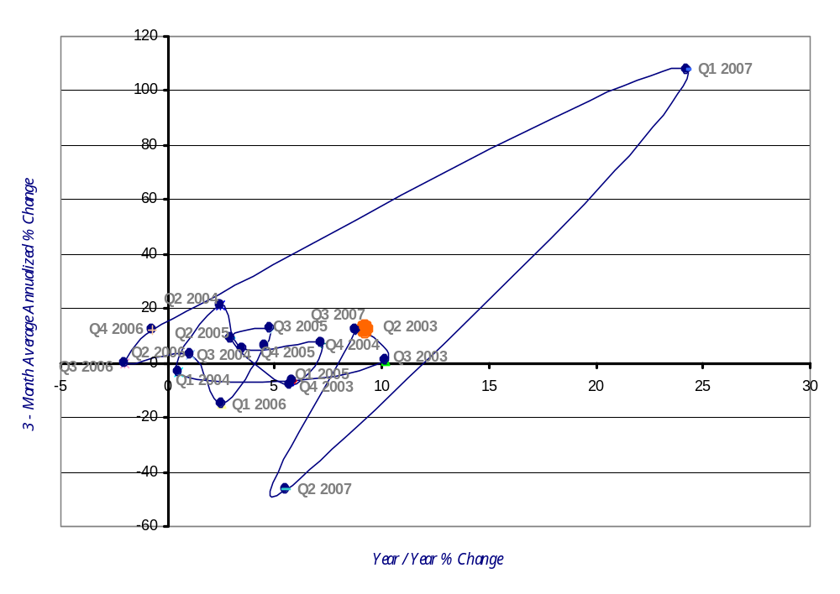
SOIC Transportation and Warehousing Sector
Employment Momentum Track (NAICS 48-49)
2nd Qtr 2003 – 3rd Qtr 2007
Improving
Leading
Lagging
Slipping
Source: Oklahoma Employment Security Commission (OESC) & Bureau of Labor Statistics
Note: All information shown in the graph included non-disclosed data.

Slide 9
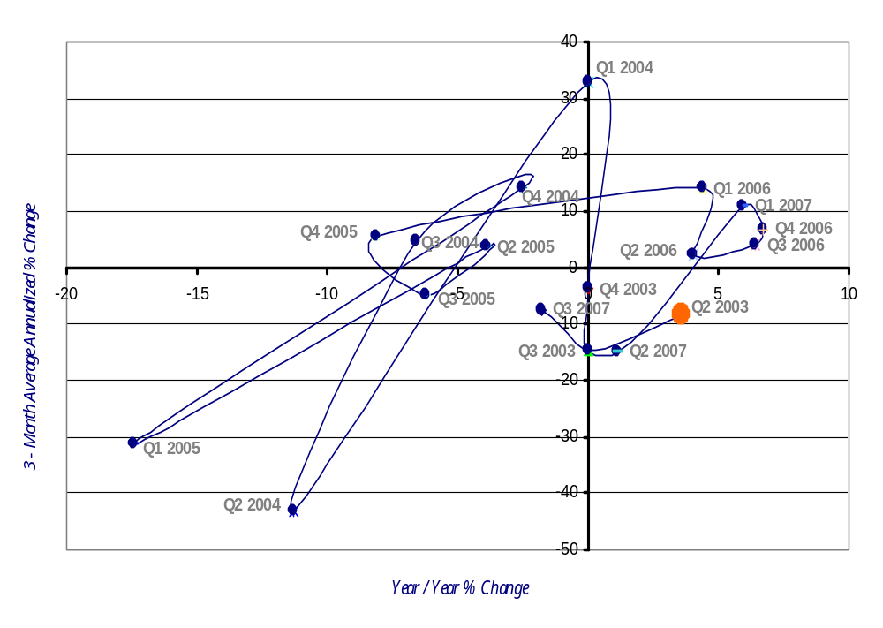
SOIC Information Sector
Employment Momentum Track (NAICS 51)
2nd Qtr 2003 – 3rd Qtr 2007
Improving
Leading
Lagging
Slipping
Source: Oklahoma Employment Security Commission (OESC) & Bureau of Labor Statistics
Note: All information shown in the graph included non-disclosed data.

Slide 10
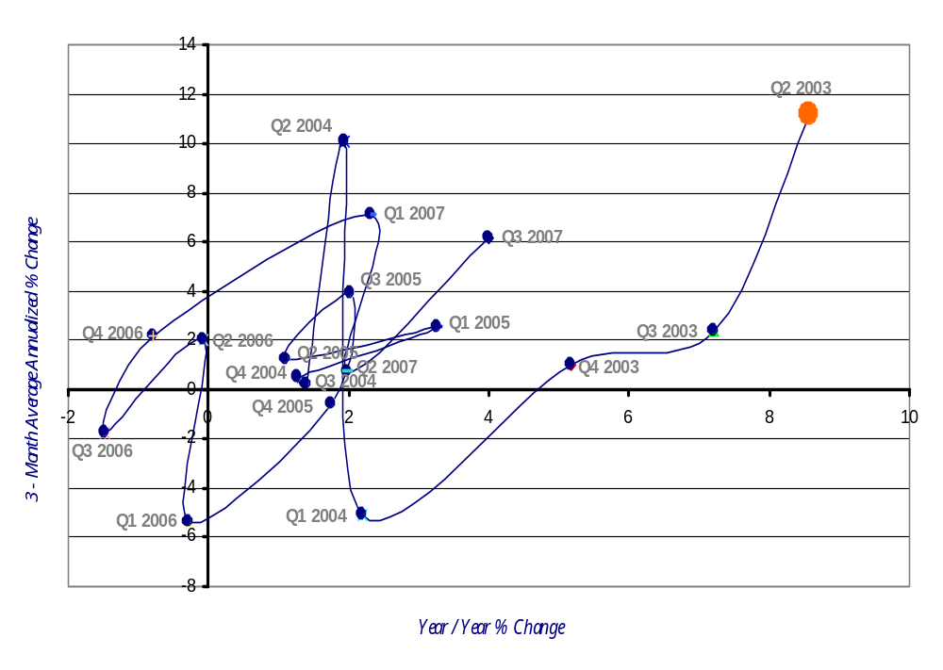
SOIC Finance and Insurance Sector
Employment Momentum Track (NAICS 52)
2nd Qtr 2003 – 3rd Qtr 2007
Improving
Leading
Lagging
Slipping
Source: Oklahoma Employment Security Commission (OESC) & Bureau of Labor Statistics
Note: All information shown in the graph included non-disclosed data.

Slide 11
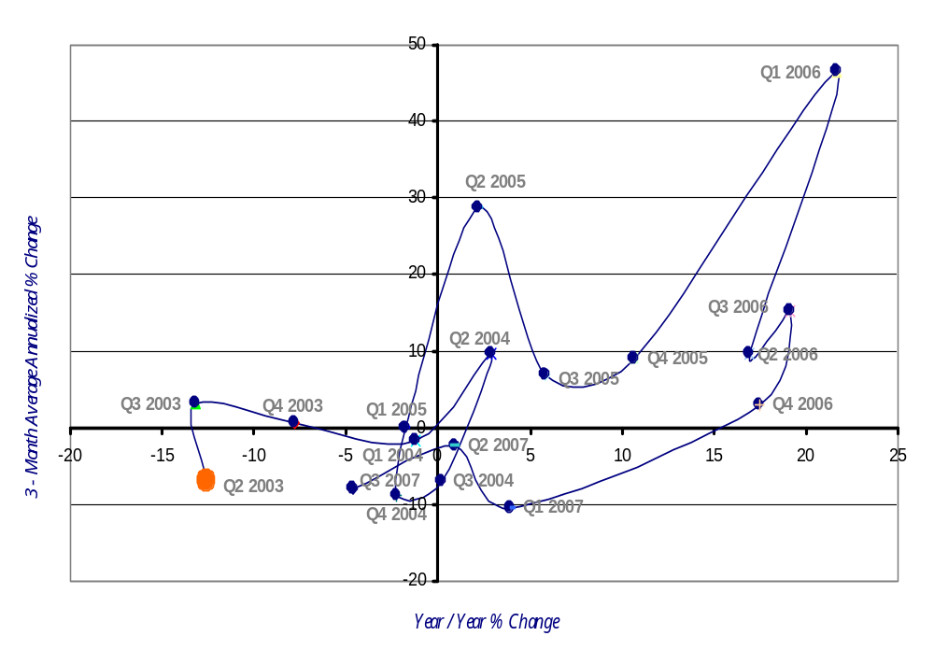
SOIC Real Estate and Rental and Leasing Sector
Employment Momentum Track (NAICS 53)
2nd Qtr 2003 – 3rd Qtr 2007
Improving
Leading
Lagging
Slipping
Source: Oklahoma Employment Security Commission (OESC) & Bureau of Labor Statistics
Note: All information shown in the graph included non-disclosed data.

Slide 12
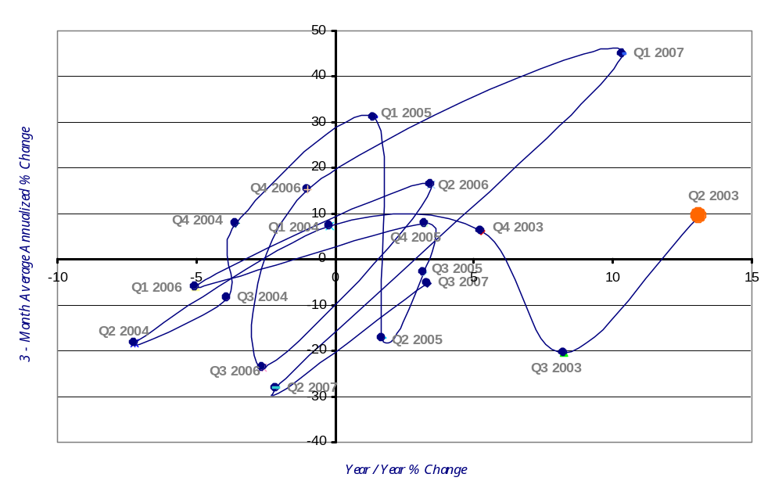
SOIC Professional, Scientific and Technical Service Sector
Employment Momentum Track (NAICS 54)
2nd Qtr 2003 – 3rd Qtr 2007
Improving
Leading
Lagging
Slipping
Source: Oklahoma Employment Security Commission (OESC) & Bureau of Labor Statistics
Note: All information shown in the graph included non-disclosed data.

Slide 13
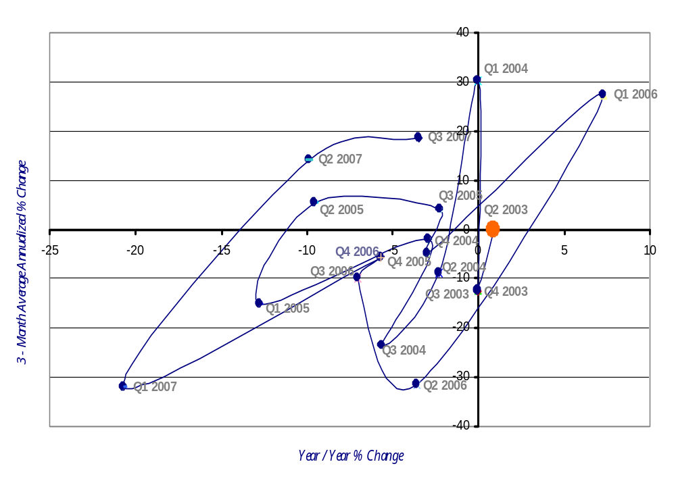
SOIC Management of Companies and Enterprises Sector
Employment Momentum Track (NAICS 55)
2nd Qtr 2003 – 3rd Qtr 2007
Improving
Leading
Lagging
Slipping
Source: Oklahoma Employment Security Commission (OESC) & Bureau of Labor Statistics
Note: All information shown in the graph included non-disclosed data.

Slide 14
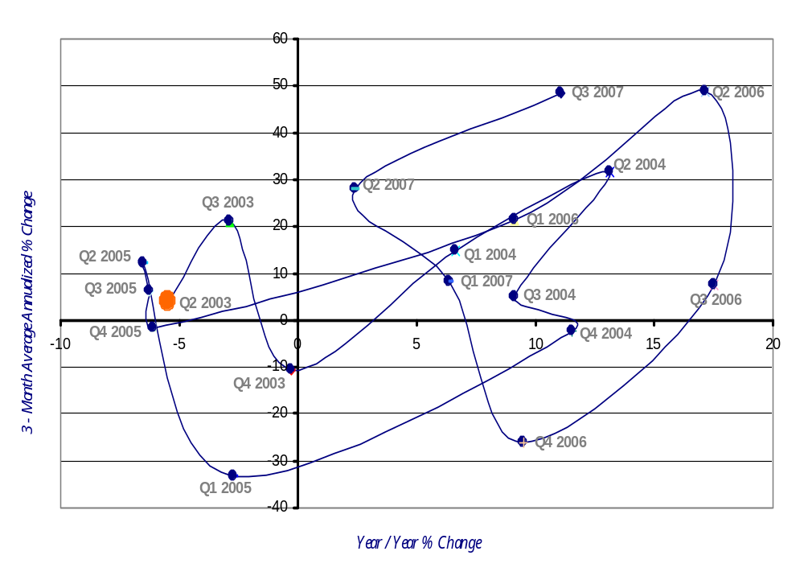
SOIC Administrative, Support, Waste Management & Remediation Sector
Employment Momentum Track (NAICS 56)
2nd Qtr 2003 – 3rd Qtr 2007
Improving
Leading
Lagging
Slipping
Source: Oklahoma Employment Security Commission (OESC) & Bureau of Labor Statistics
Note: All information shown in the graph included non-disclosed data.

Slide 15
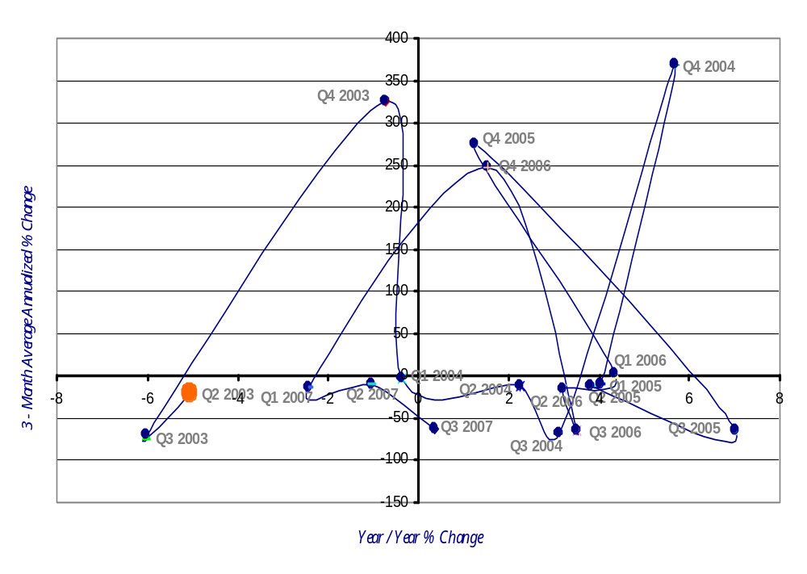
SOIC Education Service Sector
Employment Momentum Track (NAICS 61)
2nd Qtr 2003 – 3rd Qtr 2007
Improving
Leading
Lagging
Slipping
Source: Oklahoma Employment Security Commission (OESC) & Bureau of Labor Statistics
Note: All information shown in the graph included non-disclosed data.

Slide 16
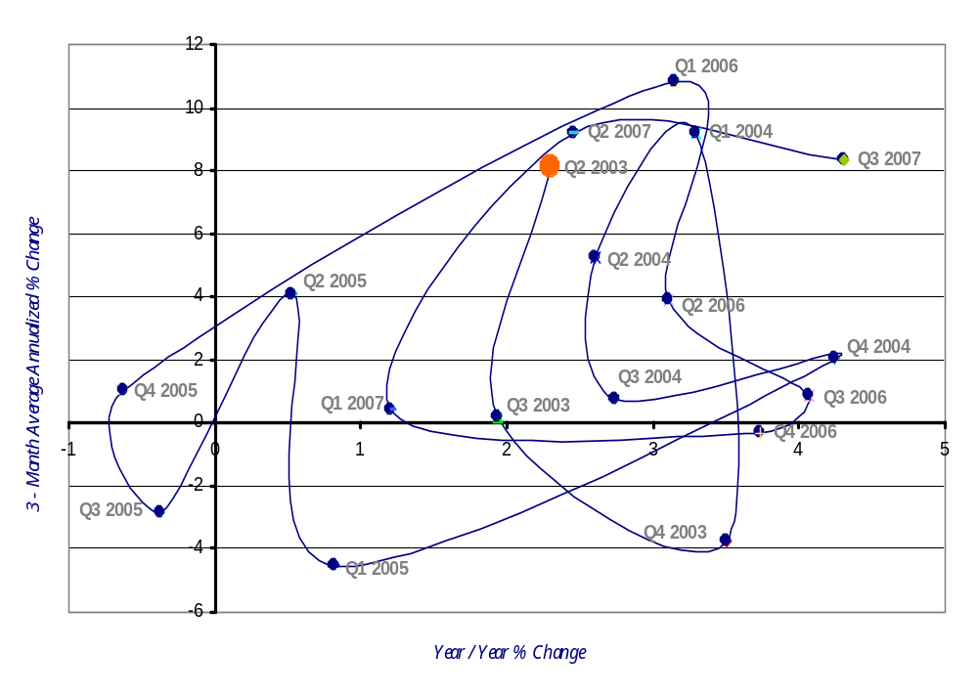
SOIC Health Care and Social Assistance Sector
Employment Momentum Track (NAICS 62)
2nd Qtr 2003 – 3rd Qtr 2007
Improving
Leading
Lagging
Slipping
Source: Oklahoma Employment Security Commission (OESC) & Bureau of Labor Statistics
Note: All information shown in the graph included non-disclosed data.

Slide 17
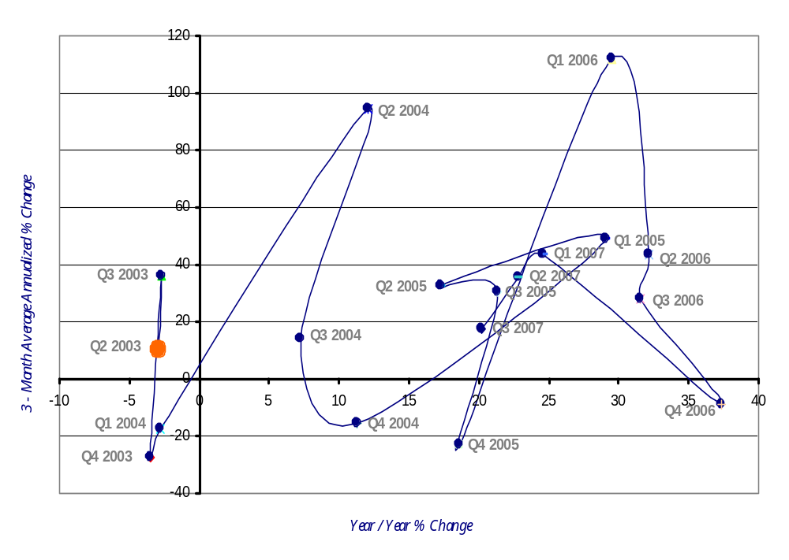
SOIC Arts, Entertainment, and Recreation Sector
Employment Momentum Track (NAICS 71)
2nd Qtr 2003 – 3rd Qtr 2007
Improving
Leading
Lagging
Slipping
Source: Oklahoma Employment Security Commission (OESC) & Bureau of Labor Statistics
Note: All information shown in the graph included non-disclosed data.

Slide 18
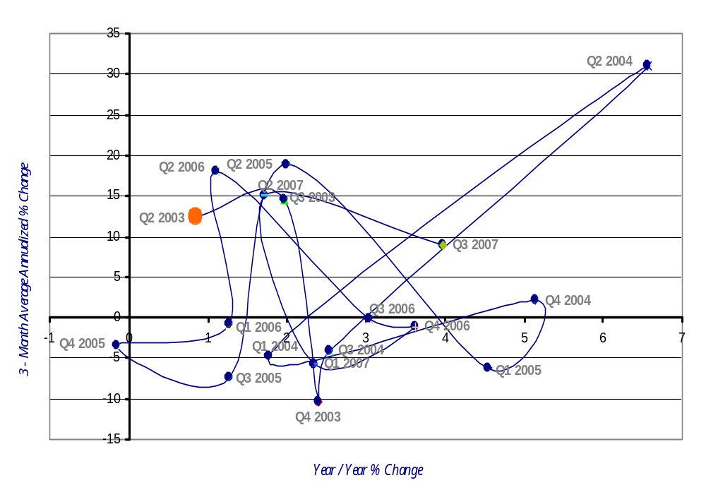
SOIC Accommodation and Food Services Sector
Employment Momentum Track (NAICS 72)
2nd Qtr 2003 – 3rd Qtr 2007
Improving
Leading
Lagging
Slipping
Source: Oklahoma Employment Security Commission (OESC) & Bureau of Labor Statistics
Note: All information shown in the graph included non-disclosed data.

Slide 19
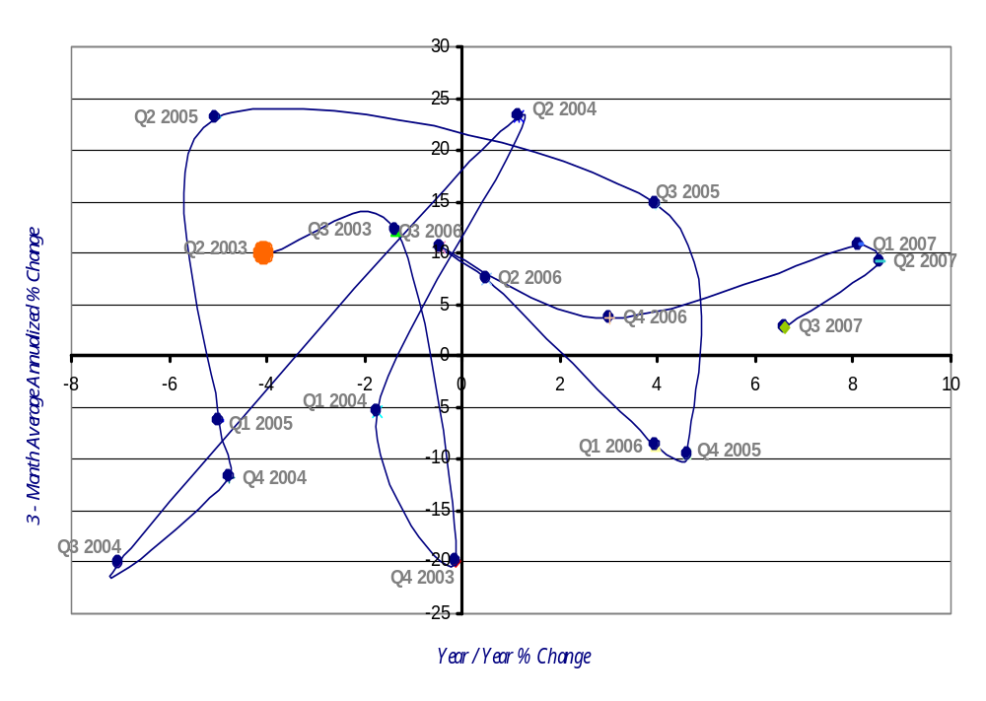
SOIC Other Services (except Public Administration) Sector
Employment Momentum Track (NAICS 81)
2nd Qtr 2003 – 3rd Qtr 2007
Improving
Leading
Lagging
Slipping
Source: Oklahoma Employment Security Commission (OESC) & Bureau of Labor Statistics
Note: All information shown in the graph included non-disclosed data.

Slide 20
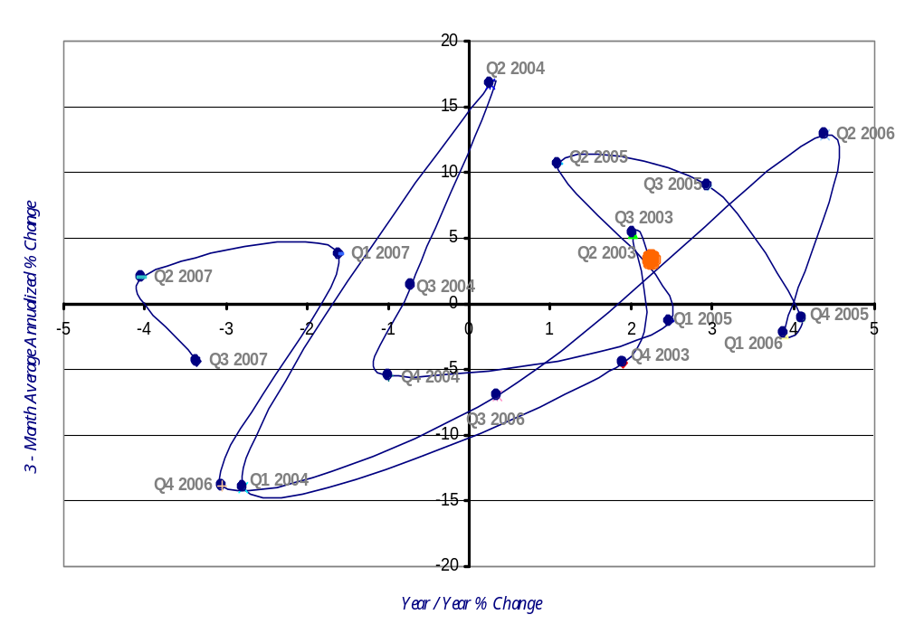
SOIC Public Administration Sector
Employment Momentum Track (NAICS 92)
2nd Qtr 2003 – 3rd Qtr 2007
Improving
Leading
Lagging
Slipping
Source: Oklahoma Employment Security Commission (OESC) & Bureau of Labor Statistics
Note: All information shown in the graph included non-disclosed data.

