Slide 1
Using rmarkdown and shiny with students

Slide 2
Summary
rmarkdown is a tool for communicating data and analysis
produce html, pdf, word documents, presentations...
I use it to:
help beginning scientists learn to visualize data and communicate results
present to students complex ideas in chemistry and biochemistry
Problem I am working on: Making student data reports consistent
rmarkdown templates
I am combining rmarkdown with r shiny to create educational apps
show students biochemical data and how to interpret results
https://github.com/CEBerndsen/R4DS_Mar_2018

Slide 3
Context
I work in a Chemistry and Biochemistry department at a mid-sized, public university
Biochemist by training
I research topics related to protein function and structure with a lab of undergraduates
Teach undergraduate Biochemistry lecture and lab
I use R for:
Visualizing data sets
Communicating data and ideas to colleagues and students
To help students learn to create data figures and communicate results

Slide 4
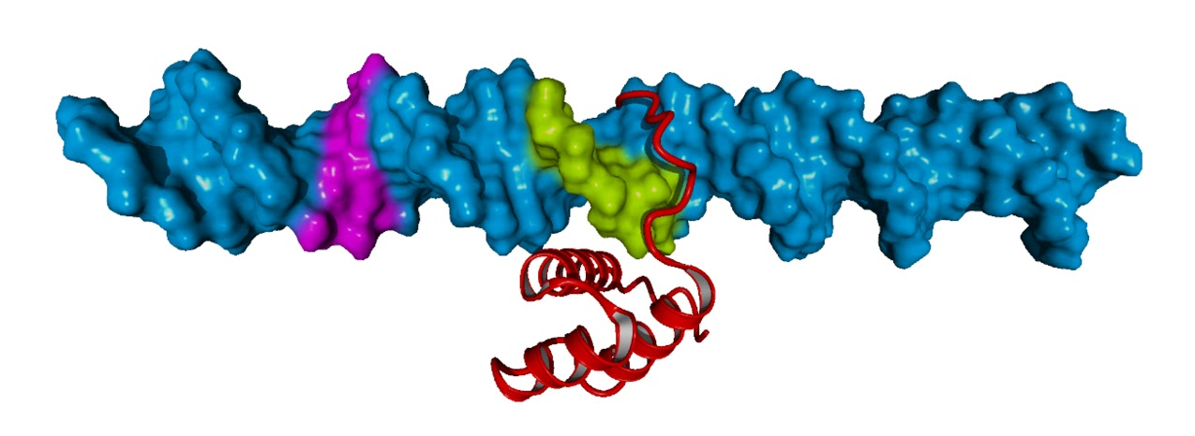
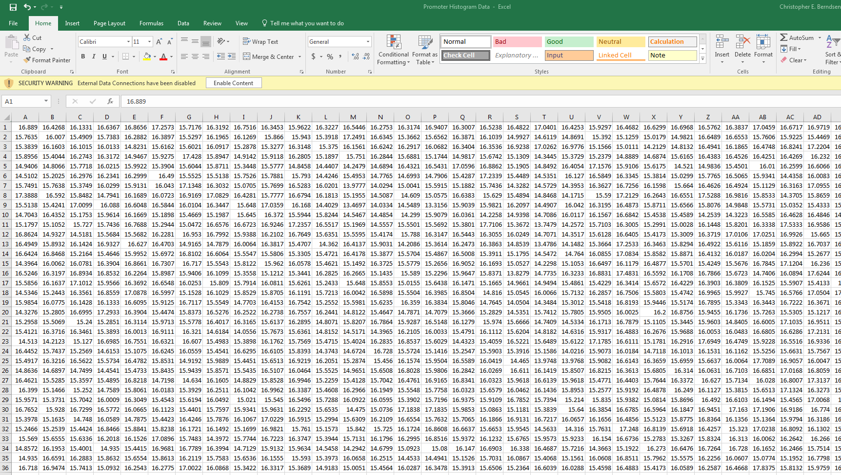
Initial steps -- visualizing DNA groove width data
DNA
protein
Simulate all atom dynamics
4 distinct simulations
Measure width of DNA grooves
~1000 measurements of ~40 positions
Get a massive (for me) .tab file of numbers

Slide 5
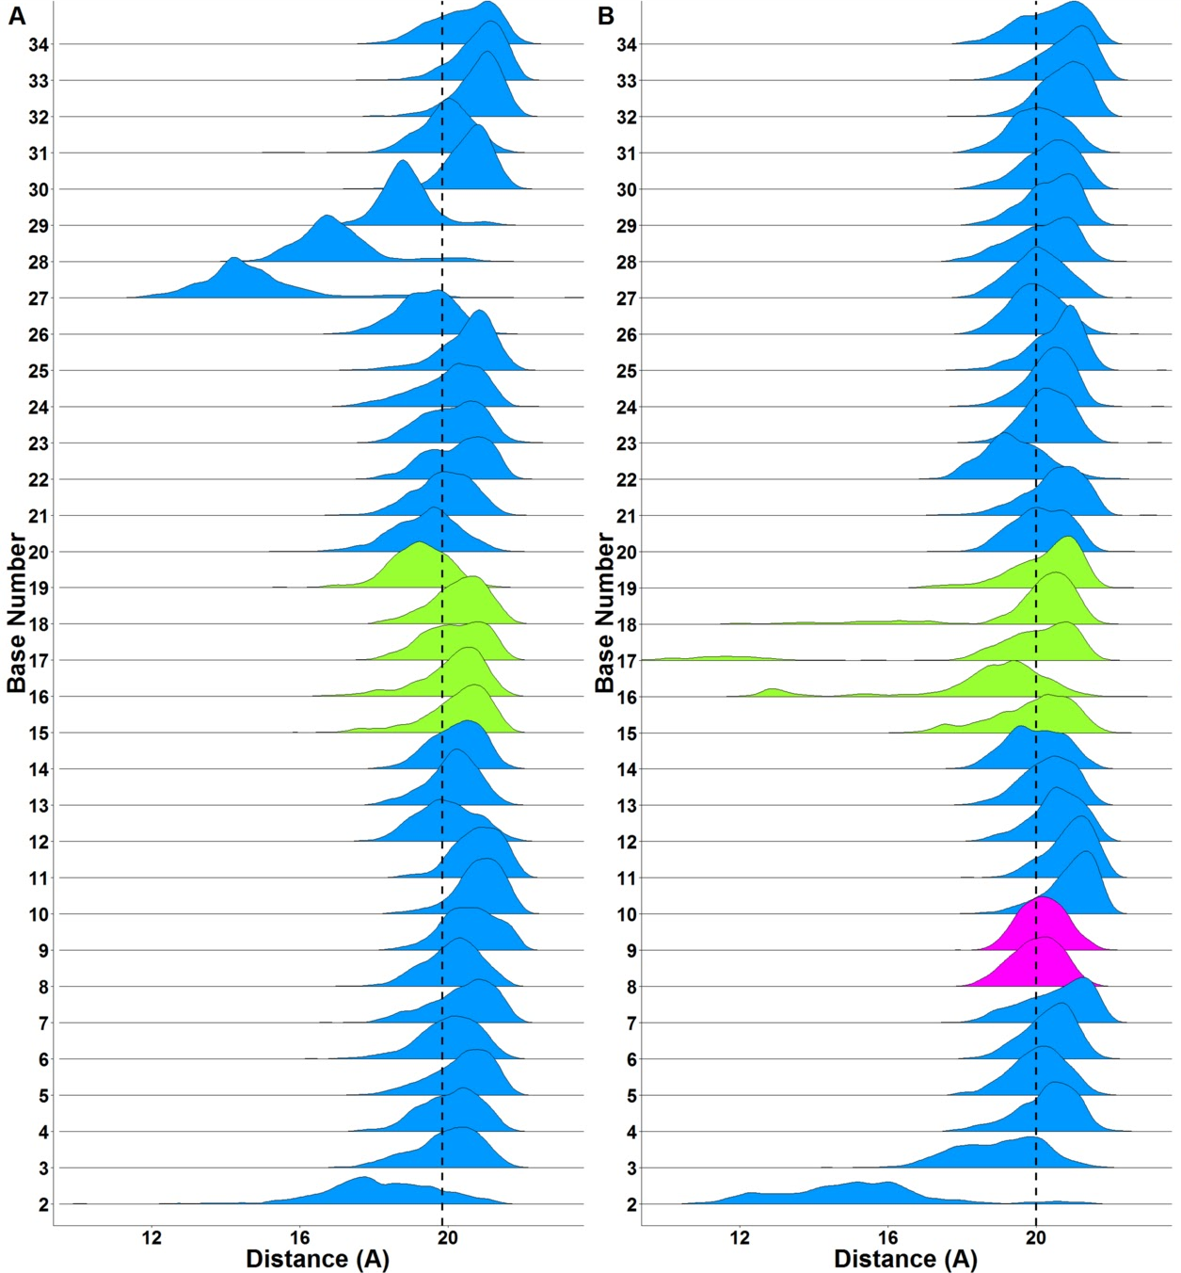
The first success
Imported .xlsx (pg. 145) of ~40,000 measurements per plot
Tidied data with gather and filter (pg. 152-154, pg. 48)
Added new values for coloring using mutate (pg. 54)
Calculated data statistics with group_by and summarise (pg. 66)
Plotted using ggplot2 (pg. 3), forcats (pg. 223) and ggridges (geom_density_ridges2)
Arranged plots using cowplot
https://cran.r-project.org/web/packages/ggridges/index.html
https://github.com/wilkelab/cowplot
Hossain, Dunham, Enke and Berndsen, 2018, Mol. Vis., in press

Slide 6
Things I learned with the first figure
Wrangling data with R
Importing
Tidying
Transforming
Visualizing
Communicating data
Usefulness of R for making figure appearance consistent

Slide 7

rmarkdown
Document or a notebook
Include R code chunks or in line code
Include plots and interactivity
Process the documents into other file formats including pdf or html or slides for a presentation
https://www.rstudio.com/resources/webinars/introducing-blogdown/
https://rmarkdown.rstudio.com/

Slide 8
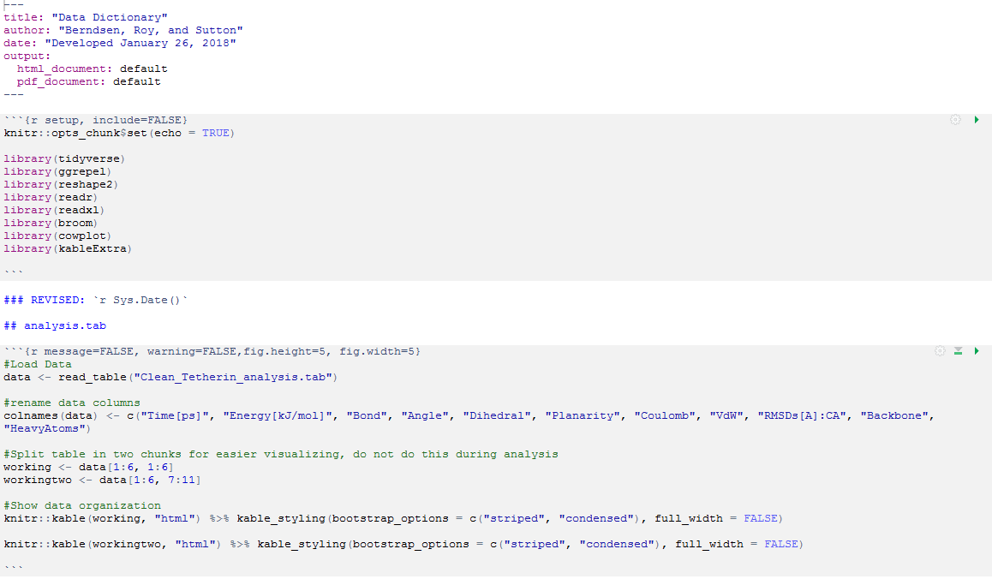
Some basics of a rmarkdown document (HTML example)
YAML Header pg. 435
R code chunk pg. 428
Text + In line R code pg. 427 and pg. 434
R code chunk
https://github.com/CEBerndsen/R4DS_Mar_2018

Slide 9
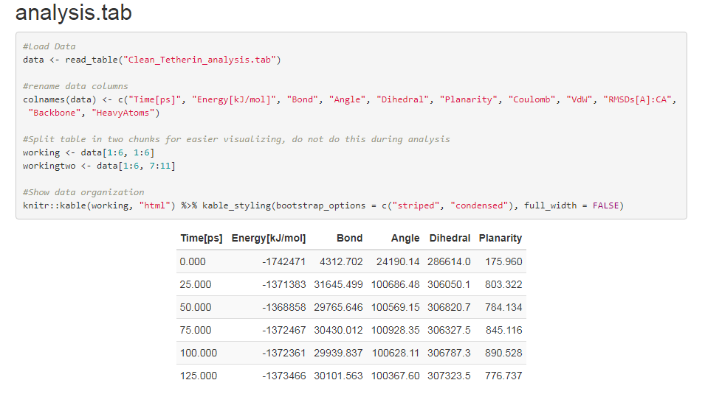
HTML output of rmarkdown

Slide 10
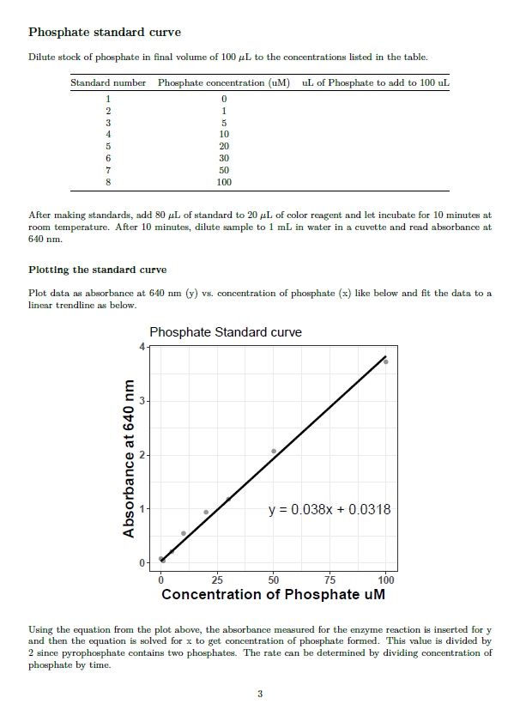
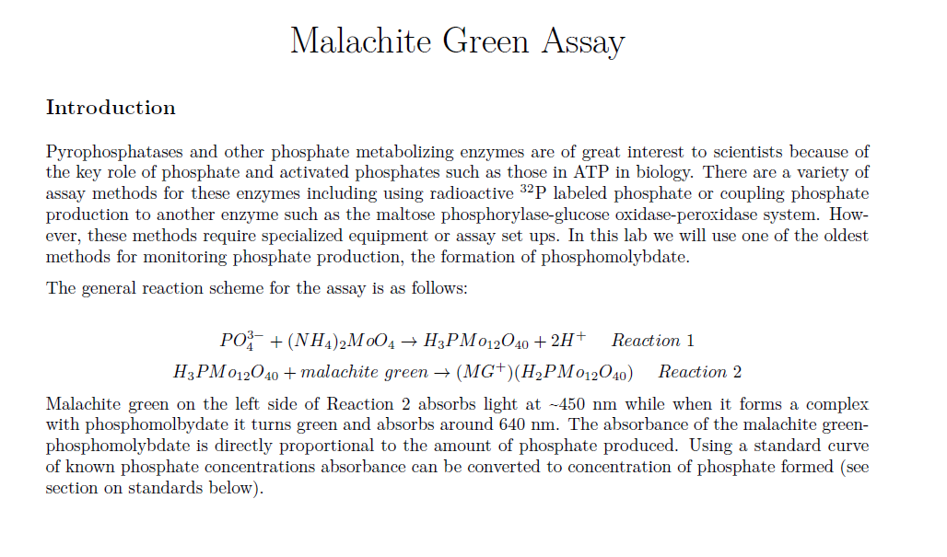
PDF example output
Need a version of LaTex to make a pdf. Here I used TinyTex: https://yihui.name/tinytex/r/

Slide 11
How has it helped?
Combines word processing and data visualization in one software
Previous workflow: Word + Excel + Inkscape
Consistency in data reports

Slide 12



Course-based undergraduate research experience (CURE)
Biochemistry lecture
50 to 100 students per semester in a single class
~70% students have no prior research experience
Analyze the effects of DNA mutation on protein structure and function
Open access mutation and protein structure databases
Molecular modeling using YASARA
Web-based modeling servers
Produce novel insights into the effects (or lack thereof) of human mutations on protein structure
https://www.ensembl.org
Student data collection
and analysis
https://www.rcsb.org/
https://osf.io/

Slide 13
How to make student reporting consistent?
Challenges
Diverse approaches and data types
Diverse backgrounds and skill levels
Providing guided instruction without blocking student innovation
Challenge but do not frustrate students
Limited instructor and student resources
Mix of operating systems (Windows, Mac, Chromebook, iPad, etc.)
Solution(?) Shiny/rmarkdown app for teaching data interpretation and communication

Slide 14
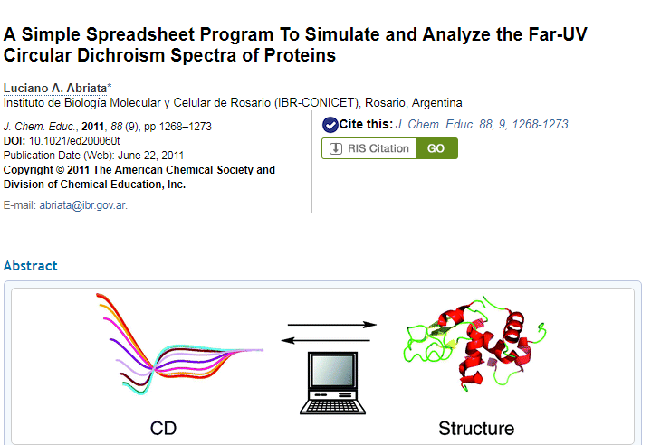
When Excel failed in the middle of class...

Slide 15
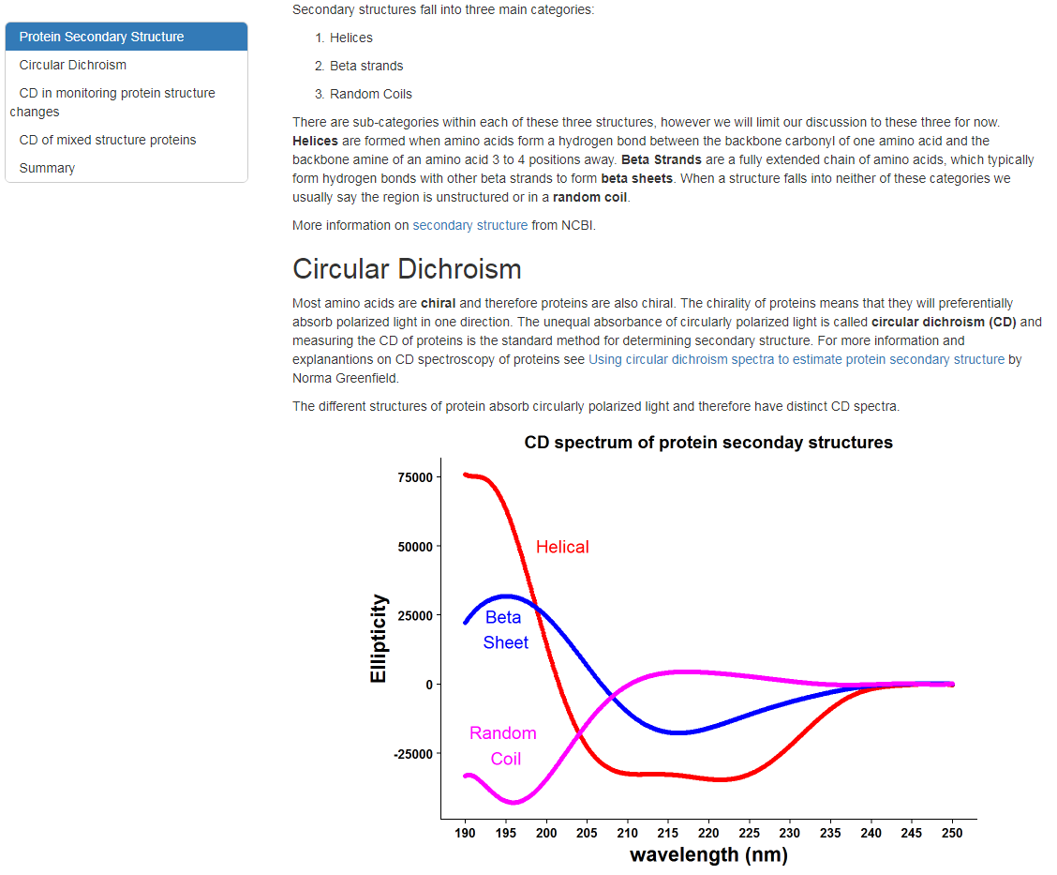
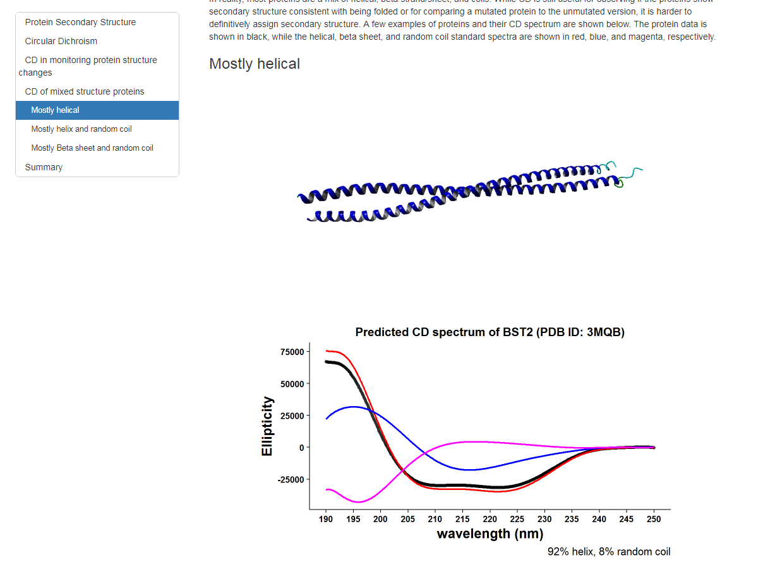
rmarkdown in RStudio (CD.Rmd/CD.html)

Slide 16
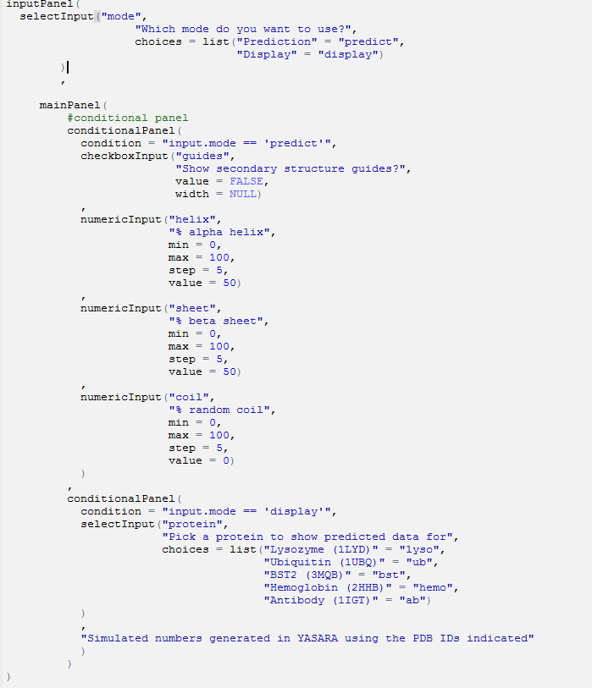
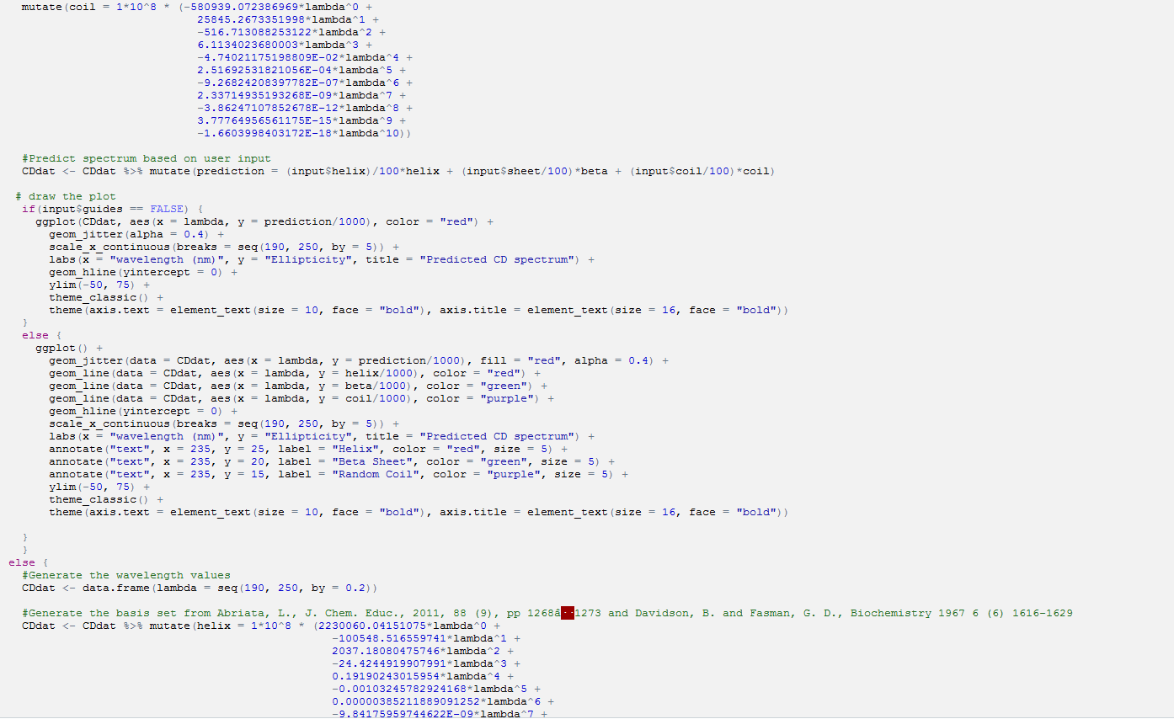
rmarkdown + Shiny (CDexplainv2.Rmd)
Shiny allows you to make interactive R code (pg. 476)
Interactive elements in a rmarkdown file
Need to include shiny app code in a R chunk.
User interface
R function

Slide 17
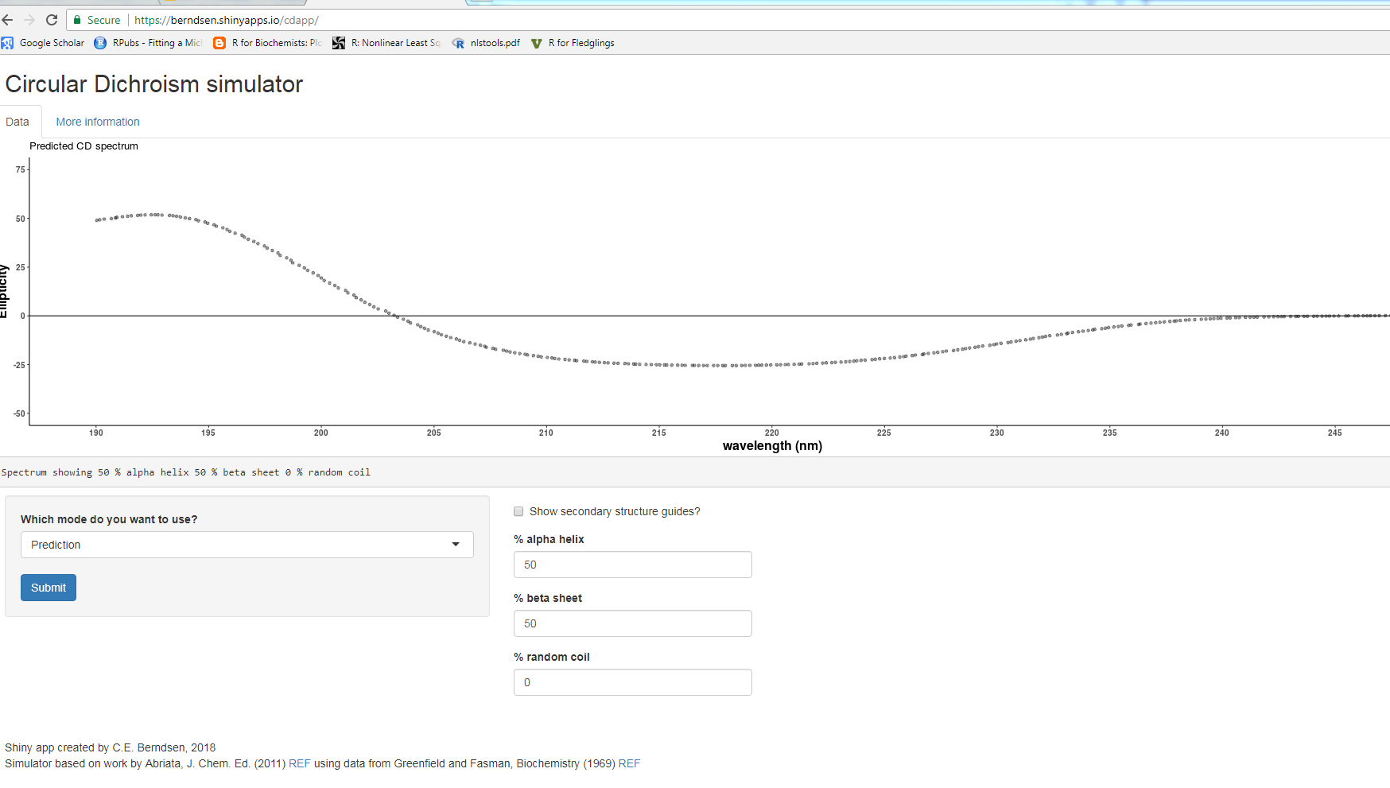
Shiny + rmarkdown (app.R)
https://berndsen.shinyapps.io/cdapp/

Slide 18
Future
Problem I am working on: Making student data reports consistent for a large class size
Solution (?): Make functions out of data report template sections → R package → interactive Rmd/Shiny app for guiding students to make figures
Refine in-class project
Challenge students but not frustrate them
Promote data and visualization literacy
Build more simulators based on rmarkdown/shiny
Show students biochemical data examples and let them explore with data

Slide 19
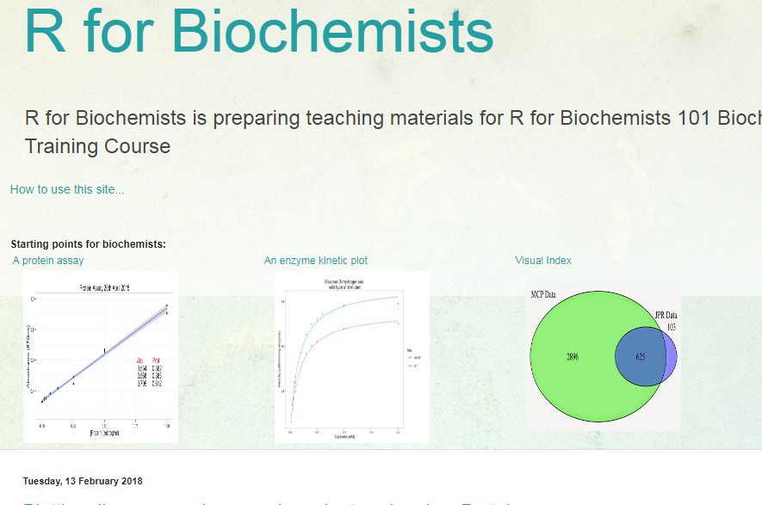
Thank you!
The AMAZING JMU STUDENTS!
Colleagues in the Dept of Chemistry and Biochemistry at JMU
Paul Brennan who writes
Jesse and the R4DS community

Slide 20
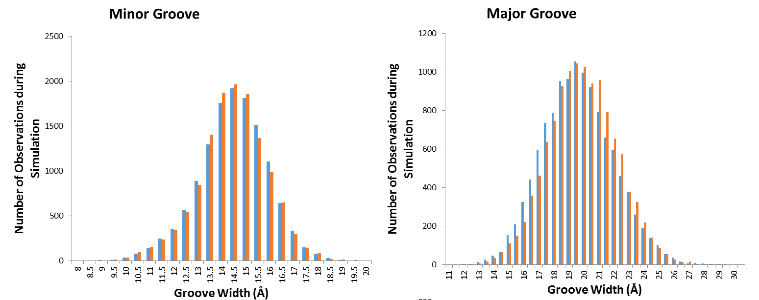
Processing and visualizing in Excel
Tedious and slow
Lacked some information about measurement position
Binning values
Was a pain to do statistics

Slide 21
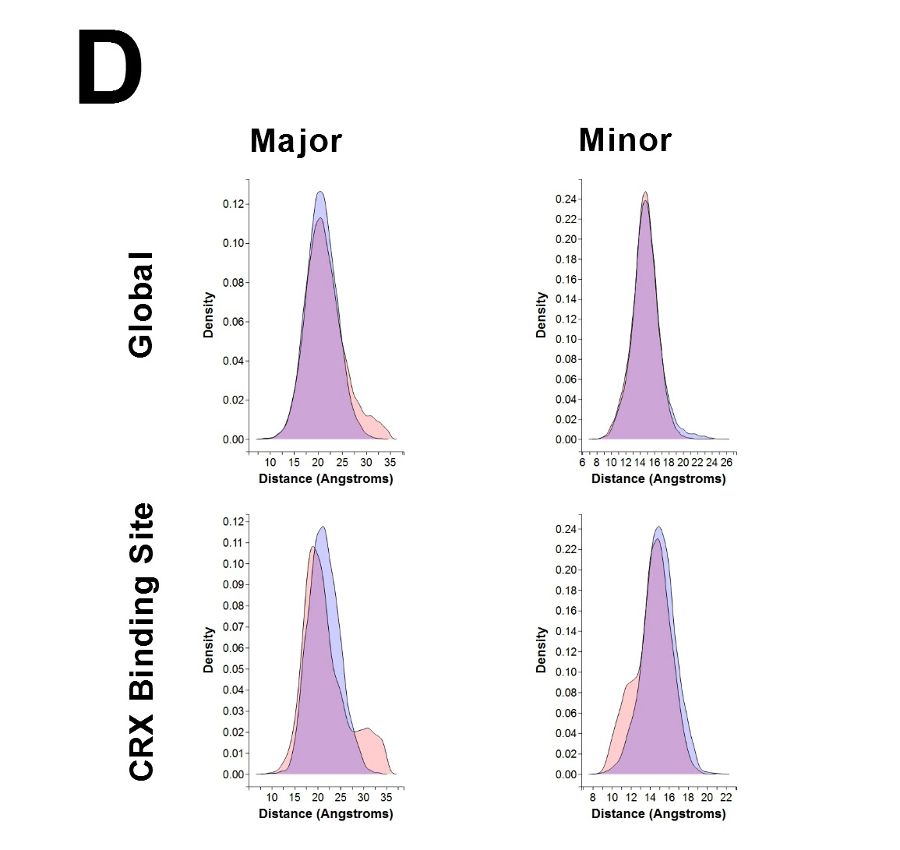
Process in Excel, visualize in ggplot2
Tedious and slow
Easier to make plots
No binning issues using a density plot
Still lacking information on position

Slide 22
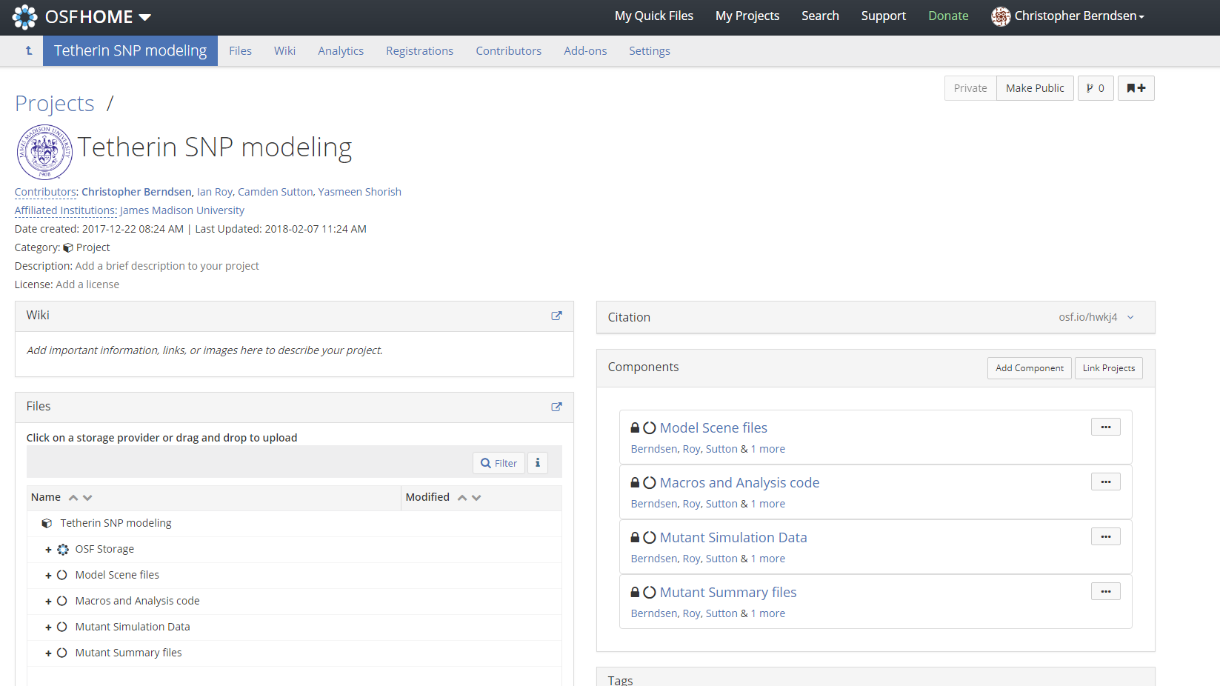
Open Science Framework
Public access to data
Forking for further development
Want students to begin to develop a portfolio of their work
Using a consistent report format allows for easier comparison and consumption of the data by others.
Students still are involved in analysis of data.

