Slide 1
BandLink | Design Review 2
Find your people when the network can't.
From concept to subsystem validation
ESP32 bring-up
MCU decision
IMU + display selection
Giorgia Cito
Gabriel Dao
Oscar Sandoval
Justin Narciso
Sourcing & purchasing
System design
ESP32 bring-up & testing
UI design & graphics
Team 1 • Meets Wednesdays 6 PM (+ some Mondays 6 PM)
Notes:
JUSTIN · ~25 s
Hi everyone, we're Team 1, and this is BandLink: a wristband that helps a group find each other when the cell network can't. I'm Justin, and I handle UI design and graphics.
[GIORGIA] I'm Giorgia, sourcing and purchasing.
[GABRIEL] I'm Gabriel, system design.
[OSCAR] I'm Oscar, ESP32 bring-up and testing.
[JUSTIN] Today we'll show what works, the decisions we've made, and how we'll test the rest.

Slide 2




How BandLink works: no cell signal, no phone, no app
Crowded festivals, concerts and trails overload cell networks, and groups lose each other. Each BandLink computes its own position and shares it directly with the bands it has been paired with.
1 Tap to pair
2 Get a fix
3 Broadcast
4 Point the way
NFC tap (< 10 cm) exchanges a shared group key. Consent is built in.
Each band computes its own GNSS position: ≤ 10 m outdoors.
AES-encrypted 24-byte packet over 915 MHz LoRa, ≥ 500 m line of sight.
Fused IMU heading turns a peer's position into an arrow and a distance.
Notes:
OSCAR · ~35 s
Here's the problem. At festivals, concerts, or on a trail, the cell network gets overloaded, and "where are you?" texts stop going through. BandLink doesn't need a network.
First, two friends tap their bands together. That NFC tap shares a secret group key, so pairing is also consent. Second, each band gets its own GPS fix. Third, it broadcasts its position over LoRa at 915 megahertz, encrypted so only paired bands can read it. Fourth, the receiving band uses its compass heading to show an arrow and a distance to your friend.
IF ASKED:
• Why not just use phones? With no cell service there's nothing to sync through, and Bluetooth only reaches tens of meters. LoRa reaches 500 m or more with no infrastructure.

Slide 3
System architecture: one MCU, five buses
MAX-M10S GNSS
UART + PPS (timing)
MCU
ESP32-S3 vs. STM32U5
What it must provide:
4+ SPI/QSPI buses
RAM for a 466×466 frame
Hardware AES
Low sleep current
Event-driven firmware + LVGL UI
SX1262 LoRa 915 MHz
SPI + BUSY, DIO1
PN7150 NFC
I²C + IRQ, VEN
AM173Q466466FLS AMOLED
QSPI + touch (I²C)
BNO085 9-DoF IMU
I²C (dev) / SPI (PCB)
Haptic: ERM → LRA
GPIO (MVP) / I²C DRV2605L
LiPo 500 mAh + buck-boost
3.3 V rail, fuel gauge (I²C)
DW3000 UWB ranging
SPI (stretch, 490B)
In hand
Part selected
Stretch goal
Notes:
GABRIEL · ~40 s
This is the hardware inside one band. The MCU is in the middle, and every peripheral gets its own bus: GPS on UART, with a pulse-per-second line we use as a shared clock; NFC and the IMU on I-squared-C; LoRa on SPI; and the round AMOLED on quad SPI.
Keeping the radios on separate buses means a display update can never delay a radio transmission.
The middle box lists what any MCU we pick must provide: enough fast buses, RAM for a full display frame, hardware AES, and low sleep current. That list is what Oscar's MCU comparison is judged against.
IF ASKED:
• Why separate buses? The SX1262 radio has a strict BUSY handshake and timed transmit slots. Isolating it keeps display DMA from delaying a transmission.

Slide 4
Whole system: two bands, three links, one firmware
GNSS satellites L1, receive only
Bracelet A same firmware
Bracelet B paired friend
LoRa 915 MHz
Application
Finder · Pairing · Group · Modes
Same firmware as A
Holds the group key after the tap
Decrypts A's packets → arrow + distance
Sends in its own GPS-timed slot
AES-128-CCM position packets, every 2–10 s
UI (LVGL 9)
Widgets, crown + touch, partial redraw
NFC tap (< 10 cm)
Services
TDMA link · AES-CCM · Nav · Battery
One-time pairing: group key + device ID
Scheduler
Event flags · main loop · deep sleep
UWB ranging (stretch)
Drivers
SX1262 · MAX-M10S · PN7150 · BNO085
±0.3 m within ~30 m, Finding mode
HAL / BSP
Vendor HAL: SPI, I²C, QSPI, DMA, AES
Optional: iPhone app over BLE via an nRF52 bridge (map, group setup); group key never leaves the band
Tooling: pogo dock (bootloader + charging) · debugger · PPK2 power profiler · GitHub CI
Hardware
MCU, LiPo + power, AMOLED, haptics
Notes:
GABRIEL · ~45 s
Zooming out, this is the whole system. Both bands run the same firmware, built in layers: the application on top, then the UI, services like encryption and navigation, a scheduler that sleeps between events, chip drivers, and the vendor's hardware layer at the bottom.
Because the drivers sit above that bottom layer, switching MCUs only changes the bottom of the stack, so the ESP32 work carries over.
Between the bands there are three links: LoRa for positions, NFC for the one-time pairing, and UWB as a stretch goal for precise distance up close. GPS also gives every band the same clock, so each band transmits in its own time slot.
IF ASKED:
• Why no RTOS? We have a handful of interrupt-driven events. A priority-ordered main loop is simpler to verify, and we can measure timing with a GPIO and a scope.
• What if two bands transmit at once? They can't: the GPS clock gives every band its own time slot (TDMA).

Slide 5

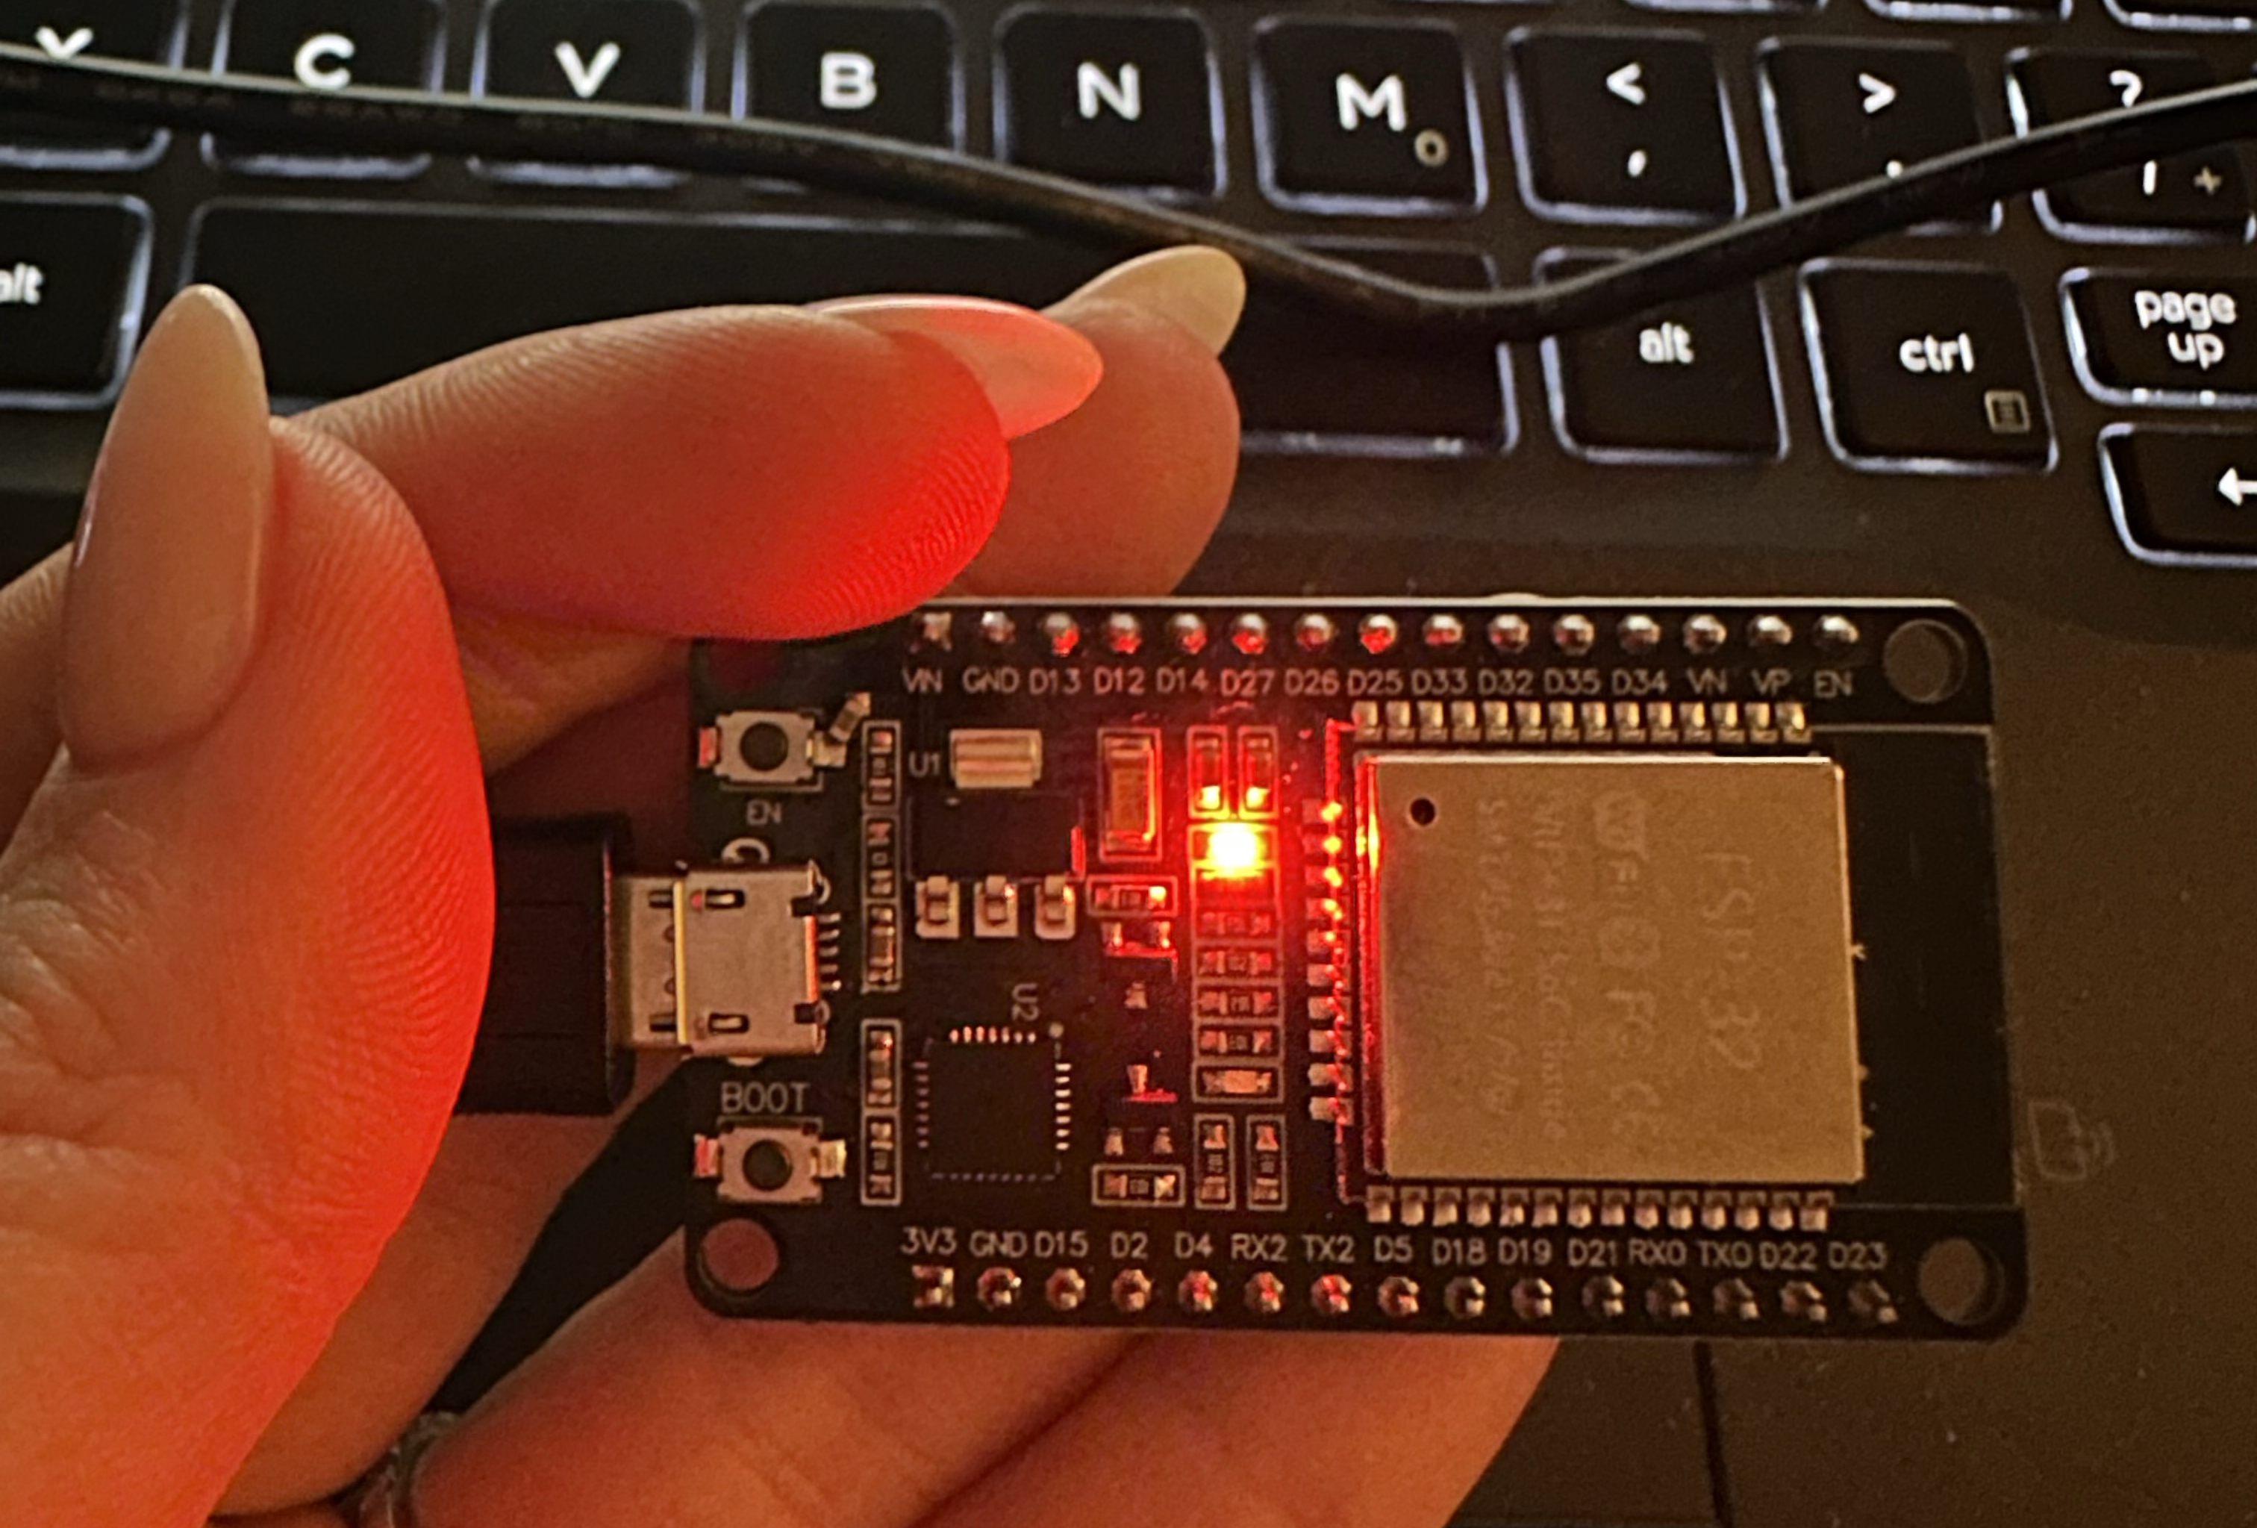

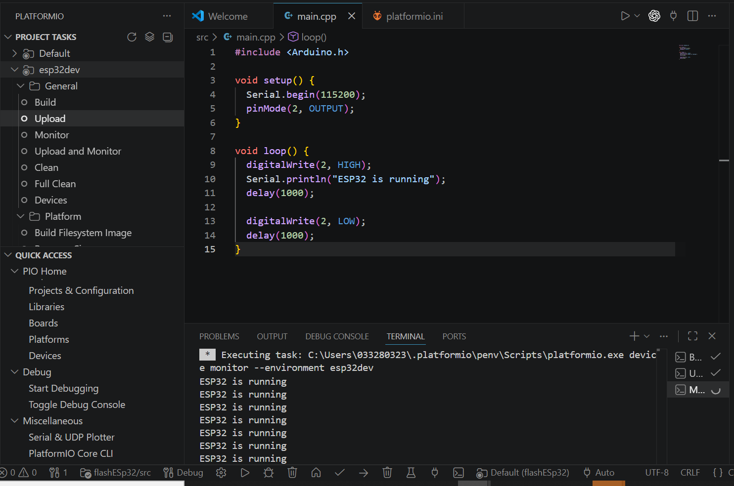
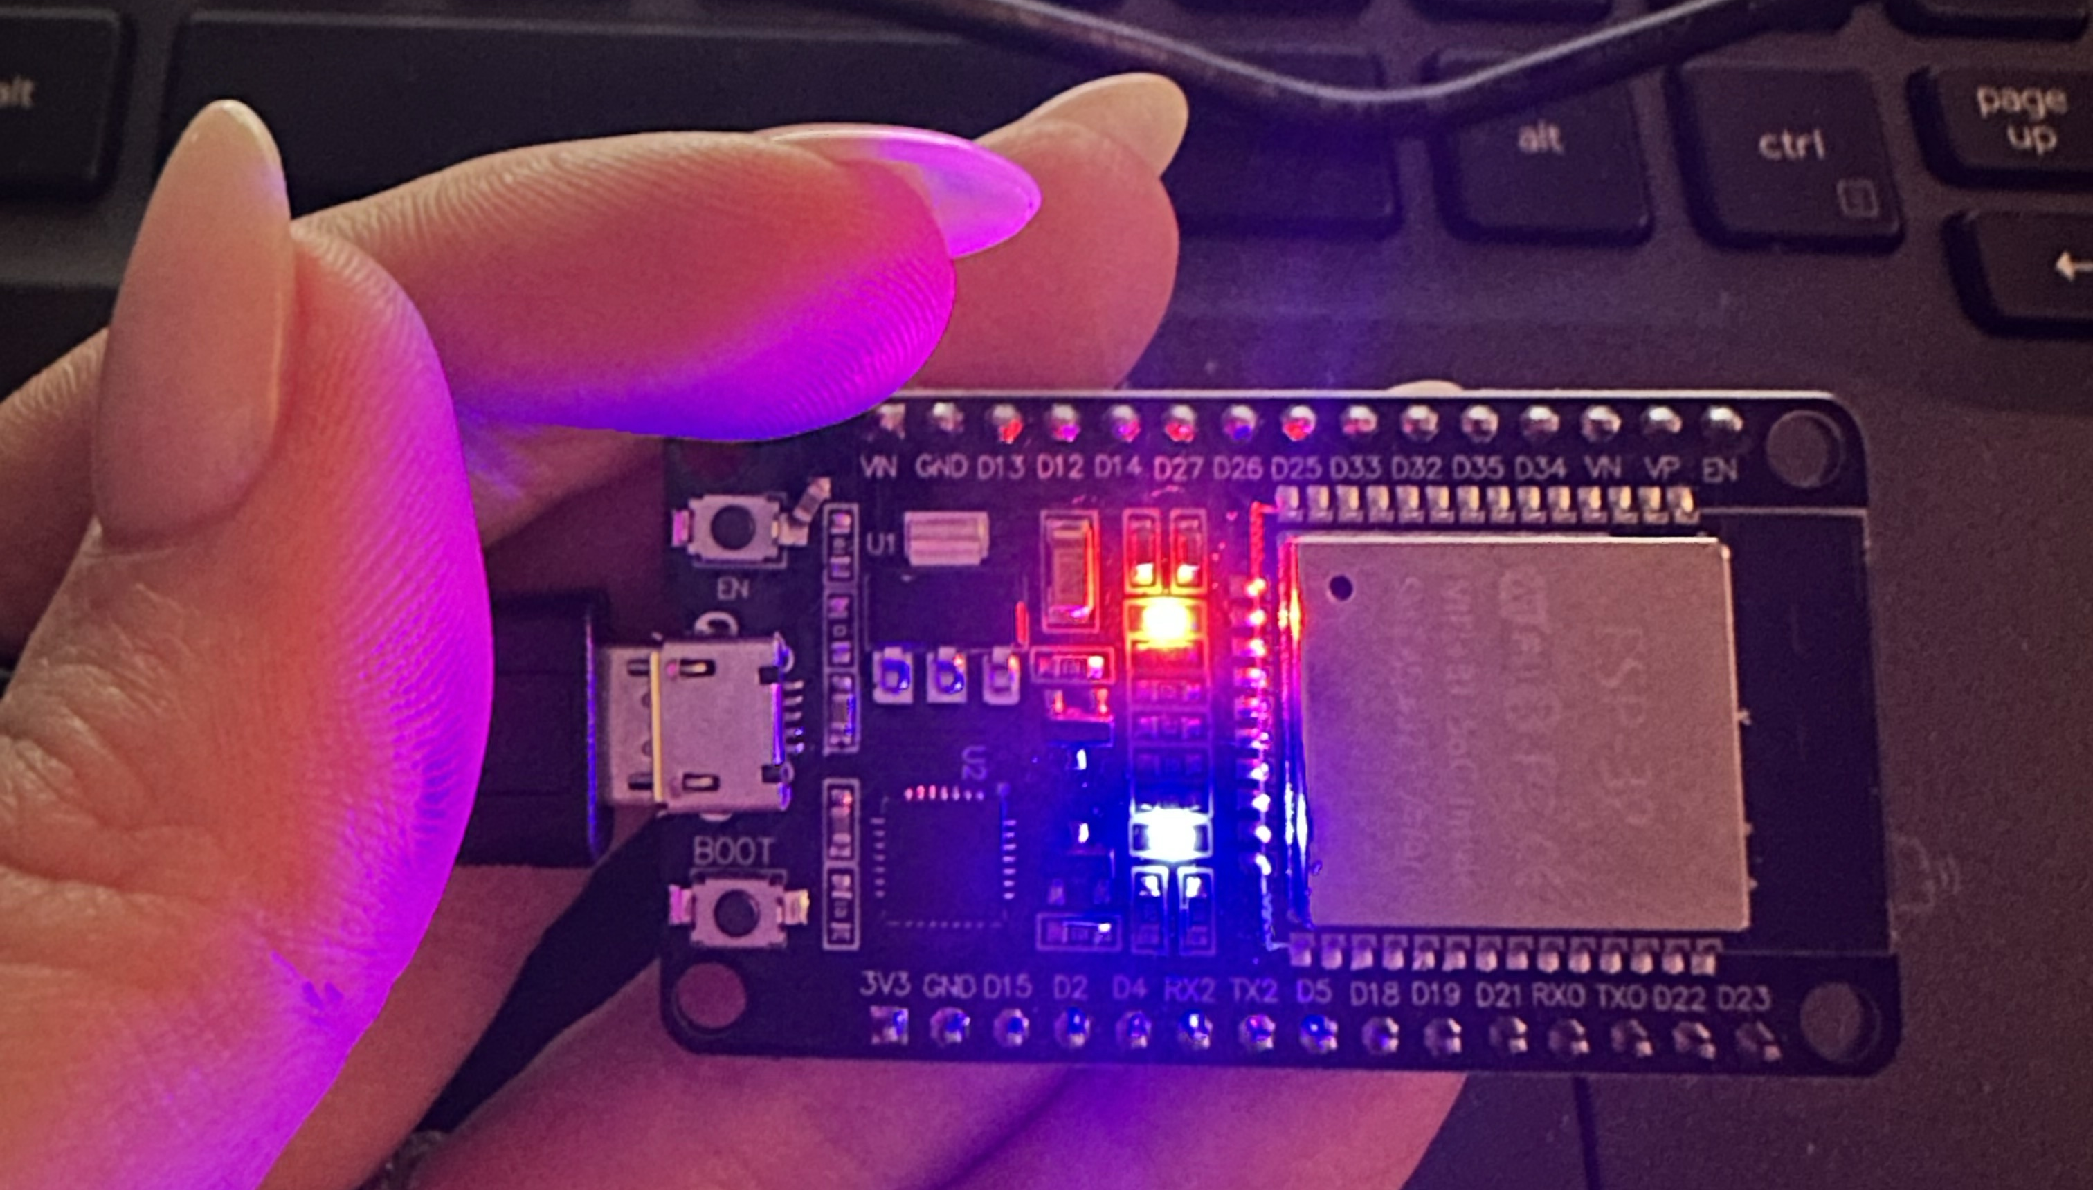
What works today
ESP32 boards received
PlatformIO set up; boards programmed and flashed
Basic board test: LED blink
ESP-NOW: one board toggles a pin on another, wirelessly
Replace with your image
Replace with your image
BNO085 IMU received (today)
Display selected; power and link budgets done
ESP32 / ESP-NOW test setup (photo)
PlatformIO build + upload log (screenshot)
Not yet tested: LoRa, GNSS, NFC, UWB, navigation
Notes:
OSCAR · ~35 s
Here's what actually works today. We received the ESP32 boards, set up PlatformIO, and programmed and flashed them. Our first test was blinking an LED, which you can see in the photos.
Then we tested ESP-NOW: one board toggles a pin on a second board, wirelessly. That's our first band-to-band link, before the LoRa radios arrive. On the right is the PlatformIO build and upload log.
The BNO085 IMU also arrived today.
To be clear about what's not done: LoRa, GPS, NFC, UWB and navigation haven't been tested yet.
IF ASKED:
• Which board is it? Say the exact ESP32 board model.
• Did you capture serial output? Only say yes if the screenshot shows it.

Slide 6

MCU decision: ESP32-S3 vs. STM32U5, by the numbers
Criterion | ESP32-S3 (in hand) | STM32U5G9 (candidate)
Sleep current, RAM retained | ~0.2–0.25 mA (light sleep) | 15.5 µA (Stop 2)
Built-in radios | Wi-Fi / BLE (unused: our radios are external) | None needed
Graphics for 466×466 AMOLED | Software rendering | NeoChrom GPU, DMA2D
On-chip RAM for frame buffer | 512 KB (+ external PSRAM) | ~3 MB
Firmware model | FreeRTOS-based SDK | Bare-metal (CubeU5 HAL)
Independent buses | 2 general-purpose SPI | 3 SPI + 2 OCTOSPI
Decision gate
STM32 board arrives: blink + UART
Measure sleep current on both with a PPK2
Drive the AMOLED over QSPI
Record the decision in the repo
Datasheet typical values (ST STM32U5G9, Espressif ESP32-S3). Blue = better fit for BandLink.
Why decide now: before integration locks in pin maps, drivers and firmware
Notes:
OSCAR · ~45 s
The ESP32 got us started fast, but before we integrate everything we're checking that it's the right chip, because switching later means remapping pins and rewriting drivers.
We compared two specific parts, the ESP32-S3 and the STM32U5G9, using datasheet numbers. The ESP32's strength is Wi-Fi and Bluetooth, but our radios are all external, so we wouldn't use them. On paper the STM32 wins on what we need: about fifteen times lower sleep current, a graphics accelerator for the round display, and enough on-chip RAM for a full frame.
But datasheets aren't measurements, so we haven't decided yet. Our gate: bring up the STM32 board, measure sleep current on both, drive the display, and record the result.
IF ASKED:
• Why not keep the ESP32 and add external PSRAM? That fixes RAM but not sleep current, and PSRAM adds power and latency to every frame.
• Is STM32 automatically lower power? No. That's why we compare specific chips and will measure both boards.

Slide 7
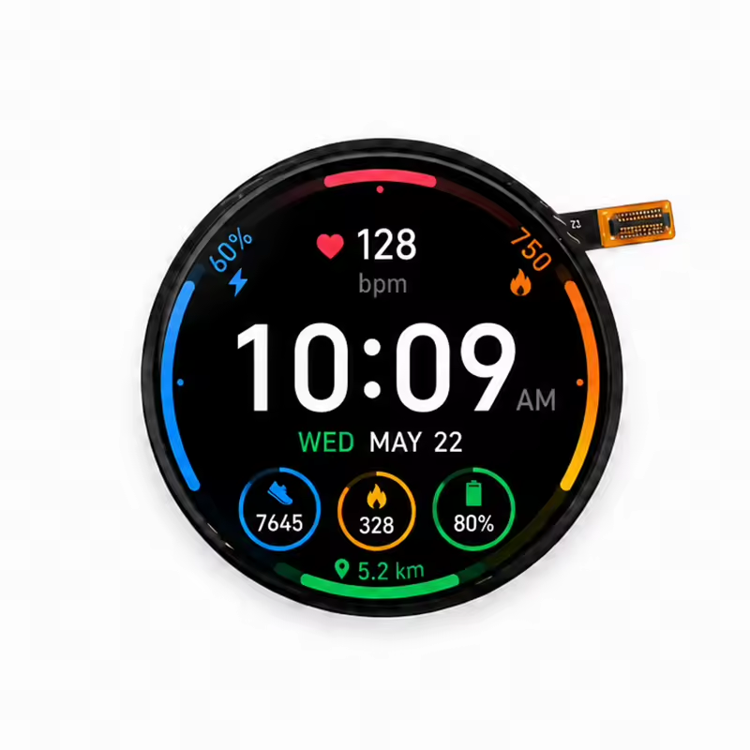
Display: OSPTEK AM173Q466466FLS round AMOLED
1.73 in
466 × 466
round AMOLED, touch
pixels, QSPI interface
424 KiB
≈ 22 ms
per full frame (RGB565)
full redraw at 40 MHz QSPI
Still to verify before committing the PCB
Driver IC + init sequence (OSPTEK example repo found)
Panel supply rails and enable pin; touch controller bus
MCU compatibility: QSPI clock and frame-buffer RAM (slide 6)
Vendor image of the selected panel (demo watch face)
Notes:
JUSTIN · ~30 s
For the display we picked the OSPTEK 1.73-inch round AMOLED: 466 by 466 pixels, touch, and a quad-SPI interface. It's about 700 nits and rated from minus 10 to 60 degrees C, so it's readable outdoors. The picture is the vendor's demo face, not our UI.
One full frame is about 424 kilobytes, and a full redraw takes about 22 milliseconds over quad SPI. Next we confirm the driver chip, supply voltages, touch, and MCU compatibility.
IF ASKED:
• How did you get 22 ms? 466 × 466 pixels × 16 bits = 3.47 Mbit per frame. A 4-bit bus at 40 MHz = 160 Mbit/s, which gives about 22 ms.
• Is 40 MHz realistic? It's an assumption until we check the controller's maximum clock. Even at 20 MHz a redraw is about 44 ms, and we usually redraw only the arrow.

Slide 8
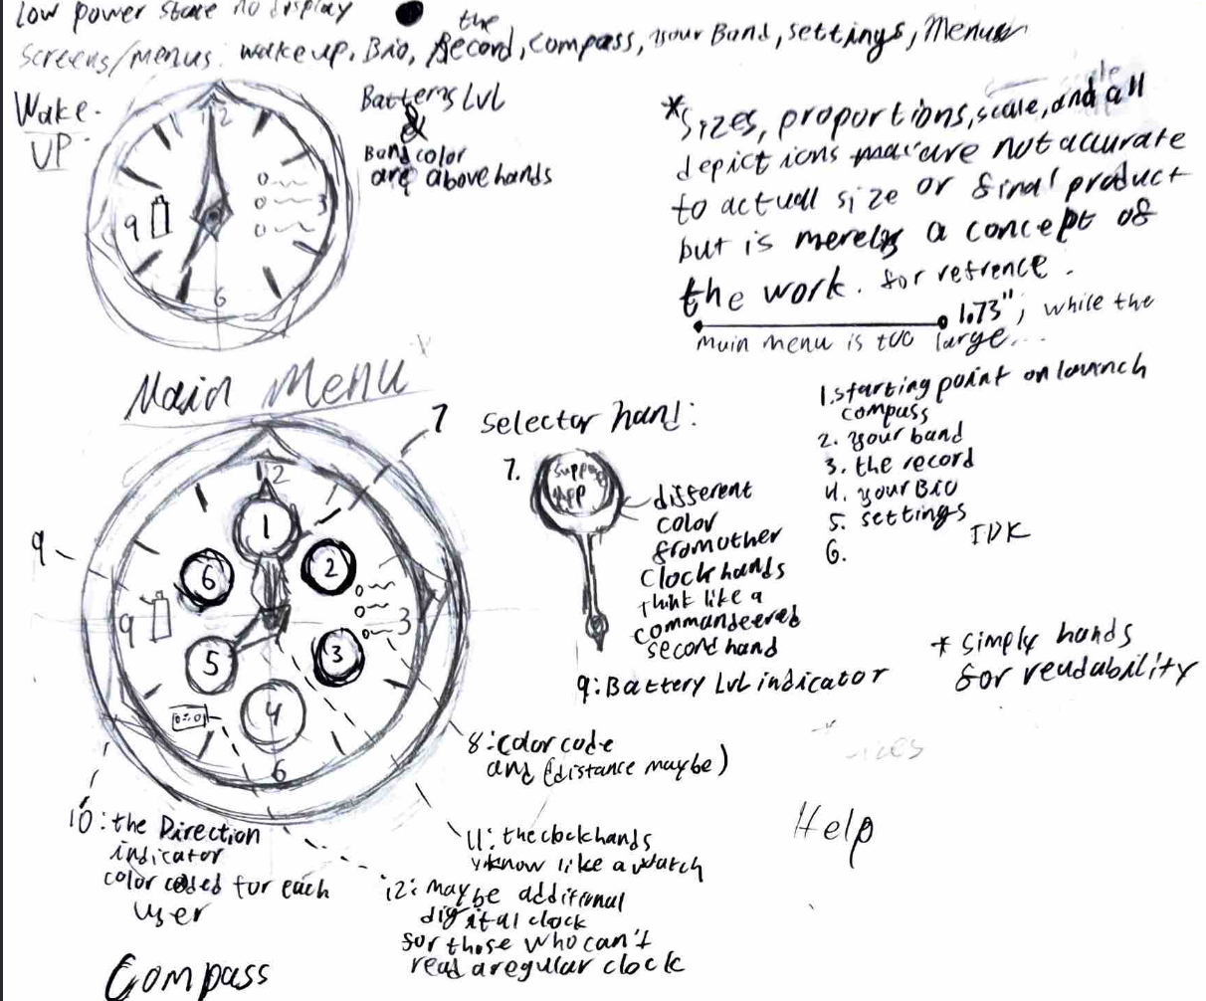
Display: User Interfacing
Round Display
UI Navigation
round AMOLED selected for its similarity to a watch, a record, and a compass
Use of rotary Encoder to navigate functions, like a watch crown and buttons.
Visuals
Locator Functions
Record motif is representing our intended customers and is based around our branding
Best way to display heading without compromise is a compass and is intuitive for the user
Still to Verify
Determine which functionalities needed to be visualized for user
Create sketches and finalized designs for all functions
Ensure readability and ease of use
Notes:
JUSTIN · ~35 s
Here's how the user will interact with it. We chose a round display because it reads like a watch, a record, and a compass. You navigate with a rotary encoder that works like a watch crown, plus buttons to select.
When the screen isn't showing location, the record motif connects to our intended users and our branding. The locator screen is built around a compass, because that's the most intuitive way to show a heading.
Next we'll decide which functions need a screen, finish the sketches, and test readability.
IF ASKED:
• Why a crown instead of only touch? It works with gloves or sweaty fingers, and you can use it without looking closely.
• What does the locator screen show? An arrow pointing to your friend and the distance, with a warning when the heading isn't reliable.

Slide 9
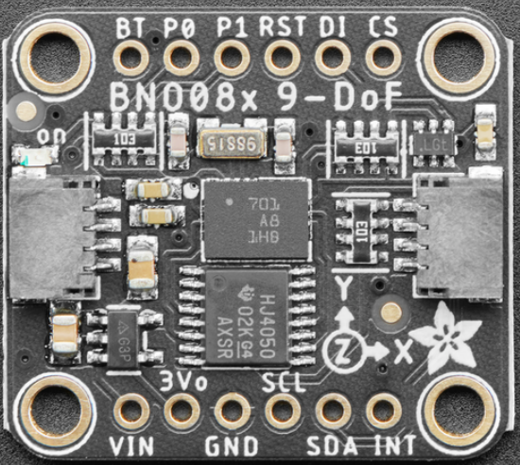
IMU: Adafruit BNO085, received today
Bring-up test plan (this week)
Why a fusion IMU
1
Wire to MCU over I²C (address 0x4A), alone on its bus
Accel + gyro + magnetometer, fused on-chip (SH-2)
2
Enable rotation vector; log quaternion → heading
Outputs a rotation-vector quaternion, so no fusion math runs on our MCU
Reports its own heading accuracy, so the UI can warn when the arrow is unreliable
3
Rotate through 8 compass headings vs. a reference compass
4
Repeat beside the haptic motor and battery to measure interference
Pass: ≤ 15° heading error after calibration (R-07)
Notes:
GIORGIA · ~35 s
The arrow is only as good as our heading, so we chose the Adafruit BNO085. It combines an accelerometer, gyroscope and magnetometer on the chip and outputs orientation directly, so our MCU doesn't have to do that math. It also reports how accurate its heading is, so we can warn the user.
It arrived today. This week we'll wire it up, log heading, compare against a compass at eight directions, and repeat next to the motor and battery. Pass is 15 degrees of error or less.
IF ASKED:
• Why not a cheaper 6-axis IMU? Without a magnetometer there's no absolute heading, so the arrow would drift.

Slide 10
The budgets close on paper
LoRa airtime per packet
0.206 s vs 0.4 s limit
SF9 / 125 kHz / CR 4/5, 24-byte payload. FCC §15.247 dwell ≤ 0.4 s.
Worst-case peak current
453 mA ≈ 0.9C
All loads at once. Firmware interlocks keep NFC off during LoRa TX.
Mix: 25% standby · 65% typical · 10% finding = 26.0 mA avg → 16.4 h vs. 8 h target
Datasheet estimates. Validate with a PPK2 power profiler in 490A.
Notes:
GIORGIA · ~35 s
Before buying everything, we checked that the design can meet its targets on paper.
Battery: active finding mode alone would last only about 7 hours, the red bar. But people spend most of a day in standby or typical mode, so a blended day averages 26 milliamps, about 16 hours on a 500 milliamp-hour cell. That's double our 8-hour target.
One LoRa packet takes 0.206 seconds on air, under the FCC's 0.4-second limit. Worst-case peak current is about 453 milliamps.
These are datasheet estimates, and we'll replace them with power-profiler measurements.
IF ASKED:
• How did you get 206 ms? Semtech's time-on-air formula at SF9 / 125 kHz: 4.096 ms per symbol × about 50 symbols for the preamble plus a 24-byte payload.
• The budget assumed a 1.43" display. The 1.73" panel draws a bit more, and we'll re-check it, but there's about 8 hours of margin.

Slide 11
Hardware sourcing status
Part | Role | Status
ESP32 dev boards | Toolchain + early bring-up | Received
STM32 dev board | MCU evaluation | In transit
Adafruit BNO085 breakout | Heading for the arrow | Received
AM173Q466466FLS AMOLED | Round touch display | Selected
LoRa / GNSS / NFC + power parts | Position, link, pairing, power | To confirm
Planned 490A budget
≈ $782
3 portable prototype sets
Dev kit for UI work
1 PPK2 power profiler
Order rules: 915 MHz (US) LoRa only; confirm GNSS antenna; NFC Click from MIKROE (SparkFun retired it)
Notes:
GIORGIA · ~25 s
Here's where purchasing stands. Received: the ESP32 boards and, as of today, the BNO085. In transit: the STM32 dev board. Selected: the AMOLED. The remaining radio and power parts wait on the MCU decision.
The planned 490A budget is about 782 dollars, for three prototype sets, a UI dev kit, and a power profiler. One lesson from sourcing: order only 915-megahertz US LoRa parts.
IF ASKED:
• Prices are estimates and get verified at DigiKey or Mouser before ordering.

Slide 12


Top risks and the test that retires each
RISK
WHY IT COULD HAPPEN
MEASUREMENT THAT RETIRES IT
Arrow points wrong
Magnet/battery interference with the magnetometer
8-heading compass test, ≤ 15°
Range drops in crowds
Bodies and wrist height attenuate 915 MHz
Walk test to ≥ 500 m; log delivery rate
MCU ↔ display mismatch
Driver IC, supply rails or QSPI timing
Drive the panel over QSPI; measure frame time
Battery too small for wrist
Real current above estimates
PPK2 active/sleep current per module
Notes:
GABRIEL · ~35 s
These are our four biggest risks, and each one has a test that settles it.
The arrow could point wrong because of magnets near the compass, so we'll do the eight-direction test. Range could drop in crowds because bodies absorb the signal, so we'll walk-test to 500 meters and log the delivery rate. The MCU and display might not work together, so we'll drive the real panel and time a frame. And the battery could fall short, so we'll measure current for each module.
IF ASKED:
• If range falls short: raise the spreading factor to SF10–11 (still under the dwell limit), use 22 dBm output power, and the relay stretch goal adds range.

Slide 13
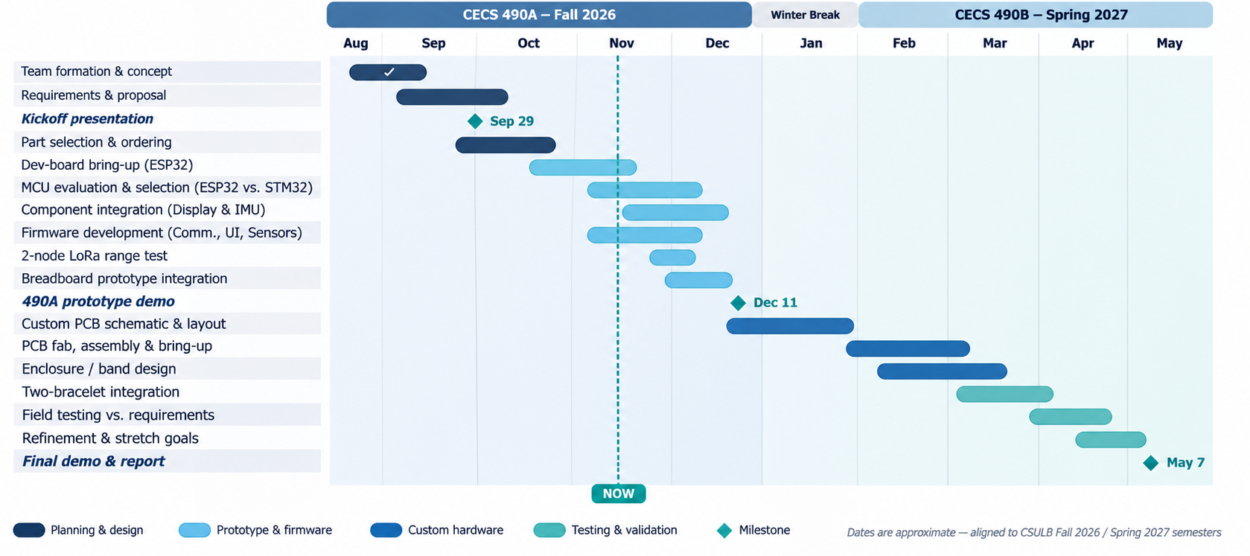
Timeline: Dec 11 prototype demo → May 7 final
Next: MCU decision · BNO085 bring-up · AMOLED check · 2-node LoRa test · breadboard integration
Notes:
GIORGIA · ~30 s
The dashed line is today. Planning, requirements and part selection are done, and we're in bring-up and MCU evaluation.
Before the December 11 prototype demo, we'll make the MCU decision, bring up the IMU and display, run a two-node LoRa range test, and integrate everything on a breadboard.
Over winter break we design the custom PCB. In the spring we build it, test against our requirements, and give the final demo on May 7.
IF ASKED:
• What if the STM32 board is late? Driver work can start on the ESP32 boards we already have, and the packet and encryption logic is portable C.

Slide 14

Questions & discussion
BandLink: Find your people. Stay connected.
Dec 11 prototype demo
Two units pair by NFC tap, exchange encrypted positions over LoRa, and each shows the other's direction and distance.
Next priority: MCU decision gate, then BNO085, AMOLED and two-node LoRa bring-up
Notes:
JUSTIN · ~10 s, then everyone for Q&A
For December 11: two bands will pair with a tap, share encrypted positions over LoRa, and point at each other. Thank you, we're happy to take questions.
IF ASKED:
• How is privacy handled? Only bands paired by a physical NFC tap hold the group key. Packets are AES-128-CCM, so they're encrypted and authenticated, and tampered or replayed packets are rejected.
• How accurate is the distance? GPS is about 10 m outdoors, so the arrow works from tens of meters out to 500 m. UWB (stretch goal) gives ±0.3 m up close.
• Is 915 MHz legal? Yes. It's an FCC Part 15.247 ISM band, and we stay under the 0.4 s dwell limit.
• Have you decided the MCU? Not yet. The STM32U5G9 leads on paper, and we decide after measuring both boards and driving the display.
• What changed since DR1? ESP32 bring-up and the ESP-NOW link work, the MCU decision gate is defined, the display is selected, the IMU is here, and the power and link budgets are done.

