Slide 1
New Benchmarks for Ranking HPC Systems
Mark Adams (LBNL)
Jed Brown (ANL,CU)
John Shalf (LBNL)
Erich Strohmaier (LBNL)
Brian Van Straalen (LBNL)
Sam Williams (LBNL)

Slide 2
Motivation
HPL is not relevant as metric for contemporary computation
Applications now exploit structure get O(1) work / word
HPL at O(N) work/word - Poor match contemporary computation
Architectures change: memory BW exponential decay?
My experience: stored matrix, 3D elasticity, algebraic multigrid, PETSc
1994 (92) IBM RS6K (my first AMG): 25% R_{peak}
2004 (00) IBM SP3 Gordon Bell: 5% R_{peak}
2014 (12) IBM BG/Q (PETSc ex56): 1% R_{peak}
Stored matrix-vector %R_{peak} drops ½ every ~5 years - Cray less dramatic
HPL got a lot right:
Solve a global problem - algebraic equation solve - fully coupled
Best practices solver algorithm, well defined & understood – Gauss LU
Good computer science implementations - block all levels memory, etc.
HPL missed one big issue:
Did not use equations with exploitable structure
Applications now use algorithms that exploit structure (eg, multigrid)

Slide 3
HPGMG design & philosophy
Design: Full geometric multigrid (FMG) Laplacian solve Cartesian grids
Non-iterative, asymptotically exact solver with O(N) work complexity
Optimal: all “fat” cut out of algorithm – robust to gaming
Built-in correctness verification – oblivious to floating point
Metric: equations solved / sec
Scale Free specification: Solution independent parallelization strategy
Do not punish/reward fine/coarse grain parallelism mathematically
Do not want to adjudicate “sub domain” – multilevel comm. strategy?
Stresses interconnect – global tree w/ non-trivial software kernels
Hard problem implicitly demands good end-to-end engineering
Benchmark remain relevant indefinitely
Increasingly effective proxy over time more apps use efficient algorithms
What is missing? Potential future additions to core design:
More complex domains, AMR, measure setup (reductions), energy, …
Particles: eg, gravity Poisson solve
Multigrid equation solve probably not good proxy MC (“IMC” later)
Big data – separate benchmark

Slide 4
Multigrid Tree++ & Nearest Neighbor Communication Patterns
FMG starts with accurate solve on coarsest grid

Slide 5
Multigrid Tree++ & Nearest Neighbor Communication Patterns
Nearest neighbor intra grid comm.
Inter grid tree++ comm.
Refine grid split processes, building tree

Slide 6
Multigrid Tree++ & Nearest Neighbor Communication Patterns
FMG goes back to coarse grid after each new level

Slide 7
Multigrid Tree++ & Nearest Neighbor Communication Patterns
Nearest neighbor intra grid comm.
Inter grid tree++ comm.
Back down

Slide 8
Multigrid Tree++ & Nearest Neighbor Communication Patterns
Nearest neighbor intra grid comm.
Inter grid tree++ comm.
refine & populate procs

Slide 9
Multigrid Tree++ & Nearest Neighbor Communication Patterns
Nearest neighbor intra grid comm.
Inter grid tree++ comm.
Populate & refine
Fully populated – continue refinement

Slide 10
Multigrid Tree+ & Nearest Neighbor Communication Patterns
Nearest neighbor intra grid comm.
Inter grid tree+ comm.
Populate & refine

Slide 11
Our proposal – HPGMG-FV/FE
The metric: equations solved / second (Q(N))
Flops/sec? Use, F(N) = K(flops/eq)•Q(N)(eq/sec)
HPL does this, F(N) = 2N³
Functionals of Q: richer data like dynamic range
Matrix free: optimized kernels R_{max}/R_{peak} as high/low as desired
Equation + discretization: free parameters
tune arithmetic intensity & higher order memory/cache
Match applications, with a few instantiations
Finite element (FE) & finite volume (FV)
Different memory access, data dependency, cache usage, …
Implementations:
FE (Jed Brown): compute, cache, network intensive
FV (Sam Williams): memory bandwidth, network intensive
Data …

Slide 12
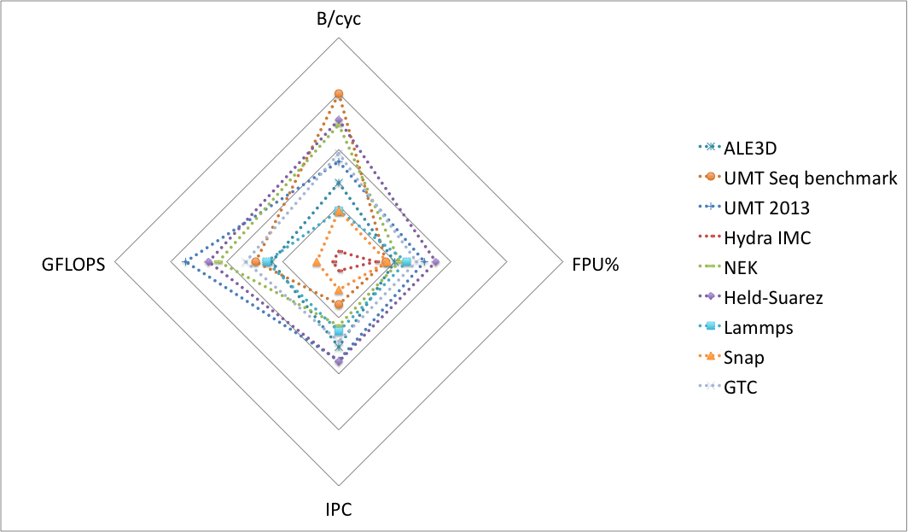
Metrics: Applications & Benchmarks HPM on IBM BG/Q data
Courtesy Bert Still and Ian Karlin, LLNL
Notes:
dotted: an application, a mini-app or a package from an application (Hydra IMC).HPM BG/Q

Slide 13
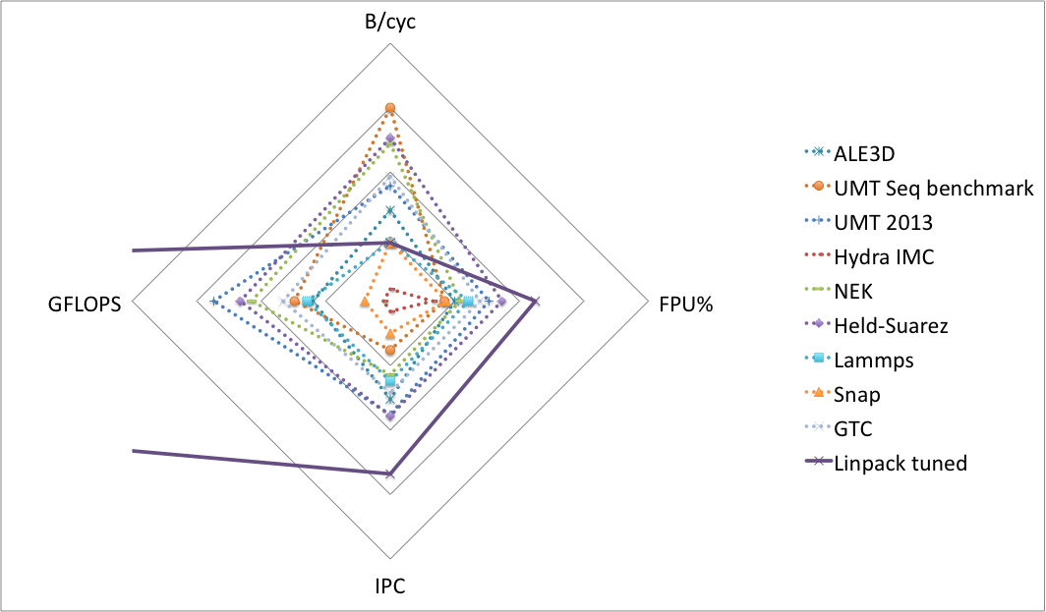
Metrics: Applications & Benchmarks HPM on IBM BG/Q data
Courtesy Bert Still and Ian Karlin, LLNL
Notes:
dotted: an application, a mini-app or a package from an application (Hydra IMC).HPM BG/Q

Slide 14
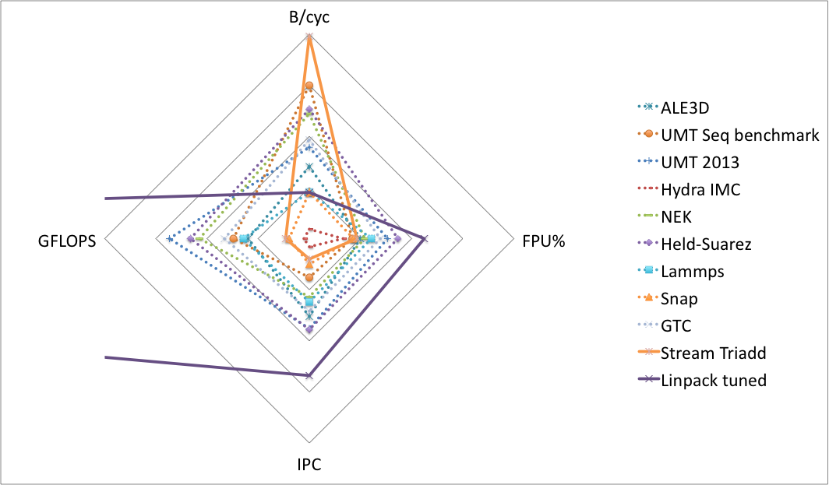
Metrics: Applications & Benchmarks HPM on IBM BG/Q data
Courtesy Bert Still and Ian Karlin, LLNL
Notes:
dotted: an application, a mini-app or a package from an application (Hydra IMC).HPM BG/Q

Slide 15
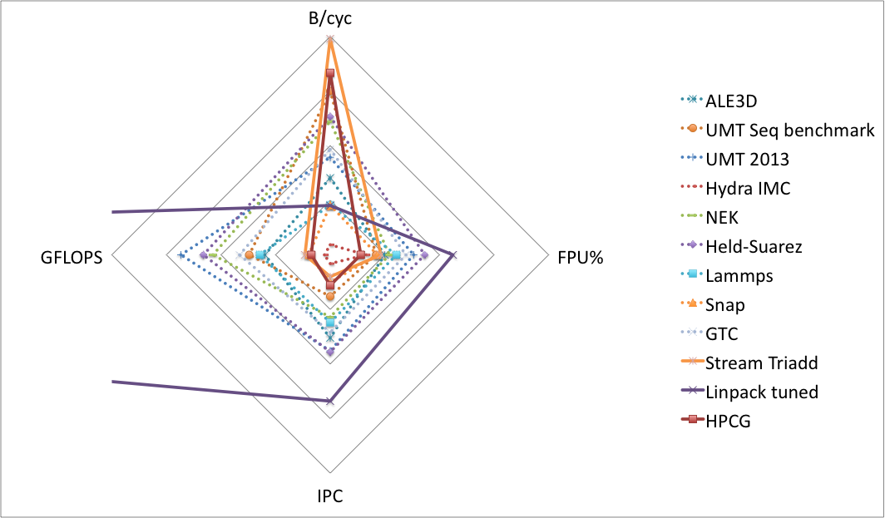
Metrics: Applications & Benchmarks HPM on IBM BG/Q data
Courtesy Bert Still and Ian Karlin, LLNL
Notes:
dotted: an application, a mini-app or a package from an application (Hydra IMC).HPM BG/Q
UMT 2013 - transport

Slide 16
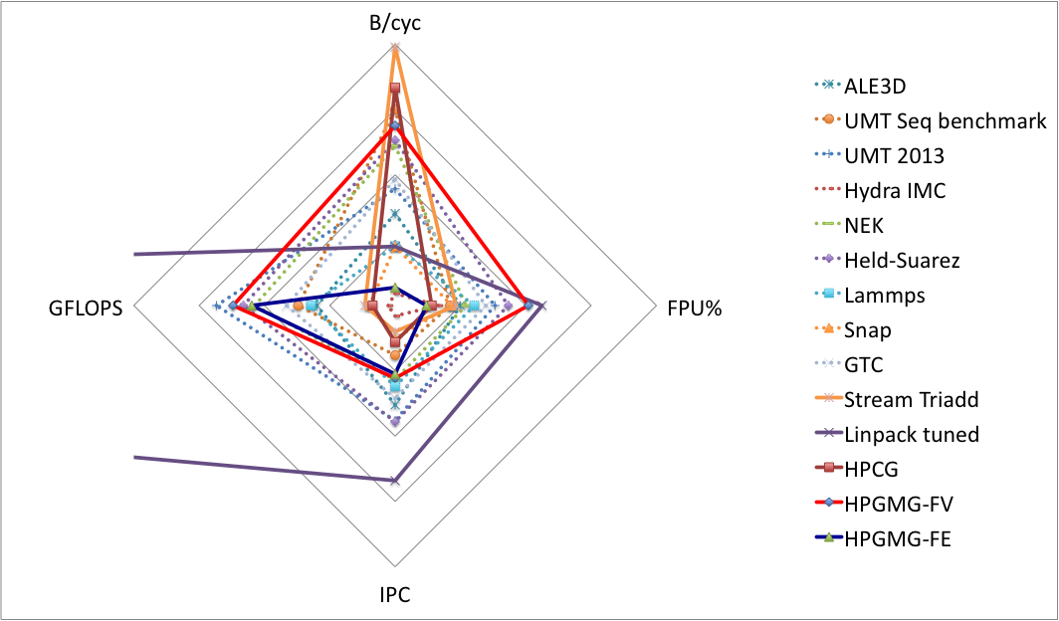
Metrics: Applications & Benchmarks HPM on IBM BG/Q data
Courtesy Bert Still and Ian Karlin, LLNL
Notes:
dotted: an application, a mini-app or a package from an application (Hydra IMC).HPM BG/Q

Slide 17
Tunable Parameter - Flop Rates
Method | Rmax/Rpeak | Machine
HPL | 80+%
FE – Q2 | 23% | Cray XC30
FE – Q2 affine | 15% | Cray XC30
FV – 7pt VC fused diagonal | 6.4% | IBM BG/Q
FV – 7pt VC | 3.5% | IBM BG/Q
Stored matrix | 1% | IBM BG/Q
Spectrum of arithmetic intensity/flop rates – some examples

Slide 18
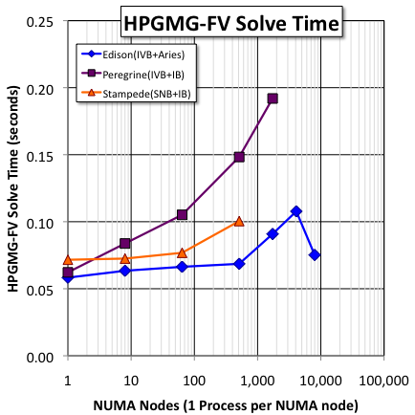
HPGMG Rewards Investment
Cray XC30 Aries interconnect – Edison NERSC
HP with Infiniband - Peregrine at NREL
Same processor as Edison (33% IVB)
Dell with Infiniband – Stampede at TACC
Using host-only, thus should be over provisioned
IB effective for HPL - 11 of top 25 (11/2013)
Edison ~90% parallel efficiency 512 sockets
Stampede 72%; Peregrine ~40%
HPGMG distinguishes Aries at 512 sockets
~#80 Peregrine, 8:1 taper – 2x speedup
#6 Stampede, 5:4 taper – 33% speedup
#10 SuperMUC, 4:1 taper – no data
Not implying Peregrine is bad - NREL:
Implicit code shop?
All medium size jobs?
Lots of dense linear algebra …
HPGMG could overprovision NREL, but not SC
NERSC procurement careful benchmark apps - Aries
Notes:
Peregrine: FDR tapered fat tree 8:1
50% knights corner, 33% Ivybridge, 17%, Sandybrook

Slide 19
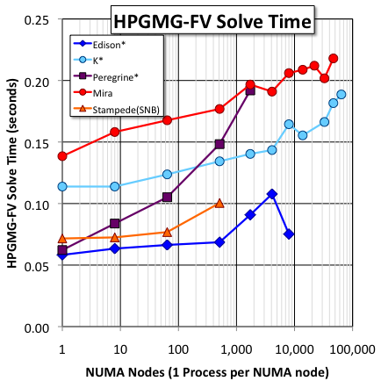
Potential reorder Top500
Top500: #4 & #5:
Mira: use 95% of machine
K: use 75%
Still: 50% increase for K/Mira
Might get 2x speedup at scale
K may beat Sequoia & Titan …
~3M threads
Machine\Metric | HPL (TFlop/s) | HPGMG (eq/s)
K (75%) | 10,510 | 711 x10⁹
Mira BGQ | 8,587 | 394 x10⁹
K/Mira | 1.2 | 1.8
 | K | Mira BGQ | K/Mira
HPL (TFlop/s) | 10,510 | 8,587 | 1.2
HPGMG (eq/s) | 711•10⁹ | 394•10⁹ | 1.8
Notes:
Peregrine: FDR tapered fat tree 1:8
50% knights corner, 33% Ivybridge, 17%, Sandybrook

Slide 20
Proposed Deployment Model (in development)
HPL could run for 24 hours -- HPGMG solve takes about one second
Community wants benchmark runs few hours – Opportunity collect data
Dynamic range, weak & strong speed up studies, etc.
Data track over time allows insight into historical trends HPC
Performant C+MPI+OMP multigrid reference implementation
Driver written in C, new programming models/languages callable C
Allow new driver implementations if needed
highest level of abstraction – try to avoid this
Performant restriction & prolongation compute kernels (C+MPI+OMP)
Performant low level kernels provided (C+MPI+OMP) as shown
Users implement architecture specific kernels as desired
apply operator is first (probably only) method to optimize
Post processing scripts generate data file, SHA1 of data, code, etc.
Create personal ranking on top500.org – weighted sum of:
HPGMG-FV-VC7, HPGMG-FE-Q2, etc, HPL, HPCG …

Slide 21

hpgmg.org
First release June 2014 – v0.1
We welcome community input and involvement: hpgmg.org
hpgmg-forum@hpgmg.org
Open code repository
https://bitbucket.org/hpgmg/hpgmg
Want experience from users, centers, vendors
run the benchmark & give us feedback
Visit hpgmg.org
Questions?
“…we seek a new metric that will have a stronger correlation to our application base and will therefore drive system designers in directions that will enhance application performance for a broader set of HPC applications.”
Toward a New Metric for Ranking High Performance Computing Systems
Jack Dongarra, Michael A. Heroux
Mark Adams (LBNL)
Jed Brown (ANL,CU)
John Shalf (LBNL)
Erich Strohmaier (LBNL)
Brian Van Straalen (LBNL)
Sam Williams (LBNL)

