Slide 1
Combining Probability Forecasts: 60% and 60% Is 60%, but Likely and Likely Is Very Likely
Robert Mislavsky, Celia Gaertig
Management Science, 68(1), 541-563

Slide 2
Backstory
We all must navigate uncertainty → ask for opinions from others
Advisors can express opinion in two types:
Numerically (e.g. “There is a 60% chance that prices will increase”)
Verbally (e.g. “It is likely that prices will increase”)
A substantial body of research has shown that numeric and verbal probabilities are interpreted differently in isolation (e.g., Lichtenstein and Newman 1967, Beyth-Marom 1982, Windschitl and Wells 1996).
But what about combining the opinions, i.e. multiple probability estimations?

Slide 3
This paper:
… demonstrates that people use different strategies to combine verbal probabilities than they do to combine numeric probabilities;
… finds that people act as if they average numeric probabilities (replicate past research results);
… finds that people act as if they “count” verbal probabilities, increasing the likelihood that their own forecast is more extreme than each of the advisors’ forecasts

Slide 4

Previous research
Combining numerical probabilities
Budescu and Yu (2006, 2007): people typically average others’ forecasts when these forecasts are provided to them as percentages
But (!) $→$ ”naïve Bayesian” approach:
people become more confident than the average prediction
E.g. when multiple advisors give relatively extreme estimates (Budescu and Yu 2006); when participants are making predictions about knowledge-based (i.e., epistemic) uncertainty (Wallsten et al. 1997a).
Combining verbal probabilities
Much less research on that
Budescu et al. (1990): participants saw two verbal probability estimates from hypothetical advisors that described how likely it was that a spinner would land on a certain colour; participants’ own estimates of that probability were both more extreme and “less fuzzy“ than the advisors’ estimates;
But (!) there is no equivalent numerical/one advisor condition in this study
It may be that participants made more extreme forecasts because they saw verbal forecasts, because they saw forecasts from two advisors, or simply be- cause of the nature of the task itself.

Slide 5
Normative combination strategies
How should we combine probability forecasts? → it depends
Some strategies:
“Averaging”
“Counting”
“Hedging”: agreeing with the general direction of an outcome (i.e., they are on the same side of 50% as the advisors) but being less certain than the advisors (i.e., they are closer to 50%)
“Contrarian”: disagreeing with a consensus opinion if you believe there is a rational reason to do so (e.g., if suspecting irrational herding of advisors)
Notes:
Ask what others think about combining forecasts

Slide 6

“Averaging”
Galton (1907) first showed that the “error of the average” (i.e., the difference between the average estimate and the truth) was substantially smaller than the “average error” (i.e., the average of the differences between individual estimates and the truth) among a group of people attempting to guess the weight of an ox.
Idiosyncratic biases or random errors: some people will overestimate and some people will underestimate the true answer. Averaging those estimates will therefore put you between these over- and underestimates and thus, closer to the truth. As a result, averaging the individual estimates will reduce the impact of these biases and errors and improve upon most individual estimates.
Works with systematic errors too

Slide 7

“Counting”
Underlying assumption of similar information: If everyone sees the same ox before guessing its weight, then the primary source of error between advisors is essentially random error or idiosyncratic bias.
The parable of the blind men and the elephant: if each individual man is only touching one part of the elephant, he cannot form a complete understanding of the whole without using information from the others. That is, when people have different information, a combination of their judgments gives a more complete picture of an event’s likelihood (Wallsten and Diederich 2001, Baron et al. 2014).
Budescu and Yu (2007): Imagine that you want to know how likely it is that a patient has a particular disease, and there are two different tests for the disease. After seeing the results of Test A, Dr. Jones believes that there is a 60% chance that the patient has the disease. After seeing the results of Test B, Dr. Smith also believes that there is a 60% chance. However, if you know both doctors’ predictions, you now know that the results of both tests point to the patient likely having the disease. Therefore, you have “the right to much higher confidence”

Slide 8
This work:
Contains 7 studies, asking participants forecast the likelihood of an uncertain event or to make a decision that is informed by others’ likelihood forecasts
In all studies, participants were shown either one or two expert predictions provided numerically (e.g., “60%–69%”) or verbally (e.g., “somewhat likely”).
In all studies, the experts always qualitatively agreed on the outcome (i.e., the forecasts were in the same “direction”).
Authors test differences in combination strategies by comparing the proportion of extreme forecasts (i.e., the proportion of participant forecasts that are more extreme than the most extreme advisor’s forecast) made by participants across conditions

Slide 9
Predictions
If participants act as if they are counting, we should expect the proportion of participants making extreme forecasts to increase when they see the second advisor’s forecast.
If participants act as if they are averaging, we should expect the proportion of participants making extreme forecasts decreasing when they see the second advisor’s forecast.
If participants use different combination strategies across verbal and numeric formats, we should expect that there is an interaction between advice format and the number of advisors.
Notes:
We use the term “averaging” to refer to a combination strategy by which the participant takes a weighted average of the advisors’ forecasts, placing her own forecast in between the advisors’ forecasts. Because the advisors’ forecasts were 7 and 9, a par- ticipant who averages these forecasts would answer somewhere at or between the two advisors’ forecasts (i.e., 7, 8, or 9). What exact forecast the participant will make depends, for example, on her own prior beliefs, whether she trusts one advisor more than the other, or some other external factor

Slide 10

Study 1
Goal: to examine whether people use different strategies to combine others’ forecasts when these forecasts are presented as numeric or verbal probabilities.
Participants were asked to predict the likelihood that a stock’s price would be higher in one year and presented them with forecasts from two advisors that were given either numerically (e.g., “60%–69%”) or verbally (e.g., “rather likely”)
Sample: 205 participants (Mturk, 35% female, M_{age} = 33.7)
Treatments: numeric vs verbal advice
Notes:
We presented participants with information about a stock (ticker symbol, company name, and most recent closing price) randomly selected from a list of 10. Before making their own forecast, participants saw forecasts made by two (fictional) advisors. We told them, “To help you make your decision, we have provided estimates from two financial analysts.”

Slide 11
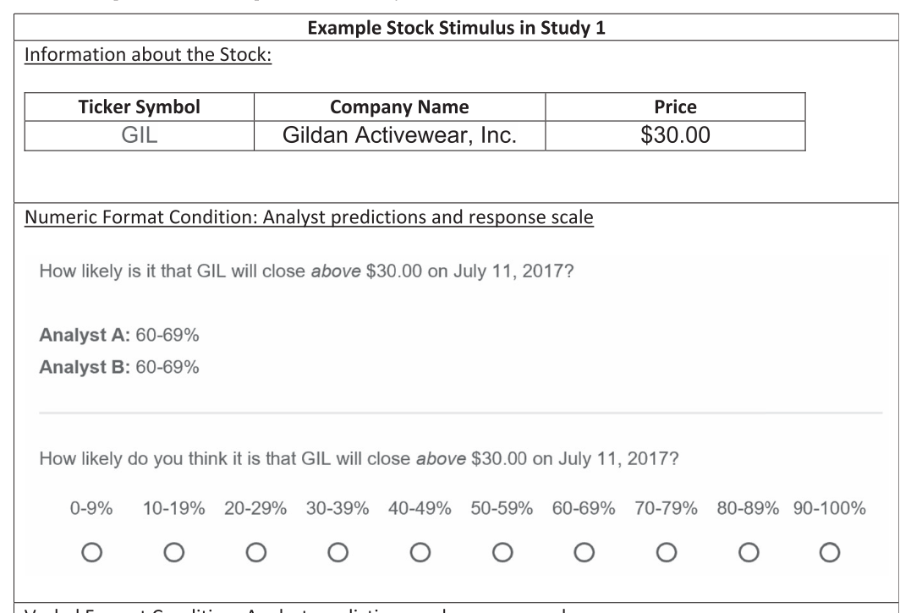
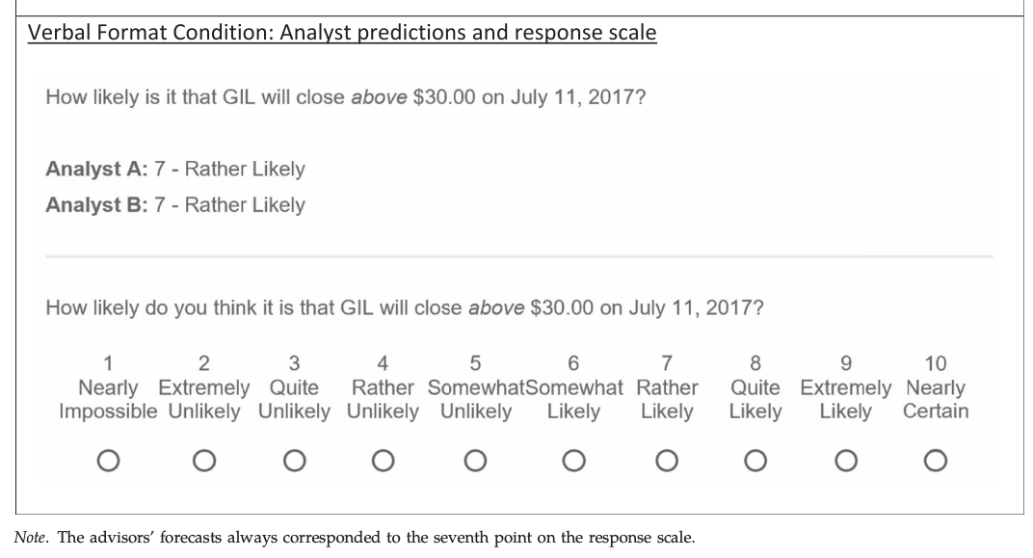
Examples of choice situations

Slide 12

Study 1: results
More participants in the verbal condition made extreme forecasts (29.4%) than in the numeric condition (10.9%), Z = 3.29, p = 0.001.
Does Seeing Verbal Forecasts Simply Make Participants’ Forecasts Noisier?
A similar proportion of participants provided forecasts below the advisors’ forecasts in the verbal (28.4%) and numeric (25.7%) conditions, Z = 0.37, p = 0.71
This pattern holds in all studies
Key limitation of Study 1: we do not know what participants’ own forecasts would have been if they had only seen one advisor’s forecast.
It is possible that participants’ own forecasts in the verbal condition are already more extreme if they only see one advisor’s forecast.
Notes:
we test differences in combination strategies by comparing the proportion of extreme fore- casts (i.e., the proportion of participant forecasts that are more extreme than the most extreme advisor’s forecast)
one alternative account for our effect is that participants’ own forecasts simply become noisier when they see verbal forecasts from two advisors than when they see numeric forecasts. For example, it may be that participants in the verbal condition are becoming not only more likely to make forecasts above the ad- visors’ forecasts (i.e., above seven) but also more likely to make forecasts below the advisors’ forecasts (i.e., below seven). However, we do not see this in the data.
TALK ABOUT ALL POSSIBLE PROBLEMS!
or example, it may be that participants in the verbal condition are becoming not only more likely to make forecasts above the ad- visors’ forecasts (i.e., above seven) but also more likely to make forecasts below the advisors’ forecasts (i.e., below seven).

Slide 13
Study 2: Sequential Evaluation (and Probabilities Below the Midpoint)
Design: 2 (format:verbal/numerical) x 2 (direction: above/below) x 2 (number of advisors: one vs two/between subjects)
Sample: 854 participants (39% female, M_{age}=33.4)
Task: same as before + manipulate the sequence of advisors (show one after the other) + manipulate the point of advisors’ forecasts (60%-69%/”rather likely” vs 30—29%/”rather unlikely”).
Notes:
Show participants two forecasts sequentially and compare the proportion of participants who make extreme forecasts after seeing only one advisor’s forecast with the proportion of participants who make extreme forecasts after seeing two advisors’ forecasts.
If people are more likely to act as if they are counting in the verbal condition, we would predict an interaction between advice format and the number of advisors, such that the proportion of participants making extreme forecasts increases as the number of advisors increases from one to two in the verbal condition but not in the numeric condition. We also extend our investigation to probability forecasts below the scale midpoint (i.e., below 50%).

Slide 14
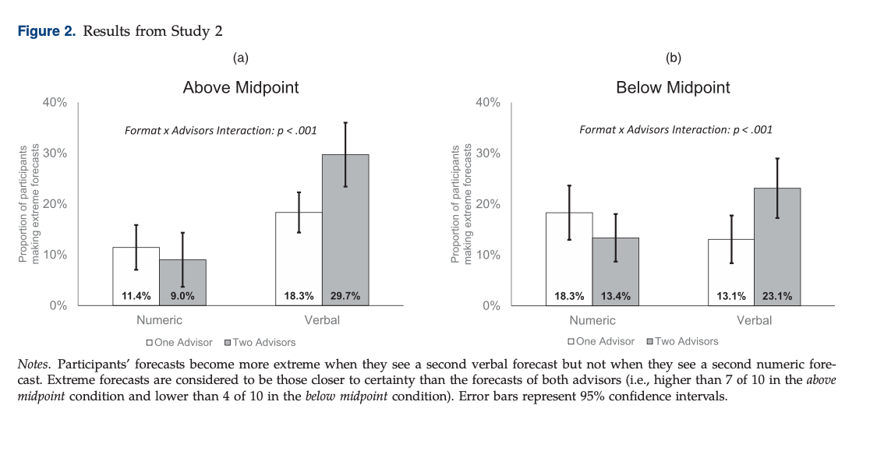
Notes:
above midpoint conditions, we classify participants’ forecasts as extreme if they are closer to certainty than each advisor’s forecast (i.e., above 7 on the 10-point response scale). In the below midpoint conditions, we classify participants’ forecasts as extreme if they are closer to impossibility than each advisor’s forecast (i.e., below 4 on the 10-point response scale).
Results: For both the above and below midpoint conditions, participants became more likely to make extreme forecasts as they saw an additional advisor’s forecast in the verbal condition, but they became less likely to do so in the numeric condition.
the interaction between format and number of advisors was also significant,

Slide 15
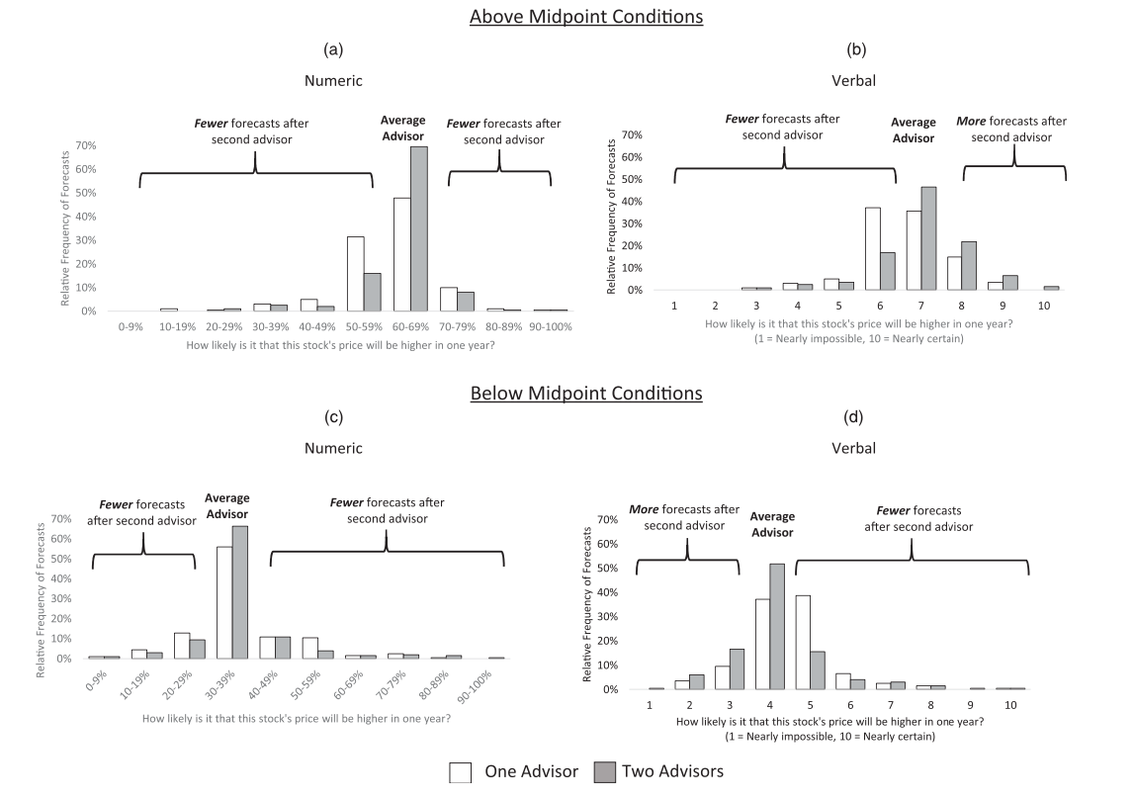
Notes:
histograms in the numeric condition (Figure 3, (a) and (c)) converge toward the “average” forecast as participants see the second advisor’s forecast. That is, there are more esti- mates at “60%–69%” (above midpoint condition) or “30%–39%” (below midpoint condition) and fewer estimates at nearly every other point.
Conversely, the histograms in the verbal condition (Figure 3, (b) and (d)) show a different pattern. Rather than only showing a spike at the average forecast (seven in the above midpoint condition and three in the below midpoint condition), there is a general shift in the distribution.

Slide 16

Conclusions
Study 2 rules out the possibility that people simply make more extreme judgments when provided with verbal probabilities, regardless of the number of forecasts they receive.
Instead, people use different combination strategies for verbal versus numeric probabilities, resulting in them making extreme forecasts more often when combining multiple verbal probabilities than when combining multiple numeric probabilities.

Slide 17

Study 3: Real experts
Introduce real experts (before they were “fake”)
Participants have to to predict outcomes of a series of baseball games + get advice from well-calibrated sports prediction websites (Fivethirtyeight.com, Fangraphs.com, or VegasInsider .com).
Authors also manipulated the number of advisors (one versus two) between subjects.
Sample: 626 participants, 42.7% female, Mage = 35.6 years)
Same measures (extreme forecast) + some knowledge on baseball
Result:
When participants saw only one advisor’s forecast, there were no differences between the proportion of extreme forecasts in the numeric (50.0%) and verbal (55.5%) conditions, Z = 1.39, p = 0.17.
When participants saw two advisors’ forecasts, they were more likely to make more extreme forecasts in the verbal condition (46.6%) than in the numeric condition (29.8%), Z = 5.11, p < 0.001
Notes:
Using baseball websites: This also introduced (a) natural variation across advisors’ forecasts, meaning that the advisors did not provide identical forecasts, and (b) more granular predictions (on a 0%–100% scale).

Slide 18
Study 4: Incentivized Decisions Based on Forecasts
Results so far: when participants see multiple verbal probability forecasts from advisors, they are much more likely to act as if they are “counting” than when they see multiple numeric probability forecasts.
But (!) maybe this is caused by differences in how participants use the respective response scales rather than becoming more certain of an event’s outcome.
Study 4 tests whether these findings extend to participants’ decision making informed by their beliefs about the event’s likelihood.
This decision also included a meaningful incentive for accuracy (opportunity to bet money on the outcome of a football game).
Sample: 1,024 participants on MTurk, of which 811 (40.3% female, Mage = 36.8 years)
Dependent variable is the proportion of participants who increased their bets after seeing the second expert opinion.
Authors predicted that participants in the verbal condition would be more likely to increase their bets (which would be consistent with a counting strategy) than participants in the numeric condition.
Results: More participants increased their bets in the verbal condition (25.4%) than in the numeric condition (11.6%), t(478) = 4.21, p < 0.001, η2 = 0.036. These results remain the same when we do not add game fixed effects and the football knowledge control to the regression, t(484) = 3.98, p < 0.001, η2 = 0.032.

Slide 19
Study 5a and 5b: are people Bayesian?
Although it is typically better to average others’ forecasts if forecasters are using correlated information (e.g., Ashton and Ashton 1985), making more extreme estimates is the normatively correct strategy if the forecasters are using uncorrelated or poorly correlated information (Wallsten and Diederich 2001, Baron et al. 2014).
If participants perceive less information correlation between two advisors who provide similar verbal forecasts than they do between advisors who provide similar numeric forecasts, it would be normatively appropriate for participants to use a “counting” strategy more often when combining verbal forecasts (Wallsten et al. 1997a, p. 51).

Slide 20
Study 5a
Design: identical to that of Study 2, except that the advisors’ forecasts were all above the midpoint and corresponded to the seventh point on the 10-point response scale (i.e., “60%–69%” in the numeric condition and “rather likely” in the verbal condition).
Two exploratory mediator questions:
“Do you think the analysts are using the same or different information to make their forecasts?”
“Do the analysts both think that the stock will go up?”
Results:
Replicate main findings
Do not find a difference in perceived correlation of the information that the advisors base their forecasts on across conditions
Evidence against the idea that participants’ combination strategies are driven by their beliefs about the correlation of the advisors’ information
Study 5b
Design: similar to Study 5a + manipulate the sources of information for the advisors
2(number of advisors) x 2 (advice format) x 2 (information source)
Source of information:
Different: used different sources of in- formation (i.e., one used a statistical model and one used general knowledge and intuition, in counter- balanced order).
Similar: participants were told that both advisors used similar sources of information (i.e., both used a model, or both used general knowledge and intuition).
Results:
Replicate main findings
Information source does not explain any effect
Effect is not driven by Bayesian updating
Notes:
(information source: different versus similar; between subjects)
we again find that participants in the verbal format condition become more likely to make an extreme forecast after seeing the second advisor’s forecast than those in the numeric format condition do.

Slide 21
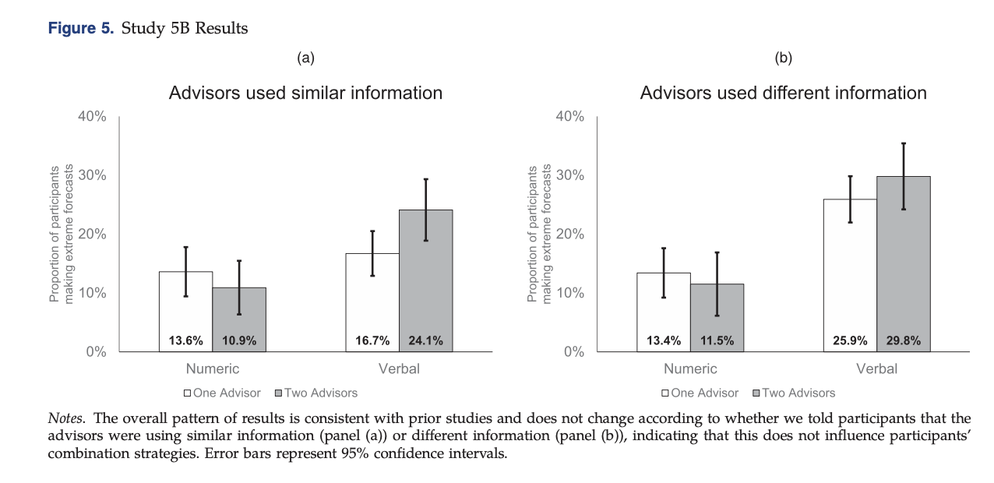

Slide 22

Study 6: Making Numeric Probabilities Evaluable
Maybe it is easier to infer the direction of the forecast from verbal probabilities than from numerical probabilities
Sample: 2,437 participants on Mturk (50.9% female, Mage = 35.9 years)
Design: similar to studies 2, 5a, and 5b + random assignment to one of three conditions:
Verbal
Numeric
Numeric with direction: numeric + note that “prediction above 50% should be considered a positive sign”
Results:
Replicate the main result (numeric vs verbal)
Numeric vs numeric with direction: slight increase, but not significant
Notes:
That is, when participants see verbal forecasts, they may have a better intuition about whether a forecast is a “good sign” or a “bad sign” that an event will occur (Teigen and Brun 1995, 1999). For example, imagine that a political pundit says that a candidate has a “40% chance” of winning an election. Is that good or bad news for the candidate? If there are only two candidates, a 40% chance is not very good, but if there are 20 candidates, a 40% chance will generally make someone the favorite to win (Windschitl and Wells 1998, Teigen 2001). In contrast, a candidate that is “likely” to win will be considered the favorite, regardless of the number of other candidates.
Expect for extreme predictions to increase after seeing the second forecast in numeric with direction

Slide 23
Study 7: additional mechanisms
Advisors’ agreement.
Same versus different information.
Knowledge versus luck.
Inside versus outside view.
Opinions versus facts.
Advisors’ thoughtfulness.
Advisors’ strength of opinion
Analyses from these questions do not provide strong evidence for one specific mechanism

Slide 24

General discussion
People combine probability forecasts from multiple advisors differently depending on whether the forecasts are given as numeric or verbal probabilities;
People seem as if they are averaging numeric probability forecasts and are more likely to act as if they are “counting” verbal probability forecasts
This effect occurs for both probabilities above and below 50%, for hypothetical scenarios and real events, when presenting advisors’ forecast simultaneously or sequentially

Slide 25

Next meeting in two weeks
Any volunteers? Topics? Suggestions?

