Slide 1

Review -1
TEAM 13
ACTIVITY ON “AUTOMMATIC SOLAR PANEL CLEANING MACHINE”
1] SANJEEVKUMAR V ANGADI
2] NUZHATKOUSAR MIRCHONI
3] SANDEEP HANUMANT BANDIVADDAR
4] SUJAN N SHET

Slide 2
Client – Designer Interaction
Sl. No. | Questions | Answers | Objective | Function | Constraint
1 | DO YOU NEED A BRUSH? | YES | YES
2 | DO YOU NEED IT TO BE REMOTE CONTROL ? | YES IT INCLUDE TO OPERATE MACHINE FROM DISTANCE |  | YES
3 | DO YOU NEED ANY CLEANING SCHEDULE ? | YES |  | YES
4 | DO YOU PREFER BODY TO BE OF ANY MATERIAL? | YES , PLASTIC OR WOOD | YES
5 | DO YOU NEED IT TO BE PORTABLE ? | IT WILL DEPENDS ON YOUR SPECIFIC REQUIREMENTS |  | YES
6 | DO YOU NEED ANY NOTIFICATION SYSTEM? | YES | YES
7 | THE LIMIT FOR PRODUCT? | 60 DAYS | YES |  | YES
8 | DO YOU NEED ANY INDICATIONS WHILE MACHINE GOES ON\OFF? | YES,LIGHT OR SOUND |  | YES
9 | MODE OF CONTROL | SWITCH\BUTTONS
10 | DO YOU NEED ANY SAFETY MEASURES GUIDES IN SYSTEM? | SOME SAFETY STICKERS ON IT | YES
11 | DO YOU NEED ANY POWER SAVING SYSTEM IN IT? | YES , TO SAVE CURRENT |  | YES
12 | DO YOU PREFER ANY OTHER CLEANING MATERIAL ? | YES | YES
13 | DO YOU NEED ANY SCREEN DISPLAY ? | YES |  | YES
14 | WHAT SHOULD BE THE DIMENSIONS ? | 2^2^2 |  |  | YES
15 | WHAT SHOULD BE THE COST ? | 3000 |  |  | YES

Slide 3
Problem Definition 1.1
THIS MACHINE WORKS ON SCHEDULE WHICH REDUCES WORK , IT IS REMOTE CONTROL WHERE WE CAN TURN IT ON\OFF ON OUR OWN IT IS DOES NOT NEED WATEERSPRAY IN IT IT CAN WASH THE PANEL CLEANLY BY THE BRUSH IT IS PORTABLE WHERE WE CAN SHIFT IT FROM ONE SOLAR PANEL TO ANOTHER WHERE IT HAS DIMENSION OF 2^2^2 AND LIGHT WEIGHT BODY WHICH CAN COST UPTO 3000

Slide 4
Identification of Functions
Team 13 | Functions from User Perspective | Functions from Designer perspective
 |  | HAS BRUSH WHICH HELPS TO CLEAN DUST
 |  | IT IS REMOTE CONTROL WHERE U CAN STOP ON YOUR WISH
 |  | IT IS PORTABLE WHERE U CAN CARRY FROM ONE PLACE TO ANOTHER
 | CLEANING | IT HAS SOUND SYSTEM IF ANYTHING GOES WRONG SOUND BEEPS
 |  | IT HAS LIGHTING WHERE IT SHOWS WETHER IS IT ON OR NOT

Slide 5
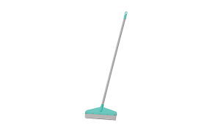
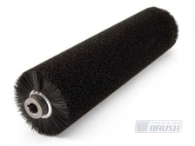
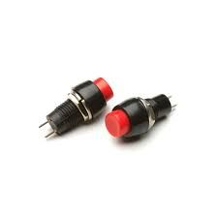
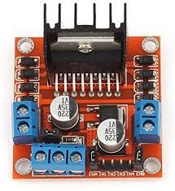
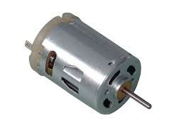
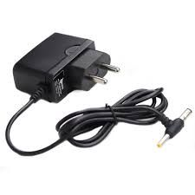
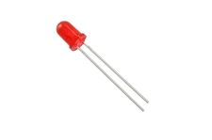
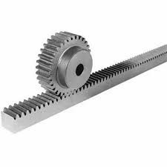
Morphological Chart
Morphological Chart
Serial No. | Sub-functions | Means 1 | Means 2 | Means 3 | Means 4
01 | CLEANING MATERIAL | WIPER | BRUSH
02 | COMPONENTS | BUTTONS | H BRIDGE | DC MOTOR | Standard 5V 2A Power Supply with Dual Pin DC Plug
03 | INDICATION | SOUND SYSTEM | MACHINE ON/OFF | LED
04 | MECHANISM | RACK AND PINION

Slide 6
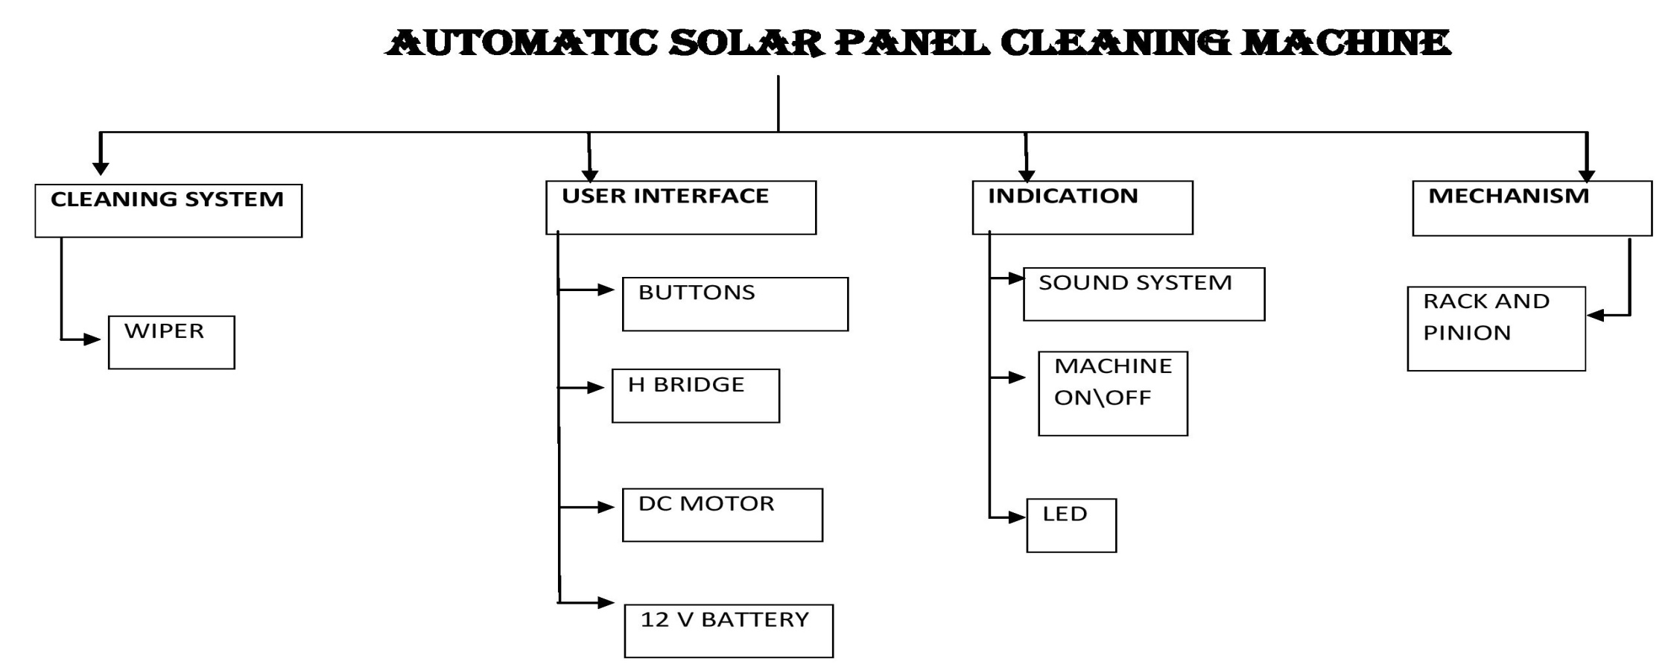
Functional Tree

Slide 7
Selection of means for each concepts
Sub-functions | Concept 1 | Concept 2 | Concept 3 | Concept 4
CLEANINNG MATERIAL | WIPER | BRUSH
COMPONENTS | BUTTONS | H BRIDGE | DC MOTOR | POWER SOCKET
INDICATION | SOUND SYSTEM | MACHINEON/OFF | LED
MECHANISM | RACK AND PINION

Slide 8
PROBLEM DEFINATION 1.2
THIS AUTOMATIC WHICH RUNS ON "5V SOCKET PLUG" MACHINE CAN DO THE WORK IN SCHEDULE IT CAN CLEAN THE SOLAR PANEL WITHOUT WATER WHICH HAS SAFETY MEASURES LIKE NOT TO TOUCH THE MAACHINE WHEN CURRENT IS ON OR KEEP IT AWAY FROM KIDS IT ALSO HELPS YOU IN SAVING CURRENT WHERE IT GOES AUTOMATICALLY OFF AFTER THE SCHEDULE IT HAS DRY BRUSH WHICH CAN CLEAN THE DUST ON SOLAR PANEL AND MAKE IT CLEAN ,THIS MACHINE WORKS ON SCHEDULE WHICH REDUCES WORK , IT IS REMOTE CONTROL WHERE WE CAN TURN IT ON\OFF ON OUR OWN IT IS DOES NOT NEED WATEERSPRAY IN IT IT CAN WASH THE PANEL CLEANLY BY THE BRUSH IT IS PORTABLE WHERE WE CAN SHIFT IT FROM ONE SOLARPANEL TO ANOTHER WHERE IT HAS DIMENSION OF 2^2^2 AND LIGHT WEIGHT BODY WHICH CAN COST UPTO 3000

Slide 9
Pugh chart
Objectives | Weights
Safety | 7
Ease of use | 8
WORK DONE IN SHORT TIME | 6
COST | 5
Pugh chart for the 4 alternative designs shown in figures
Design Objectives | Weights | Design 1 | Design 2 | Design 3 | Design 4
Safety | 7 | + | + | - | DATUM
Ease of use | 8 | + | - | - | DATUM
 | 6 | - | ++ | ++ | DATUM
Cost | 5 | + | - | + | DATUM
Score(+) |  | 20 | 19 | 17 | --
Score (-) |  | 6 | 13 | 15 | --
Total | 26 | 14 | 6 | 2 | 0

Slide 10
Justification for the scores given
Design No. | Objective | Score Allocated | Justification for the Score
1 | SAFETY | 7 | THE SOFTWRE AND MATERIALS ARE INSTALLED INSIDE
 | EASE OF USE | 8 | ITS PORTABLE
 | WORK DONE IN SHORT TIME | -6 | DUE TO RACK AND PINION MACHANISM IT CLEANS EVERYTHING IN ONW SWIPE
 | COST | 5 | EVERY PRODUCT USED MAKE THIS IS CHEAP IN MARKET
2 | SAFETY | 7 | SOME MATERIALS ARE INSTALLED INSIDE WHERE THE OTHER CURRENT RELATED ARE OUTSIDE
 | EASE OF USE | -8 | IT IS ONE TIME INSTALLMENT(NOT PORTABLE)
 | WORK DONE IN SHORT TIME | 12 | DUE TO GEAR MECHANISM IT IS DONE QUICKLY
 | COST | -5 | ITS EXPENSIVE COMPARED TO DATUM MODEL
3 | SAFETY | -7 | IT IS NOT SAFE AS CHAIN MECHANISM COMES OUTSIDE
 | EASE OF USE | -8 | IT IS ONE TIME INSTALLMENT(NOT PORTABLE)
 | WORK DONE IN SHORT TIME | 12 | DUE TO CHAIN MECHANISM IT CAN BE DONE QUICKLY WHEN COMPARED TO DATUM
 | COST | 5 | THE PRODUCTS ARE CHEAP IN MARKET
4 | SAFETY | -- | --
 | EASE OF USE | -- | --
 | WORK DONE IN SHORT TIME | -- | --
 | COST | -- | --

Slide 11
Sub-function Interaction Details
CLEANING MATERIAL | COMPONENTS | INDICATION | MECHANISM
Spatial
Data
Material
Subsystem List
SL. No. | Subsystem
1 | CLEANING MATERIAL
2 | COMPONENTS
3 | INDICATION
4 | MECHANISM
COMPONENTS | CLEANING MATERIAL | INDICATION | MECHANISM
Spatial
Data
Material
INNDICATION | CLEANING MATERIAL | COMPONENTS | MECHANISM
Spatial
Data
Material
MECHANISM | CLEANING MATERIAL | COMPONENTS | INDICATION
Spatial
Data
Material

