Slide 1
Tutorial 6

Slide 2
Names
https://www.google.com/search?q=random%20number%20generator

Slide 3
Tutorial 6
Yu Xiao Liang <yuxiao@comp>
Adapt from Wei Tsang's slide

Slide 4
Problem 13.1

Slide 5
long square(long x)
{
return x*x;
}
double hypotenuse_of(long base, long height)
{
return sqrt(square(base) + square(height));
}
int main()
{
hypotenuse_of(3, 4);
}

Slide 6
long square(long x)
{
return x*x;
}
double hypotenuse_of(long base, long height)
{
return sqrt(square(base) + square(height));
}
int main()
{
hypotenuse_of(3, 4);
}
hypotenuse_of
3
base
height
4
main

Slide 7
long square(long x)
{
return x*x;
}
double hypotenuse_of(long base, long height)
{
return sqrt(square(base) + square(height));
}
int main()
{
hypotenuse_of(3, 4);
}
square
x
x
3
hypotenuse_of
3
base
height
4
main

Slide 8
long square(long x)
{
return x*x;
}
double hypotenuse_of(long base, long height)
{
return sqrt(square(base) + square(height));
}
int main()
{
hypotenuse_of(3, 4);
}
hypotenuse_of
x
base
3
height
4
main
x

Slide 9
long square(long x)
{
return x*x;
}
double hypotenuse_of(long base, long height)
{
return sqrt(square(base) + square(height));
}
int main()
{
hypotenuse_of(3, 4);
}
square
x
x
4
hypotenuse_of
3
base
height
4
main

Slide 10
long square(long x)
{
return x*x;
}
double hypotenuse_of(long base, long height)
{
return sqrt(square(base) + square(height));
}
int main()
{
hypotenuse_of(3, 4);
}
hypotenuse_of
3
base
height
4
main

Slide 11
long square(long x)
{
return x*x;
}
double hypotenuse_of(long base, long height)
{
return sqrt(square(base) + square(height));
}
int main()
{
hypotenuse_of(3, 4);
}
sqrt
x
x
25
hypotenuse_of
3
base
height
4
main

Slide 12
long square(long x)
{
return x*x;
}
double hypotenuse_of(long base, long height)
{
return sqrt(square(base) + square(height));
}
int main()
{
hypotenuse_of(3, 4);
}
hypotenuse_of
3
base
height
4
main

Slide 13
long square(long x)
{
return x*x;
}
double hypotenuse_of(long base, long height)
{
return sqrt(square(base) + square(height));
}
int main()
{
hypotenuse_of(3, 4);
}
main

Slide 14
long square(long x)
{
return x*x;
}
double hypotenuse_of(long base, long height)
{
return sqrt(square(base) + square(height));
}
int main()
{
hypotenuse_of(3, 4);
}

Slide 15
Problem 13.2

Slide 16
long factorial(long n) {
if (n == 0) {
return 1;
}
return factorial(n-1) * n;
}
int main() {
factorial(3);
}

Slide 17
long factorial(long n) {
if (n == 0) {
return 1;
}
return factorial(n-1) * n;
}
int main() {
factorial(3);
}
factorial
n
3
main

Slide 18
long factorial(long n) {
if (n == 0) {
return 1;
}
return factorial(n-1) * n;
}
int main() {
factorial(3);
}
factorial
n
2
factorial
n
3
main

Slide 19
long factorial(long n) {
if (n == 0) {
return 1;
}
return factorial(n-1) * n;
}
int main() {
factorial(3);
}
factorial
n
1
factorial
n
2
factorial
n
3
main

Slide 20
long factorial(long n) {
if (n == 0) {
return 1;
}
return factorial(n-1) * n;
}
int main() {
factorial(3);
}
factorial
n
0
factorial
n
1
factorial
n
2
factorial
n
3
main

Slide 21
long factorial(long n) {
if (n == 0) {
return 1;
}
return factorial(n-1) * n;
}
int main() {
factorial(3);
}
factorial
n
1
factorial
n
2
factorial
n
3
main

Slide 22
long factorial(long n) {
if (n == 0) {
return 1;
}
return factorial(n-1) * n;
}
int main() {
factorial(3);
}
factorial
n
2
factorial
n
3
main

Slide 23
long factorial(long n) {
if (n == 0) {
return 1;
}
return factorial(n-1) * n;
}
int main() {
factorial(3);
}
factorial
n
3
main

Slide 24
long factorial(long n) {
if (n == 0) {
return 1;
}
return factorial(n-1) * n;
}
int main() {
factorial(3);
}
main

Slide 25
long factorial(long n) {
if (n == 0) {
return 1;
}
return factorial(n-1) * n;
}
int main() {
factorial(3);
}

Slide 26
Problem 13.3

Slide 27
void incr(long x) {
x += 1;
}
int main() {
long x = 10;
incr(x);
incr(x);
cs1010_print_long(x);
}

Slide 28
Problem 14.1

Slide 29
long *ptr1;
long *ptr2;
long x;
long y;
ptr1 = &x;
ptr2 = &y;
*ptr1 = 123;
*ptr2 = -1;
cs1010_println_long(x);
cs1010_println_long(y);
cs1010_println_long(*ptr1);
cs1010_println_long(*ptr2);

Slide 30
long *ptr1;
long *ptr2;
long x;
long y;
ptr1 = &x;
ptr2 = &y;
*ptr1 = 123;
*ptr2 = -1;
cs1010_println_long(x);
cs1010_println_long(y);
cs1010_println_long(*ptr1);
cs1010_println_long(*ptr2);

Slide 31
y
-1
x
123
ptr2
ptr1

Slide 32
ptr1 = ptr2;
*ptr1 = 1946;
cs1010_println_long(x);
cs1010_println_long(y);
cs1010_println_long(*ptr1);
cs1010_println_long(*ptr2);

Slide 33
y
1946
x
123
ptr2
ptr1

Slide 34
y = 10;
cs1010_println_long(x);
cs1010_println_long(y);
cs1010_println_long(*ptr1);
cs1010_println_long(*ptr2);

Slide 35
y
10
x
123
ptr2
ptr1

Slide 36
Problem 14.2

Slide 37
double *addr_of(double x) {
return &x;
}
int main() {
double c = 0.0;
double *ptr;
ptr = addr_of(c);
*ptr = 10;
}

Slide 38
double *addr_of(double x) {
return &x;
}
int main() {
double c = 0.0;
double *ptr;
ptr = addr_of(c);
*ptr = 10;
}
ptr
main
c
0.0

Slide 39
double *addr_of(double x) {
return &x;
}
int main() {
double c = 0.0;
double *ptr;
ptr = addr_of(c);
*ptr = 10;
}
addr_of
x
0.0
main
ptr
c
0.0

Slide 40
double *addr_of(double x) {
return &x;
}
int main() {
double c = 0.0;
double *ptr;
ptr = addr_of(c);
*ptr = 10;
}
10
main
ptr
c
0.0

Slide 41
double *triple_of(double x) {
double triple = 3 * x;
return &triple;
}
int main() {
double *ptr;
ptr = triple_of(10);
cs1010_println_double(*ptr);
}

Slide 42
double *triple_of(double x) {
double triple = 3 * x;
return &triple;
}
int main() {
double *ptr;
ptr = triple_of(10);
cs1010_println_double(*ptr);
}
triple_of
triple
30.0
x
10.0
main
ptr

Slide 43
double *triple_of(double x) {
double triple = 3 * x;
return &triple;
}
int main() {
double *ptr;
ptr = triple_of(10);
cs1010_println_double(*ptr);
}
30.0
main
ptr

Slide 44
int main() {
long a = 0;
printf("%ld\n", max(&a, 10));
}

Slide 45
int main() {
long a = 0;
printf("%ld\n", max(&a, 10));
}
max
length
10
list
main
a

Slide 46
Fun stuff - Valgrind
http://valgrind.org/
http://valgrind.org/docs/manual/quick-start.html

Slide 47
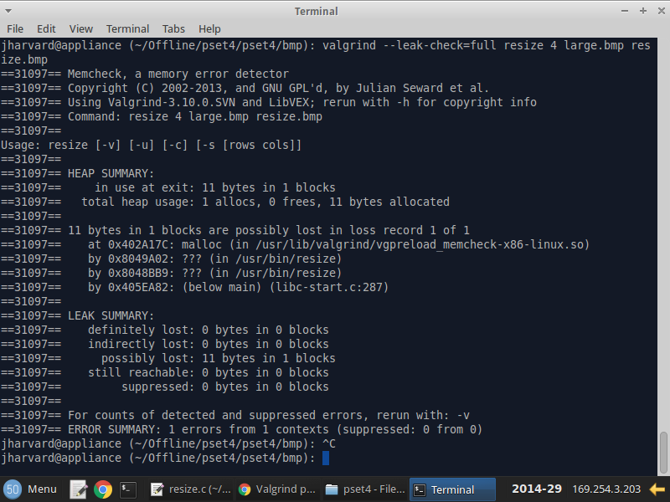
http://valgrind.org/docs/manual/quick-start.html

Slide 48
Problem 15.1

Slide 49
Write the function average that takes an array of k integers and k and returns the average of the k values in the array.

Slide 50
Problem 15.2

Slide 51
int main() {
long a = 0;
printf("%ld\n", max(&a, 10));
}

Slide 52
Problem 15.3

Slide 53
long max(long *list, long length) {
long max_so_far;
long *curr;
max_so_far = *list;
curr = list + 1;
for (long i = 1; i != length; i += 1) {
if (*curr > max_so_far) {
max_so_far = *curr;
}
curr += 1;
}
return max_so_far;
}

Slide 54
list
curr
curr = list + 1;

Slide 55
list
curr
curr += 1;

Slide 56
Assignment 3

