Slide 1
Tutorial 4
(Next tutorial is on Mooncake festival! :D OR :/ ?)
Download this slide

Slide 2
Names

Slide 3
Tutorial 4
Xiao Liang

Slide 4
Problem 10.1 Question
(x > 1) && (y != 10)
!eating && drinking
(has_cs2030 || has_cs2113) && has_cs2040c

Slide 5
(x > 1) && (y != 10)
(x <= 1) || (y == 10)

Slide 6
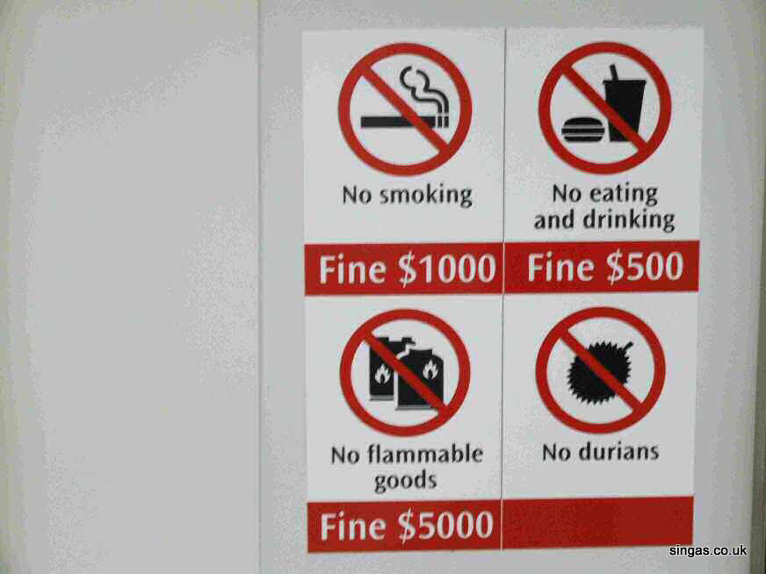

Slide 7
!eating && drinking
eating || !drinking

Slide 8
(has_cs2030 || has_cs2113) && has_cs2040c
(!has_cs2030 && !has_cs2113) || !has_cs2040c

Slide 9
Problem 10.2 Question
long score = 4;
if (something) {
score = 10;
} else {
score = 0;
}
// { ??? }
if (score == 4) {
score = 1;
} else {
score += 10;
}
// { ??? }
if (score >= 10) {
cs1010_println_string("ok");
} else {
cs1010_println_string("failed");
}

Slide 10
Problem 10.2 Solution
long score = 4;
if (something) {
score = 10;
} else {
score = 0;
}
// { score == 10 || score == 0 }
if (score == 4) {
score = 1;
} else {
score += 10;
}
// { score == 20 || score == 10 }
if (score >= 10) {
cs1010_println_string("ok");
} else {
cs1010_println_string("failed");
}

Slide 11
Factorial from Unit 11
long factorial(long n)
{
long product = n;
for (long i = n-1; i >= 2; i -= 1) {
product *= i;
}
return product;
}

Slide 12
Problem 11.1 Question
long factorial(long n)
{
long i = n-1;
for (long product = n; i >= 2; product *= i) {
i -= 1;
}
return product;
}

Slide 13
Guess-A-Number from Unit 11
long answer = (random() % 100) + 1;
long guess;
do {
// Read guess and feedback to user
guess = cs1010_read_long();
if (guess > answer) {
cs1010_println_string("too high");
} else if (guess < answer) {
cs1010_println_string("too low");
}
} while (guess != answer);
cs1010_println_string("you got it. congrats!");

Slide 14

Problem 11.2 (a)
long count = 0;
do {
// Read guess and feedback to user
guess = cs1010_read_long();
count += 1;
if (guess > answer) {
cs1010_println_string("too high");
} else if (guess < answer) {
cs1010_println_string("too low");
}
} while (guess != answer);

Slide 15
Problem 11.2 (a) Solution
long count = 0;
do {
// Read guess and feedback to user
guess = cs1010_read_long();
count += 1;
if (guess > answer) {
cs1010_println_string("too high");
} else if (guess < answer) {
cs1010_println_string("too low");
}
} while (guess != answer);
cs1010_print_long(count);

Slide 16
Problem 11.2 (b) Solution
// Read guess and feedback to user
guess = cs1010_read_long();
while (guess != answer) {
if (guess > answer) {
cs1010_println_string("too high");
} else if (guess < answer) {
cs1010_println_string("too low");
}
// Read guess and feedback to user
guess = cs1010_read_long();
}

Slide 17
Problem 11.2 (c)

Slide 18
Problem 11.2 (d) Question
What is the optimal strategy?
Why did the class shouted out 50, 75, etc? during the lecture when guessing a number between 1 and 100?

Slide 19
cowsay
git clone https://github.com/yxliang01/cs1010-fun-stuff
cd cs1010-fun-stuff/fun-programs
./cowsay “whatever you want the cow say”

Slide 20
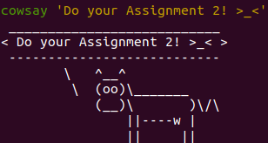

Slide 21
Ponysay
https://github.com/erkin/ponysay

Slide 22
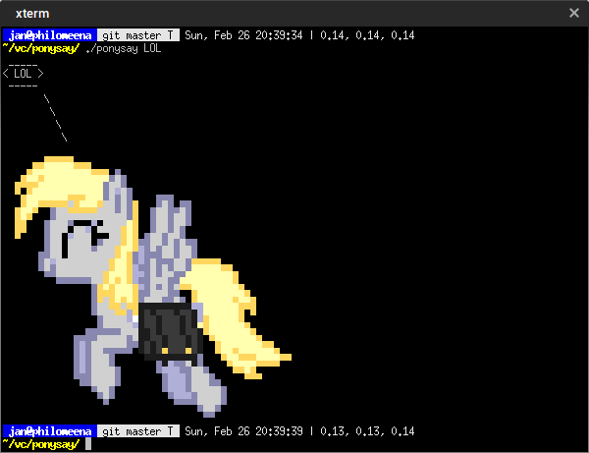

Slide 23
Problem 11.3 Question
long mystery(long n, long k)
{
long something = n;
long count = -1;
while (something >= 1) {
something /= k;
count += 1;
}
return count;
}
mystery(8, 2) return ??
mystery(81, 3) return ??
mystery(100, 5) return ??

Slide 24
Problem 12.1 Question
long i = 10;
long j = 0;
while (i != 0) {
i -= 1;
j += 1;
}
a) Value of j when exiting?
b) Relationship between i and j ?
c) Loop invariant?

Slide 25
Assignment 1

